Slide 1
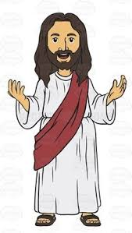


Slide 2

What message did Jesus bring?

Slide 3

Simon says. . .

Slide 4
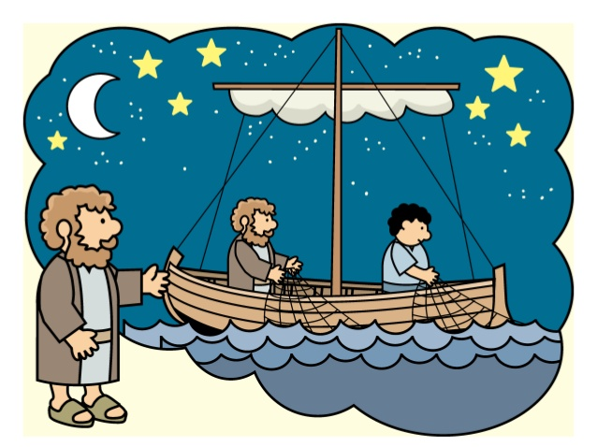
The Fishermen were tired . . .

Slide 5
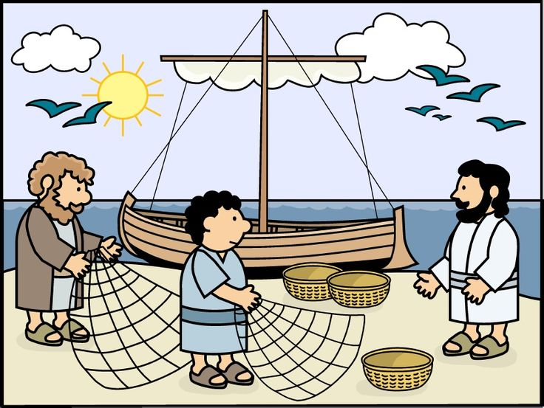
Jesus said, “Put your nets in the water, you will catch some fish’.

Slide 6
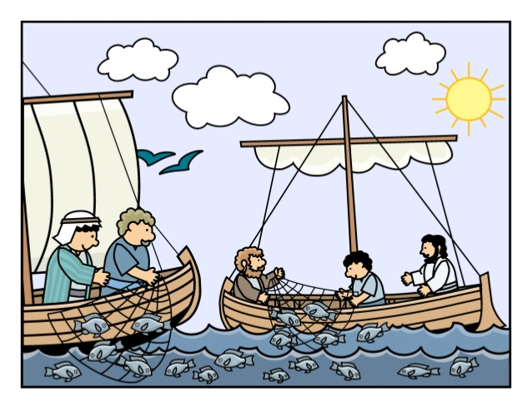
They followed Jesus and did as he had said. Their nets were full of fish!

Slide 7
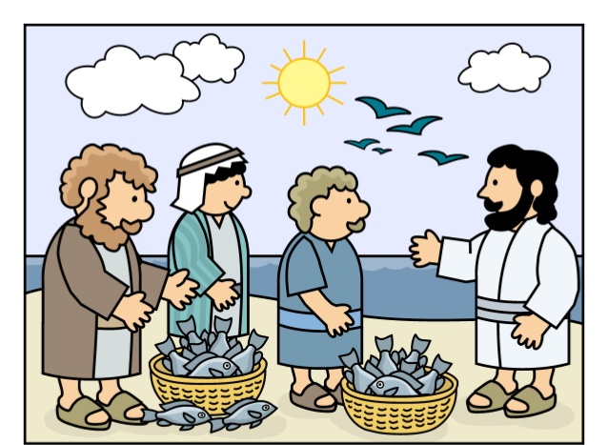
Jesus said, “Come and be fishers of men’.

Slide 8
Friendship

Slide 9
You may like to click on the link and watch this short cartoon of the story and then complete one of the art and craft activities. https://www.youtube.com/watch?v=J8HYI-jvW2Y
Have fun and don’t forget to send us a photo of your creation!

