Slide 1


I spy with my little eye. . .
Oral blending

Slide 2
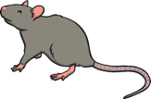









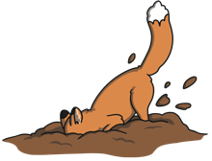






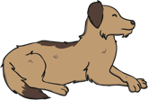

I spy with my little eye. . .
Next I Spy

Slide 3



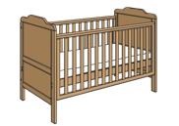











I spy with my little eye. . .
Next I Spy

Slide 4


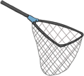






I spy with my little eye. . .
Next I Spy

