Slide 1

Goldilocks and The Three Bears
By Poppy Class

Slide 2
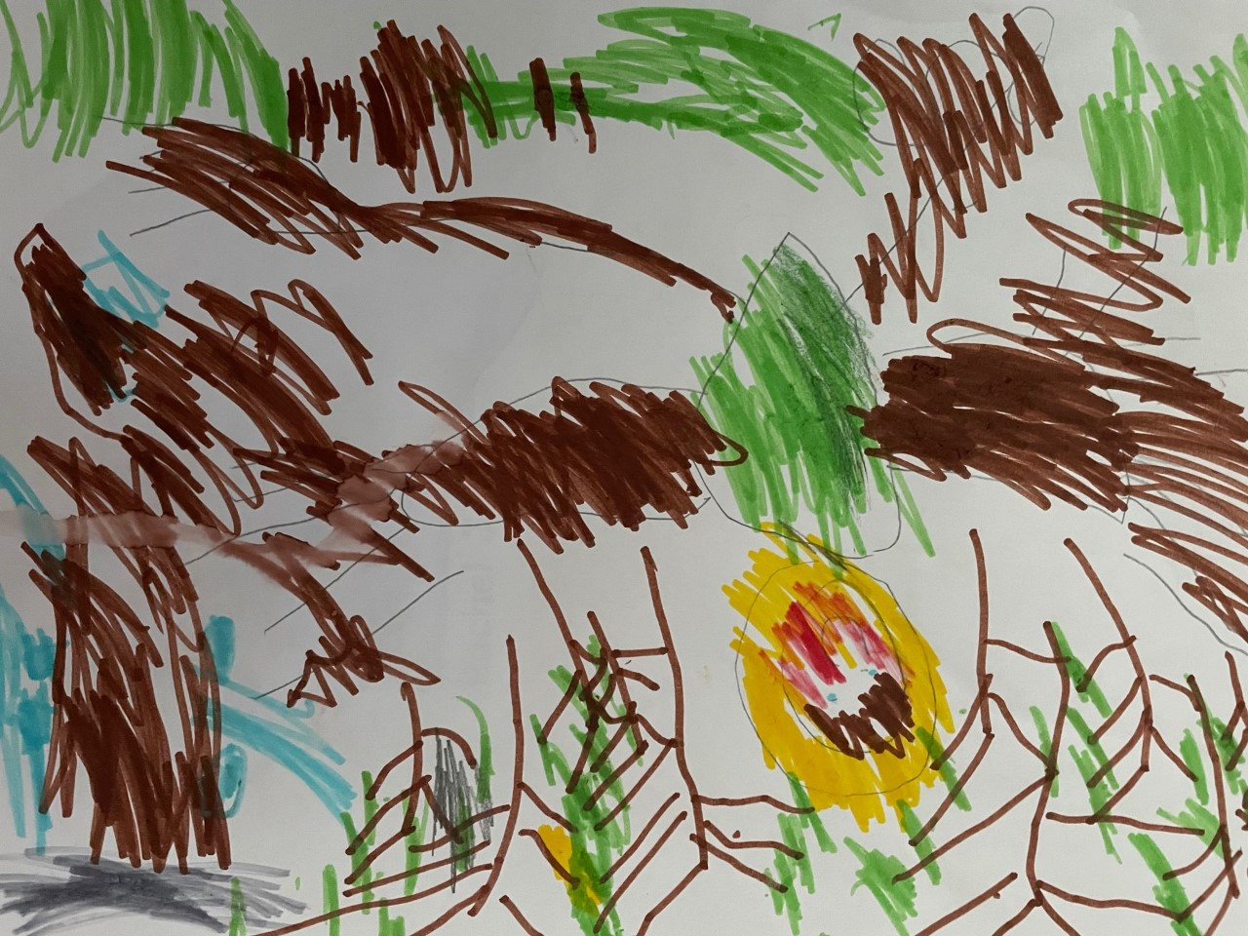

Once upon a time there was a girl called Goldilocks. She went on a walk in the forest and she was chasing a butterfly.
She got lost in the forest. She found a house and she went in…
(Bobby)

Slide 3
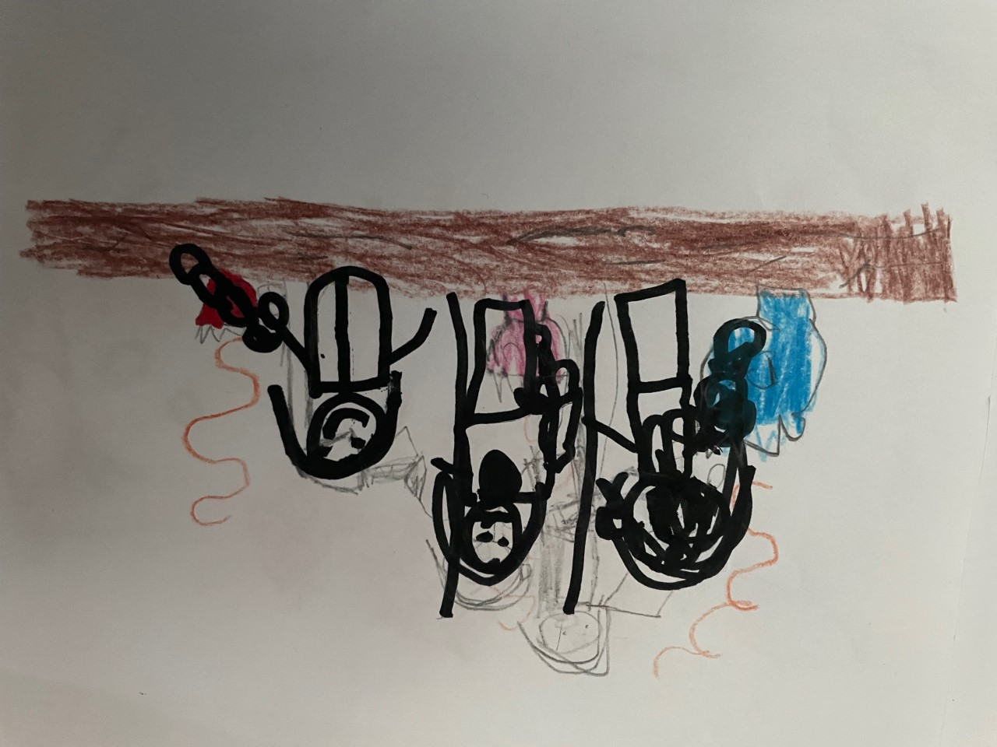
Goldilocks was hungry. She saw three bowls of delicious hot porridge. She ate the first bowl but it was too hot.
She ate the second bowl but it was too cold.
She ate the third bowl - it was just right and she ate it all up!
(Patrick)

Slide 4
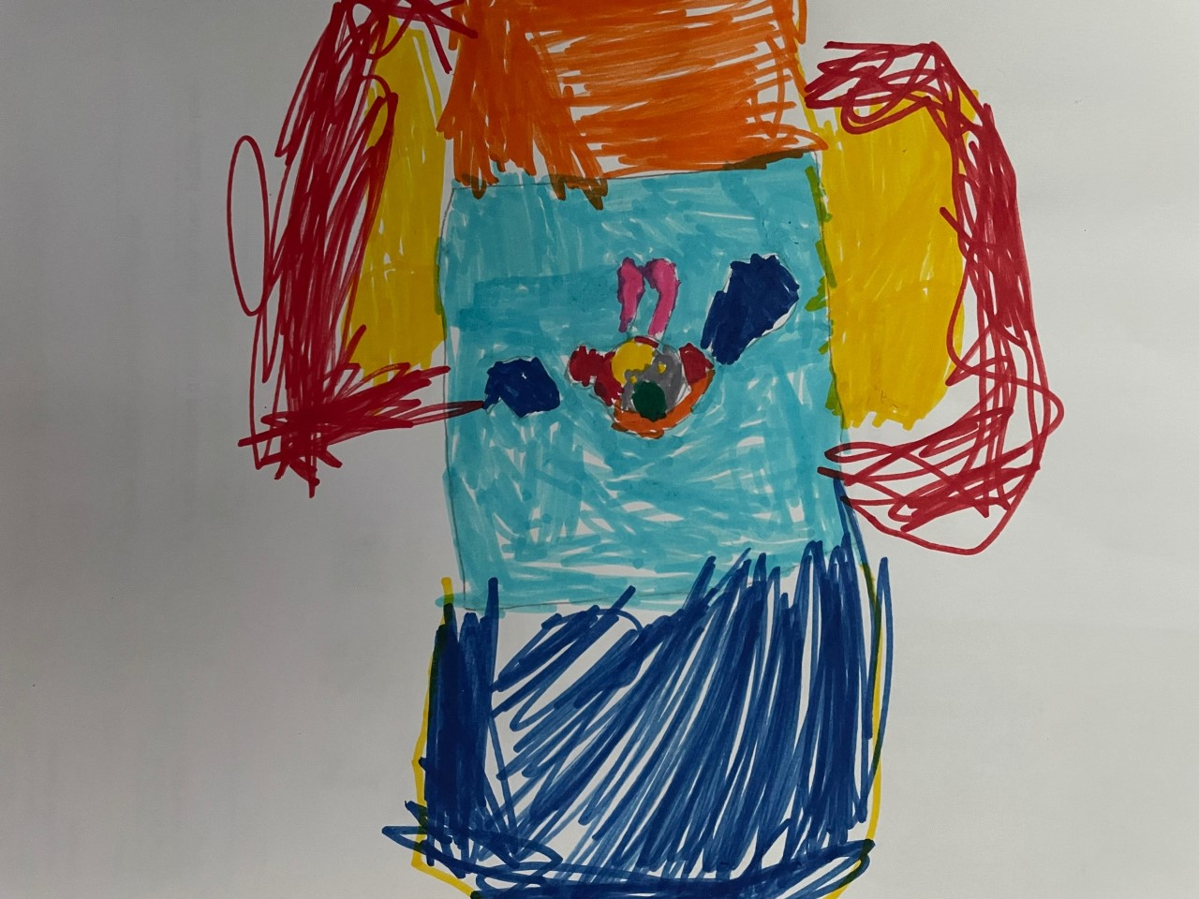
Goldilocks sat on the chairs. The big chair was too hard.
The middle-sized chair was too soft.
The little chair was just right. Then CRACK! The little chair broke. Goldilocks fell on the floor- bump!
(Rachel)

Slide 5
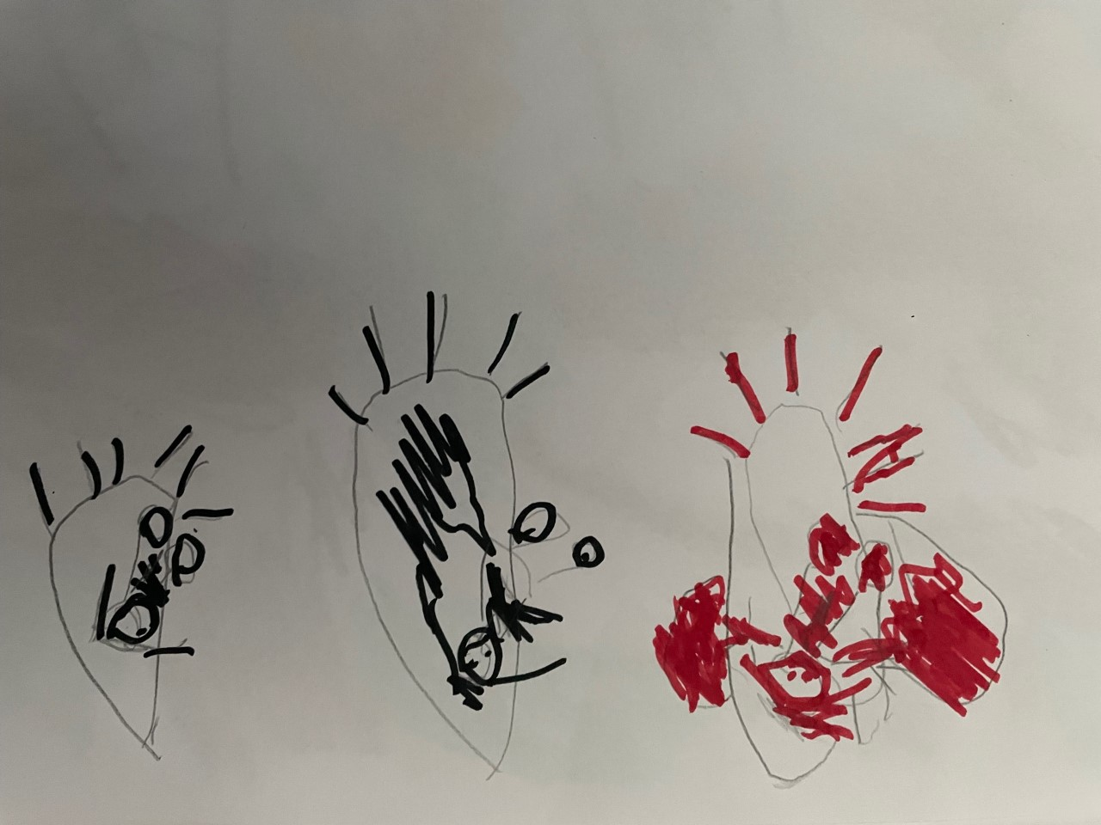
Goldilocks felt sad and sleepy. First, the big bed was too hard.
Second, the middle-sized bed was too soft.
Third, the little bed was just right and Goldilocks fell asleep- zzzzzzzzzzz!
(Jonathan)

Slide 6
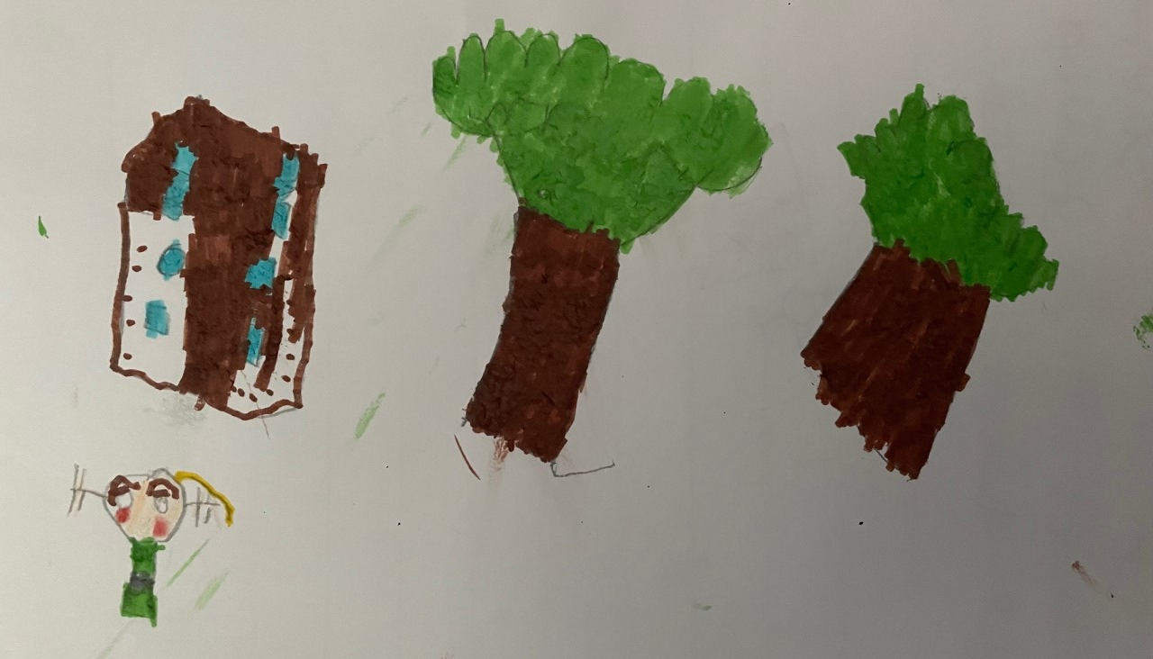
Goldilocks woke up. She saw the three bears! The three bears growled at her. Goldilocks ran out of the house and they never saw each other again!
(Ethan)

Slide 7
The End

