Slide 1


Slide 2
The mighty River Indus
L.I: To begin to learn some facts about the Indus River.
I can learn where the Indus River begins
I can name the continent and counties it flows through
I can begin to know some facts about the river.

Slide 3
Key vocabulary
Tibet – Is a region in China
Himalayas - The name of the range of mountains
Glaciers - Is a river of ice
River Indus - Asian river that rises in Tibet and flows through northern India and then southwest through Kashmir and Pakistan to the Arabian Sea.
.
Tributaries - A river or stream flowing into a larger river
Stream - A small, narrow river
Arabian Sea – A region of the northern Indian Ocean

Slide 4
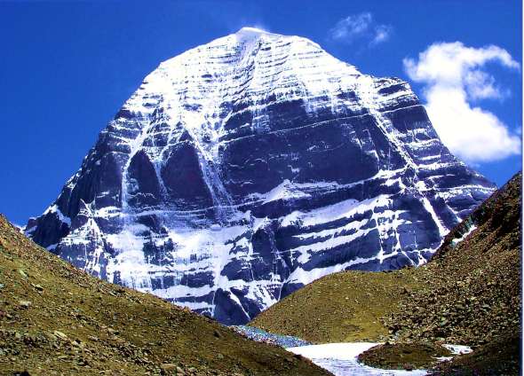
1. The mighty River Indus
This mountain is high up in a place called Tibet.
The mountain is part of a great mountain range called the Himalayas.
Apart from the snow on the mountain, it looks very dry. But look more closely at the bottom of the photograph.
What can you see? It looks like water flowing through a patch of snow. This little stream of water is trickling across the stony land.
It comes from underground springs. As the ice and snow melt, the water swells. This makes the water flow faster and faster.

Slide 5
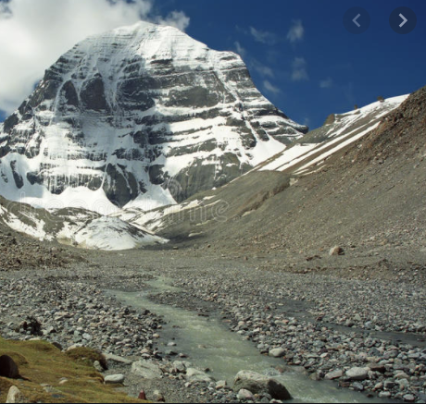
Now we are looking at the same mountain but we are much further away from it. We can now see the stream flowing quickly towards us. This tiny stream will become a vast river, the mighty River Indus, one of the longest rivers in the world.
The River Indus is 3,200 kilometres long! When it leaves Tibet, it passes through two other countries, called India and Pakistan.

Slide 6
The stream is now flowing very fast because more and more melting ice and snow are coming from huge glaciers in the mountains.
Between June and September, during the rainy season, rainwater will swell the river even more. The picture below shows the river much further along in its course, in India. The land is flatter now, but the river flows fast. It is wide and deep, moving quickly through its smooth, wide channel.

Slide 7
There is yet another reason why the Indus river fills with so much water and grows so big. Can you work this out from the photograph above? It shows another river flowing into the Indus. We call the smaller rivers that flow into bigger rivers tributaries.

Slide 8
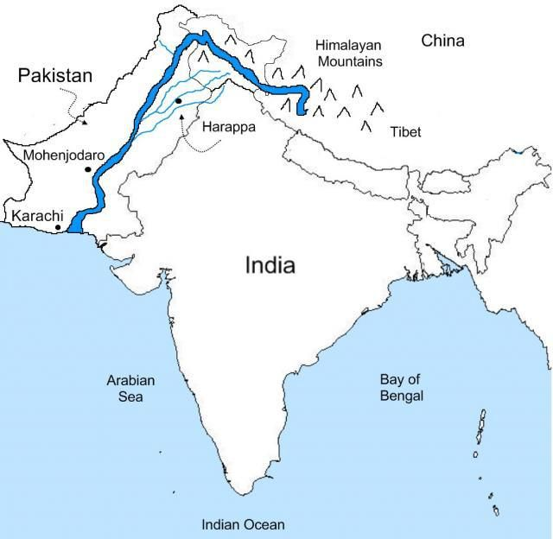
On this map, follow the line of the River Indus as it flows from Tibet into in northern India and then into Pakistan.
Most of the river is in Pakistan. You can see that when the river reaches the coast, it flows into the Arabian Sea. The map also shows some of the tributaries that flow into the Indus.
How many tributaries can you find?

Slide 9
Here is close-up photograph of another tributary of the River Indus. This is close to the border with Afghanistan, in northern Pakistan.
See how fast this river is flowing! It is full of water, rushing rapidly.
When this water reaches the River Indus it will make the Indus swell into an even bigger river

