Slide 1
Measures and Data
Compare and measure weight
Objectives
Day 1
I can compare the weight of objects using balance scales.
I can compare the weight of objects with a 100g weight.
I can compare the weight of objects with 100g and 1kg weights.

Slide 2
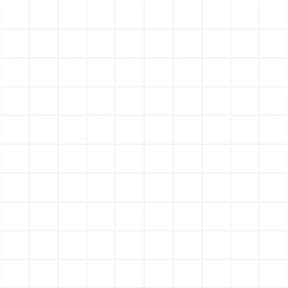

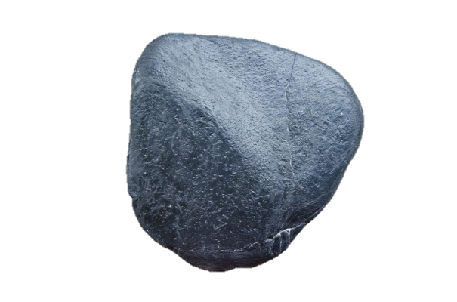
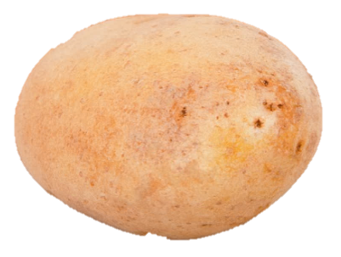
Day 1: I can compare the weight of objects using balance scales. I can compare the weight of objects with a 100g weight. I can compare the weight of objects with 100g and 1kg weights.
Pass round a potato and a large pebble.
Both objects should be
about the same size.
Which is heavier?
What will happen if we put the potato in one side of a bucket scale and the potato in the other?
Notes:
Teaching with Y1 and Y2

Slide 3
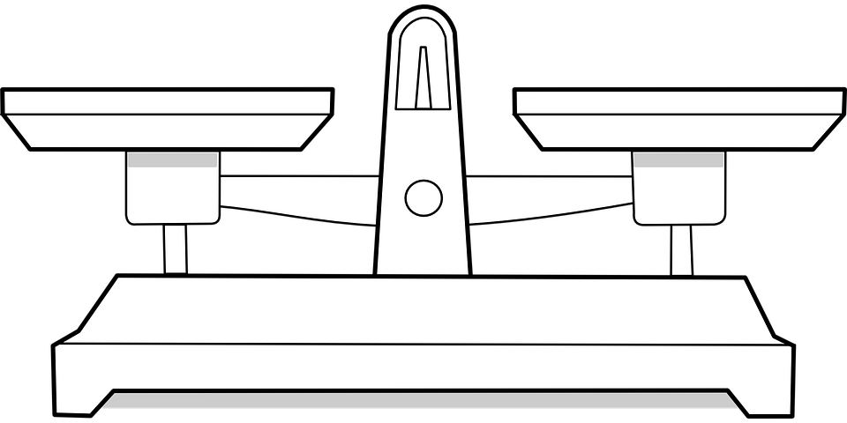
Day 1: I can compare the weight of objects using balance scales. I can compare the weight of objects with a 100g weight. I can compare the weight of objects with 100g and 1kg weights.
Which is lighter?
What’s happened? Why?
Put the stone and potato in the buckets on either side of the balance scale.
Compare the scales to
a see-saw.

Slide 4
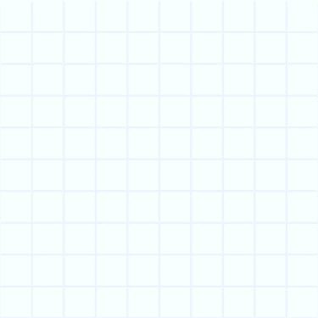
Day 1: I can compare the weight of objects using balance scales. I can compare the weight of objects with a 100g weight. I can compare the weight of objects with 100g and 1kg weights.
Now pretend that you are a see-saw.
Stretch your arms out to the side.
Hold a bag of potatoes in one hand and a bag of large pebbles in the other…
What will happen? Why?
Notes:
Check their prediction using the bucket balance.

Slide 5
Day 1: I can compare the weight of objects using balance scales. I can compare the weight of objects with a 100g weight. I can compare the weight of objects with 100g and 1kg weights.
Now imagine one bag is of cotton wool and the other bag of potatoes…
What will happen? Why?
Suggest other items, one obviously heavier than the other.

Slide 6
Day 1: I can compare the weight of objects using balance scales. I can compare the weight of objects with a 100g weight. I can compare the weight of objects with 100g and 1kg weights.
What do you think might be heavier than this potato?
What do you think might be lighter than this potato?
Notes:
Place the potato in one of the buckets.

Slide 7
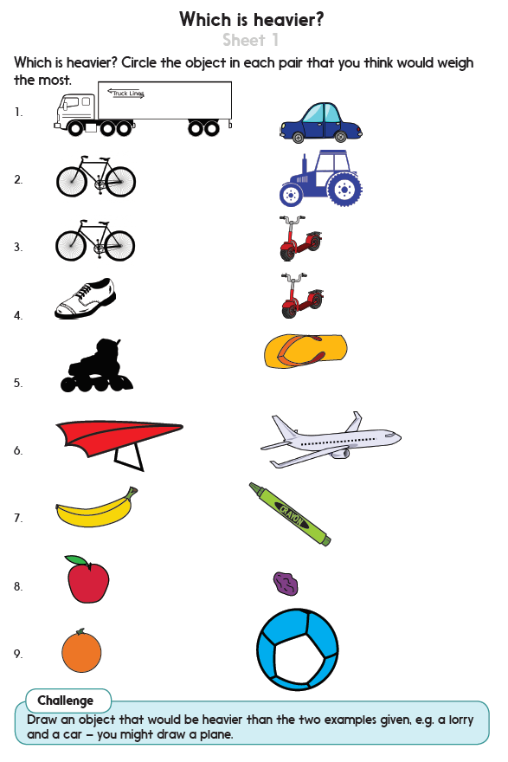
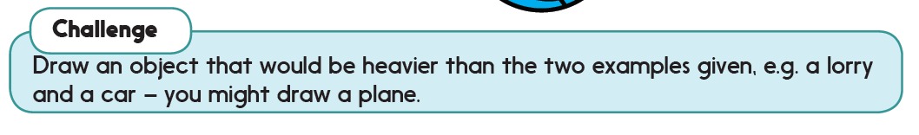

Challenge

Slide 8
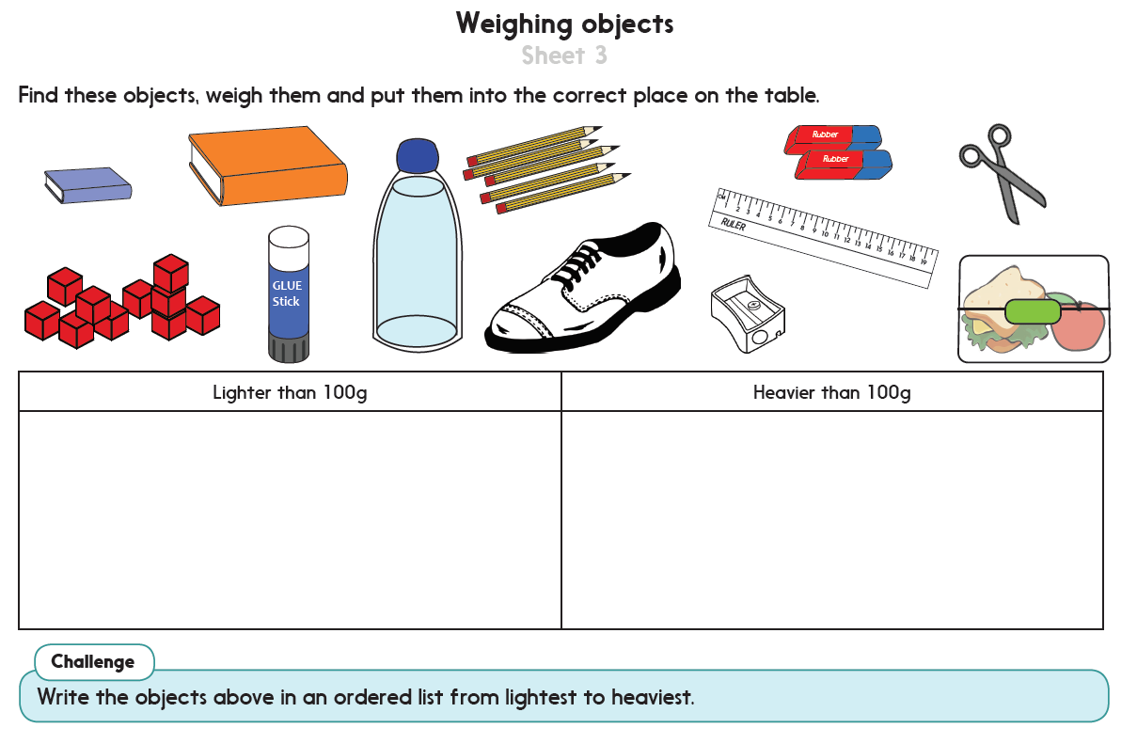
Challenge

Slide 9
Measures and Data
Compare and measure weight
Objectives
Day 2
I can make sensible estimates then measure the weight of items using uniform objects.
I can find ten objects which have a total weight of exactly 1kg.
I can accurately weigh to the nearest 100g.

Slide 10
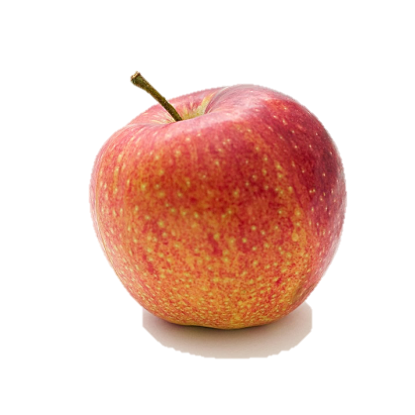
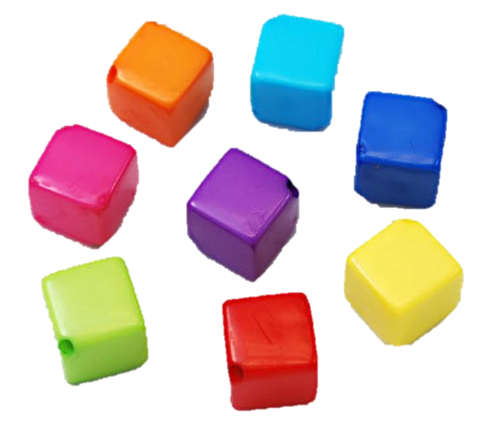
Day 2: I can make sensible estimates then measure the weight of items using uniform objects. I can find ten objects which have a total weight of exactly 1kg.
I can accurately weigh to the nearest 100g.
How many marbles weigh the same as an apple?
Let’s count one
marble at a time into the empty pan/ bucket until they are at the same level.
Notes:
Teaching with Y1 and Y2

Slide 11

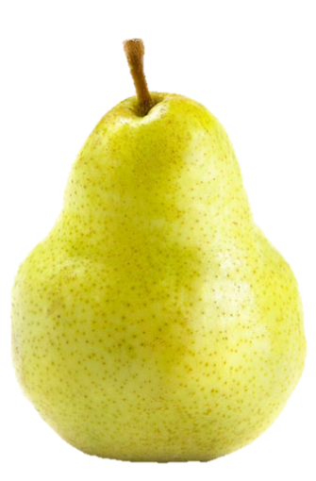
Day 2: I can make sensible estimates then measure the weight of items using uniform objects. I can find ten objects which have a total weight of exactly 1kg.
I can accurately weigh to the nearest 100g.
Will we need more or fewer marbles to balance the banana?
Let’s try with other types of fruit…
Record the information
in a simple pictogram, drawing a circle for each marble.
Notes:
Ask Y2 children: Which fruit was the heaviest/lightest?

Slide 12
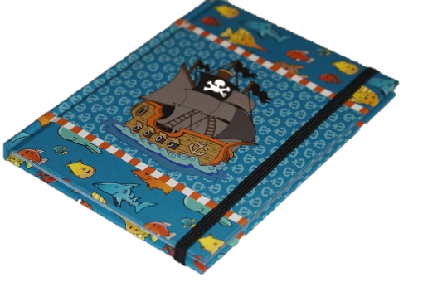
Day 2: I can make sensible estimates then measure the weight of items using uniform objects. I can find ten objects which have a total weight of exactly 1kg.
I can accurately weigh to the nearest 100g.
Both sides of the balance are level. What does that tell us?
What has happened?
Place wooden bricks or other uniform objects in the empty bucket until the scale balances.
Notes:
Establish that neither side is lower than the other, so the book and the number of bricks must weigh the same.

Slide 13
Day 2: I can make sensible estimates then measure the weight of items using uniform objects. I can find ten objects which have a total weight of exactly 1kg.
I can accurately weigh to the nearest 100g.
Let’s record how many bricks weigh the same as our book.
The book and the bricks must weigh the same!
Repeat with other items, asking children to predict how many bricks might balance the object.
Record information in a pictogram, drawing a square to represent each brick.

Slide 14
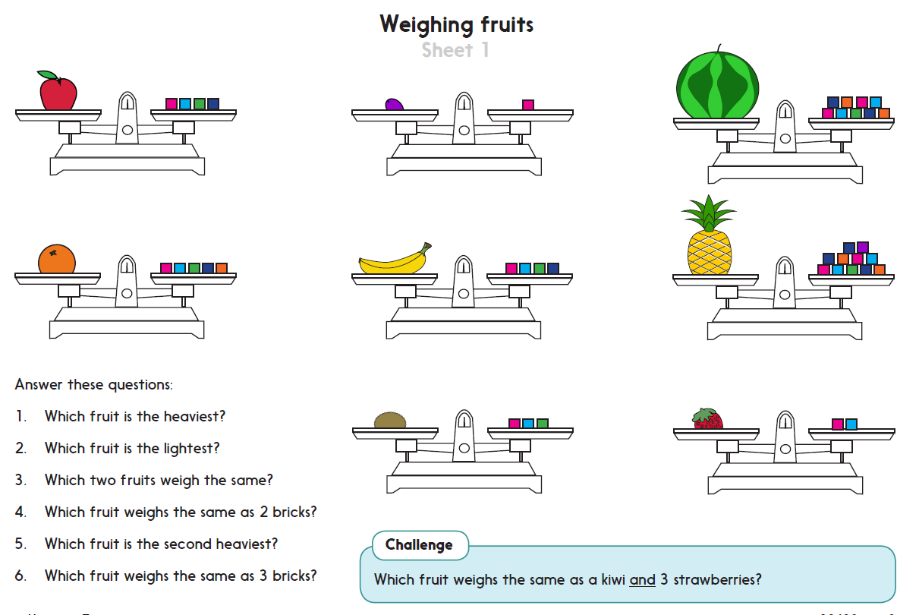
Challenge

Slide 15
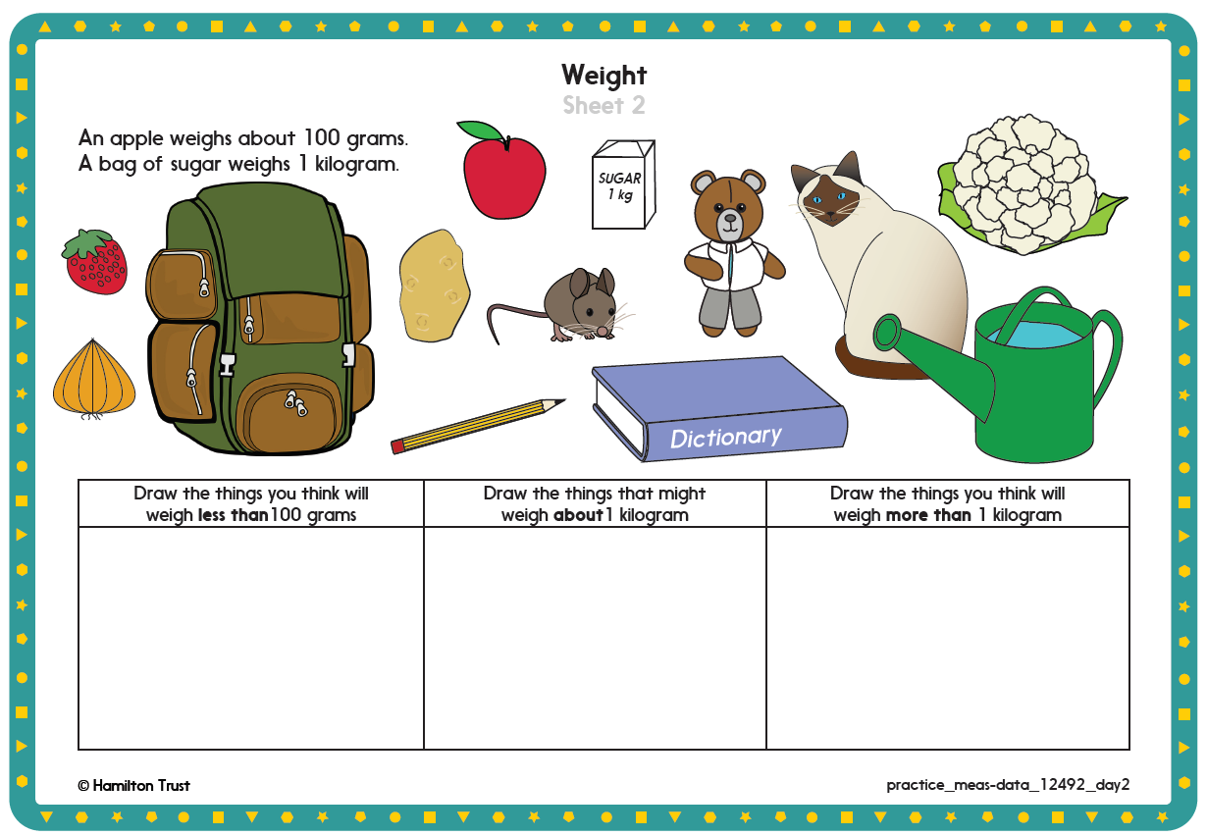

Slide 16
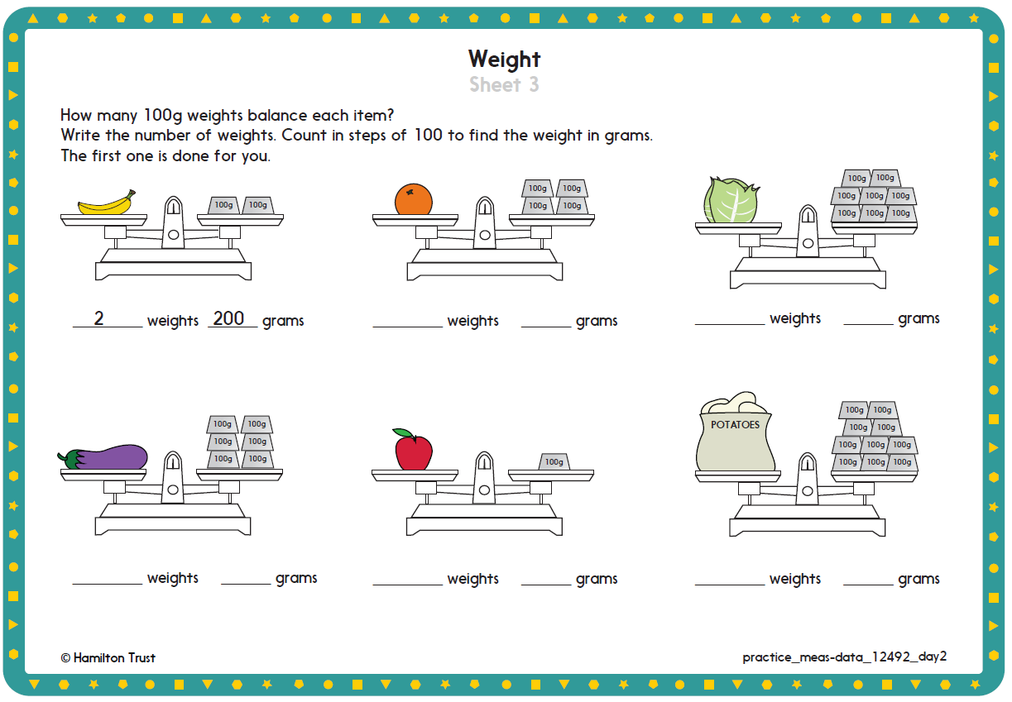

Slide 17
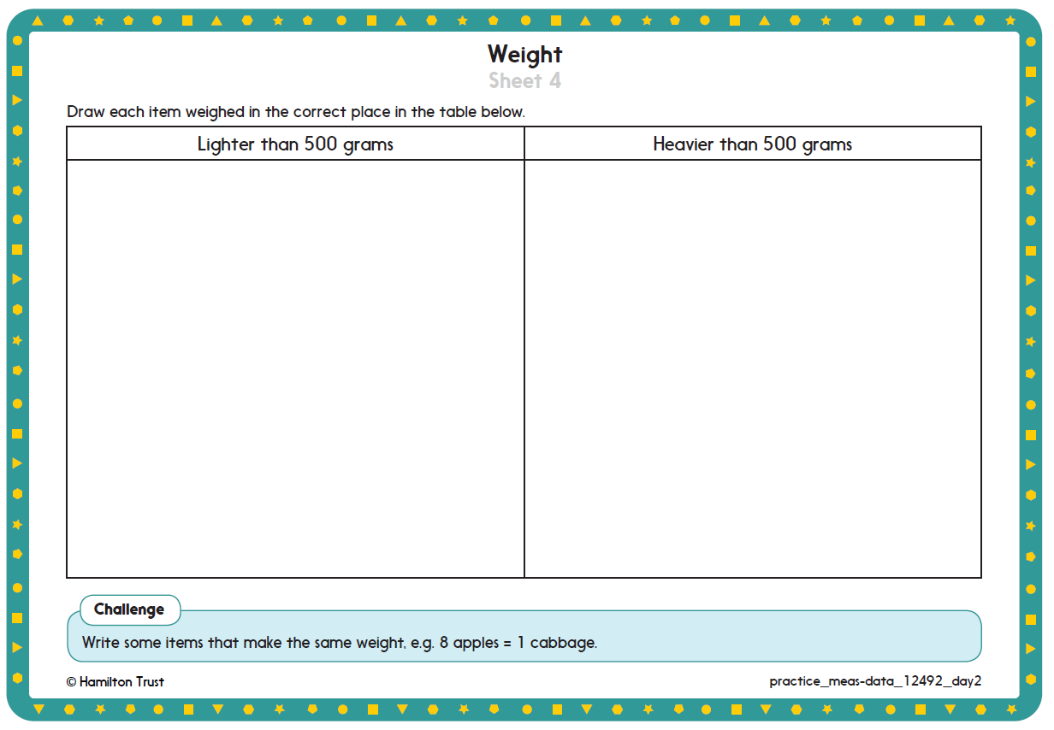

Slide 18

Measures and Data
Compare and measure weight
Well Done! You’ve completed this unit.
Day 1
I can compare the weight of objects using balance scales.
I can compare the weight of objects with a 100g weight.
I can compare the weight of objects with 100g and 1kg weights.
Day 2
I can make sensible estimates then measure the weight of items using uniform objects.
I can find ten objects which have a total weight of exactly 1kg.
I can accurately weigh to the nearest 100g.
Notes:
You can now use the Mastery: Reasoning and Problem-Solving questions to assess children’s success across this unit. Go to the next slides.

Slide 19
Problem solving and reasoning questions group 1, 2
Which is heavier:
(i) A potato or a pebble?
(ii) A book or a shoe?
(iii) A soft toy or a paint pot?
Use a bucket balance to find out.
Sometimes, always, never true...
-- A book is the same weight as 12 marbles
-- A shoe is heavier than a sock?
-- A big handful of cotton wool is lighter than three 50p coins?
Weigh two of your favourite books using wooden bricks.
Write their weight.
Which weighs more?

Slide 20
Problem solving and reasoning questions Group 3
Does each item weigh more or less than 100g?
-- A ruler
-- Can of lemonade
-- A hard-boiled egg
Check using a balance scale.
How many 100g weights balance 1 kilogram?
Match each object to one of the weights:
tin of beans 1 gram
bag of sugar 3 kilograms
grapefruit 400 grams
feather 1 kilogram
box of books 200 grams

