Slide 1
Big Question: What is the Trinity?
Look out for the sound symbol ⇨
to hear me talk about some of the slides…
?

Slide 2

Draw a spider diagram on some paper and write what you think it might be…
What is the Trinity?
CLUE: ‘tri’ means 3 (like triangle – 3 sides). So can you think of 3 things it could be?

Slide 3

3 in 1…
FATHER
SON
HOLY SPIRIT

Slide 4
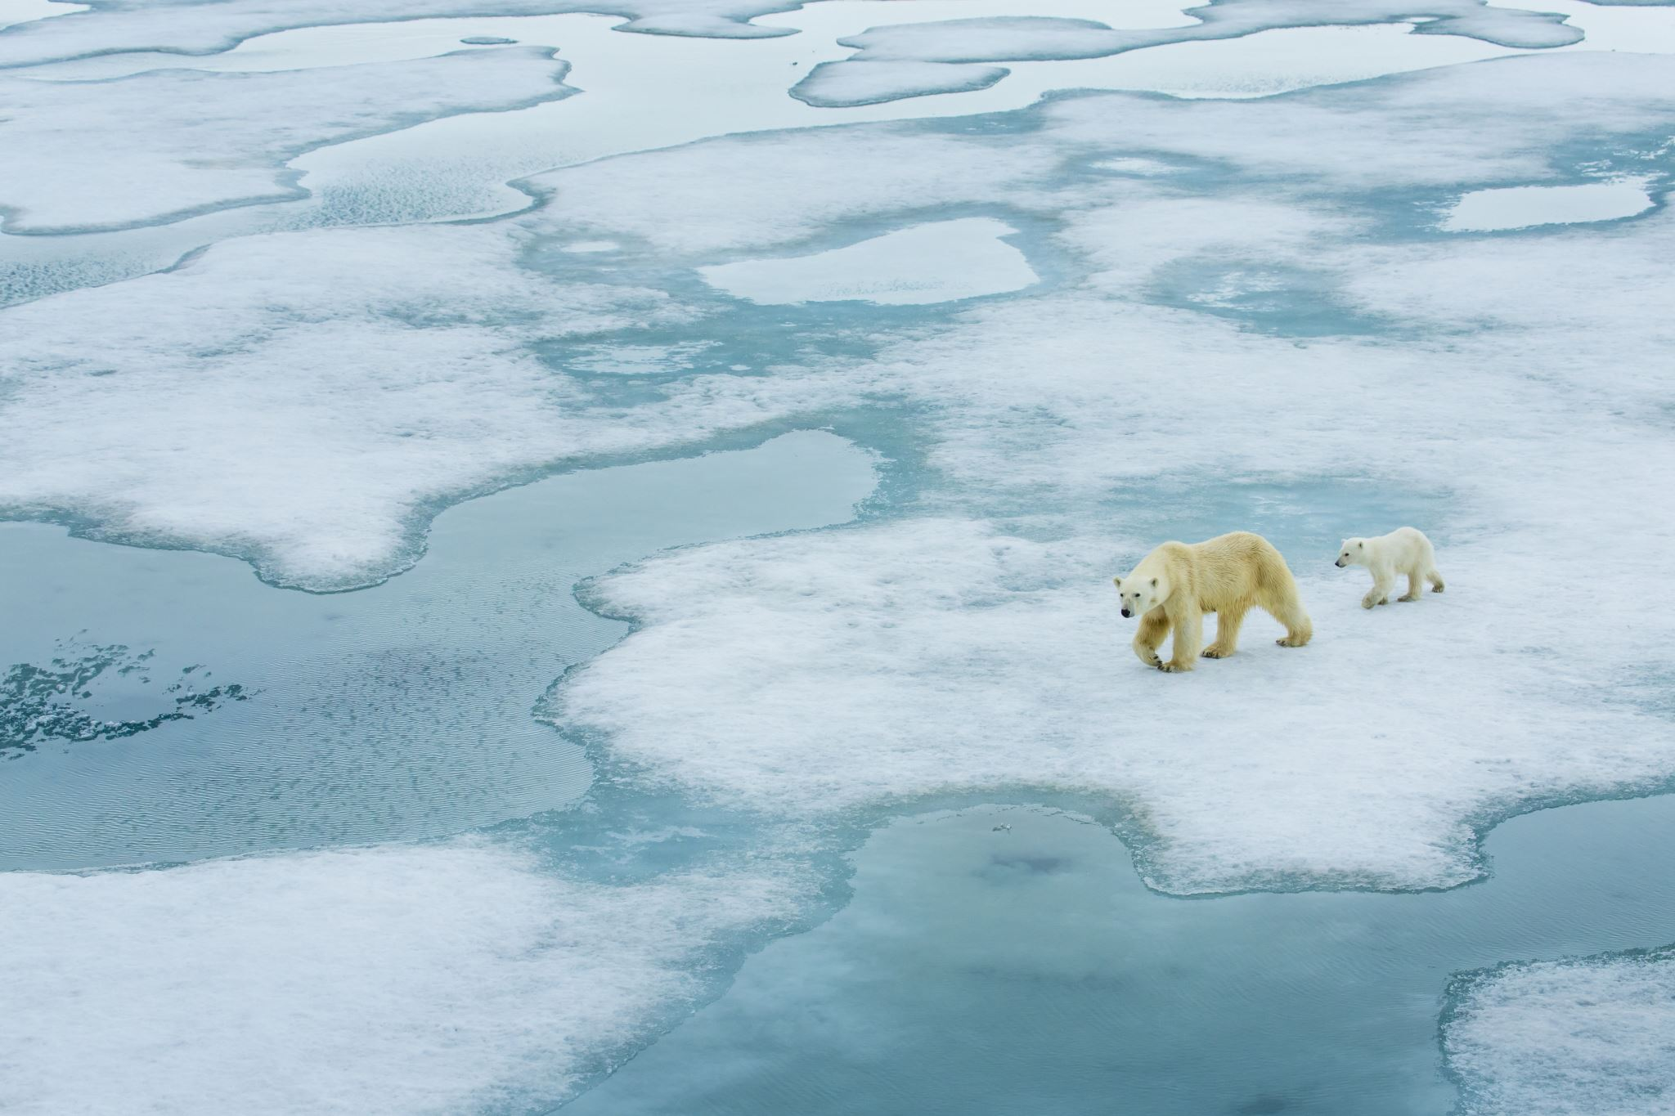

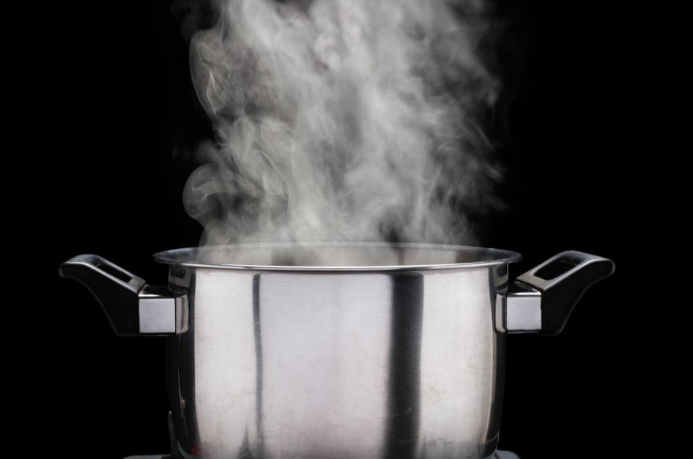
How does water link to the Trinity?
SOLID: ICE
LIQUID: WATER
GAS: STEAM
Different forms – but still all water!

Slide 5

Time to think…
What do people use water for?
On your paper, write down all the different uses you can think of.

Slide 6
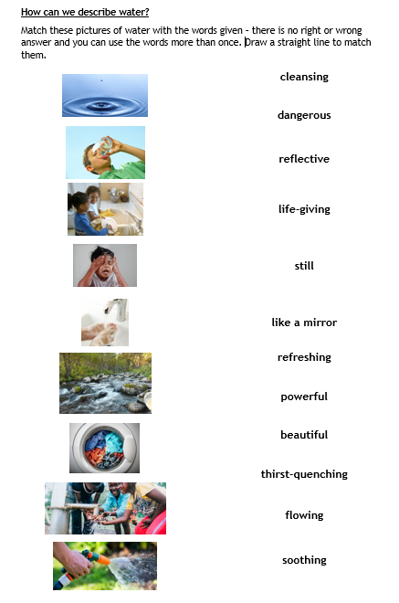
How can we describe water?
Using a pencil and ruler, please complete the sheet that looks like this →
(It’s on the website with this slideshow).

Slide 7
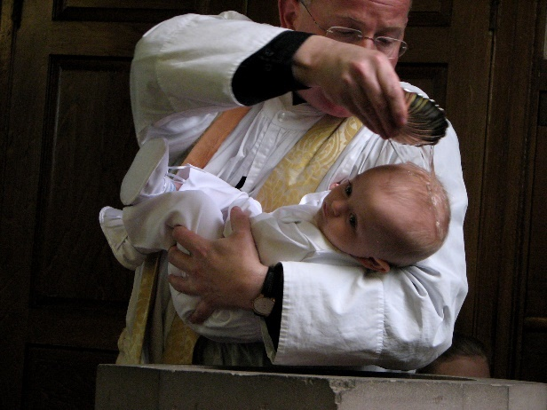
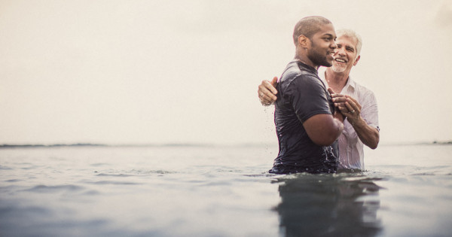
Water and Baptism
Baptism is a ceremony or act that many Christians do either as a baby or as an adult, to show that they are now part of the Christian family. Water is used within the ceremony because of its different symbolic meanings.
What happens in a baptism service? Are they all the same? Can you spot the Trinity in the service?
Look at some pictures and videos to find out and talk about what you find with a grown up.
Final Activity:

