Slide 1


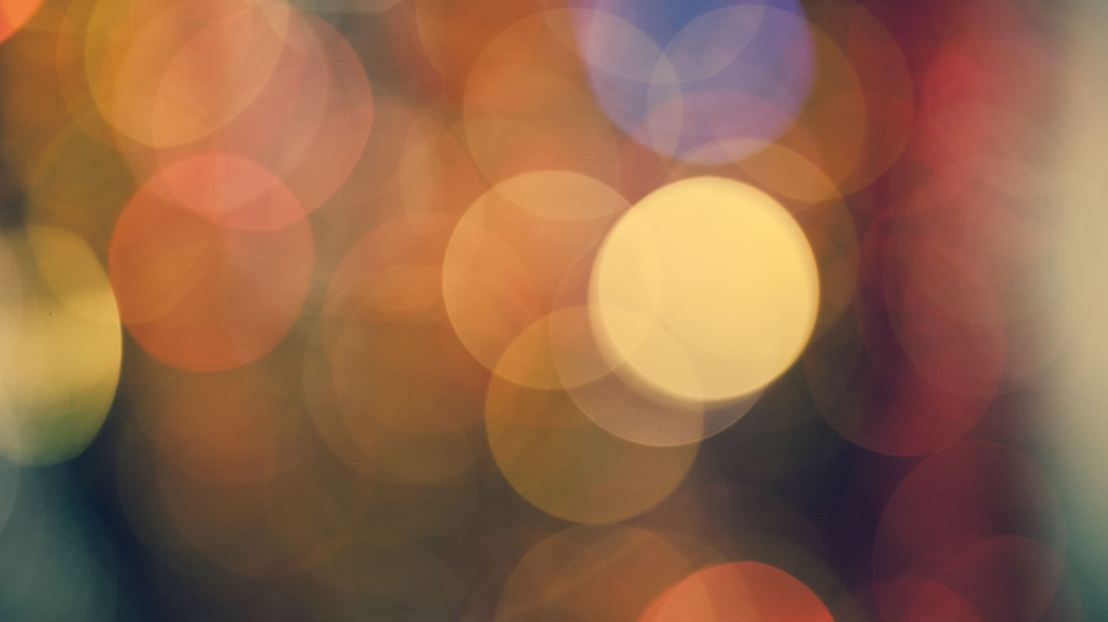
All About Light!

Slide 2


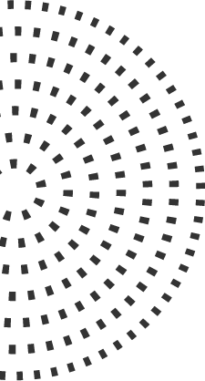

What do you know about light?
In a spider diagram, write down everything you know about light.
Underneath, write down any questions you might have, or things you would like to know about light.

Slide 3
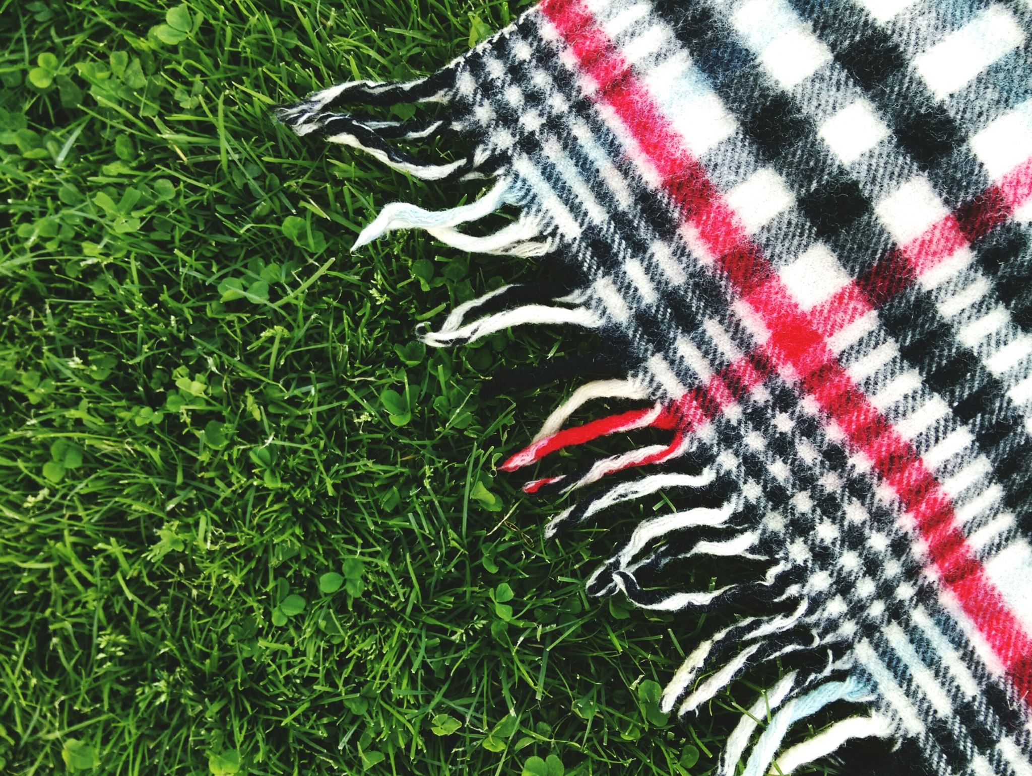
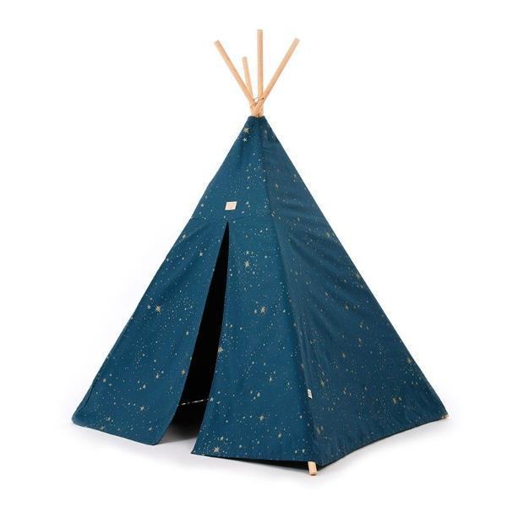
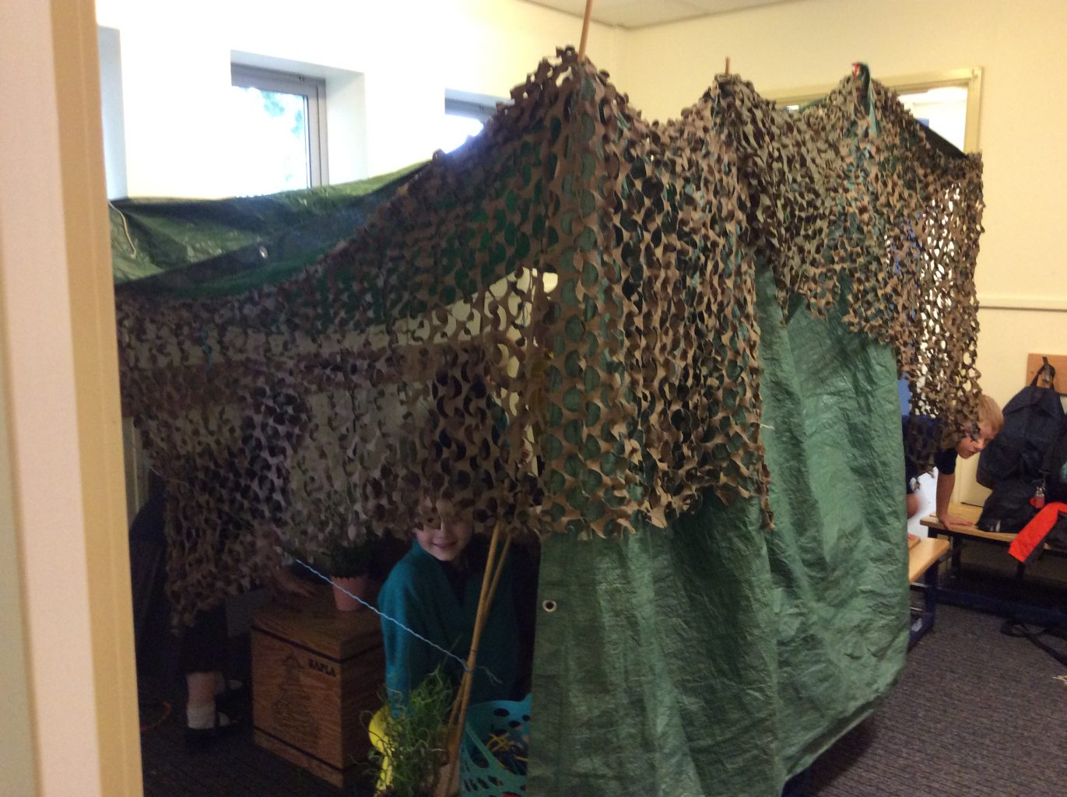
Den Building!
Find the darkest place in your house and build a den – make it as dark as you can!
When you have finished, ask your grown up to hide 5 different objects in there – but they must not tell you what the objects are!
Once the objects have been hidden, go inside your den and see if you can work out what the objects are – you can’t take them out of the den until you’ve had a guess!
Now try again, but this time with a torch. Which was easier? Why?
How does light help us to see? Talk about your ideas with a grown up.

Slide 4
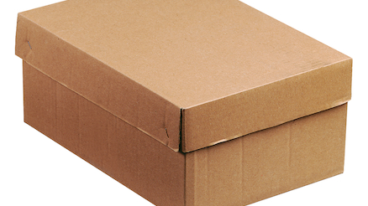
What’s in the box!
Find a cardboard box that can be easily closed tightly – a shoe box is probably the best. Cover up any holes with card or tape.
In one end of the box make a small viewing hole. Then, ask your grown up to place a small object in the end of the box, which you must describe when looking through the viewing hole.
Try to stop any light from entering the box.
You can then add holes in the top of the box so that light can enter the box.
TRY THIS FOR MORE CHALLENGE!
https://www.bassettsvitamins.co.uk/fun-activities/make-a-pinhole-projector

