Slide 1
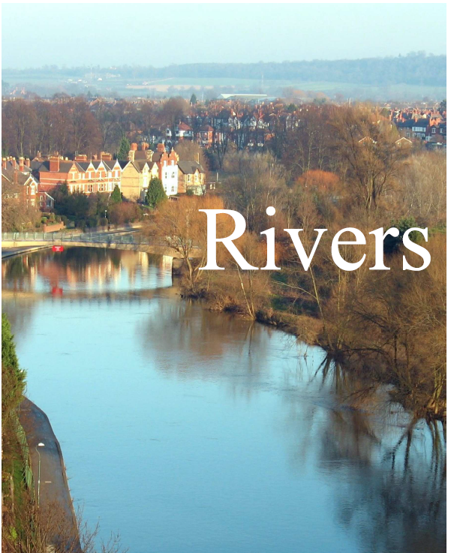

Slide 2
The changing River Indus
L.I: To learn and create how people used the Indus River.
I can name some of the things people used the river for.
I can make a part of the Indus river and grow a crop.

Slide 3
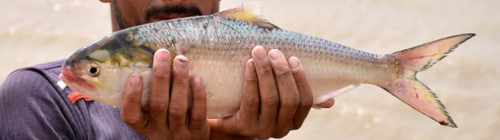
Key vocabulary
river levels – The depth of the river compared to the banks of the river
Banks - The ground at the side of a river.
Dams - a wall that is built across a river in order to stop the water flowing and to make a lake.
Reservoirs - is a lake that is used for storing water before it is supplied to people.
Canals - is a long, narrow stretch of water that has been manmade to bring water to a particular area.
Irrigation (Irrigate) - The supply of water to farmland so that crops can grow in areas
Channels – A groove in the land that a river flows along.
Turbine – Is an engine that takes energy from moving water.
hydro-power - Is power that is generated from moving water such as rivers.
Parched – Land dries out as they have no access to natural water.
Palla –
province of Sindh – Is the area people settled and named after the river.

Slide 4
2. The changing River Indus
What words could you use to describe the River Indus in the photograph?
It looks so peaceful, doesn’t it? It feels still. It seems quiet and unchanging, as though nothing could disturb it. Does the River Indus always look like this?
No! The River Indus certainly does not stay the same! We have already seen that it changes as it moves along its course. It also changes as the seasons change. The weather changes the shape and size of the Indus. Moreover, as it changes through the year, the Indus changes the land all around it as well. It also changes the lives of people who live and work near it too.
The River Indus feels alive!

Slide 5
During June, the snow melting in Pakistan’s northern mountains makes the river levels rise. In July and August, the monsoon rains pour from the sky. In some places, the Indus river bursts its banks and flows into the fields. In other places, the extra water is captured by dams which make it flow into reservoirs and canals. The farmers use this water to make their crops grow. At the bottom of this page, you can see rice growing in a very wet field in Pakistan. Rice needs a lot of water to grow. All this water comes from the River Indus! When water is spread around the land to make crops grow, we call this irrigation. Farmers use the water to irrigate the land.
As well as rice, the water from the River Indus makes it possible for many other crops to grow. Farmers in Pakistan grow rice, wheat, cotton and corn. The River Indus irrigates about 44 million acres of land!

Slide 6
Farmers irrigate the land by creating small channels of water through the fields like the left one. Sometimes farmers channel the water into pipes which spray the land with water. In these ways, the farmers control how much water reaches the land.

Slide 7
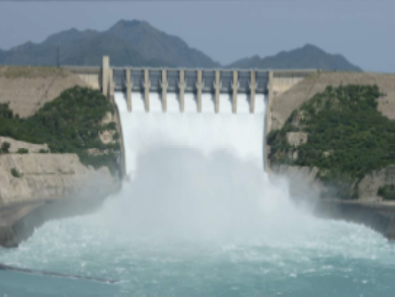
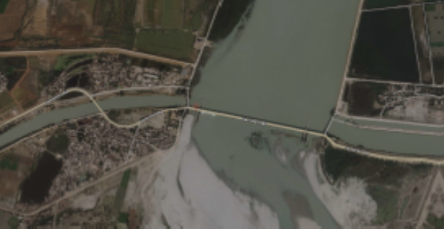
Irrigation is even more important when the river levels fall and the rainfall stops! The river levels start falling in September when the monsoon ends. By January, the fields become dry and brown. But the many dams along the river, such as this one on the left, capture the water and store it in big reservoirs. Canals can then move this water from place to place.
The photograph on the right was taken from the air. It shows a dam on the Indus. Can you see the two canals flowing off it? These canals carry water to where it is needed.
The people of India and Pakistan use the River Indus in other ways too. Fast flowing water is used to make power. The dams can make the rushing water pour into a turbine which turns so fast that it creates power. We call this hydro-power. ‘Hydro’ means ‘water’. The water from the River Indus is also used to cool down machinery in factories.

Slide 8
So far, we have seen how the people and the river work well together. Sometimes, things do not go so well. Sometimes, the River Indus fills with so much water that the floods are huge and dangerous. In 2010, terrible floods in Pakistan destroyed farms and took many lives. The two images on the right were taken from space. In the lower image you can see how the Indus River poured into the surrounding land. The top image shows part of the Indus in July 2009. The lower image shows the same place in the 2010 floods.
This photograph shows people and animals stranded in the 2010 floods. They all had to be rescued by boats and by air.

Slide 9
Sometimes there is too much water, and sometimes not enough! This parched ground is trying to grow rice, but the river’s water did not reach these fields.
It isn’t just the weather that causes problems with the River Indus. Sometimes, the things that people do can make new problems. Using dams to control the flow of water in one part of the river can take water from other parts. Looking after the Indus River is complicated.
One group of people not happy about the way the water in the River Indus is managed are the fishermen who fish for the palla fish in the province of Sindh. On this map of Pakistan, Sindh province is in red. You can see that the River Indus flows through Sindh province and into the sea. For hundreds of years, the fishermen of Sindh have caught the palla fish. The fishermen have made their living by selling it in the fish markets.

Slide 10
The palla fish is a local delicacy. The people of Sindh love this fish.
The photograph at the bottom shows how fishermen used to catch the palla fish in the Indus. The photograph is over 100 years old! The fishermen used a large net shaped like a bag tied to a long pole, with a fork at the end. The fisherman floated downstream on a large earthen pot. The fish were caught in the net, stabbed with an iron spike and placed into the pot. But nowadays, the dams further up the river are stopping the flow of water and so the fish are disappearing. The fishermen have lost their livelihoods. What do the fishermen think about this? Let us listen to some of them.

Slide 11

The palla used to bring so much joy to the people that they always held their Children’s weddings during that time.
Muhammad Mallah, one of the elders of the fishing community, says :
Now we rarely get palla fom the Indus river. We often return with empty nets. If the river doesn’t flow, we cannot get fish.
One fisherman
called Aslan says:
The Indus is a living thing. You cannot chain a river through dams. We should revive the Indus River. It’s the right of the river… I believe in the natural flow of the river.
Muhammad Ali Shah, Chairman of the Pakistan Fisher folk Forum, says:

Slide 12
When geographers study places, they listen to the people who live and work there. Listening carefully, we find out how lives have been changed by the changing River Indus. As you can hear, some of them are also very concerned about the river itself. The River Indus is home to many living things. It is full of beautiful plants. About 60,000 birds migrate to the Indus every year. The River Indus even has its own dolphins! These dolphins are called blind river dolphins because they cannot see.

