Slide 1
Measures and Data
Compare and measure weight
Objectives
Day 1
I can compare and order the capacity of containers.
I can measure liquid in cupfuls.
I understand a block graph.
Notes:
Before teaching, be aware that:
On Day 1 you will need, various containers, empty 2-litre plastic bottle, strip of paper to label the bottle in cups, washing-up bowl, water, plastic cup, funnel, water jug, a prepared block graph showing the capacity of four containers in cupsful.

Slide 2
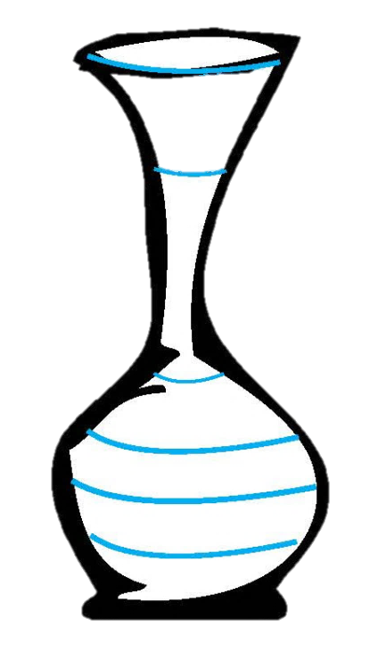



Day 1: I can compare and order the capacity of containers. I can measure liquid in cupfuls. I understand a block graph.
Show two containers with different capacities and of different proportions.
Fill the larger with water and demonstrate pouring water into the smaller, letting the water overflow into a washing up bowl.
Which container holds the most water?
Pour the water from the smaller container into the larger one and show how this does not fill the larger container.
Notes:
Teaching for all

Slide 3
Day 1: I can compare and order the capacity of containers. I can measure liquid in cupfuls. I understand a block graph.
Discuss how much water is in the larger container.
Empty
Full
Is it empty, full, half full, nearly full or nearly empty?
Half full
Nearly full
Repeat, comparing capacities of different pairs of containers and using this key vocabulary.
Nearly empty

Slide 4
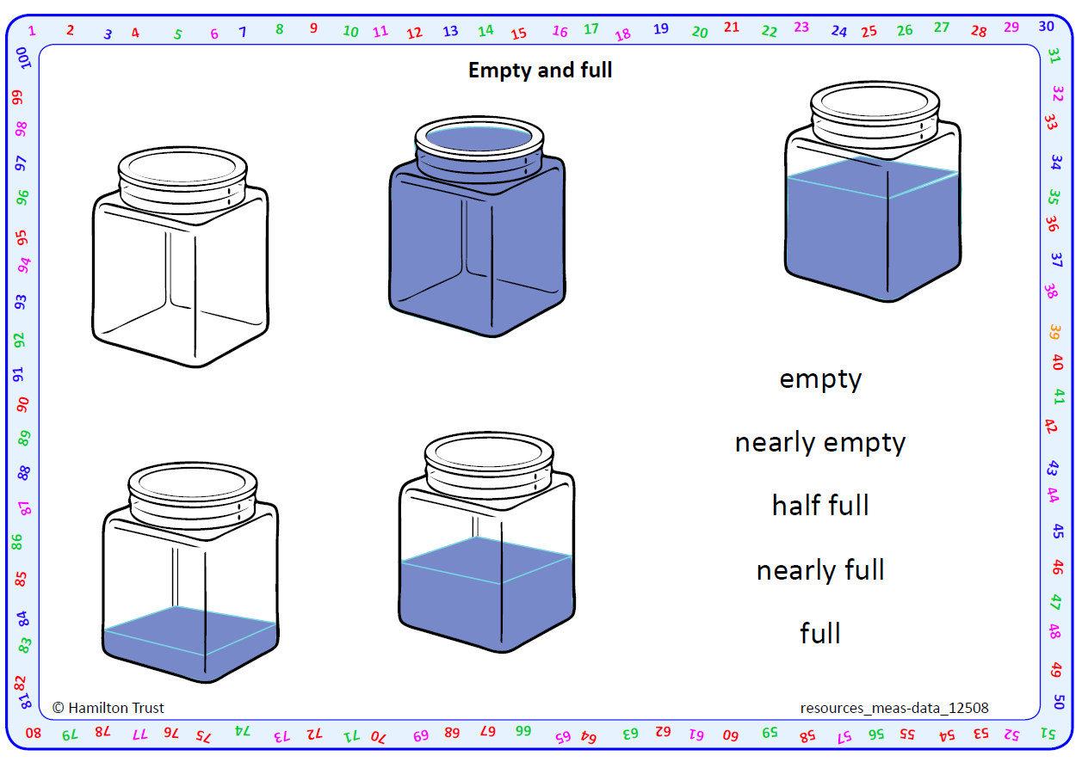
Notes:
LCF and TK:
Activity 1: Give 3 containers of different sizes. Discuss which container might hold the most water and which the least. How can we check? Try filling the container they think holds the least and pour this into the other two containers in turn. If the 2 containers are not full the first container has the least capacity. If the water over flows the 1st container more capacity. Do this in a washing-up bowl to collect any spillages. Also check by filling the largest container with water and pouring into the other two to check that the water overflows. Ensure that children see that the tallest container is not necessarily the container which holds the most water. A wider but shorter container can hold more. Keep the containers for tomorrows lesson.
Activity 2: Match labels to pictures of containers. After match cut the containers with the labels, compare and order containers by capacity. Empty and full activity. Resource page 1

Slide 5
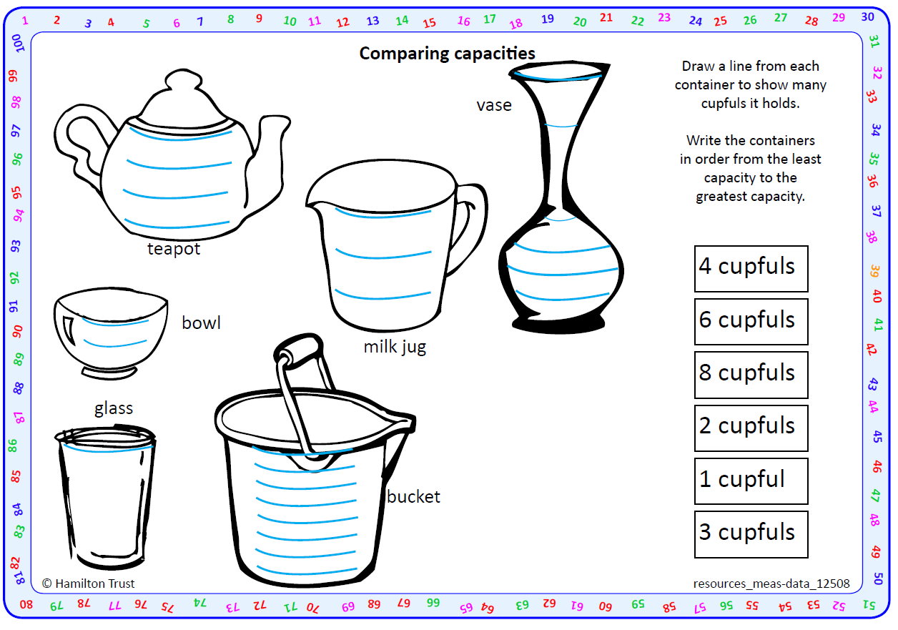
Notes:
FE, SE, JG , OL, DB, TW, AL, BT and JH: Match containers and capacities. Resources page 2

Slide 6
Day 1: I can measure liquid in cupfuls. I understand a block graph.
Show children a 2-litre plastic bottle with a strip of paper glued to one side, from the bottom to near the top. Stand the bottle in a washing-up bowl to catch any spillages.
Ask a child to fill a plastic cup with water and pour it into the plastic bottle using a funnel. Then mark the level of the water on the strip of paper and write ‘1’. Ask another child to do the same and write ‘2’. Repeat until no more whole cups of water will fit.
Notes:
Further teaching
Do not use the word litre at the start.
Stand the bottle in a washing-up bowl to catch any spillages.

Slide 7
Day 1: I can measure liquid in cupfuls. I understand a block graph.
Empty the water out and explain that you’ve made a measuring bottle. This can be used to find out how much water other containers can hold. We call this their capacity. Show children a water jug and ask how many cupfuls of water this might hold: fewer than 5? Between 5 and 10? More than 10? Take suggestions.
Ask a child to fill the jug with water and carefully pour the water into the measuring bottle. Read this off the scale to find the capacity of this jug to the nearest cupful. Then fill the cup and tip into the jug until it is full to confirm that this is the same number of cups.

Slide 8
Day 1: I can measure liquid in cupfuls. I understand a block graph.
capacity
(cupfuls)
A block graph to show the capacity of four different containers
10
9
8
7
6
5
4
3
2
1
0
container 3
container 4
jug
container 2
Notes:
ADAPT THIS GRAPH. Show three other containers and explain the block graph showing their capacity, WITHOUT labels to say which is which. Can children deduce which conainer goes with which column on the graph?

Slide 9
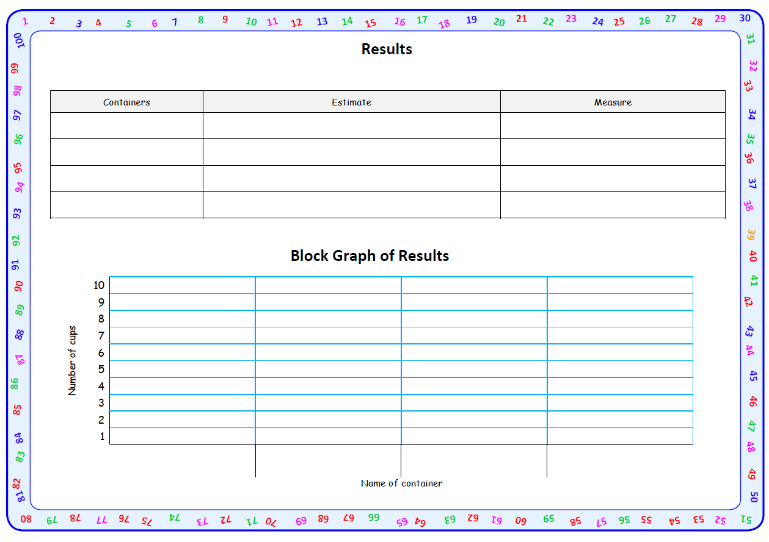
Notes:
FE, SE, JG , OL, DB, TW, AL, BT and JH:
Activity 1 Make or use measuring 2 litre bottle, Get 4 other containers. Estimate how many cups will each container hold. Then measure and record in the table repeat for each container. Record the result in the block graph and label each bar. Resource page 3

Slide 10
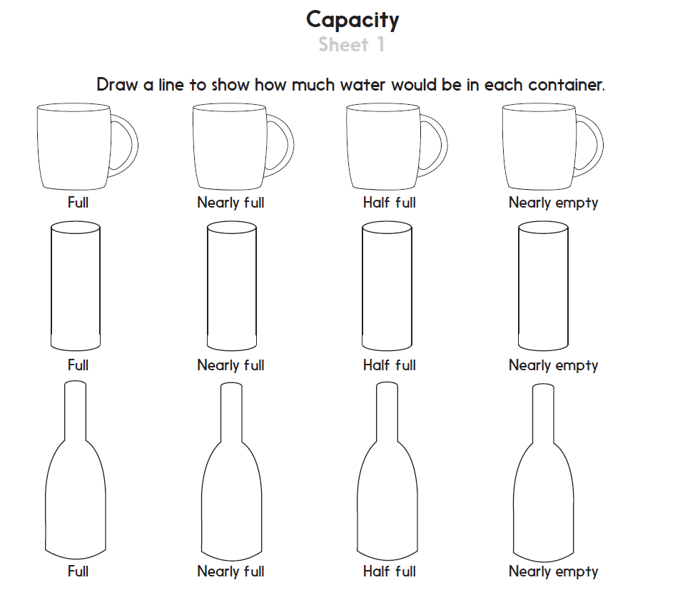
Notes:
LCF and TK: Draw levels showing how full up the containers are. More practice Sheet 1

Slide 11
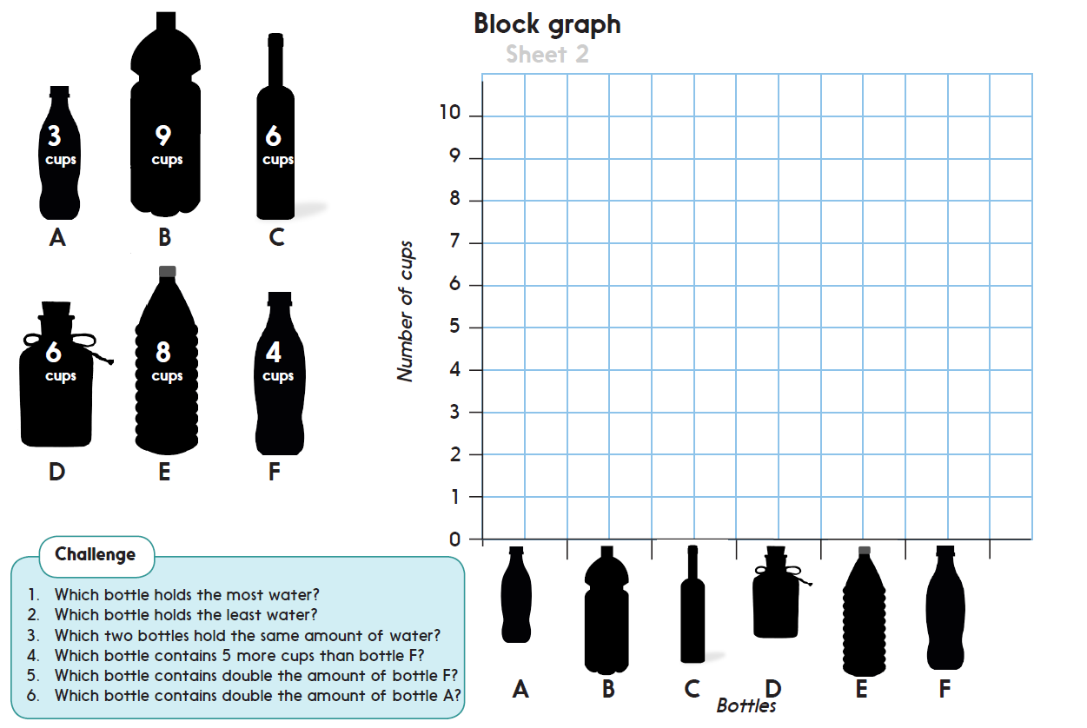

Challenge
Notes:
FE, SE, JG , OL, DB, TW, AL, BT and JH:
Activity 2: Create a block graph to show different bottle capacities. Answer questions about the block graph. More practice Sheet 2

Slide 12
Measures and Data
Measure and represent capacity
Objectives
Day 2
I can sort containers into which holds more and less than a cup and make sensible estimates about the capacity.
I can estimate and begin to measure liquid in litres.
I understand 1 litre as a measure of capacity.
Notes:
Before teaching, be aware that:
On Day 2 you will need litre measuring jug, 2-litre bottle, marker pen, plastic cups, a water bottle, a teacup, a small teapot, a fromage-frais or yoghurt pot.

Slide 13
Day 2: I can sort containers into which holds more and less than a cup and make sensible estimates about the capacity. I can estimate and begin to measure liquid in litres. I understand 1 litre as a measure of capacity.
Shopkeepers, farmers and factories which package or sell liquids such as milk, squash, fruit juice and petrol don't use cupfuls or bottles to measure liquids. They use litres and millilitres. This makes life easier as they all use the same units of measurement.
Show children that the 2-litre bottle holds 2 litres by filling up the litre measuring jug and emptying it in to the 2-litre bottle twice.
How many cupfuls filled the 2-litre bottle?
So how many cupfuls do you think will fill the litre jug?
Notes:
Teaching All

Slide 14

Day 2: I can sort containers into which holds more and less than a cup and make sensible estimates about the capacity. I can estimate and begin to measure liquid in litres. I understand 1 litre as a measure of capacity.
LCF+TK: How many cups make half a litre?
Show children a 1 litre capacity measure.
Show where one litre and half a litre come to.
Clearly mark these two capacities with a dry-wipe pen.
Fill the container to the half-litre mark with water, then measure this amount roughly using cups.
Show children 4 containers, e.g. water bottle, tea cup, small teapot, yoghurt pot.
Can you estimate which of these will hold more than and which less than half a litre?
Draw a table (see next slide) to record children’s estimates and actual results.
Notes:
When estimating hold up the litre jug again for them to visualise what half a litre looks like.

Slide 15
Day 2: I can sort containers into which holds more and less than a cup and make sensible estimates about the capacity. I can estimate and begin to measure liquid in litres. I understand 1 litre as a measure of capacity.
Result Table
Holds less than ¹/₂ litre | Holds more than ¹/₂ litre
LCF+TK: Is the water level below or above the half-litre mark?
Check suggestions by filling each container with water and pouring the water into the litre jug over a washing bowl.
Notes:
Children can now go on to do differentiated GROUP ACTIVITIES. You can find Hamilton’s group activities in this unit’s TEACHING AND GROUP ACTIVITIES download.
LCF and TK: Show the children the same containers from day 1 and a plastic cup. Take each container in turn and ask how many cups of water might be needed to fill it. Less than 5? More than 5?
Children take turns to fill each container with cups of water, whilst the other children count the number of cups needed. They record the results. Which container holds the most cups of water? And the fewest? Place the three containers in order of capacity.
‘
FE, SE, JG and OL: DB, TW, AL, BT and JH: Give either an egg cup, yoghurt pot or plastic cup. Challenge them to estimate how many of the smaller container will fill the litre bottle and then to find out.
They place the litre bottle in the washing-up bowl, fill their containers and pour carefully into the litre bottle, counting how many times they do this. How many egg cups did your bottle hold? And how many yoghurt pots did yours hold ? So, does the egg cup hold more water than the yoghurt pot? Why not? So, how many egg cups is the same as half a litre? And yoghurt pots?

Slide 16
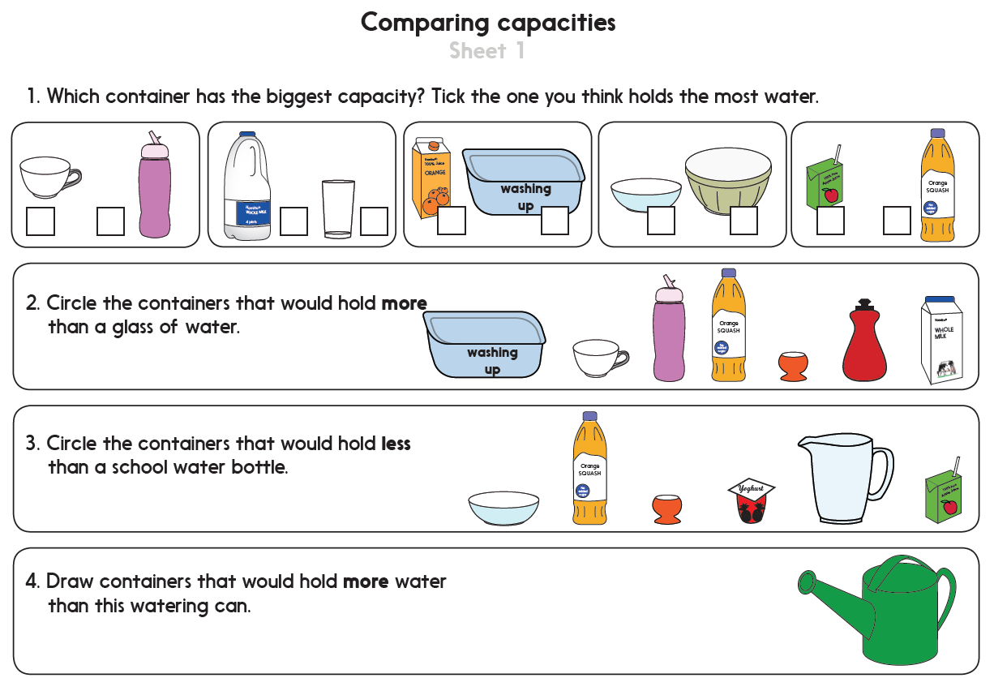
Notes:
LCF and TK: Compare container capacities. More practice Sheet 1

Slide 17
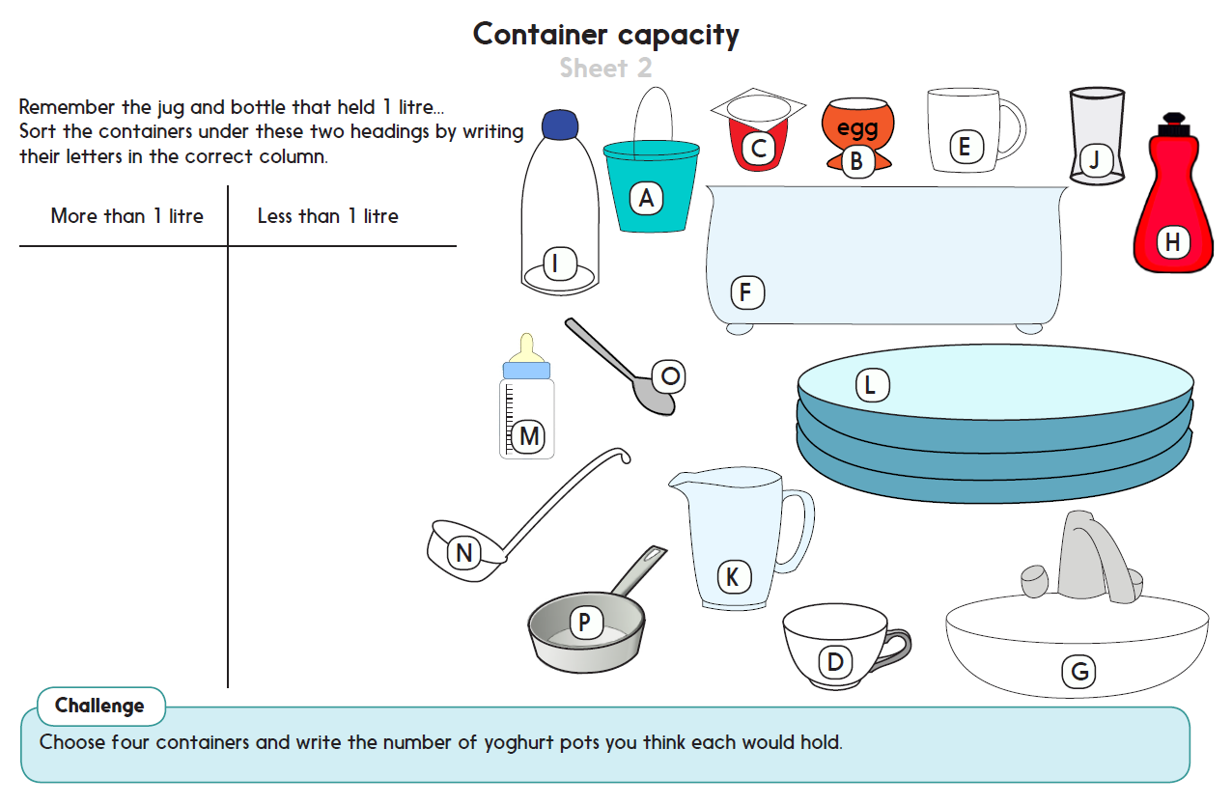
Challenge
Notes:
FE, SE, JG , OL, DB, TW, AL, BT and JH: Sort a variety of containers under headings: more than 1 litre and less than 1 litre. More practice Sheet 2

Slide 18
Measures and Data
Compare and measure weight
Objectives
Day 3
I can create my own pictogram and find simple information from my it.
I know that how much bottles hold can be measured in millilitres.
I can draw a pictogram and discuss what it shows.
Notes:
Before teaching, be aware that:
On Day 3 you will need four pudding bowls, flipchart, cups, water, ‘Pictogram to show the capacity of the three bears’ bowls’ (see resources), 4 labelled bottles of different sizes, 1 litre measuring jug, marked in 100ml divisions.

Slide 19

Day 3: I can create my own pictogram and find simple information from my it. I know that how much bottles hold can be measured in millilitres. I can draw a pictogram and discuss what it shows.
Show children 4 cereal/ pudding bowls, all of different sizes. Explain that these were the bowls left in the Three Bears’ house.
Who might the biggest bowl belong to?
Discuss the sizes and to whom they might belong.
Notes:
Teaching ALL

Slide 20

Day 3: I can create my own pictogram and find simple information from my it. I know that how much bottles hold can be measured in millilitres. I can draw a pictogram and discuss what it shows.
We can measure the capacity of the bowls by filling each with cups of water.
Notes:
Teaching All

Slide 21
Day 3: I can create my own pictogram and find simple information from my it. I know that how much bottles hold can be measured in millilitres. I can draw a pictogram and discuss what it shows.
Character | Number of cups
Daddy Bear | 6
Mummy Bear | 4
Baby Bear | 2
Goldilocks | 3
Fill in a table like this on the flipchart/sheet to show how many whole cups of water are needed to fill each bowl.
Use the next slide to show how the pictogram works. Each picture represents 1 cup of water, so for Daddy Bear we need 6 pictures of the cup and so on…
Explain that you are going to create a pictogram to show these results.
Tell children that a pictogram shows us the results in pictures rather than numbers; that each picture represents a number.
Use your own results to create a pictogram on the flipchart/sheet and discuss what it shows.
Notes:
Measure the capacity of each bowl (how many cups until it overflowed) and record the results in the table on the sheet/ flipchart

Slide 22
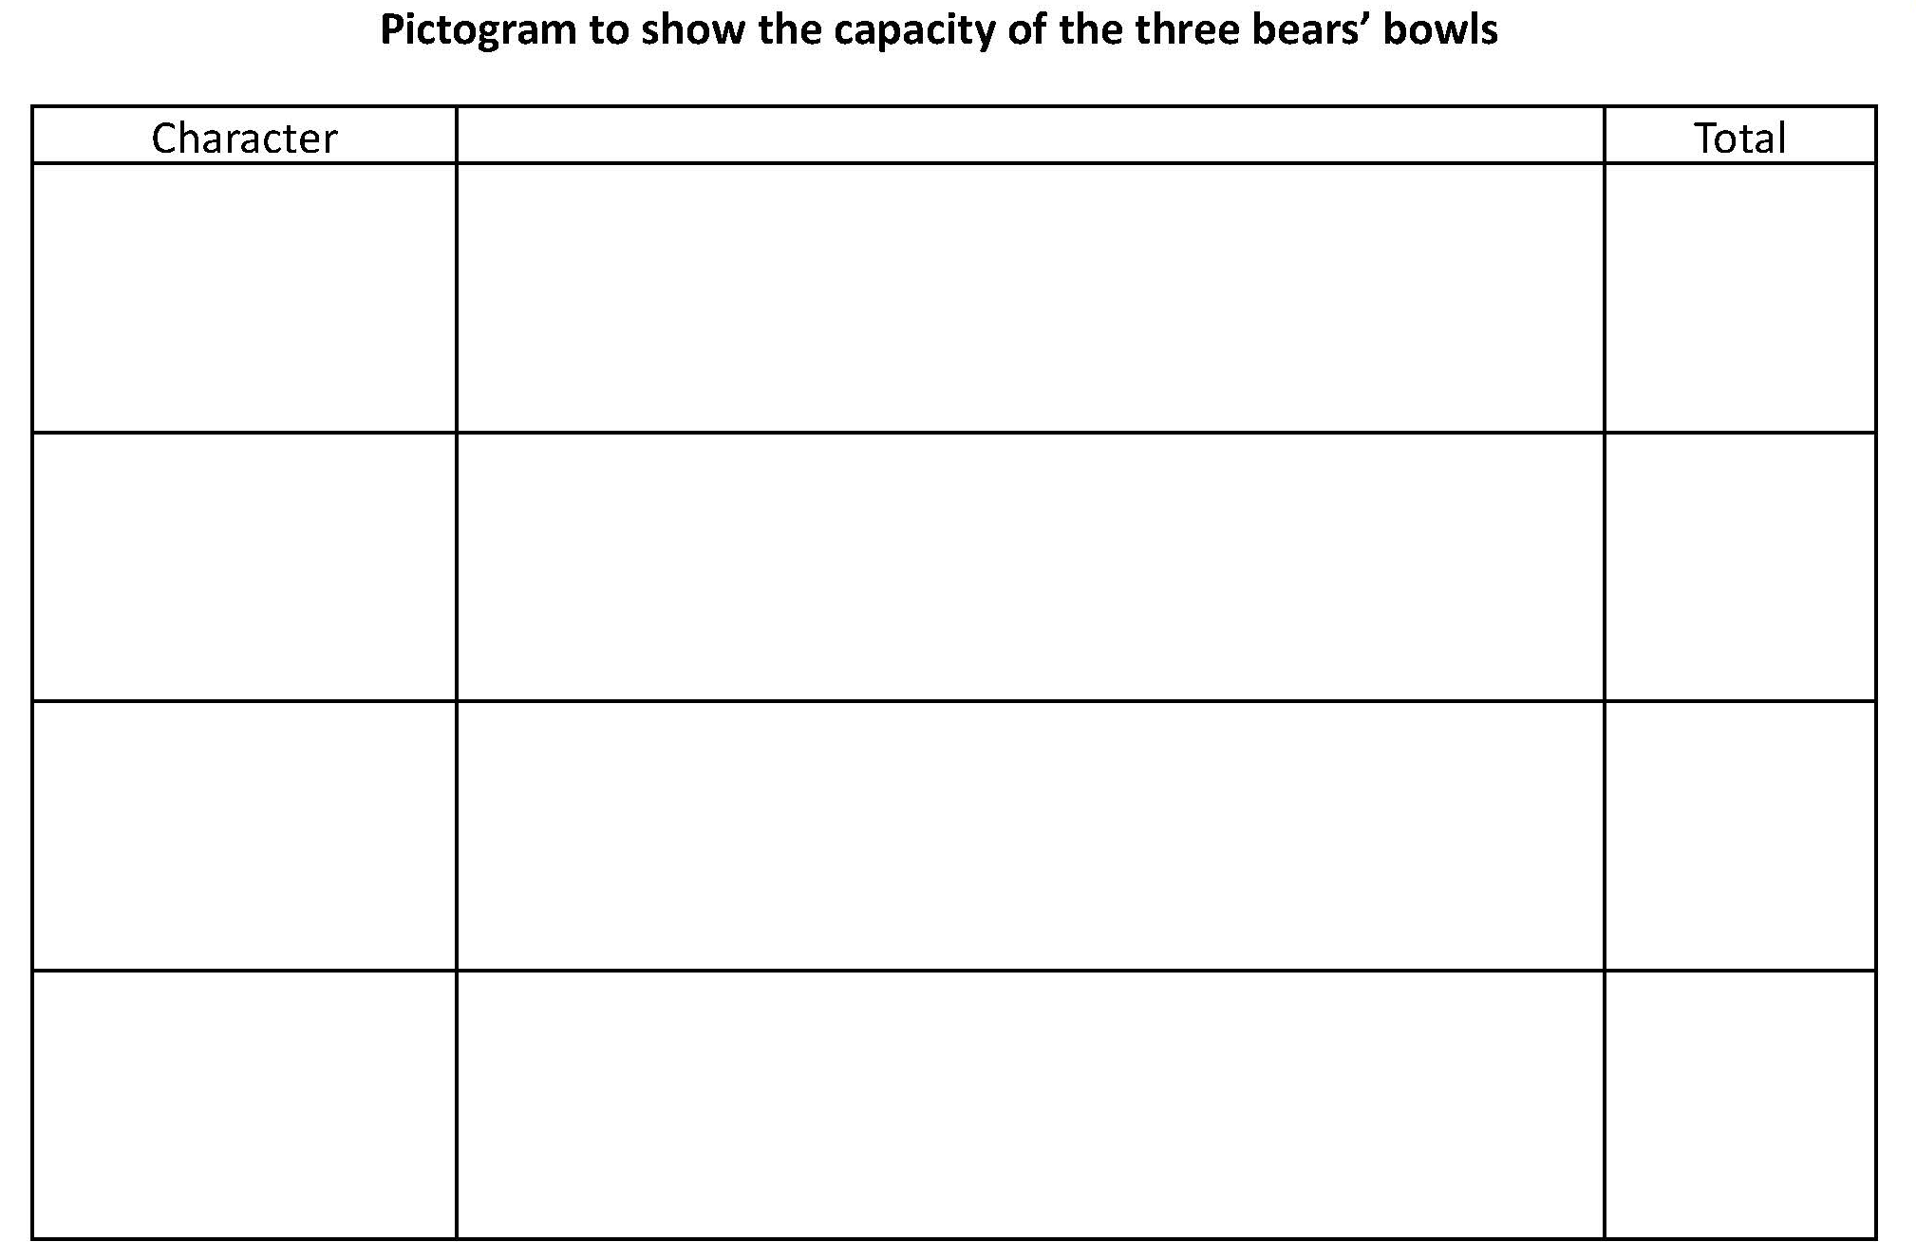
Day 3: I can create my own pictogram and find simple information from my it. I know that how much bottles hold can be measured in millilitres. I can draw a pictogram and discuss what it shows.
Daddy Bear
6
4
Mummy Bear
2
Baby Bear
3
Goldilocks
Notes:
Draw a picture of a cup – this picture represents 1 cup of water. How many cups would we have to draw to show the capacity of Mummy Bear’s bowl?
Model recording the number of cups in the blank pictogram. LCF and TK to record a pictogram on the bowls at home.
FE, SE, JG , OL, DB, TW, AL, BT and JH: Ask children/family to vote for their favourite drink out of four choices, e.g. milk, orange juice, apple juice, squash. Keep a record of the results. Then Draw a pictogram to show the results.
LCF and TK Create a pictogram to show the capacity of the three bears’ bowls. Resource

Slide 23
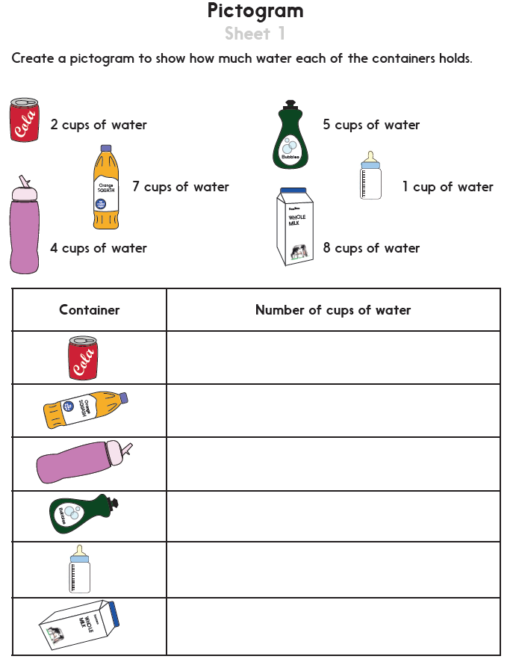
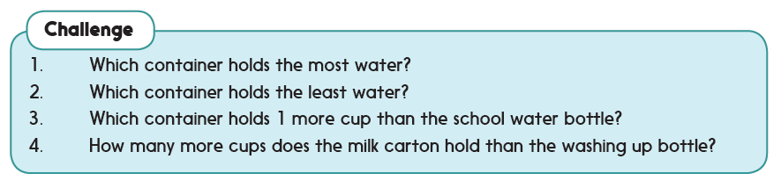
Challenge
Notes:
LCF and TK: Create a pictogram to show different capacities. Answer questions about the pictogram. More practice Sheet 1

Slide 24
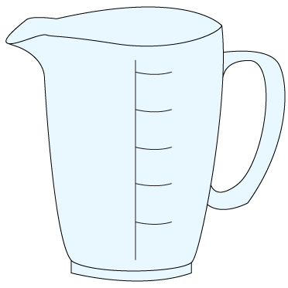

Day 3: I know that how much bottles hold can be measured in millilitres. I can draw a pictogram and discuss what it shows.
Show children a litre measuring jug. Point out the lines showing 100ml. Count in 100ml steps from 0 to 1000ml.
We use litres to measure capacity.
But a litre is too big to measure many things...
1000ml
… we can use millilitres instead, abbreviated to ml.
900ml
800ml
Show children a teaspoon and explain that it holds 5 millilitres… millilitres are very tiny!
700ml
600ml
500ml
1litre = 1000ml
400ml
300ml
200ml
100ml
Notes:
FE, SE, JG , OL, DB, TW, AL, BT and JH: Scribe the word thousand on the board for children to see. Get a teaspoon to show hoe little 5 mls are.

Slide 25
Day 3: I know that how much bottles hold can be measured in millilitres. I can draw a pictogram and discuss what it shows.
Show children four different-sized bottles, of different proportions, each labelled 1, 2, 3, or 4.
Which bottle do you think holds the most?
… And the least?
1000ml
900ml
800ml
700ml
600ml
Order the bottle according to the children’s ideas. Write the labels in order.
500ml
400ml
300ml
200ml
100ml
Notes:
Order the 4 bottles (of different sizes) according to the children’s ideas. Write the labels in order.
Measure how much each of these bottles will hold. Compare this to their prediction.
FE, SE, JG , OL,: Measures bottles’ capacities to the nearest 100ml.
DB, TW, AL, BT and JH: Measure to nearest 10ml

Slide 26
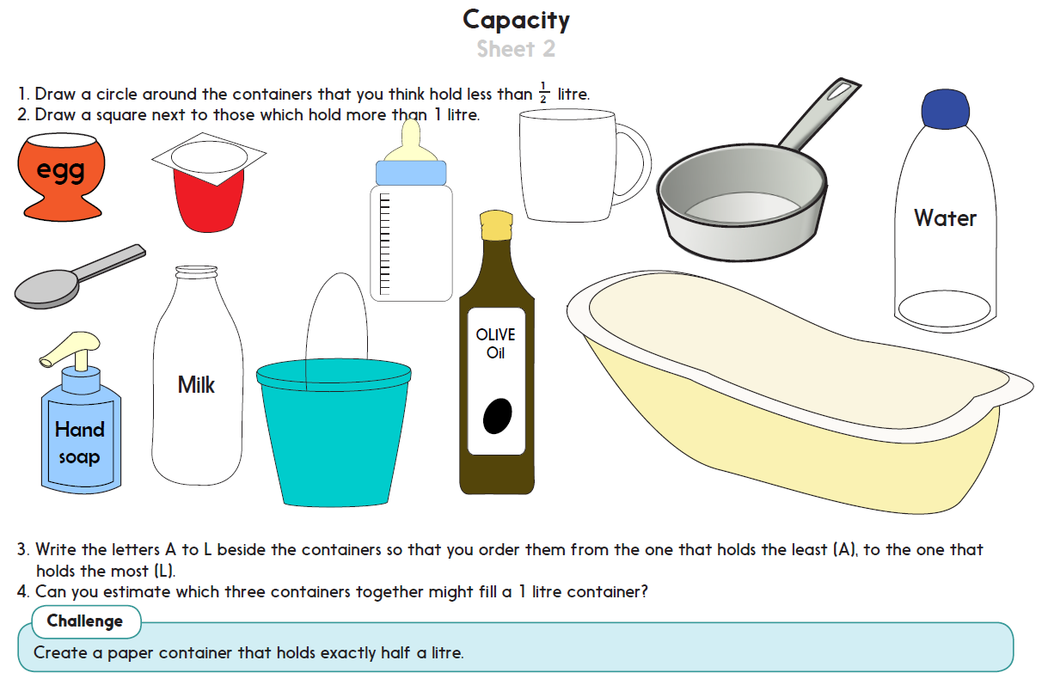
Challenge
Notes:
FE, SE, JG , OL: Estimate and order container capacity relative to half a litre and 1 litre. More practice Sheet 2 Question 1 and 2
DB, TW, AL, BT and JH: Estimate and order container capacity relative to half a litre and 1 litre. More practice Sheet 2 Question 1, 2, 3 and 4

Slide 27

Measures and Data
Measure and represent capacity
Well Done! You’ve completed this unit.
Objectives
Day 1
I can compare and order the capacity of containers.
I can measure liquid in cupfuls.
I understand a block graph.
Day 2
I can sort containers into which holds more and less than a cup and make sensible estimates about the capacity.
I can estimate and begin to measure liquid in litres.
I understand 1 litre as a measure of capacity.
Day 3
I can create my own pictogram and find simple information from my it.
I know that how much bottles hold can be measured in millilitres.
I can draw a pictogram and discuss what it shows.
Notes:
You can now use the Mastery: Reasoning and Problem-Solving questions to assess children’s success across this unit. Go to the next slides.

Slide 28
Problem solving and reasoning questions
How many cups full of sand would it take to fill a tray from the maths equipment cupboard?
-- Make a good guess
-- Write it down.
-- Use cups to measure and check
Make a cone out of paper. Estimate how many egg cups of lentils or rice it will hold. Measure to check your estimate.
How many cups more does your water bottle hold when it is full, than it does when it is half empty?
Notes:
FE, SE, JG , OL, LCF and TK: try these problems

Slide 29
Problem solving and reasoning questions
Estimate how many egg cups will fill each of these:
A yoghurt pot
A mug
Half an orange when the edible part is gone!
Laila has just spilled a ¹/₄ litre of juice from a 1-litre measuring jug. There is now a ¹/₂ litre in the jug. How much juice was in the jug before some was spilled?
Use paper to create a cone. Fill it with dried lentils or beans.
Is this less or more than half a litre?
Can you make a cone that holds exactly half a litre?
Jay found two part-used bottles of squash in the kitchen cupboard.
He poured them both into one bottle and discovered that he had ¹/₄ of a litre in total.
How much more would he need to make 1 litre?
Notes:
FE, SE, JG , OL, DB, TW, AL, BT and JH: Try these problems.

