Slide 1
Big Question: What is the Trinity?
Week 2: All About Baptism

Slide 2

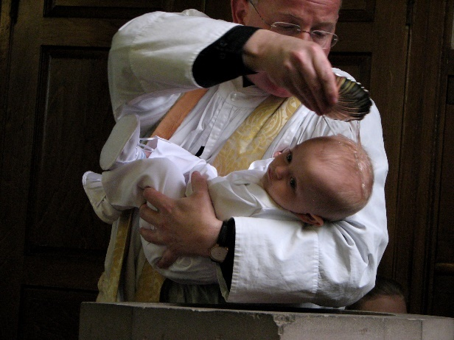
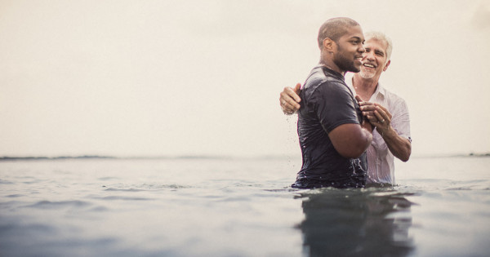
Last week: Water and Baptism
Baptism is a ceremony or act that many Christians do either as a baby or as an adult, to show that they are now part of the Christian family. Water is used within the ceremony because of its different symbolic meanings.
What happens in a baptism service? Are they all the same? Can you spot the Trinity in the service?
Look at some pictures and videos to find out and talk about what you find with a grown up.
Final Activity:

Slide 3

Different Types of Baptism
Watch these videos about Christian baptism – can you spot anything similar or different about the services?
Click the shells to watch.
1
2
3

Slide 4
Jesus’ Baptism
Jesus was baptised by his cousin, John the Baptist, and the story of this event is retold in the gospel of Matthew, Chapter 3. Read the chapter below with your grown up and then watch the clip of it that is posted on the website.
*NB – You Tube link is suitable for viewing but to avoid opening in You Tube, click on the red ‘play’ button to watch through the website.
The Preaching of John the Baptist
3 At that time John the Baptist came to the desert of Judea and started preaching. ² “Turn away from your sins,” he said, “because the Kingdom of heaven is near!” ³ John was the man the prophet Isaiah was talking about when he said,
“Someone is shouting in the desert,
‘Prepare a road for the Lord;
make a straight path for him to travel!’”
⁴ John's clothes were made of camel's hair; he wore a leather belt around his waist, and his food was locusts and wild honey. ⁵ People came to him from Jerusalem, from the whole province of Judea, and from all over the country near the Jordan River. ⁶ They confessed their sins, and he baptized them in the Jordan.
⁷ When John saw many Pharisees and Sadducees coming to him to be baptized, he said to them, “You snakes—who told you that you could escape from the punishment God is about to send? ⁸ Do those things that will show that you have turned from your sins. ⁹ And don't think you can escape punishment by saying that Abraham is your ancestor. I tell you that God can take these rocks and make descendants for Abraham! ¹⁰ The ax is ready to cut down the trees at the roots; every tree that does not bear good fruit will be cut down and thrown in the fire. ¹¹ I baptize you with water to show that you have repented, but the one who will come after me will baptize you with the Holy Spirit and fire. He is much greater than I am; and I am not good enough even to carry his sandals. ¹² He has his winnowing shovel with him to thresh out all the grain. He will gather his wheat into his barn, but he will burn the chaff in a fire that never goes out.”
The Baptism of Jesus
¹³ At that time Jesus arrived from Galilee and came to John at the Jordan to be baptized by him. ¹⁴ But John tried to make him change his mind. “I ought to be baptized by you,” John said, “and yet you have come to me!”
¹⁵ But Jesus answered him, “Let it be so for now. For in this way we shall do all that God requires.” So John agreed.
¹⁶ As soon as Jesus was baptized, he came up out of the water. Then heaven was opened to him, and he saw the Spirit of God coming down like a dove and lighting on him. ¹⁷ Then a voice said from heaven, “This is my own dear Son, with whom I am pleased.”

Slide 5
What do you think the dove, water and voice mean?
Talk about your ideas with your grown-up…

Slide 6
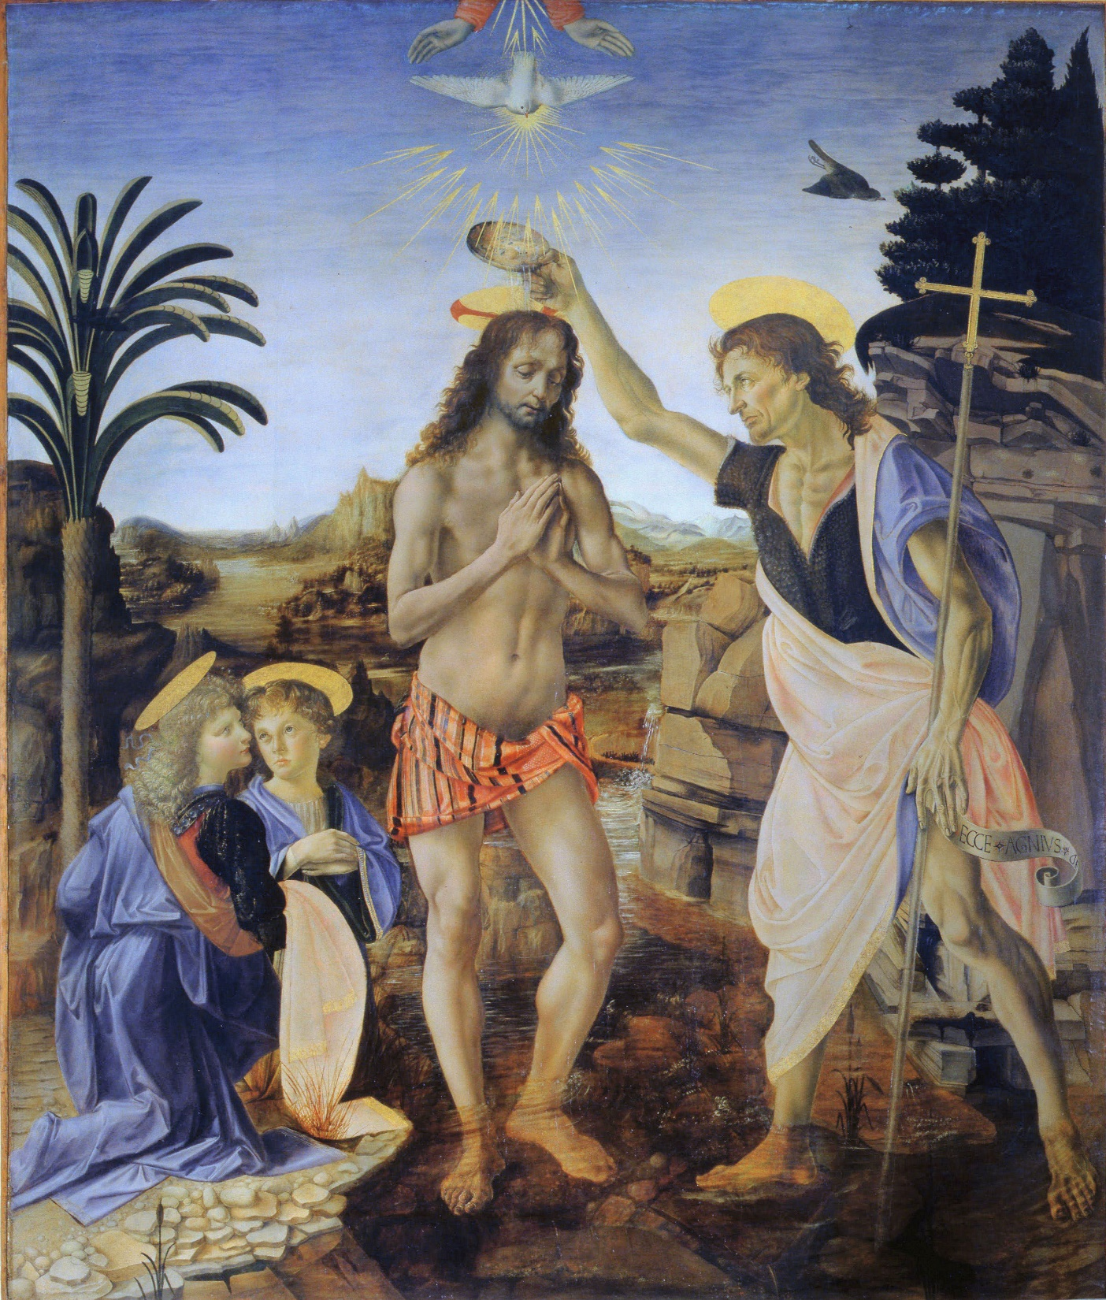
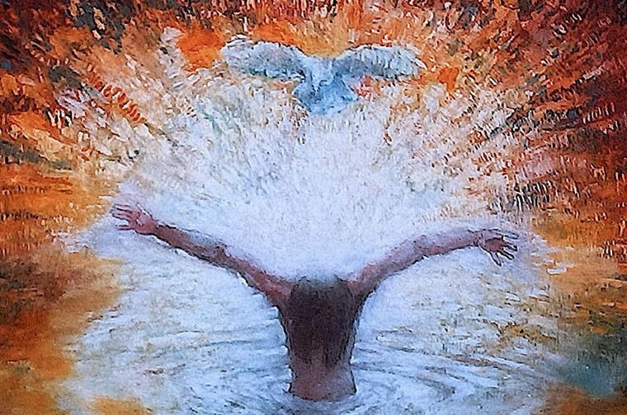
Baptism in Art
Look carefully at these two paintings of the Baptism. What is similar and different about how the different painters show God? Christians believe God is three in one, Father, Son and Holy Spirit.

Slide 7
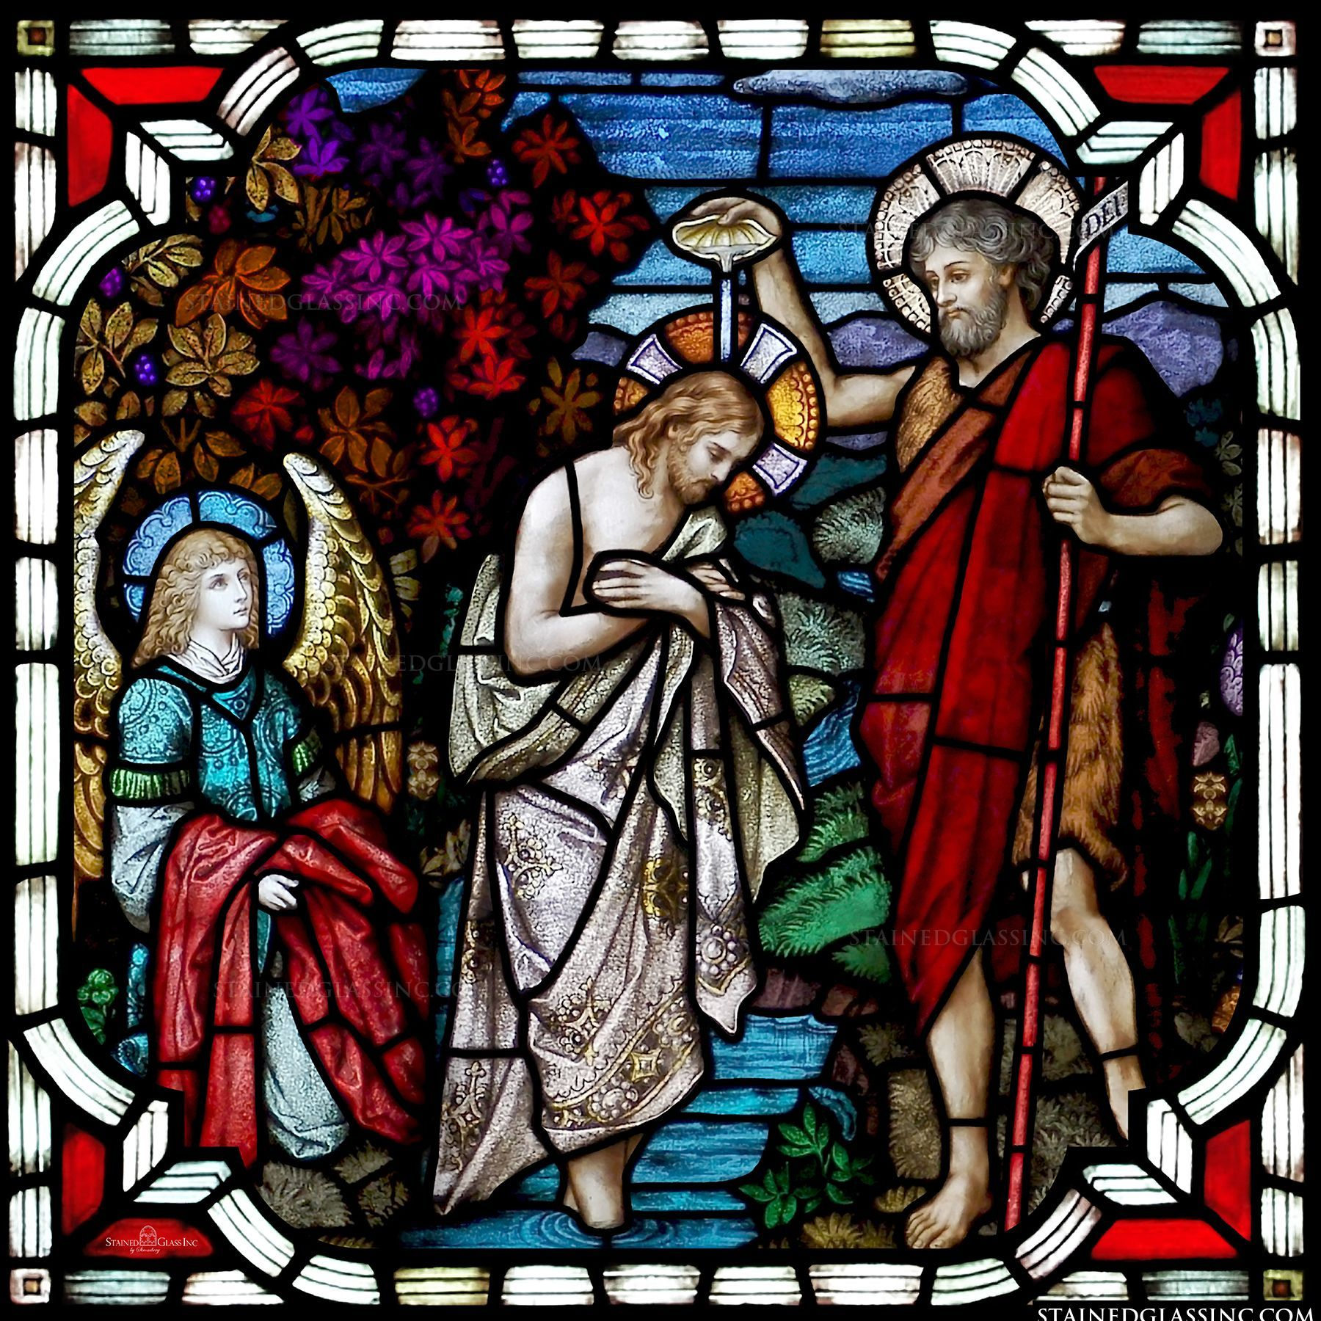
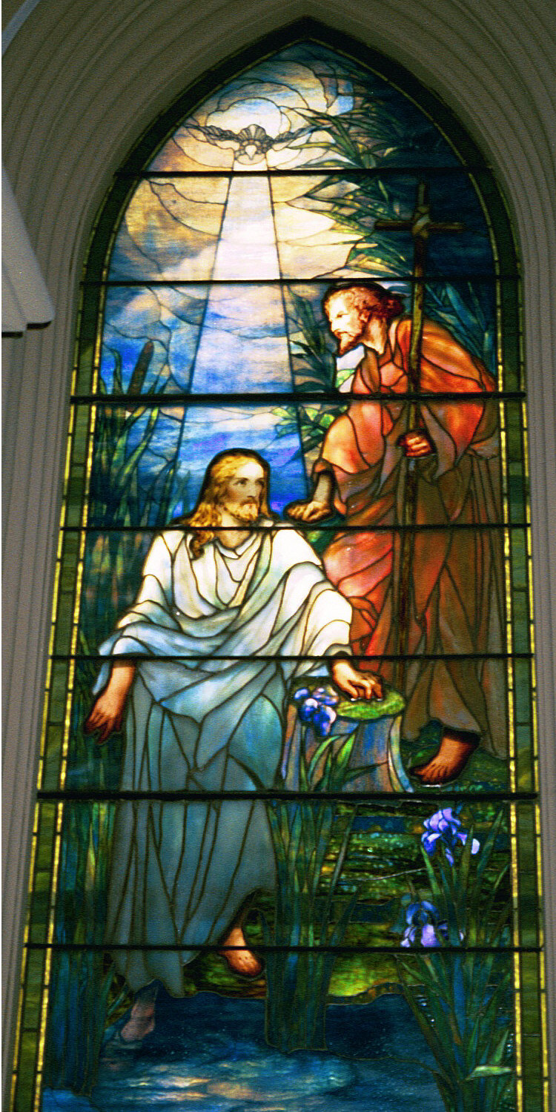
Baptism in stained glass
Jesus’ baptism can be shown using stained glass windows as well – like in the pictures here.
CHALLENGE:
St. Mary’s Church needs a new window!
Make your own ‘stained glass’ window of Jesus’ baptism – how will yours look?
Make sure you include things to show the Father, Son and Holy Spirit.

