Slide 1
L.I: To know how rivers get their water.
I can tell you the main events in the water cycle.
I can explain where the processes of evaporation and condensation occur in the water cycle.
I can explain why the water cycle is a closed cycle.

Slide 2
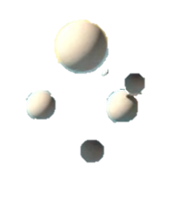

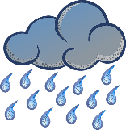
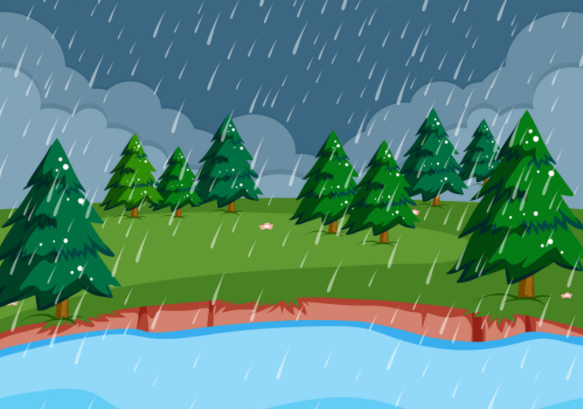
Water cycle vocabulary
Evaporation – Evaporation occurs when a liquid changes into a gas or water vapour.
Transpiration – Transpirations is when plants give out water vapour from their leaves.
Condensation – Condensation is when a gas cools and forms clouds.
Precipitation – when clouds become heavy with water droplets, they fall as rain/snow/hail.
Groundwater – Other rain water soaks into the ground, going deep underground.
Runoff – When rain reaches the ground, some of it runs over the ground into streams or rivers
Closed Cycle- is when the water level never changes just states.

Slide 3
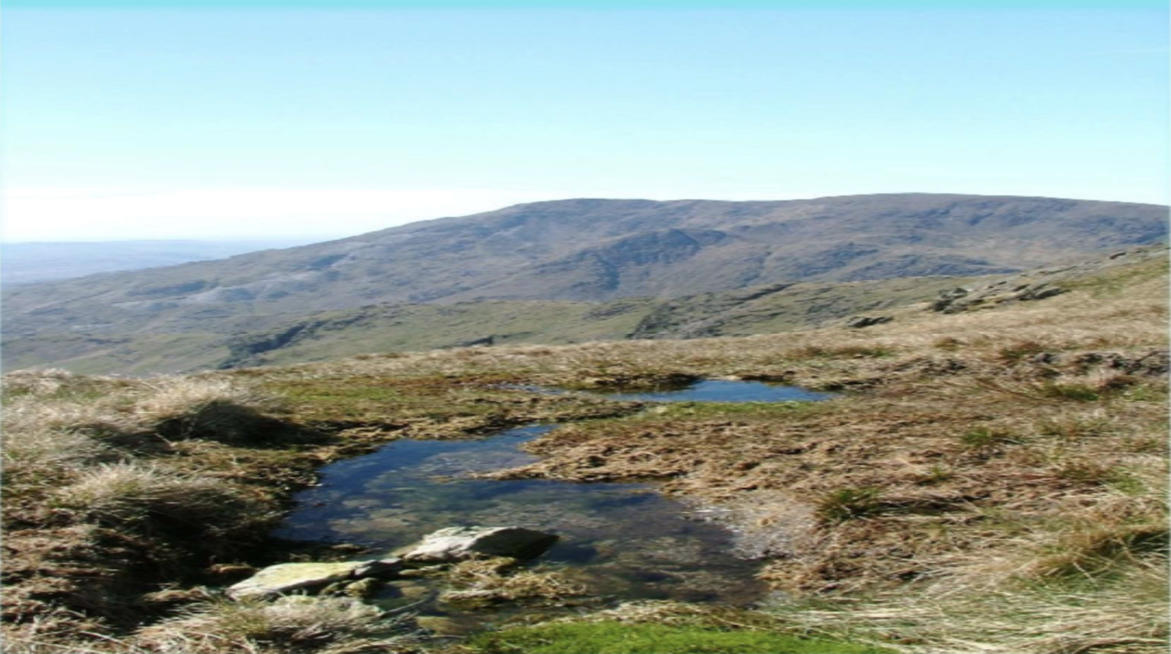
Most rivers start on mountains because that is where a lot of rain falls. Rainwater collects in lakes or bogs. Sometimes rainwater soaks through soft rock but cannot get through the hard rock that is lower down. This water bursts out of the mountain in a spring. The start of a river is called its source.

Slide 4
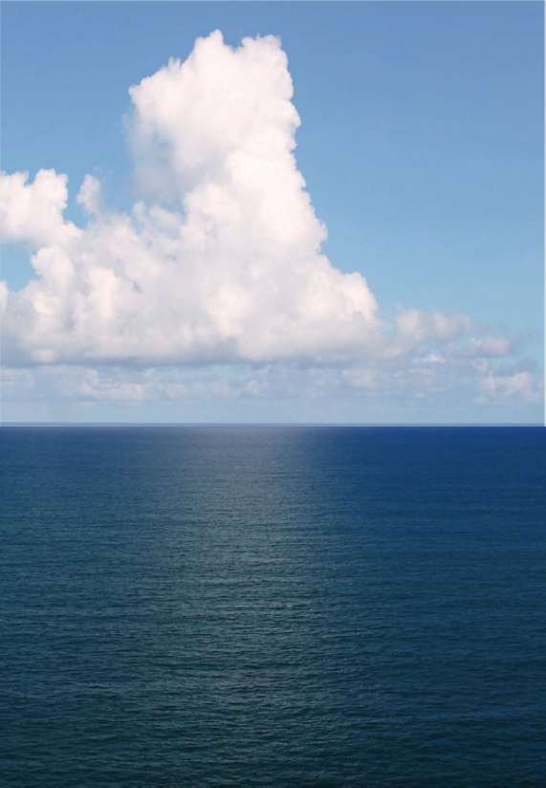
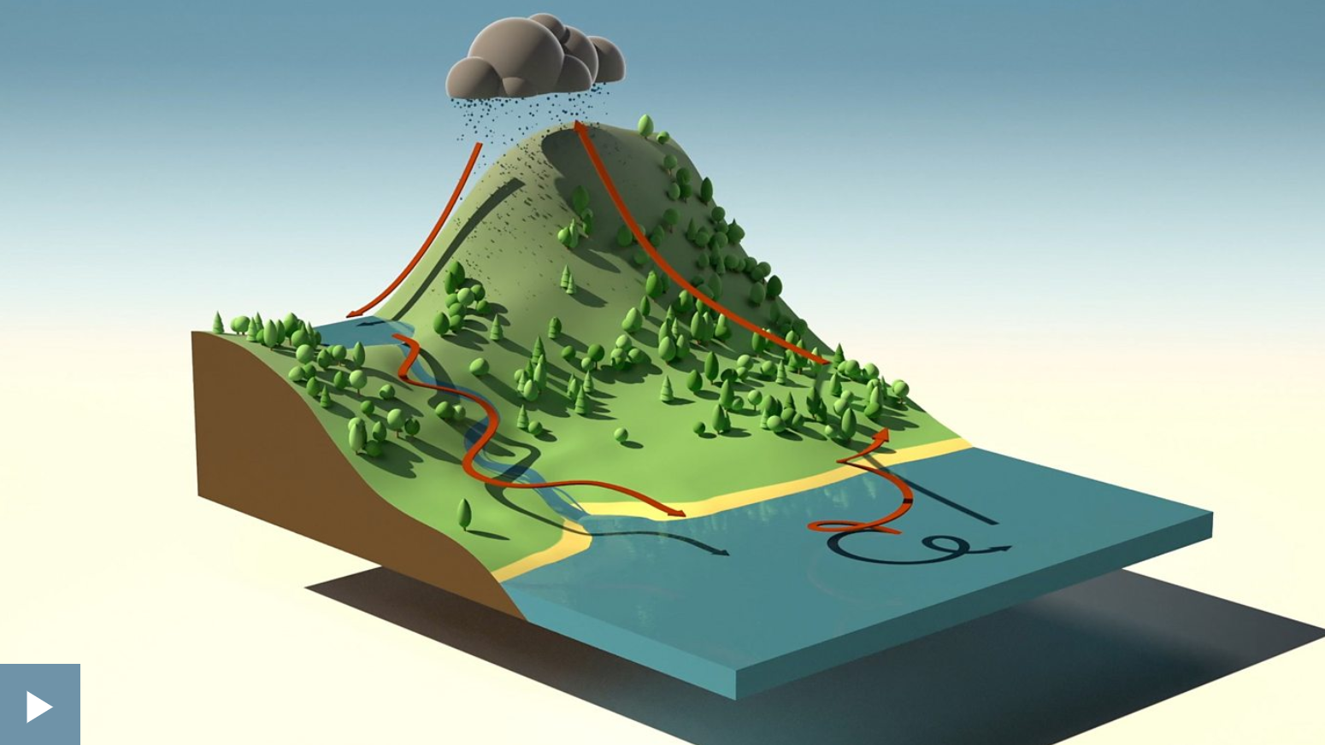
Living things need water to survive. Our planet is full of life, but life is only possible because we have so much water! Nearly ¾ of the Earth’s surface is covered by water.
The amount of water on the Earth and in the Earth’s atmosphere is always roughly the same. The water just moves from place to place! You have seen how much water moves in the Indus River. You saw how it moves from the mountains of Tibet, into India, across Pakistan and into the Arabian Sea.
Water on Earth is constantly moving. It is recycled over and over again. This recycling process is called the water cycle.
Water isn’t always a liquid! It can be a solid, a liquid or a gas. When water is frozen or semi-frozen as ice, snow or hail, we say it has become a solid. When water warms up it turns into water vapour and rises into the air. Water vapour is a gas.
Below is video is explaining the water cycle.

Slide 5
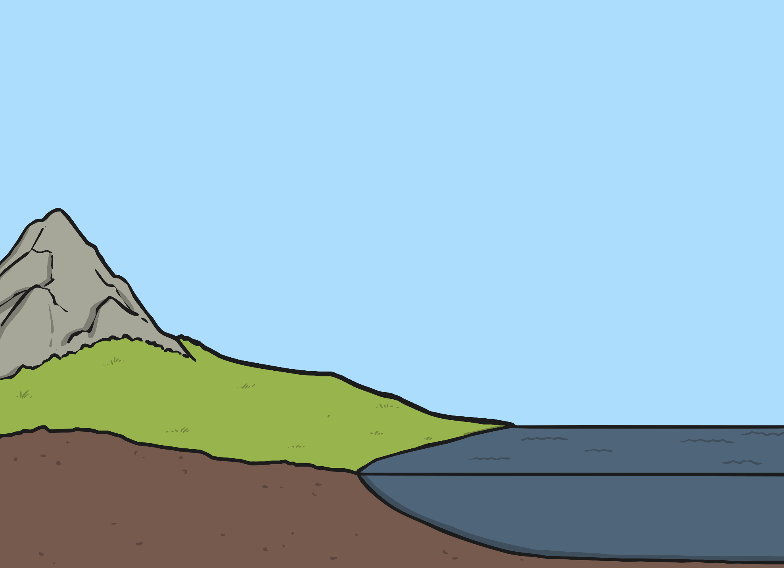

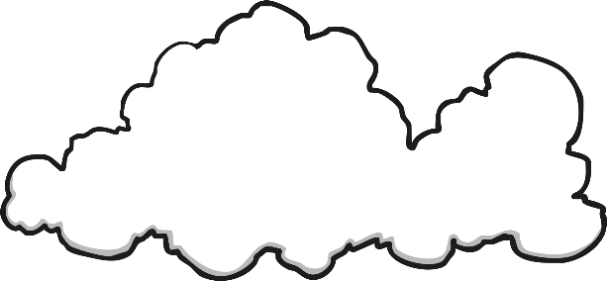



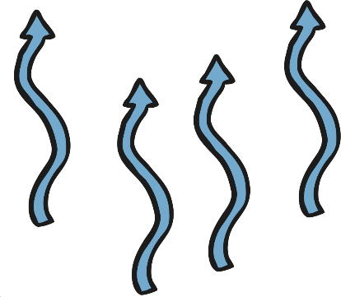
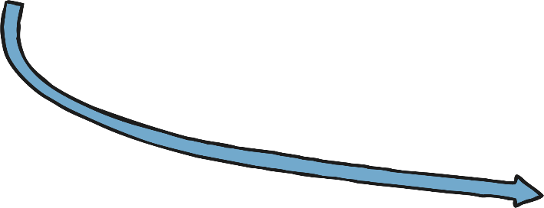

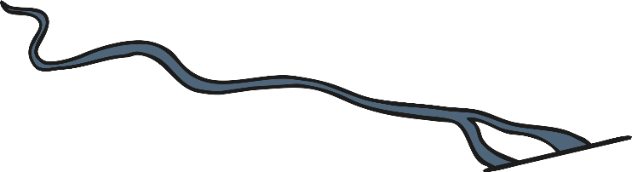
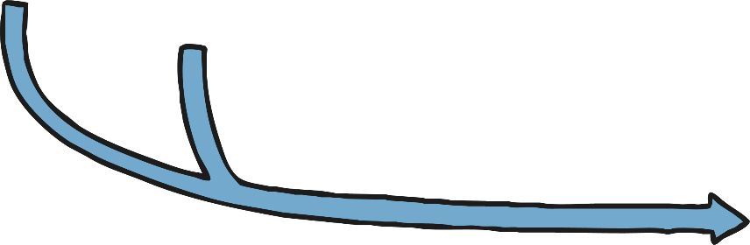
The Water Cycle
Sun
wind
condensation
precipitation
(rain/snow)
evaporation
runoff
rivers and streams
sea
groundwater

Slide 6

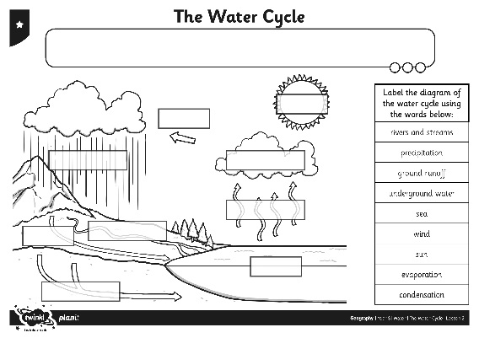
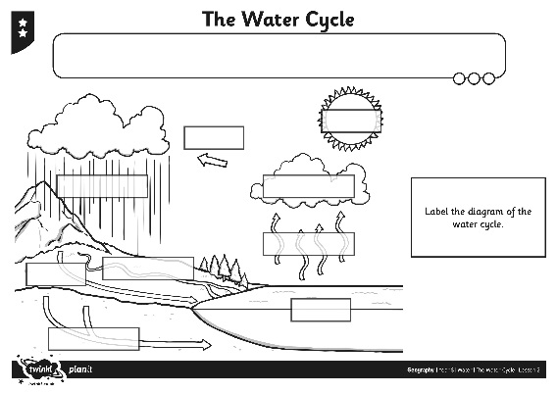
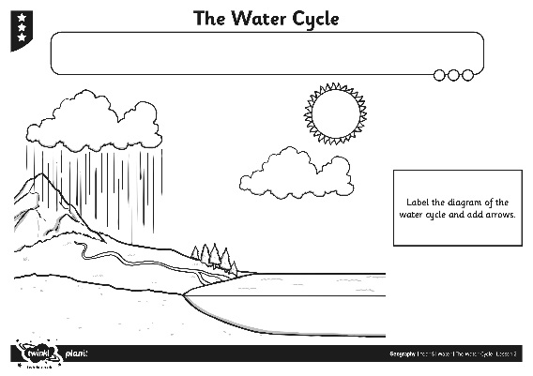
The Water Cycle
Fill in the Water Cycle Activity Sheet!

