Slide 1

Fractions and Multiplication
Clever counting; multiplication
Day 1
I can begin to learn to count in 2s.
I can multiply by 5s using bead lines.
I can use the 4 x to learn the 8 x.

Slide 2

Day 1: I can begin to learn to count in 2s. I can multiply by 5s using bead lines. I can use the 4 x to learn the 8 x.
We are going to do some whisper counting today.
Divide into two teams. Each team will take turns to say the next number in the count.
Team 1
Team 2
Whispering voices
Louder voices
Notes:
First count in 1s then 2s, whisper 1 then say 2, whisper 3 say 4 until 20.

Slide 3
Day 1: I can begin to learn to count in 2s. I can multiply by 5s using bead lines. I can use the 4 x to learn the 8 x.
Now I am going to start counting.
As soon as you realise the sequence, join in with me.
2
4
6
8
10
12
14
16
18
20

Slide 4
Day 1: I can begin to learn to count in 2s. I can multiply by 5s using bead lines. I can use the 4 x to learn the 8 x.
Counting in 2s saves us a lot of time, rather than counting each shoe individually!
We sometimes call this clever counting.

Slide 5
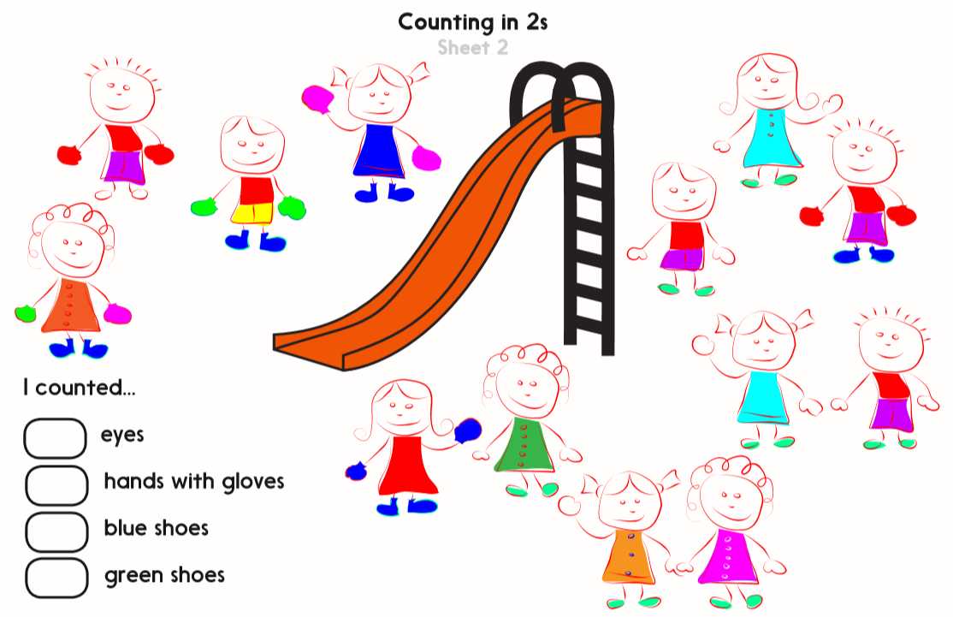
Notes:
Practice sheet 1 and 2

Slide 6

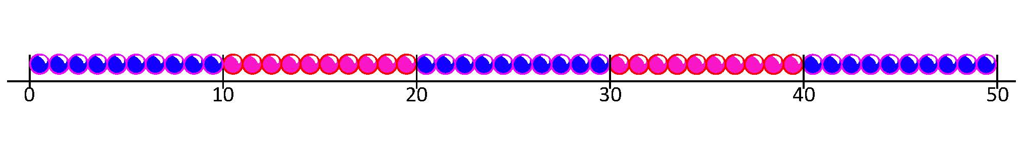
Day 1: I can multiply by 5s using bead lines. I can use the 4 x to learn the 8 x.
Think about counting in 5s with the bead string for a few moments.
4 × 5 =
We can read this as
4 lots of 5, or 4 times 5.
4 × 5 = 20
Let’s ring 4 groups of 5 beads.
How many beads is that altogether?

Slide 7
Day 1: I can multiply by 5s using bead lines. I can use the 4 x to learn the 8 x.
Let’s find 3 × 5.
Let’s draw hops this time…
3 × 5 = 15
How many beads is that altogether?

Slide 8
Day 1: I can multiply by 5s using bead lines. I can use the 4 x to learn the 8 x.
Let’s find 6 × 5.
How many hops this time?
Let’s count them.
6 × 5 = 30
How many beads is that altogether?
Count in 5s.

Slide 9
Day 1: I can multiply by 5s using bead lines. I can use the 4 x to learn the 8 x.
Let’s find 10 × 5. How many hops this time?
Let’s count them.
10 × 5 = 50
How many beads is that altogether?
Count in 5s.
Notes:
Generate and solve times 5 multiplication sentences with dice, using hops on beaded lines or fingers in resources.

Slide 10
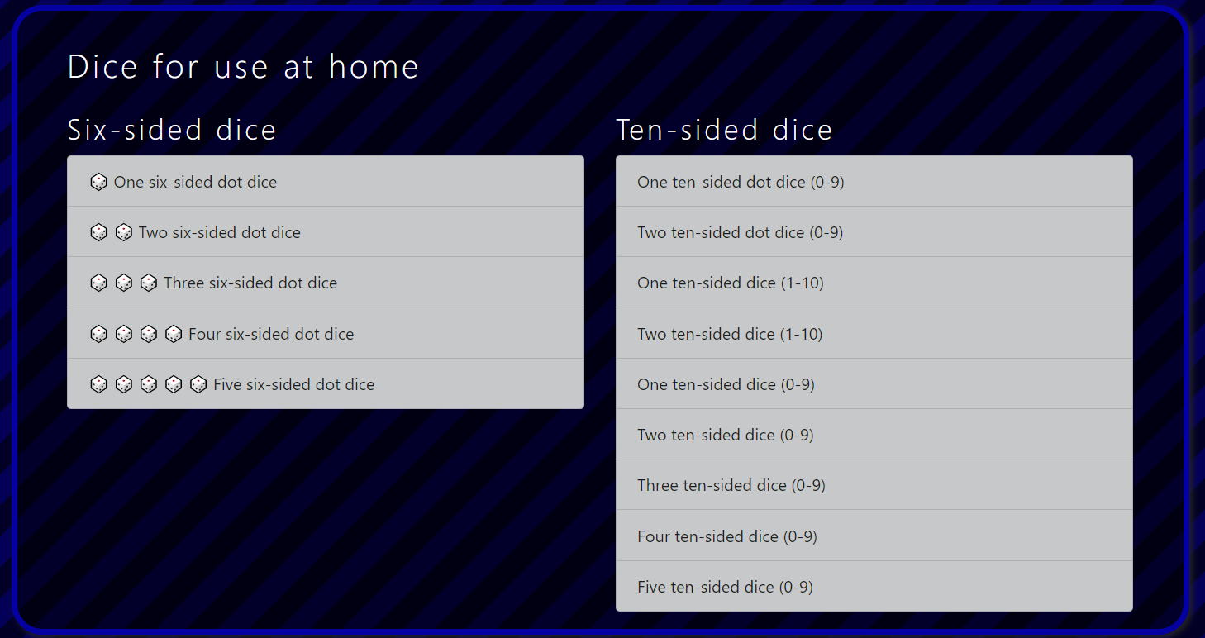
Notes:
For anyone that needs more practice on their 5 times table

Slide 11
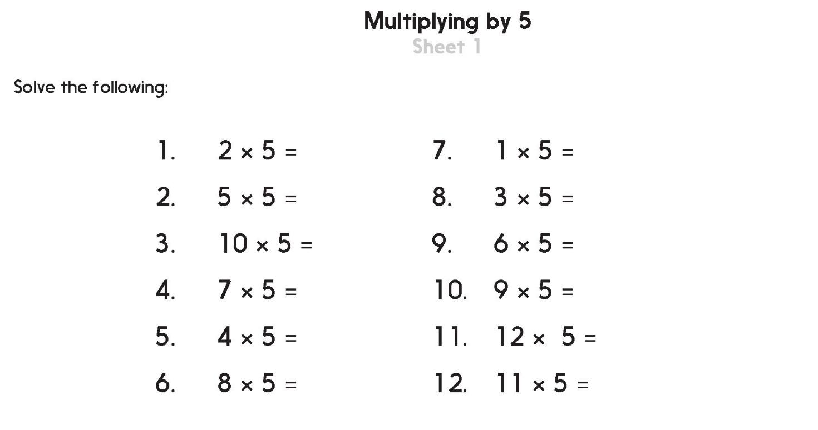

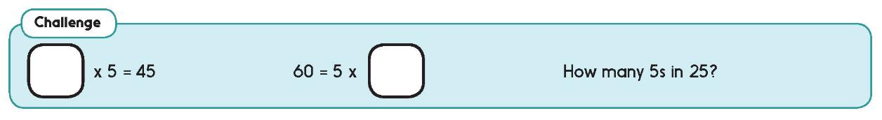
Challenge
Notes:
Practice 2 - Multiplying by 5 Sheet 1 - Beaded number lines is avaible for children who need them, otherwise children count on multiples with their fingers or in their heads then use a beaded line to check (see practice ).

Slide 12


Day 1: I can use the 4 x to learn the 8 x.
Now write the 8× table.
You can double the 4s!
Write the 4× table on your whiteboards/sheet.
1 × 4 =
4
1 × 8 =
8
2 × 4 =
8
2 × 8 =
16
3 × 4 =
12
3 × 8 =
24
4 × 4 =
16
4 × 8 =
32
5 × 4 =
20
5 × 8 =
40
6 × 4 =
24
6 × 8 =
48
7 × 4 =
28
7 × 8 =
56
8 × 4 =
32
8 × 8 =
64
9 × 4 =
36
9 × 8 =
72
Let’s check.
10 × 4 =
40
10 × 8 =
80
Let’s check.
11 × 4 =
44
11 × 8 =
88
12 × 4 =
48
12 × 8 =
96
Notes:
Any one comfortable learning the 4 times table.

Slide 13
Day 1: Use the 4 times table to learn the 8 times table. Understand the relationship between 4 and 8 times tables.
Look at the answers in the 8× table.
8× are always double the 4×
1 × 4 =
4
1 × 8 =
8
2 × 4 =
8
2 × 8 =
16
3 × 4 =
12
3 × 8 =
24
4 × 4 =
16
4 × 8 =
32
6 × 4 = 24
5 × 4 =
20
5 × 8 =
40
Double 24 is 48.
6 × 4 =
24
6 × 8 =
48
7 × 4 =
28
7 × 8 =
56
8 × 4 =
32
8 × 8 =
64
9 × 4 =
36
9 × 8 =
72
Double 32 is 64.
8 × 4 = 32.
10 × 4 =
40
10 × 8 =
80
11 × 4 =
44
11 × 8 =
88
12 × 4 =
48
12 × 8 =
96

Slide 14
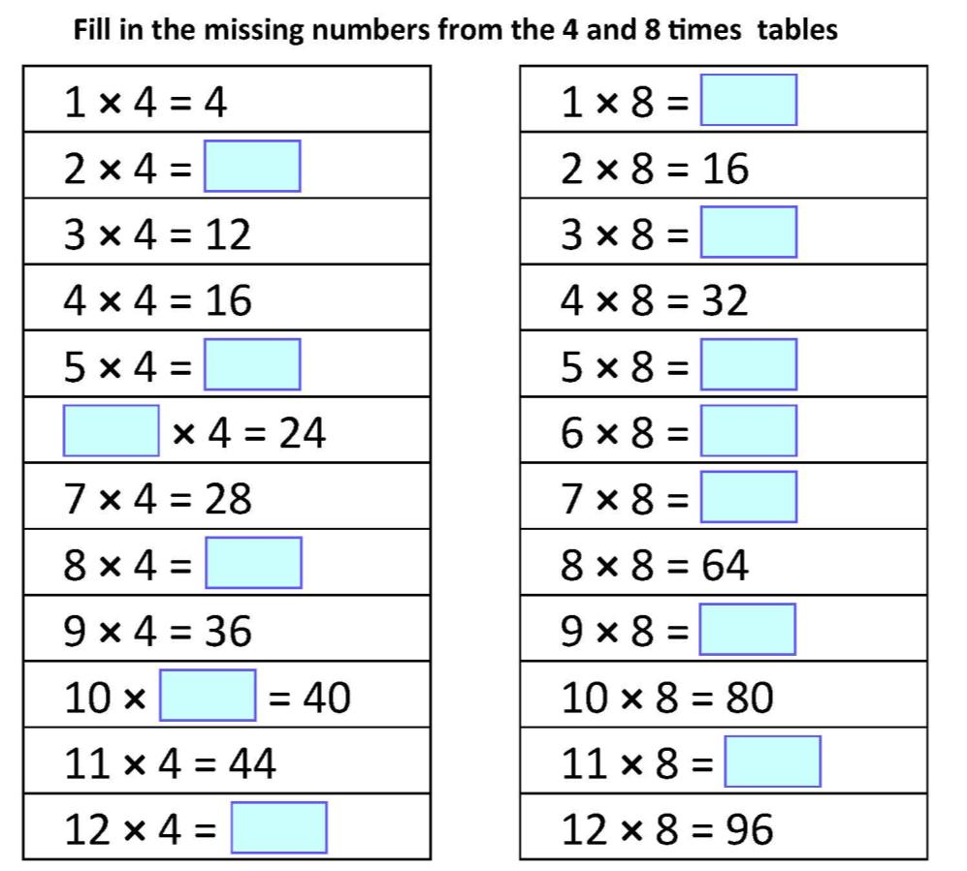
Day 1: Use the 4 times table to learn the 8 times table. Understand the relationship between 4 and 8 times tables.
Find the missing numbers.
8
8
24
Double the answers to the 4s if you don’t know the 8s!
20
40
6
48
56
32
72
Let’s check those.
4
88
48
Notes:
This sheet is in resources

Slide 15
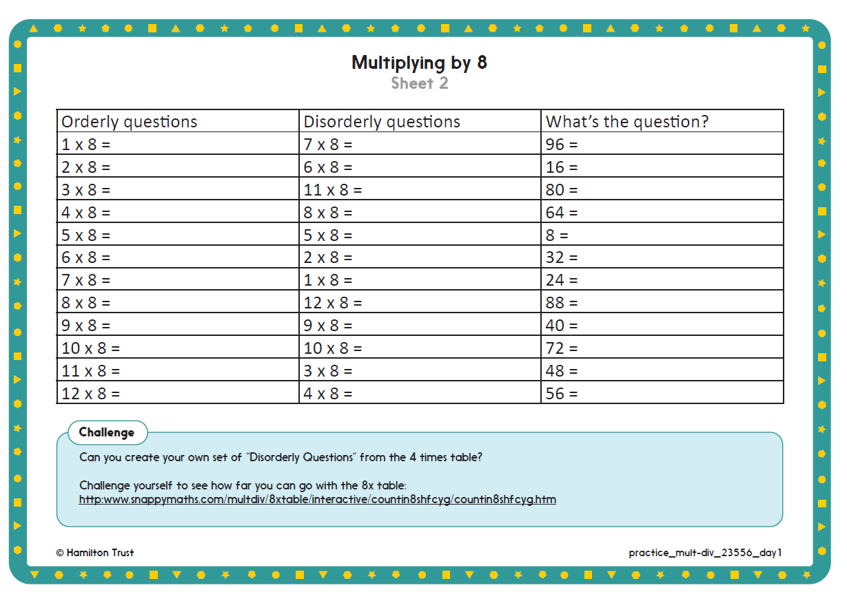
Challenge
Notes:
All groups can try the first Challenge and higher group try the second Challenge. (Practice sheet 2)

