Slide 1
Fractions and Multiplication
Clever counting; multiplication
Day 2
To begin to recognise odd and even numbers.
I can multiply by 2, 5 and 10, using beaded lines.
I can recall x2, 3, 4, 5, 8, 10 tables; Use a range of strategies to make links between times tables.

Slide 2


Day 2: To begin to recognise odd and even numbers. I can multiply by 2, 5 and 10, using beaded lines. I can recall x2, 3, 4, 5, 8, 10 tables; Use a range of strategies to make links between times tables.
Place some socks on the floor and divide the flipchart/sheet into two columns, labelled odd and even.
Notes:
You need 12 pairs of socks. A sheet in (resources) with odd and even and pencil

Slide 3

Day 2: To begin to recognise odd and even numbers. I can multiply by 2, 5 and 10, using beaded lines. I can recall x2, 3, 4, 5, 8, 10 tables; Use a range of strategies to make links between times tables.
Talk to your partner/adult.
Is 4 an odd or even number?

Slide 4
Day 2: To begin to recognise odd and even numbers. I can multiply by 2, 5 and 10, using beaded lines. I can recall x2, 3, 4, 5, 8, 10 tables; Use a range of strategies to make links between times tables.
Let’s make some pairs with the socks...
There are 2 pairs and no socks left over, so 4 is an even number.
Write 4 on the even number side of the flip chart/sheet.

Slide 5
Day 2: To begin to recognise odd and even numbers. I can multiply by 2, 5 and 10, using beaded lines. I can recall x2, 3, 4, 5, 8, 10 tables; Use a range of strategies to make links between times tables.
Now pick out 7 socks.
Talk to your partner.
Is 7 an odd or even number?

Slide 6
Day 2: To begin to recognise odd and even numbers. I can multiply by 2, 5 and 10, using beaded lines. I can recall x2, 3, 4, 5, 8, 10 tables; Use a range of strategies to make links between times tables.
Let’s make some pairs again.
There are 3 pairs and 1 sock left over, so 7 is an odd number.
Repeat for all numbers up to 12.
Complete in a random order.
Write 7 on the odd number side of the flip chart/sheet.
Notes:
You can use the socks to support sorting numbers to 12 to make is visual.

Slide 7


Day 2: To begin to recognise odd and even numbers. I can multiply by 2, 5 and 10, using beaded lines. I can recall x2, 3, 4, 5, 8, 10 tables; Use a range of strategies to make links between times tables.
Can you predict where we will write 11?
How?
odd
even
7
4
9
2
1
8
5
What about 12? How?
10
3
6
11
12

Slide 8
Day 2: To begin to recognise odd and even numbers. I can multiply by 2, 5 and 10, using beaded lines. I can recall x2, 3, 4, 5, 8, 10 tables; Use a range of strategies to make links between times tables.
Continue, writing the numbers to 24.
Numbers ending in
0, 2, 4, 6, 8 are even.
These patterns are always true for even and odd numbers.
We can’t always use socks to help with odds and evens so we need to spot some patterns.
Numbers ending in
1, 3, 5, 7, 9 are odd.

Slide 9
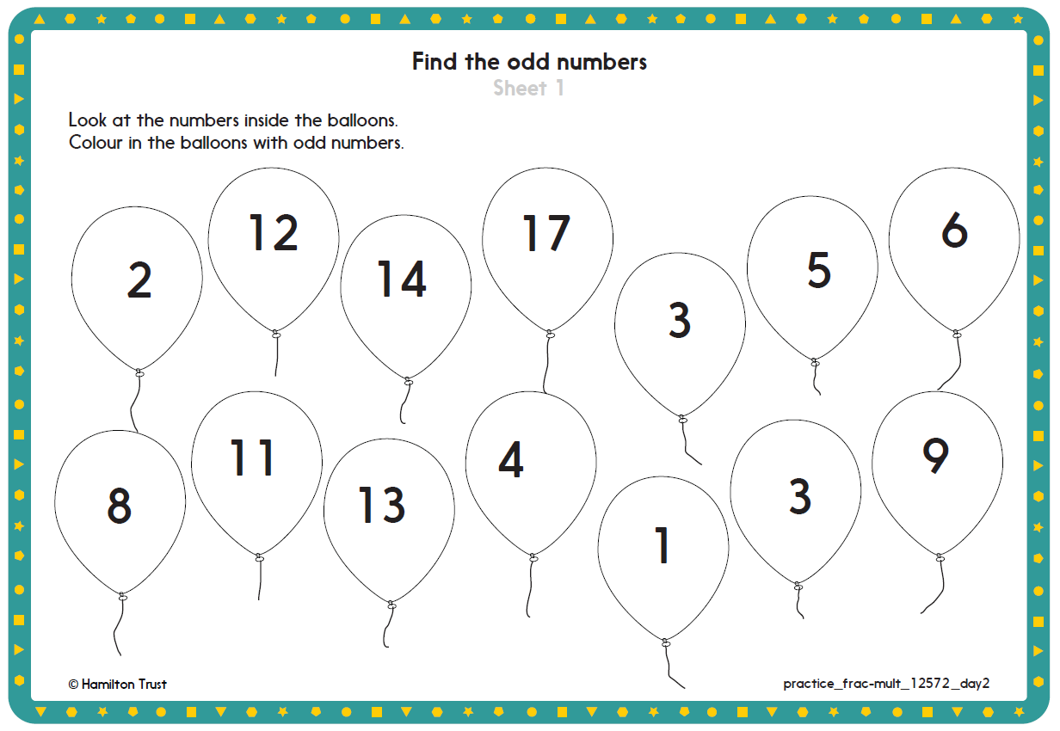
Notes:
More practice sheet 1 and 2
Colour the odd numbers the ones that has a sock left over. Sheet 1
Can you sort the 10 to 30 cards into sort number by looking at the ones digit? Sheet 2

Slide 10

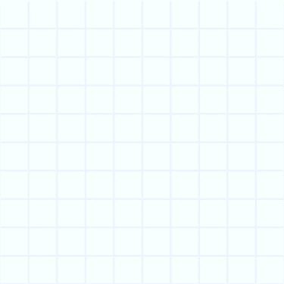
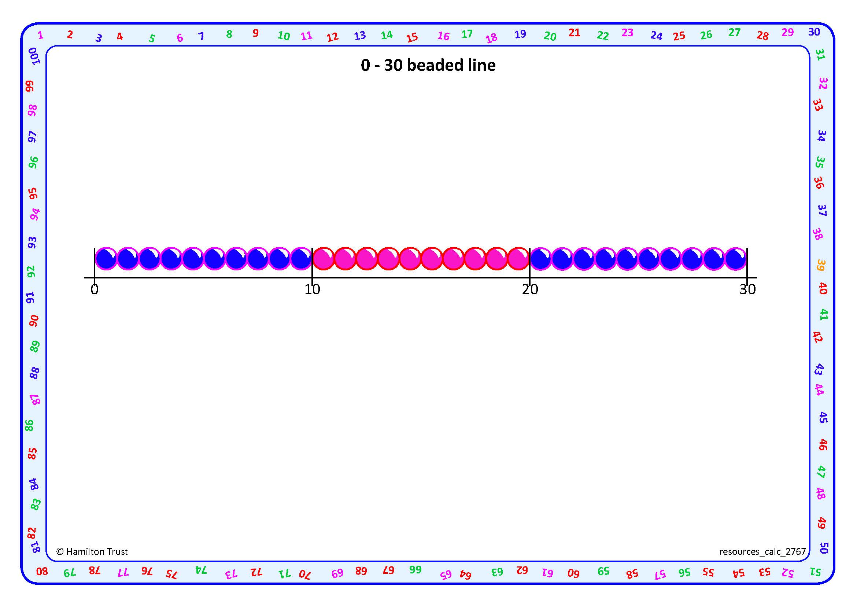
Day 2: I can multiply by 2, 5 and 10, using beaded lines. I can recall x2, 3, 4, 5, 8, 10 tables; Use a range of strategies to make links between times tables
4 × 2 =
Think about counting in 2s with the bead string for a few moments.
We can read this as
4 lots of 2, or 4 times 2.
4 × 2 = 8
Let’s ring 4 groups of 2 beads.
How many beads is that altogether?

Slide 11
Day 2: I can multiply by 2, 5 and 10, using beaded lines. I can recall x2, 3, 4, 5, 8, 10 tables; Use a range of strategies to make links between times tables
Let’s find 8 × 2, this time drawing hops …
8 × 2 = 16
How many beads is that altogether? Count the jumps in 2s to check.

Slide 12
Day 2: I can multiply by 2, 5 and 10, using beaded lines. I can recall x2, 3, 4, 5, 8, 10 tables; Use a range of strategies to make links between times tables
Let’s find 3 × 10.
How many jumps?
How big is each jump?
Remember it’s
3 lots of 10!
3 × 10 = 30
How many beads is that altogether?

Slide 13
Day 2: I can multiply by 2, 5 and 10, using beaded lines. I can recall x2, 3, 4, 5, 8, 10 tables; Use a range of strategies to make links between times tables
Let’s find 5 × 5.
How many jumps?
How big is each jump?
That’s 5 jumps of 5!
5 × 5 = 25
How many beads is that altogether? Count the jumps in 5s to check.
Notes:
Y2 children can now go on to do differentiated GROUP ACTIVITIES. You can find Hamilton’s group activities in this unit’s PLANNING download.
Y2 WT/ARE/GD: Solve and create word problems for multiplication by 2, 5 and 10.

Slide 14
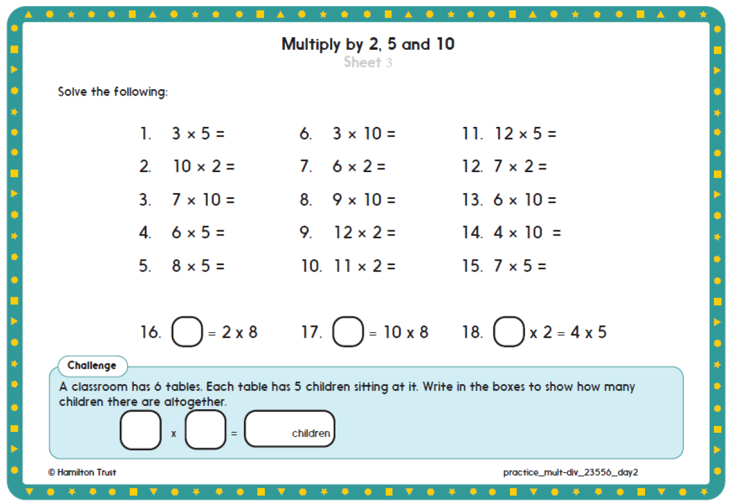
Notes:
Practice sheet 3 you can also use resources multiplying 2,5 and 10 beaded line to help count up in steps.

Slide 15
Day 2: I can recall x2, 3, 4, 5, 8, 10 tables; Use a range of strategies to make links between times tables
6 × 4 = 24. Let’s see where that goes…
× | 1 | 2 | 3 | 4 | 5 | 6 | 7 | 8 | 9 | 10 | 11 | 12
1
2
3
4
5
6
7
8
9
10
11
12
24
24
24
8 × 3 = 24 (or 3 × 8)
4 × 6 = 24 too!
24
Any other multiplication facts that make 24?
24
12 × 2 = 24 (or 2 × 12).
24
Notes:
Further teaching use the multiplication grid in resources. They can fill in the numbers as you go through the next slides.

Slide 16
Day 2: I can recall x2, 3, 4, 5, 8, 10 tables; Use a range of strategies to make links between times tables
× | 1 | 2 | 3 | 4 | 5 | 6 | 7 | 8 | 9 | 10 | 11 | 12
1
2
3
4
5
6
7
8
9
10
11
12
2s?
2 4 6 8 10 12 14 16 18 20 22 24
5s?
5 10 15 20 25 30 35 40 45 50 55 60
Which rows would you find easy to fill?
10s?
10 20 30 40 50 60 70 80 90 100 110 120

Slide 17
Day 2: I can recall x2, 3, 4, 5, 8, 10 tables; Use a range of strategies to make links between times tables
× | 1 | 2 | 3 | 4 | 5 | 6 | 7 | 8 | 9 | 10 | 11 | 12
1
2
3
4
5
6
7
8
9
10
11
12
Complete as much of your grid as you can.
If you know a row you can also fill in a column!
If you know the 3s then double to fill in the 6s.
Start with the tables or facts you know.
If you know the 4s then double to fill in the 8s.
We haven’t learnt the 9s but if you know 9 × 4 you can also fill in 4 × 9…

Slide 18
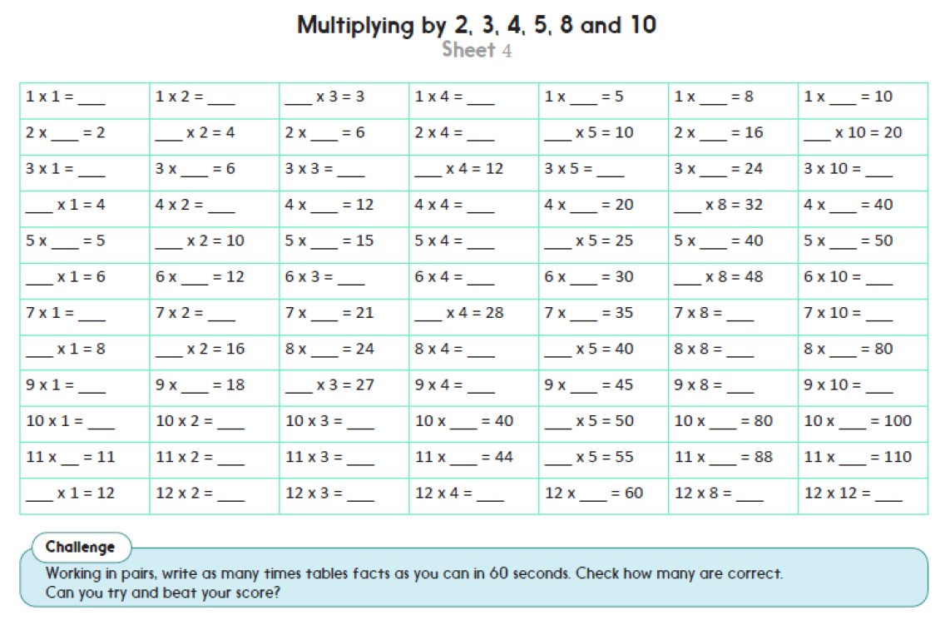
Notes:
Fro more practice sheet 4
1: Multiplying by 2, 3, 4, 5, 8, and 10 Sheet 2. Complete first four columns using a multiplication grid.
2: Multiplying by 2, 3, 4, 5, 8, and 10 Sheet 2. Complete first five columns; use a multiplication grid to check answers, circling any that are wrong. Hide multiplication grid and try those again before trying next 2 columns.
3: Multiplying by 2, 3, 4, 5, 8, and 10 Sheet 2. Start at third column and complete five columns; use a multiplication grid to check answers, circling any that are wrong. Hide multiplication grid and try those again.

