Slide 1
Fractions and Multiplication
Clever counting; multiplication
Day 3
I can recognise and recall doubles.
I can count in 3s and recognise multiples of 3.
I can divide whole numbers by 2, 3, 4, 5, 8 or 10, using times tables knowledge and record remainders.

Slide 2



Day 3: I can recognise and recall doubles.
What is double 3?
When we double a number, we are adding it to itself.
How did you work this out? Or did you know it?
With your parent or sibling
Show double 1, double 2, double 3, double 4, double 5, then double 6.
Shout out the answer each time!
Notes:
Ask children to show double 1, 2, 3, 4, 5 and 6, by each child showing 1, 2, 3, 4, 5, then 6 fingers

Slide 3
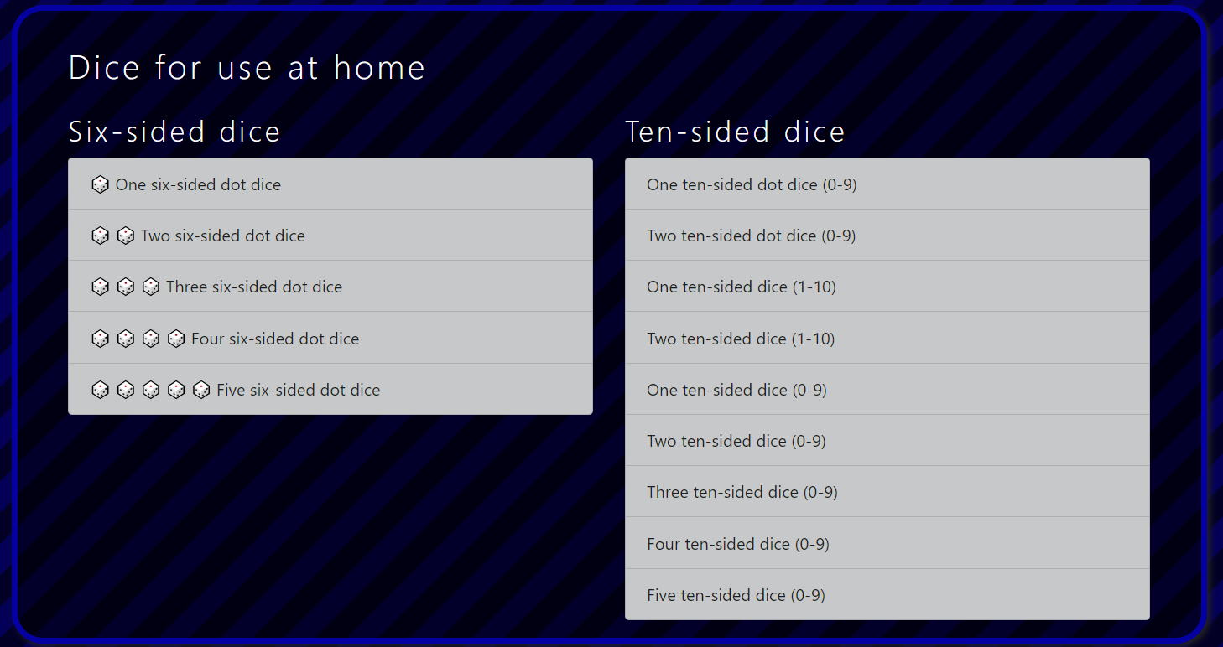

Notes:
To add doubles to 6

Slide 4
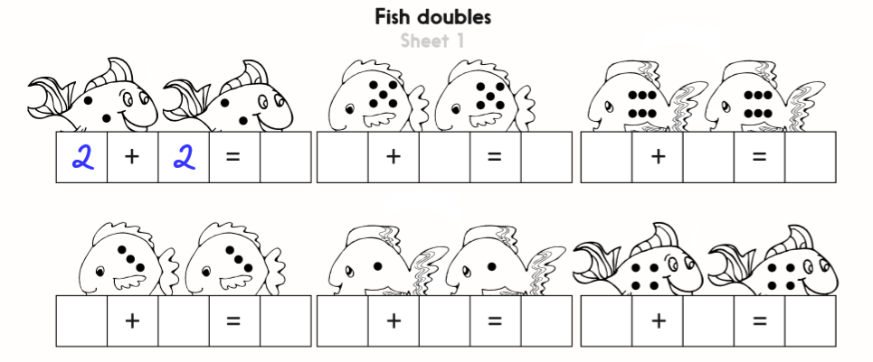
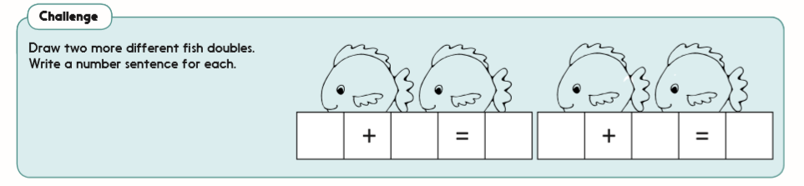

Challenge
Notes:
The practice sheet
Double numbers 1-6. Sheet 1.

Slide 5
Day 3: I can count in 3s and recognise multiples of 3.
We are going to do some more whisper counting today.
Divide children into 3 teams and try ‘whisper counting’ in steps of 3, up to 21.
Team 1
Team 2
Team 3
Whispering voices
Whispering voices
Louder voices

Slide 6
Day 3: I can count in 3s and recognise multiples of 3.
You’re getting good at this. Let’s try again!
This time, write the louder numbers on the board/ sheet up to 21.
Team 1
Team 2
Team 3
Whispering voices
Whispering voices
Louder voices

Slide 7
Day 3: I can count in 3s and recognise multiples of 3.
3
6
9
12
15
18
21
24
27
30
33
What will the next four numbers be?
Rehearse the whisper-counting to find them.

Slide 8
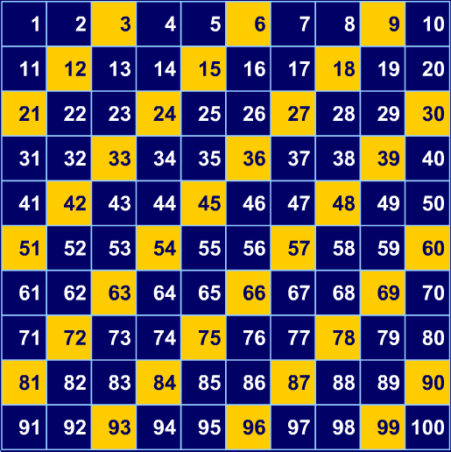
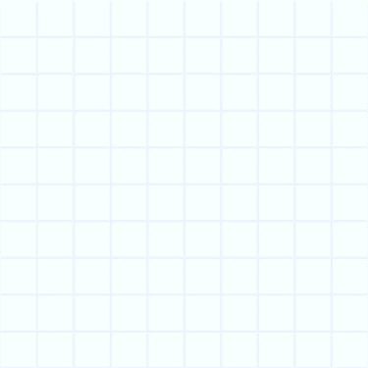
Day 3: I can count in 3s and recognise multiples of 3.
Let’s count in 3s to 60!
What pattern can you see?
Notes:
In resources Identify multiples of 3 on a 1–100 grid.

Slide 9
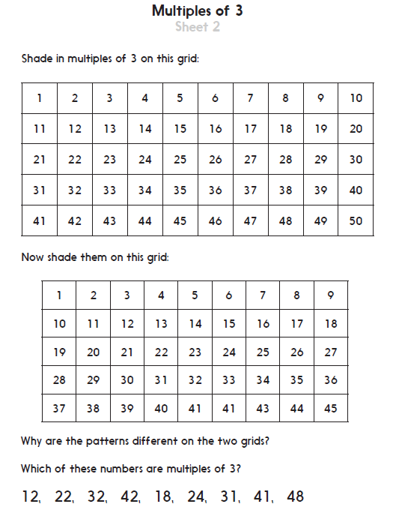

Challenge
Notes:
The Practice Sheet
Shade multiples of 3 number grids. Sheet 2.
Or
Identify multiples of 3 from a set of 2-digit numbers. Sheet 3.

Slide 10
Day 3: I can divide whole numbers by 2, 3, 4, 5, 8 or 10, using times tables knowledge and record remainders.
× | 1 | 2 | 3 | 4 | 5 | 6 | 7 | 8 | 9 | 10 | 11 | 12
1 | 1 | 2 | 3 | 4 | 5 | 6 | 7 | 8 | 9 | 10 | 11 | 12
2 | 2 | 4 | 6 | 8 | 10 | 12 | 14 | 16 | 18 | 20 | 22 | 24
3 | 3 | 6 | 9 | 12 | 15 | 18 | 21 | 24 | 27 | 30 | 33 | 36
4 | 4 | 8 | 12 | 16 | 20 | 24 | 28 | 32 | 36 | 40 | 44 | 48
5 | 5 | 10 | 15 | 20 | 25 | 30 | 35 | 40 | 45 | 50 | 55 | 60
6 | 6 | 12 | 18 | 24 | 30 | 36 | 42 | 48 | 54 | 60 | 66 | 72
7 | 7 | 14 | 21 | 28 | 35 | 42 | 49 | 56 | 63 | 70 | 77 | 84
8 | 8 | 16 | 24 | 32 | 40 | 48 | 56 | 64 | 72 | 80 | 88 | 96
9 | 9 | 18 | 27 | 36 | 45 | 54 | 63 | 70 | 81 | 90 | 99 | 108
10 | 10 | 20 | 30 | 40 | 50 | 60 | 70 | 80 | 90 | 100 | 110 | 120
11 | 11 | 22 | 33 | 44 | 55 | 66 | 77 | 88 | 99 | 110 | 121 | 132
12 | 12 | 24 | 36 | 48 | 60 | 72 | 84 | 96 | 108 | 120 | 132 | 144
The multiplication grid can help with division.
Trace
along from 3 until you get to 18.
Let’s find
18 ÷ 3.
What if we traced along the 6s row?
What number is at the top of the column?
Notes:
You can use Lego or bricks or beaded lines to support understanding of remainders or you can get them sharing into groups on a piece of paper.

Slide 11

Day 3: I can divide whole numbers by 2, 3, 4, 5, 8 or 10, using times tables knowledge and record remainders.
× | 1 | 2 | 3 | 4 | 5 | 6 | 7 | 8 | 9 | 10 | 11 | 12
1 | 1 | 2 | 3 | 4 | 5 | 6 | 7 | 8 | 9 | 10 | 11 | 12
2 | 2 | 4 | 6 | 8 | 10 | 12 | 14 | 16 | 18 | 20 | 22 | 24
3 | 3 | 6 | 9 | 12 | 15 | 18 | 21 | 24 | 27 | 30 | 33 | 36
4 | 4 | 8 | 12 | 16 | 20 | 24 | 28 | 32 | 36 | 40 | 44 | 48
5 | 5 | 10 | 15 | 20 | 25 | 30 | 35 | 40 | 45 | 50 | 55 | 60
6 | 6 | 12 | 18 | 24 | 30 | 36 | 42 | 48 | 54 | 60 | 66 | 72
7 | 7 | 14 | 21 | 28 | 35 | 42 | 49 | 56 | 63 | 70 | 77 | 84
8 | 8 | 16 | 24 | 32 | 40 | 48 | 56 | 64 | 72 | 80 | 88 | 96
9 | 9 | 18 | 27 | 36 | 45 | 54 | 63 | 70 | 81 | 90 | 99 | 108
10 | 10 | 20 | 30 | 40 | 50 | 60 | 70 | 80 | 90 | 100 | 110 | 120
11 | 11 | 22 | 33 | 44 | 55 | 66 | 77 | 88 | 99 | 110 | 121 | 132
12 | 12 | 24 | 36 | 48 | 60 | 72 | 84 | 96 | 108 | 120 | 132 | 144
Let’s find
20 ÷ 3.
What happens when we trace
along the 3s?
18 is not enough…
….21 is too much.
So, 20 ÷ 3 is 6 with 2 left over or 6 r 2.

Slide 12

Day 3: I can divide whole numbers by 2, 3, 4, 5, 8 or 10, using times tables knowledge and record remainders.
× | 1 | 2 | 3 | 4 | 5 | 6 | 7 | 8 | 9 | 10 | 11 | 12
1 | 1 | 2 | 3 | 4 | 5 | 6 | 7 | 8 | 9 | 10 | 11 | 12
2 | 2 | 4 | 6 | 8 | 10 | 12 | 14 | 16 | 18 | 20 | 22 | 24
3 | 3 | 6 | 9 | 12 | 15 | 18 | 21 | 24 | 27 | 30 | 33 | 36
4 | 4 | 8 | 12 | 16 | 20 | 24 | 28 | 32 | 36 | 40 | 44 | 48
5 | 5 | 10 | 15 | 20 | 25 | 30 | 35 | 40 | 45 | 50 | 55 | 60
6 | 6 | 12 | 18 | 24 | 30 | 36 | 42 | 48 | 54 | 60 | 66 | 72
7 | 7 | 14 | 21 | 28 | 35 | 42 | 49 | 56 | 63 | 70 | 77 | 84
8 | 8 | 16 | 24 | 32 | 40 | 48 | 56 | 64 | 72 | 80 | 88 | 96
9 | 9 | 18 | 27 | 36 | 45 | 54 | 63 | 70 | 81 | 90 | 99 | 108
10 | 10 | 20 | 30 | 40 | 50 | 60 | 70 | 80 | 90 | 100 | 110 | 120
11 | 11 | 22 | 33 | 44 | 55 | 66 | 77 | 88 | 99 | 110 | 121 | 132
12 | 12 | 24 | 36 | 48 | 60 | 72 | 84 | 96 | 108 | 120 | 132 | 144
Discuss in pairs what would happen if we tried 63 ÷ 10.
6 r 3.
Can you see why?
Trace along the 10s.

Slide 13
Day 3: I can divide whole numbers by 2, 3, 4, 5, 8 or 10, using times tables knowledge and record remainders.
× | 1 | 2 | 3 | 4 | 5 | 6 | 7 | 8 | 9 | 10 | 11 | 12
1 | 1 | 2 | 3 | 4 | 5 | 6 | 7 | 8 | 9 | 10 | 11 | 12
2 | 2 | 4 | 6 | 8 | 10 | 12 | 14 | 16 | 18 | 20 | 22 | 24
3 | 3 | 6 | 9 | 12 | 15 | 18 | 21 | 24 | 27 | 30 | 33 | 36
4 | 4 | 8 | 12 | 16 | 20 | 24 | 28 | 32 | 36 | 40 | 44 | 48
5 | 5 | 10 | 15 | 20 | 25 | 30 | 35 | 40 | 45 | 50 | 55 | 60
6 | 6 | 12 | 18 | 24 | 30 | 36 | 42 | 48 | 54 | 60 | 66 | 72
7 | 7 | 14 | 21 | 28 | 35 | 42 | 49 | 56 | 63 | 70 | 77 | 84
8 | 8 | 16 | 24 | 32 | 40 | 48 | 56 | 64 | 72 | 80 | 88 | 96
9 | 9 | 18 | 27 | 36 | 45 | 54 | 63 | 70 | 81 | 90 | 99 | 108
10 | 10 | 20 | 30 | 40 | 50 | 60 | 70 | 80 | 90 | 100 | 110 | 120
11 | 11 | 22 | 33 | 44 | 55 | 66 | 77 | 88 | 99 | 110 | 121 | 132
12 | 12 | 24 | 36 | 48 | 60 | 72 | 84 | 96 | 108 | 120 | 132 | 144
Discuss in pairs what would happen if we tried 28 ÷ 5.
5 r 3.
Can you see why?
Trace along the 5s.

Slide 14
Notes:
10-50 shuffle the cards pick a number. Then roll a 1-10 dice. You divide the number on the card by the roll of the dice it must land one of these numbers, 2, 3, 4, 5, 8 or 10.
In resources you have beaded lines for support to work it out.

Slide 15
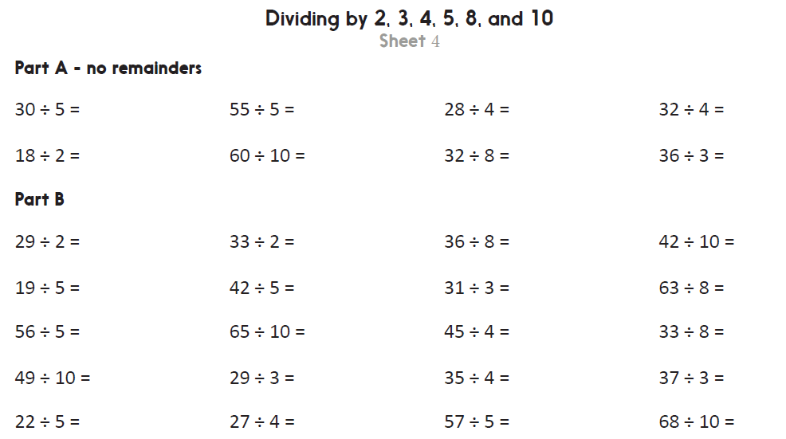

Challenge
Challenge
Notes:
The Practice Sheet
Dividing by 2, 3, 4, 5, 8, and 10 Sheet 4. Use counters / multiplication grid to help or
for more challenge Dividing by 2, 3, 4, 5, 8, and 10 Sheet 4. Use multiplication grid to Complete all and Challenge.
.

