Slide 1
How rivers shape the land: the mature river

Slide 2
As a river moves away from the mountains, the ground is less rocky, and so the river can flow more quickly. The river carves out its own course by moving away tons of rock and soil. This widens and deepens the river. Meanwhile, other streams and rivers join the river, making it even bigger. You will remember from our study of the River Indus that these are called tributaries. They are called tributaries because they contribute to the flow of the river, adding more water and giving it more power.
Once the river is wide, deep and curving, we call it a mature river. A mature river can be very deep and run very fast.

Slide 3
Now we will learn how the mature river carries its load.
There is a lot going on the riverbed of a mature river!
The fast-flowing river rolls stones along its bed. Smaller stones bounce along, pushed through the water by the river’s flow. Some small bits of rock or gravel are carried along as well. Some of the rocks are ground into tiny particles which dissolve in the water.

Slide 4
As the river reaches flatter, lower land, it gets very curvy. Rivers like to wiggle! We call these curves meanders (mee-an-ders). When we say that a river meanders, we mean it wiggles through lots of curves.
Why do rivers end up with so many big meanders? This is where we will need the two words that we learned earlier – deposition and erosion.

Slide 5
The diagram below shows how meanders form.
As water flows round a corner, it goes faster on the outside of the bed. The fast-flowing water on that side erodes the riverbank. On the inside of the bend, the water goes much more slowly. Do you remember what happens to the river’s load when the river slows down?
The water is moving too slowly for it to carry the load, so the river deposits the load on the riverbed. The deposited load is called sediment. Over hundreds of years, that sediment keeps building up. It eventually becomes land, pushing the river into deeper and deeper curves. This is why rivers meander so much.
Now you know how rivers shape the land. But we haven’t finished yet!
Rivers carry on shaping and shaping the land, right up to the sea. Let’s now look at what happens when the river meets the sea.

Slide 6
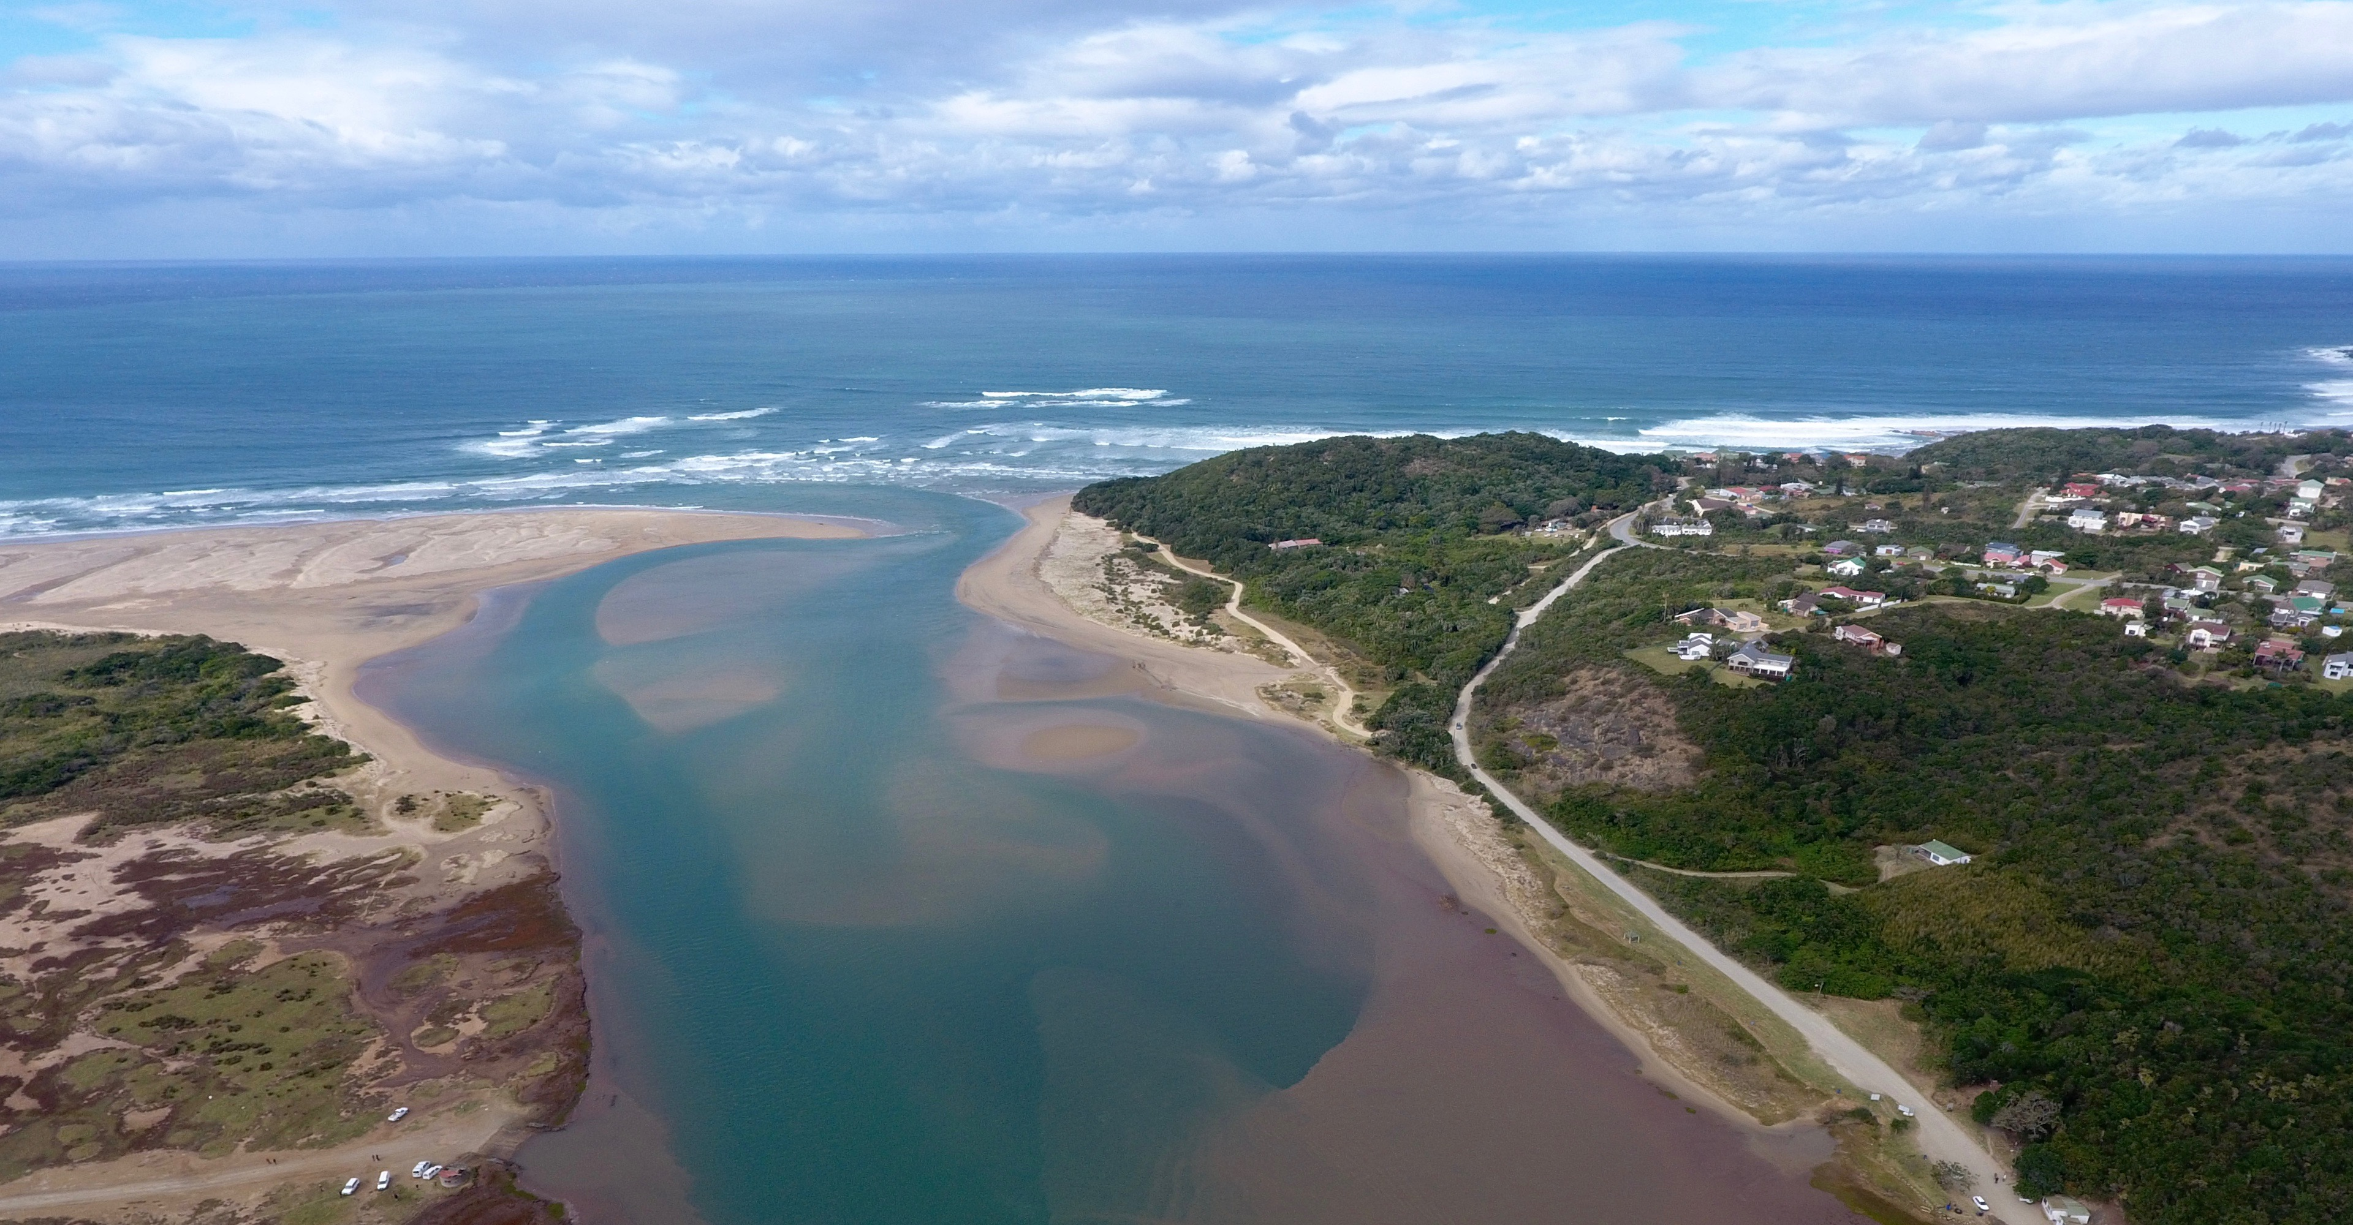
The river mouth is where the river meets the sea. The part of the river that flows into the sea is also known as estuary. Water in an estuary is a mixture of fresh water from the river and salt water from the sea. Salt water can harm many plants, but some plants such as seagrasses and reeds like the slightly salty water of the estuary.

Slide 7
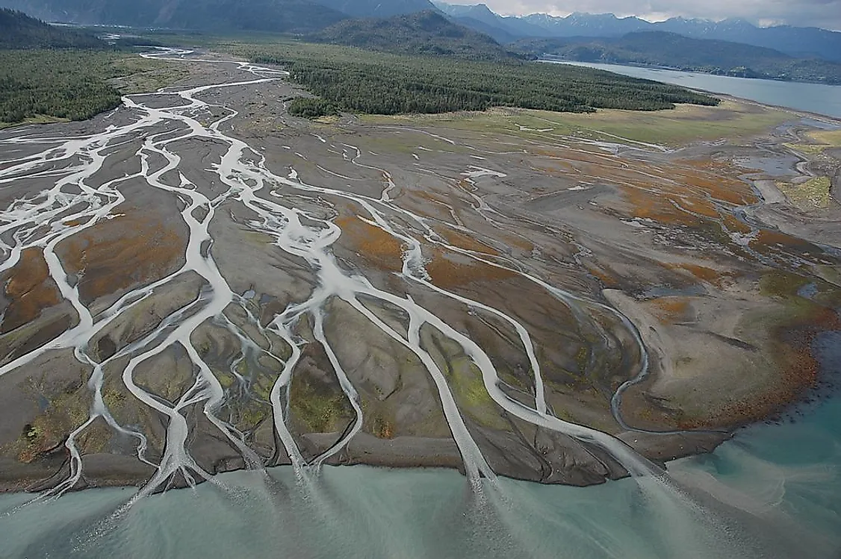
In really big estuaries, sometimes lots of water channels weave their way around islands of land. We call this a delta. Here is a photograph of a big delta in Alaska. The islands of land are made of sediment that has been deposited over hundreds of years.
The River Nile in Egypt has a huge delta. The Nile Delta covers 150 miles of coastline.

Slide 8
Let’s now look at a delta on a river you know. Can you guess where this is?
Yes, this is the River Indus!
This is where the Indus meets the Arabian Sea. The image is taken from space. The Indus River delta is so big that 900,000 people live here. Some people are leaving, however, because dams further up the river are stopping the water from flowing freely and causing problems for fishing.
In very hot climates, the heat and the slightly salty water where the river meets the sea are ideal for mangroves. Next to this, you can see some mangroves in the Indus delta. See how their tangled roots are not underground, nor under water, but in the air! The Indus River delta has the biggest mangrove forests in the world. Local people use the wood of the mangroves for fuel. Many birds and fish live here, too and the Indus dolphin. The people of Pakistan need to look after the mangrove forests by planting fresh mangroves so that they do not die out.

