Slide 1
Britain’s longest river: the River Severn

Slide 2
This tiny trickle of water and patch of swampy ground is the source of the longest river in the United Kingdom. High up in the Welsh mountains, this is this tiny trickle of water and patch of swampy ground is the source of the longest river in the United Kingdom. High up in the Welsh mountains, this is the source of the River Severn. When it leaves Wales, the River Severn flows into England. Tributaries pour into the Severn, making the river wider. Many towns and cities have been built on this beautiful river. The front cover of this booklet shows the River Severn, gleaming brightly as it passes through the town of Shrewsbury (shroos-berry). The flat land around the Severn has good soil for farming. When the Severn floods, it enriches the soil. Farmers raise cattle and grow crops like corn and potatoes in fields by the Severn.

Slide 3
WALES
Shrewsbury
source
Farmers graze their cattle by the Severn
mouth
Gloucester
Bristol
estuary
London

Slide 4
The River Severn is famous for salmon. Salmon is a type of fish that is born in the upper course of a river. After they hatch from eggs, the young salmon drift slowly down the Severn to the sea. When they are older, the salmon make the long journey back to where they were born to lay their eggs. To get back up the river, the salmon make a remarkable journey. They make their way around the meanders and even up the waterfalls! The salmon’s strong tail and streamlined shape help to push it through the water. Sometimes you can see salmon leaping out of the Severn. They can leap up to 2 metres high!
This photograph below shows the Severn bore. The bore is a huge wave which surges up the river as far as Gloucester (gloss-terr) on around 130 days of the year. The bore is caused by the tide in the Severn estuary. When the tide rises, so much water is pushed up from the wide estuary into the narrow river that it makes a wave. About 60 rivers in the world have bores. The Indus has a bore too.

Slide 5
Let’s now look more closely at the huge Severn estuary. You can see the start of it here. Find the two long bridges. Cars travel on these bridges between England and Wales. Many birds live in the Severn estuary.
The birds like the worms and insects that live in the huge sandy banks of sediment. Birds like curlews and sandpipers have long legs to help them wade through the water and long beaks to help to help them dig for food.
The Severn estuary is a special area of conservation. This means that the area is protected to make sure that all the plants and animals are safe. Factories and farms are not allowed to pour waste into rivers and pollute them.

Slide 6
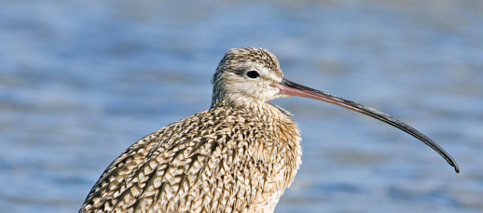
A curlew in the Severn estuary.
Pollution will harm the plants, animals and fish. This is why we must not throw litter into any river. Litter pollutes the Severn.
Each of us must play our part in keeping our rivers safe, healthy and beautiful.
A sandpiper in the Severn estuary.

