Slide 1


Spelling, Punctuation and Grammar
Sentences with Capital Letters and Full Stops
Year One
SPaG | Sentences with Capital Letters and Full Stops

Slide 2

Sentences with Capital Letters and Full Stops

Slide 3

Sentences with Capital Letters and Full Stops
Introductory Activity
Independent Focused Activity
Consolidation Activity

Slide 4
Aim
I can write a sentence with a capital letter and full stop.
Success Criteria
I can start a sentence with a capital letter.
I can end a sentence with a full stop.
I can work out where a sentence should start and end.

Slide 5
Introductory Activity

Slide 6

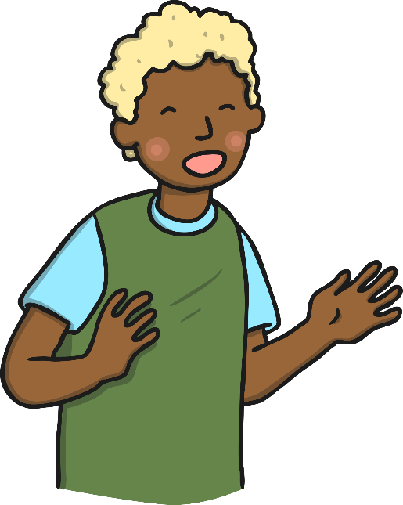


Sentences
A sentence is a group of words which are connected to each other and it makes sense by itself.
Talk to your grown up…
What do you need to remember when writing a sentence?

Slide 7


Sentences
What you need to remember when writing a sentence:
The letters need to be the same size.
The letters need to be written the right way round.
The letters should sit on the line.
There should be a finger space between each word.
A sentence should start with a capital letter.
Special names should start with capital letters.
A sentence should end with a full stop.
A sentence should always make sense.
Super Girl and Super Boy are good friends.

Slide 8

Sentences – Spot the Mistake
What is wrong with this sentence?
The sentence needs a capital letter.
this is Super Girl.
This is Super Girl.

Slide 9

Sentences – Spot the Mistake
What is wrong with this sentence?
The sentence needs a full stop.
This is Super Boy
This is Super Boy.

Slide 10
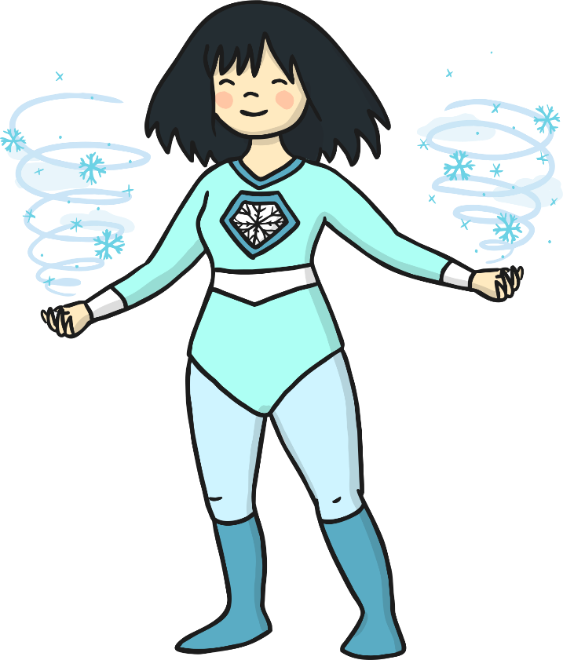
Sentences – Spot the Mistake
What is wrong with this sentence?
The sentence needs to make sense.
Ice Girl cool is.
Ice Girl is cool.

Slide 11

Sentences – Spot the Mistake
What is wrong with this sentence?
The sentence needs finger spaces between the words.
ZoomBoycanfly.
Zoom Boy can fly.

Slide 12

Sentences – Spot the Mistake
What is wrong with this sentence?
The sentence needs a capital letter and a full stop.
the breath of fire is hot
The breath of fire is hot.

Slide 13
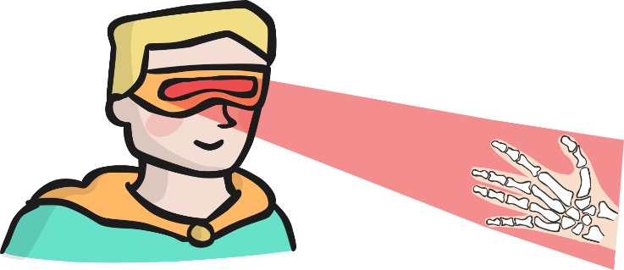
Sentences – Spot the Mistake
What is wrong with this sentence?
The letters need to be the same size.
Spyman has suPer x-ray vision.
Spyman has super x-ray vision.

Slide 14
Independent Focused Activity

Slide 15

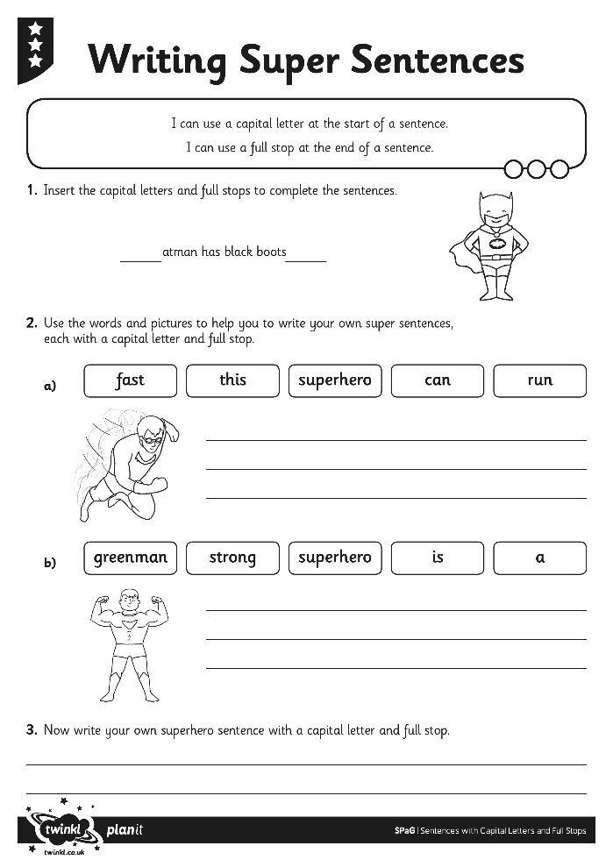
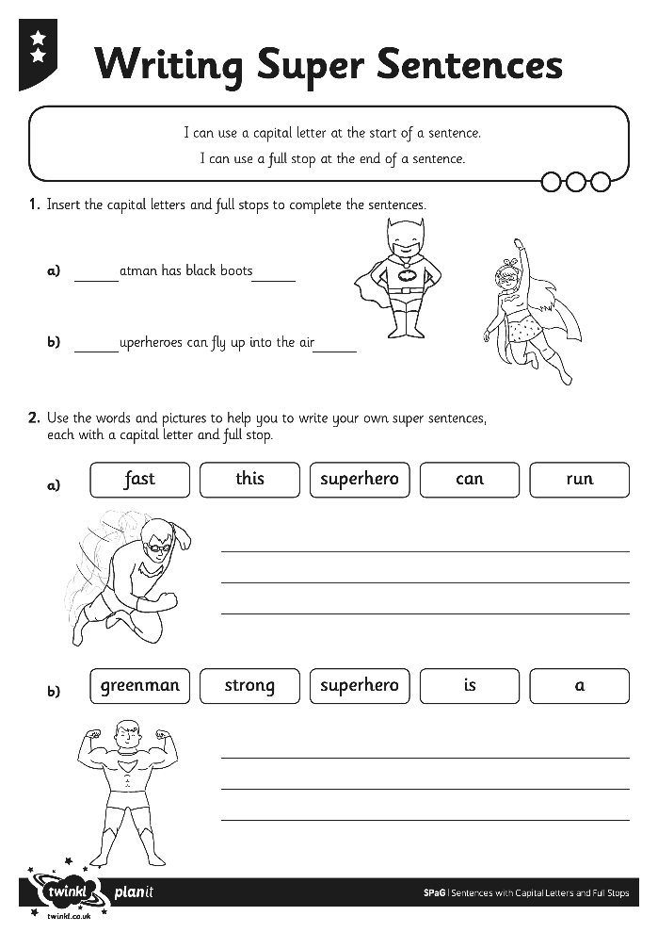
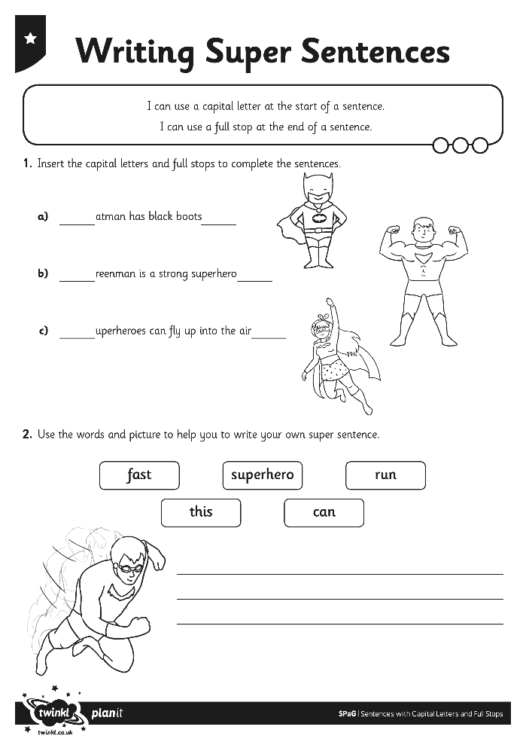
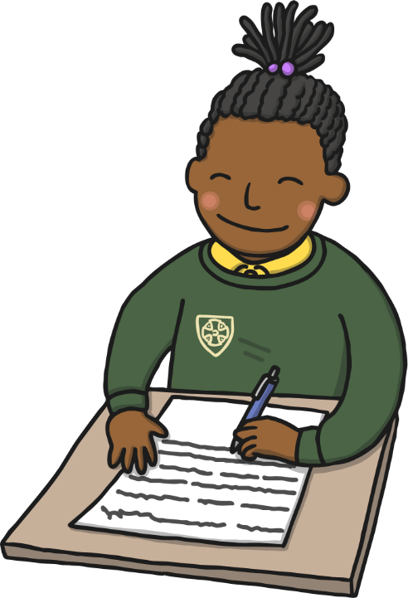
Writing Super Sentences
You are going to work on your own to complete the Writing Super Sentences Activity Sheet.

Slide 16
Consolidation Activity

Slide 17

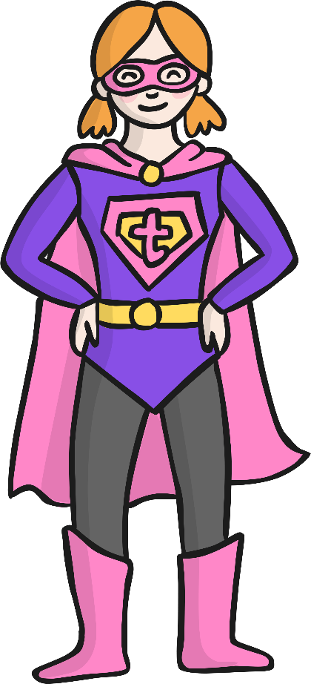
Starting and Ending Sentences
What is wrong here?
terrific girl was the best superhero in the world she could run faster than a cheetah her magic mind power helped her to see who was in danger she was amazing
There are no capital letters or full stops!
This makes the text very tricky to read.
Can you work out where the capital letters and full stops should be?

Slide 18
Starting and Ending Sentences
Terrific Girl was the best superhero in the world. She could run faster than a cheetah. Her magic mind power helped her to see who was in danger. She was amazing.
Did you spot where all the capital letters and full stops needed to be?
Well done!

Slide 19
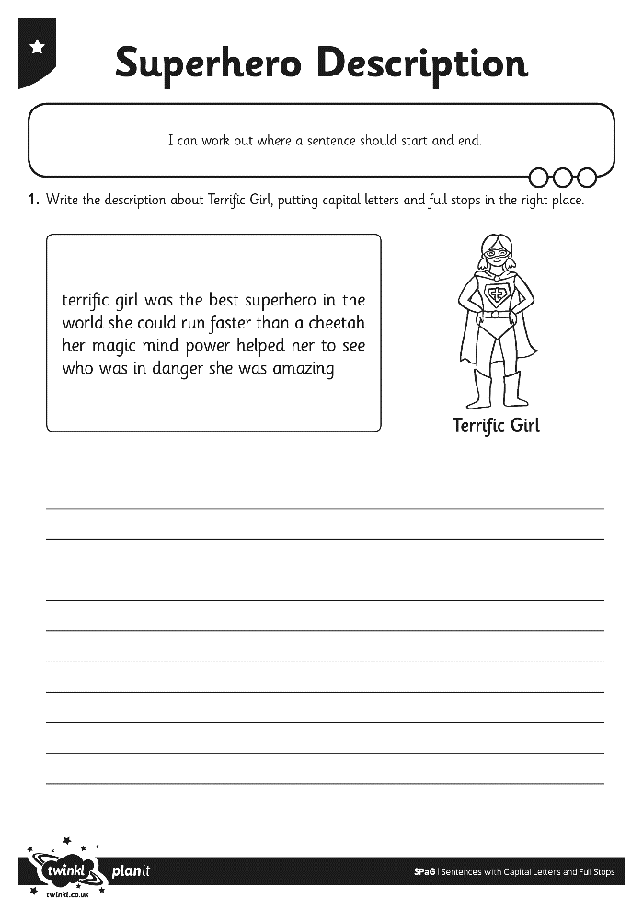
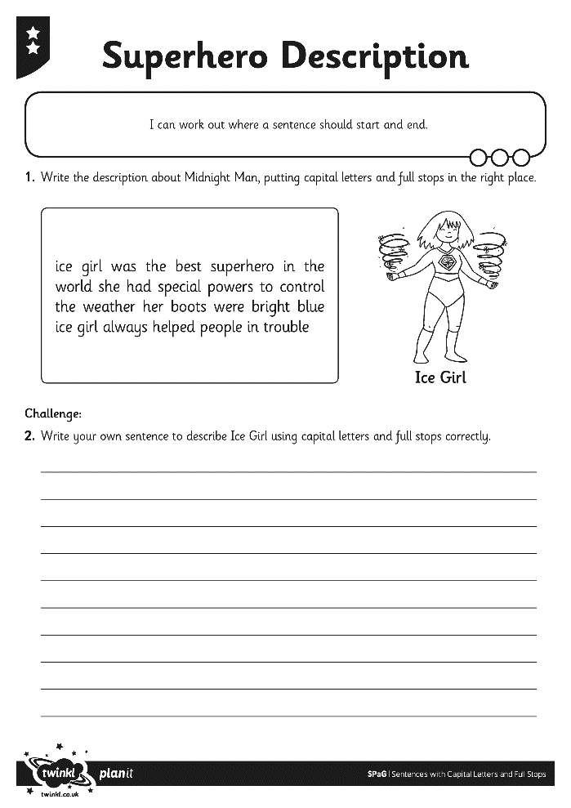
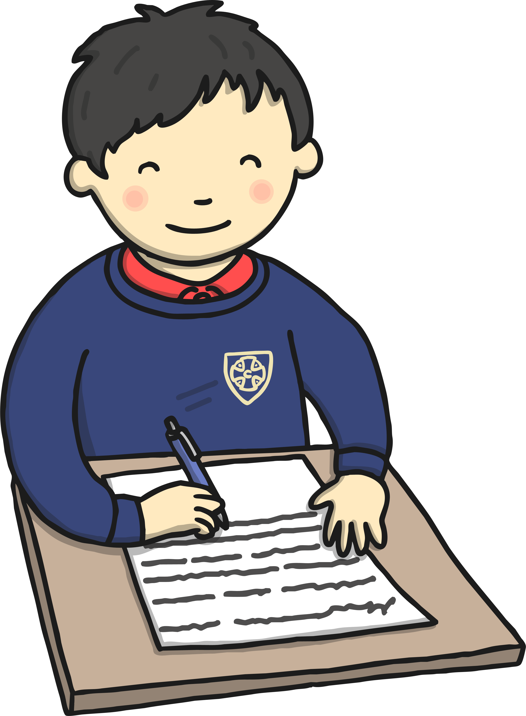
Starting and Ending Sentences
You are going to work on your own to add capital letters and full stops to the sentences on your Superhero Description Activity Sheet.

Slide 20
Aim
I can write a sentence with a capital letter and full stop.
Success Criteria
I can start a sentence with a capital letter.
I can end a sentence with a full stop.
I can work out where a sentence should start and end.

