Slide 1

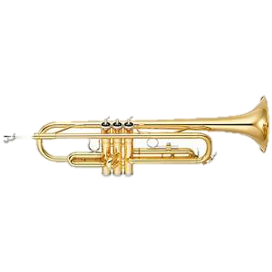
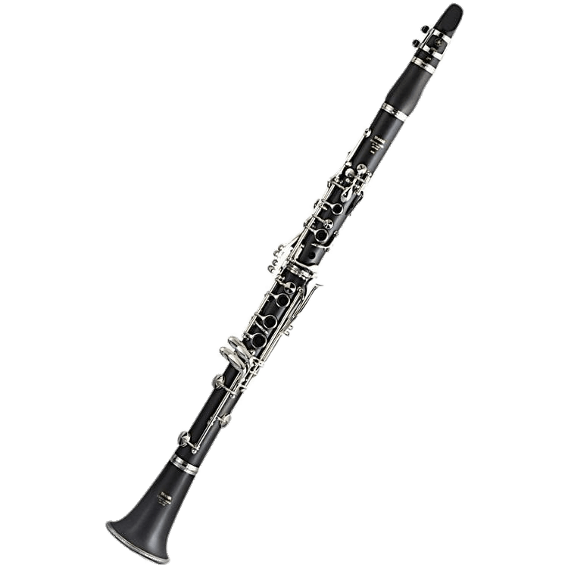
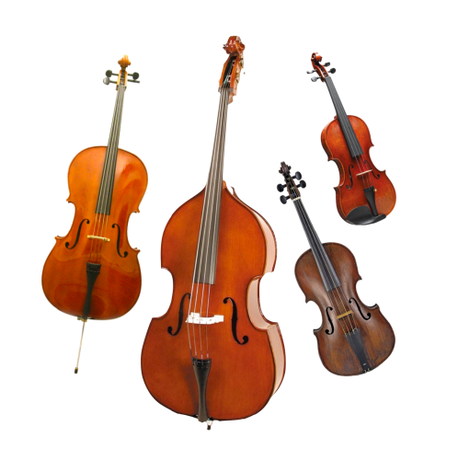
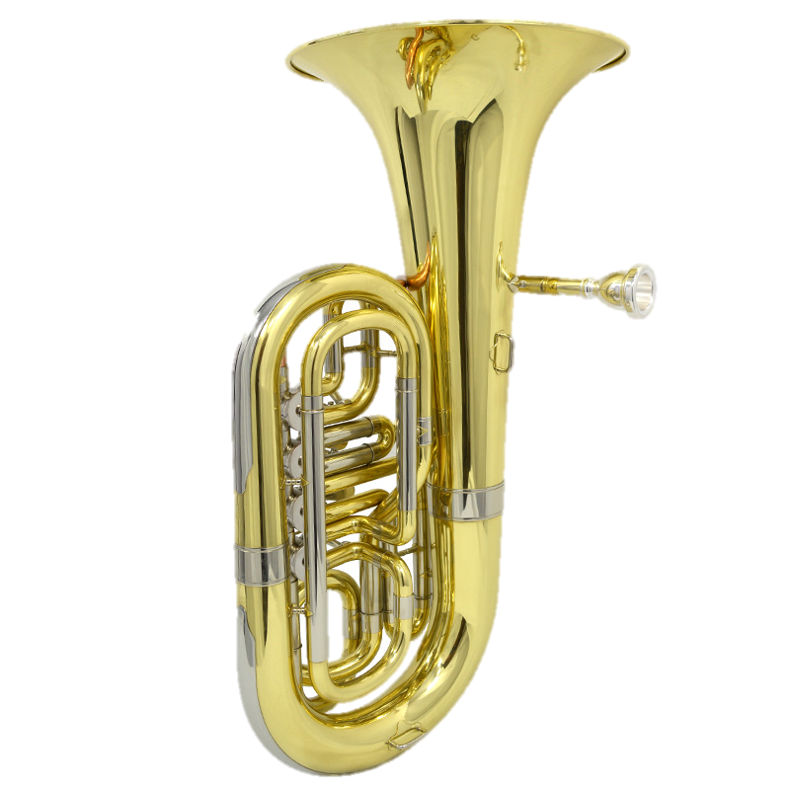

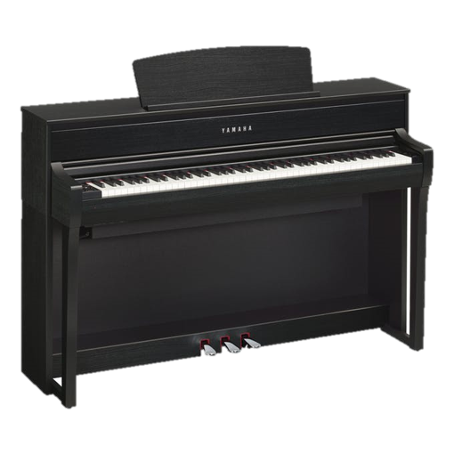
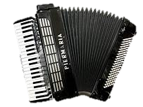
Zoom In
What instrument do
you see? Click
on the next slide
to play the
game!

Slide 2
Instructions:
Look carefully at each photo.
Guess the instrument as it is revealed.
Can you work out the answer by picture 3?
3

Slide 3
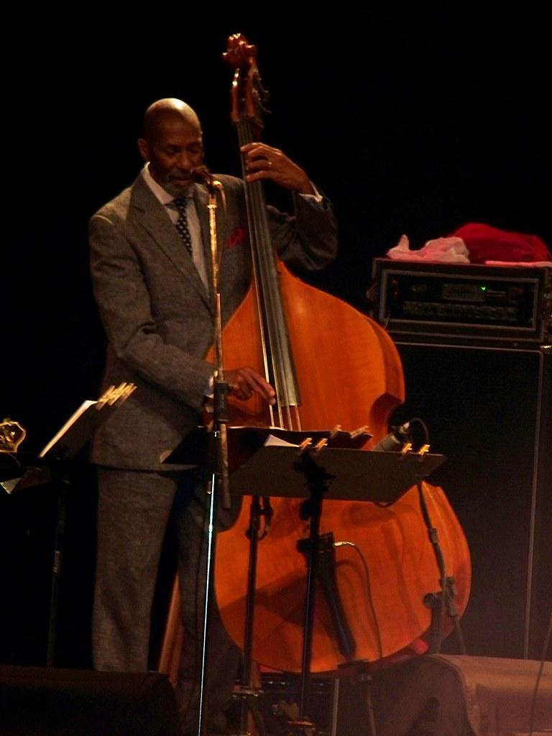
1

Slide 4
2

Slide 5
3

Slide 6
4

Slide 7
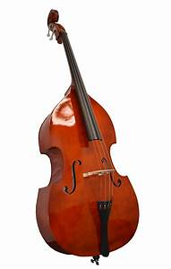
DOUBLE
BASS
Answer:
Click on the answer to listen to the string family!

Slide 8
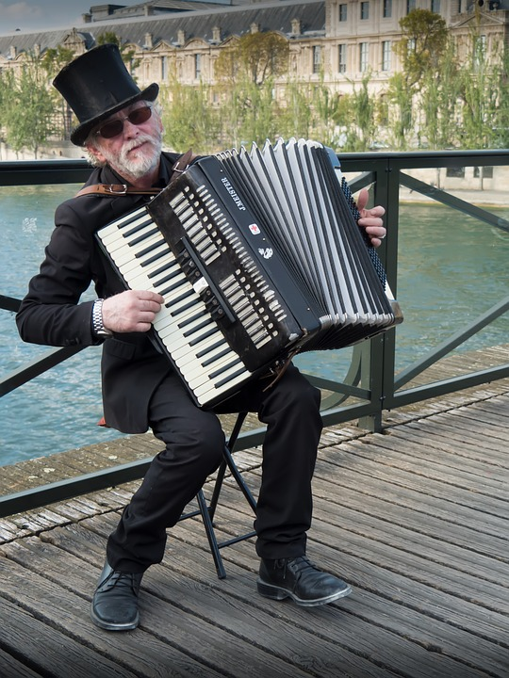
1

Slide 9
2

Slide 10
3

Slide 11
4

Slide 12
ACCORDION
Answer:
Click on the answer for a video of rapper Nadia Rose who raps alongside an accordion!

Slide 13
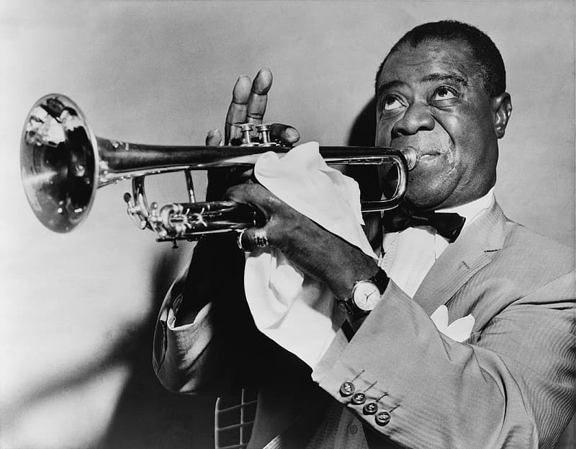
1

Slide 14
2

Slide 15
3

Slide 16
4

Slide 17
TRUMPET
Answer:
Click on the answer for a recording of Louis Armstrong playing the trumpet!

Slide 18




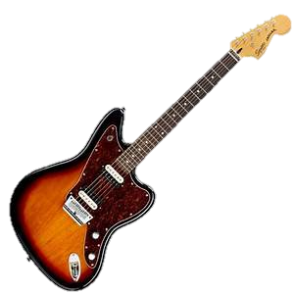


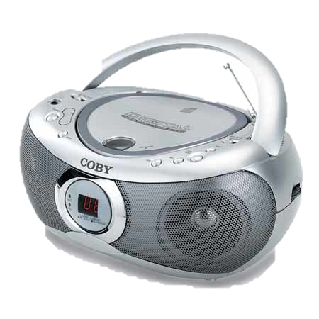
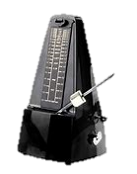

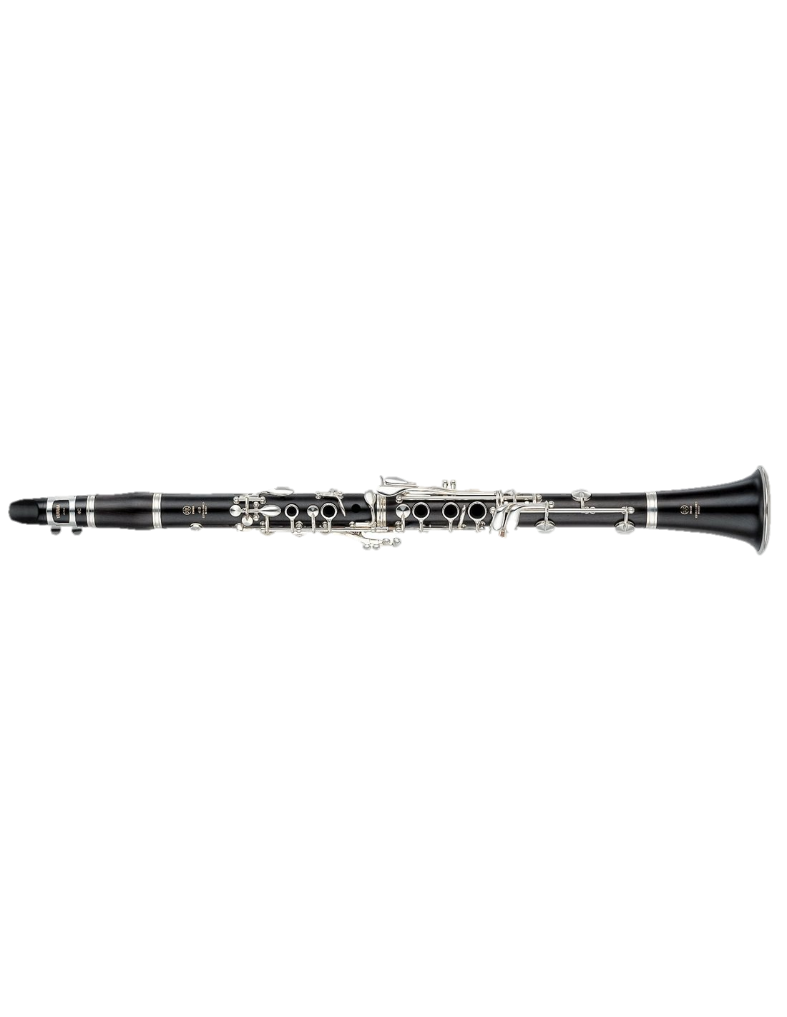

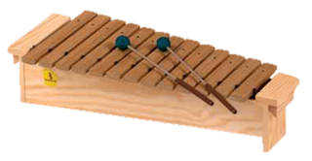

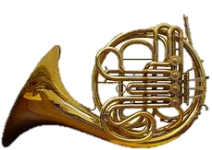
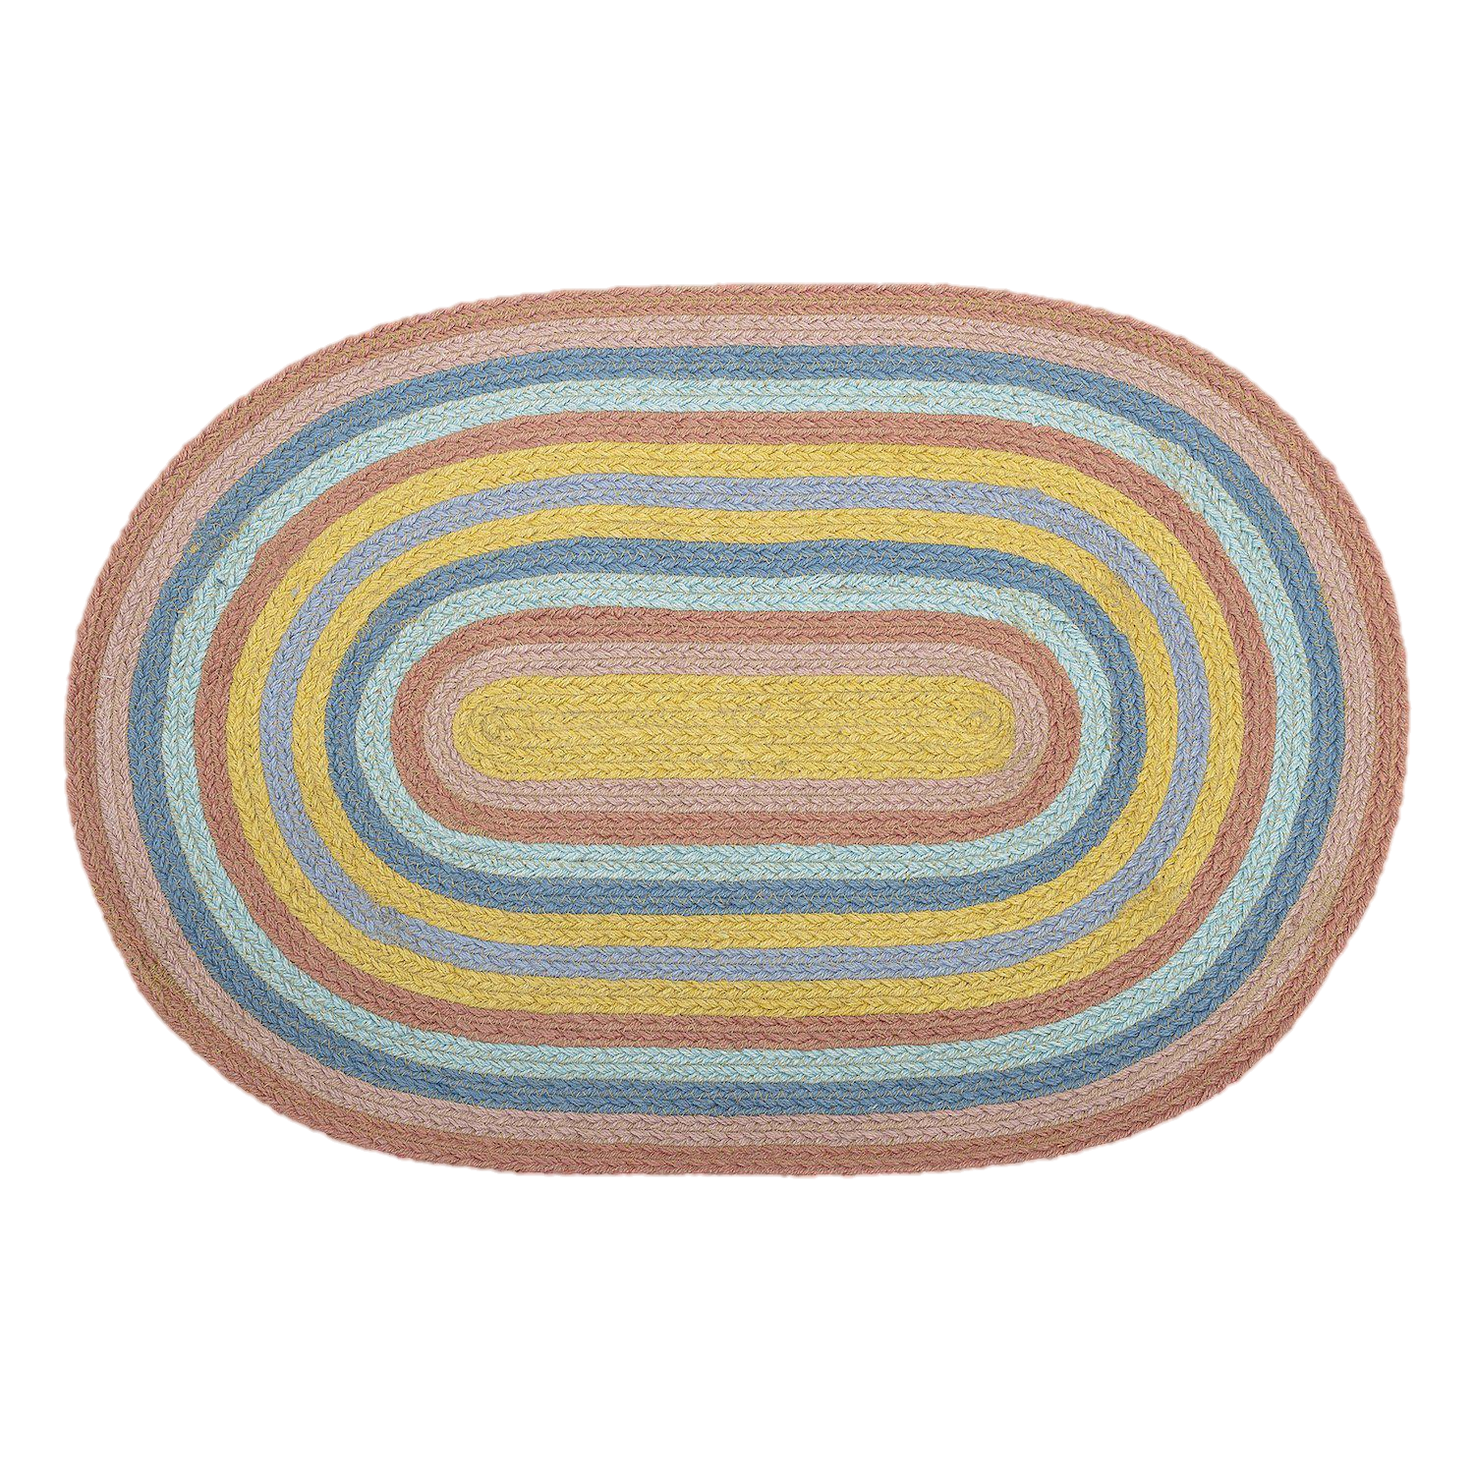
Hello everyone!
Click on the pictures to explore more musical games and videos of instruments!
Have fun! Mrs Cripps ☺

