Slide 1
How does music make you feel?

Slide 2
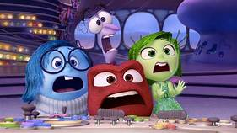
Emotions
Talk to your adult
What are emotions or feelings?
How do you feel when you are happy, sad, cross or worried?
Do you think different emotions and feelings have different colours?
Click here!

Slide 3



Mood of the Music
Music can make you feel different emotions. Some songs make you feel happy or excited, while others make you feel sad or scared.
These feelings come from how the song is composed, the instruments used and how performers play them. To be able to achieve a particular mood, composers also have to consider the following musical elements: tempo (speed), dynamics (volume) and pitch (high/low).
Listening to a happy piece of music can be a good way of cheering you up when you are feeling sad! Can you think of any songs which make you feel cheerful and happy?
This song always makes Mrs Cripps feel happy!
Click here!

Slide 4

Task 1
Watch the following video. How do you feel when you hear the music?

Slide 5



Task 2
Can you think of any of your favourite songs which make you feel these emotions?
Emotion | Excited | Miserable | Calm
Song Title

Slide 6
Task 3
We are going to listen carefully to some pieces of classical music and think about the emotions we feel when we are listening to them.
Try to describe how the music makes you feel. What instruments can you hear being played? Consider how musical elements have been used to help create a certain mood such as the tempo (speed) and dynamics (volume).
Fill in the chart on the following page. The first example has been done for you! Click on the titles to hear each song!

Slide 7
Song Title | Mood/Emotion | Instruments | Musical Elements
Danse Macabre by Camille Saint Saëns | Scared Spooky Nervous | Violins Xylophone Trumpet | It started slow and quiet and then got faster and louder.
Tritsch-Tratsch-Polka by Johann Strauss II
Clair de lune By Claude Debussy

Slide 8


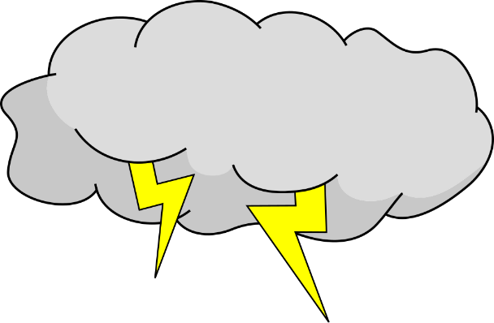
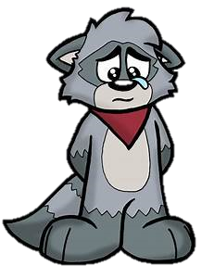


Task 4
Choose one of your favourite songs or a classical piece of music from Task 3. How does this piece of music make you feel?
Draw pictures or create a scene to show your feelings and mood when you listen to your chosen song! What images do you create in your mind?

