Slide 1

Humanism
Session 1:
What is Humanism?

Slide 2

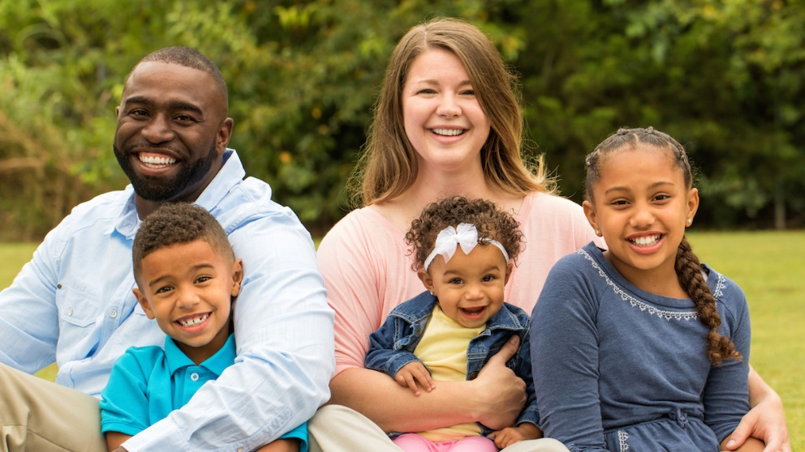
Meet Taryn and her family…
Hi! My name is Taryn, and I am in year 5. This is my Mum Sarah and my baby sister Thandi.
Hi! My name is Jayden, and I am in year 2. This is my Dad Toben.

Slide 3
What questions do you have about this week’s learning question?
Add your thoughts to a bubble like this:
What is Humanism?

Slide 4
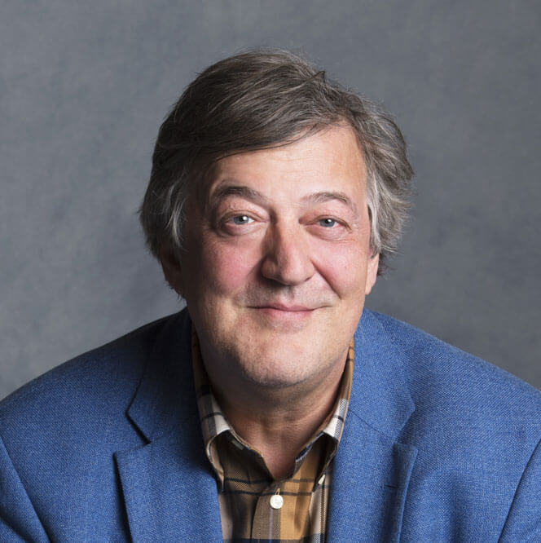
Meet Stephen Fry…
‘A humanist is someone who will never tell you what to believe. We will never tell you what is absolutely true. We will never make claims that cannot be proven and that you cannot find out for yourself. We believe life is an adventure and that nobody knows the answers or the destination.’
Stephen Fry, Patron of Humanists UK

Slide 5
What things do you think are important to Humanists?
You might like to underline or note down any words from Stephen’s quotes to help you.
Make a list of what you think is important to Humanists.

Slide 6
Taryn tells us about Humanist beliefs…
We believe science provides the best way to understand the world.
We do not believe there is a god or believe we cannot know if there is a god.
We do not believe in an afterlife, and therefore believe we should make the most of the one life we know we have, and respect different people’s choices and ways of life.
We believe we should use reason and empathy when deciding how to behave.
We value humanity and celebrate human achievements. (scientific, artistic, social)
What questions do you have about these beliefs and values?

Slide 7
Humanism is not a religion…
For me, the most important thing is not whether I believe in a god or not, but how I live my life. Humanists believe we can be good and happy without the need for gods or religion.

Slide 8
Big Questions of Life
Does it matter whether you believe in a god or not?
Is how you live your life more important?

