Slide 1

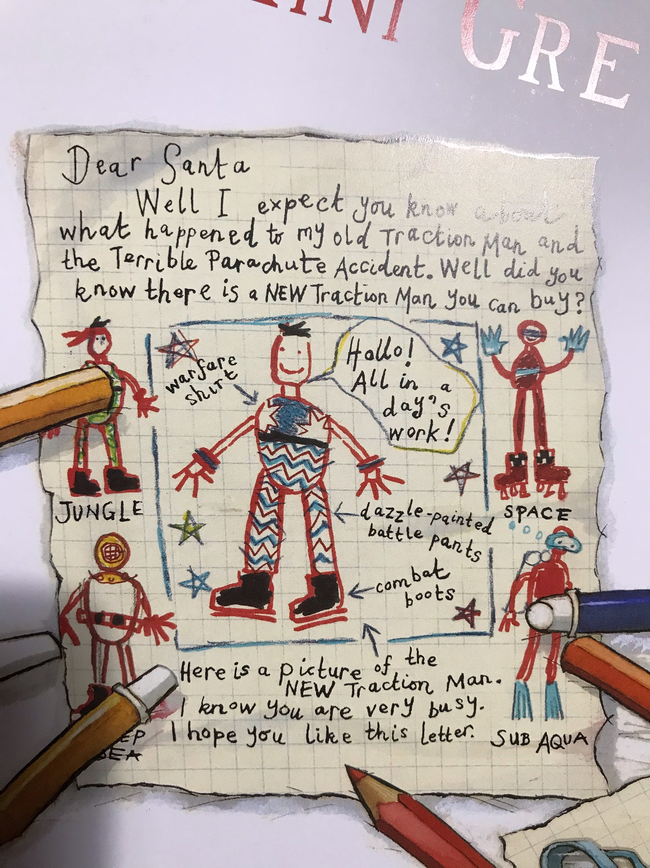
Who do you think has written the letter?
What do you think happened in the ‘Terrible Parachute Incident’?
What do you think a Traction Man toy is? Would you like one? Why? Why not?
What do you notice about the different costumes or outfits the child has drawn?
What does this suggest about the toy?
What could ‘dazzle-painted’ battle pants be?
What is Traction Man saying? Have you heard this before? Where?

Slide 2
Tell us about your toy…
Record a video that tells us all about your toy. You might like to include:
Name
Age
What they look like
What they like doing
Special powers
Draw a picture of your toy with labels to show this information. If you don’t have one, create one that you’d love to own.

Slide 3
Prediction time!
What do you think this story might be about?
Make a note of your ideas - we’ll look back at these in a few weeks’ time to compare your ideas to what happens

Slide 4
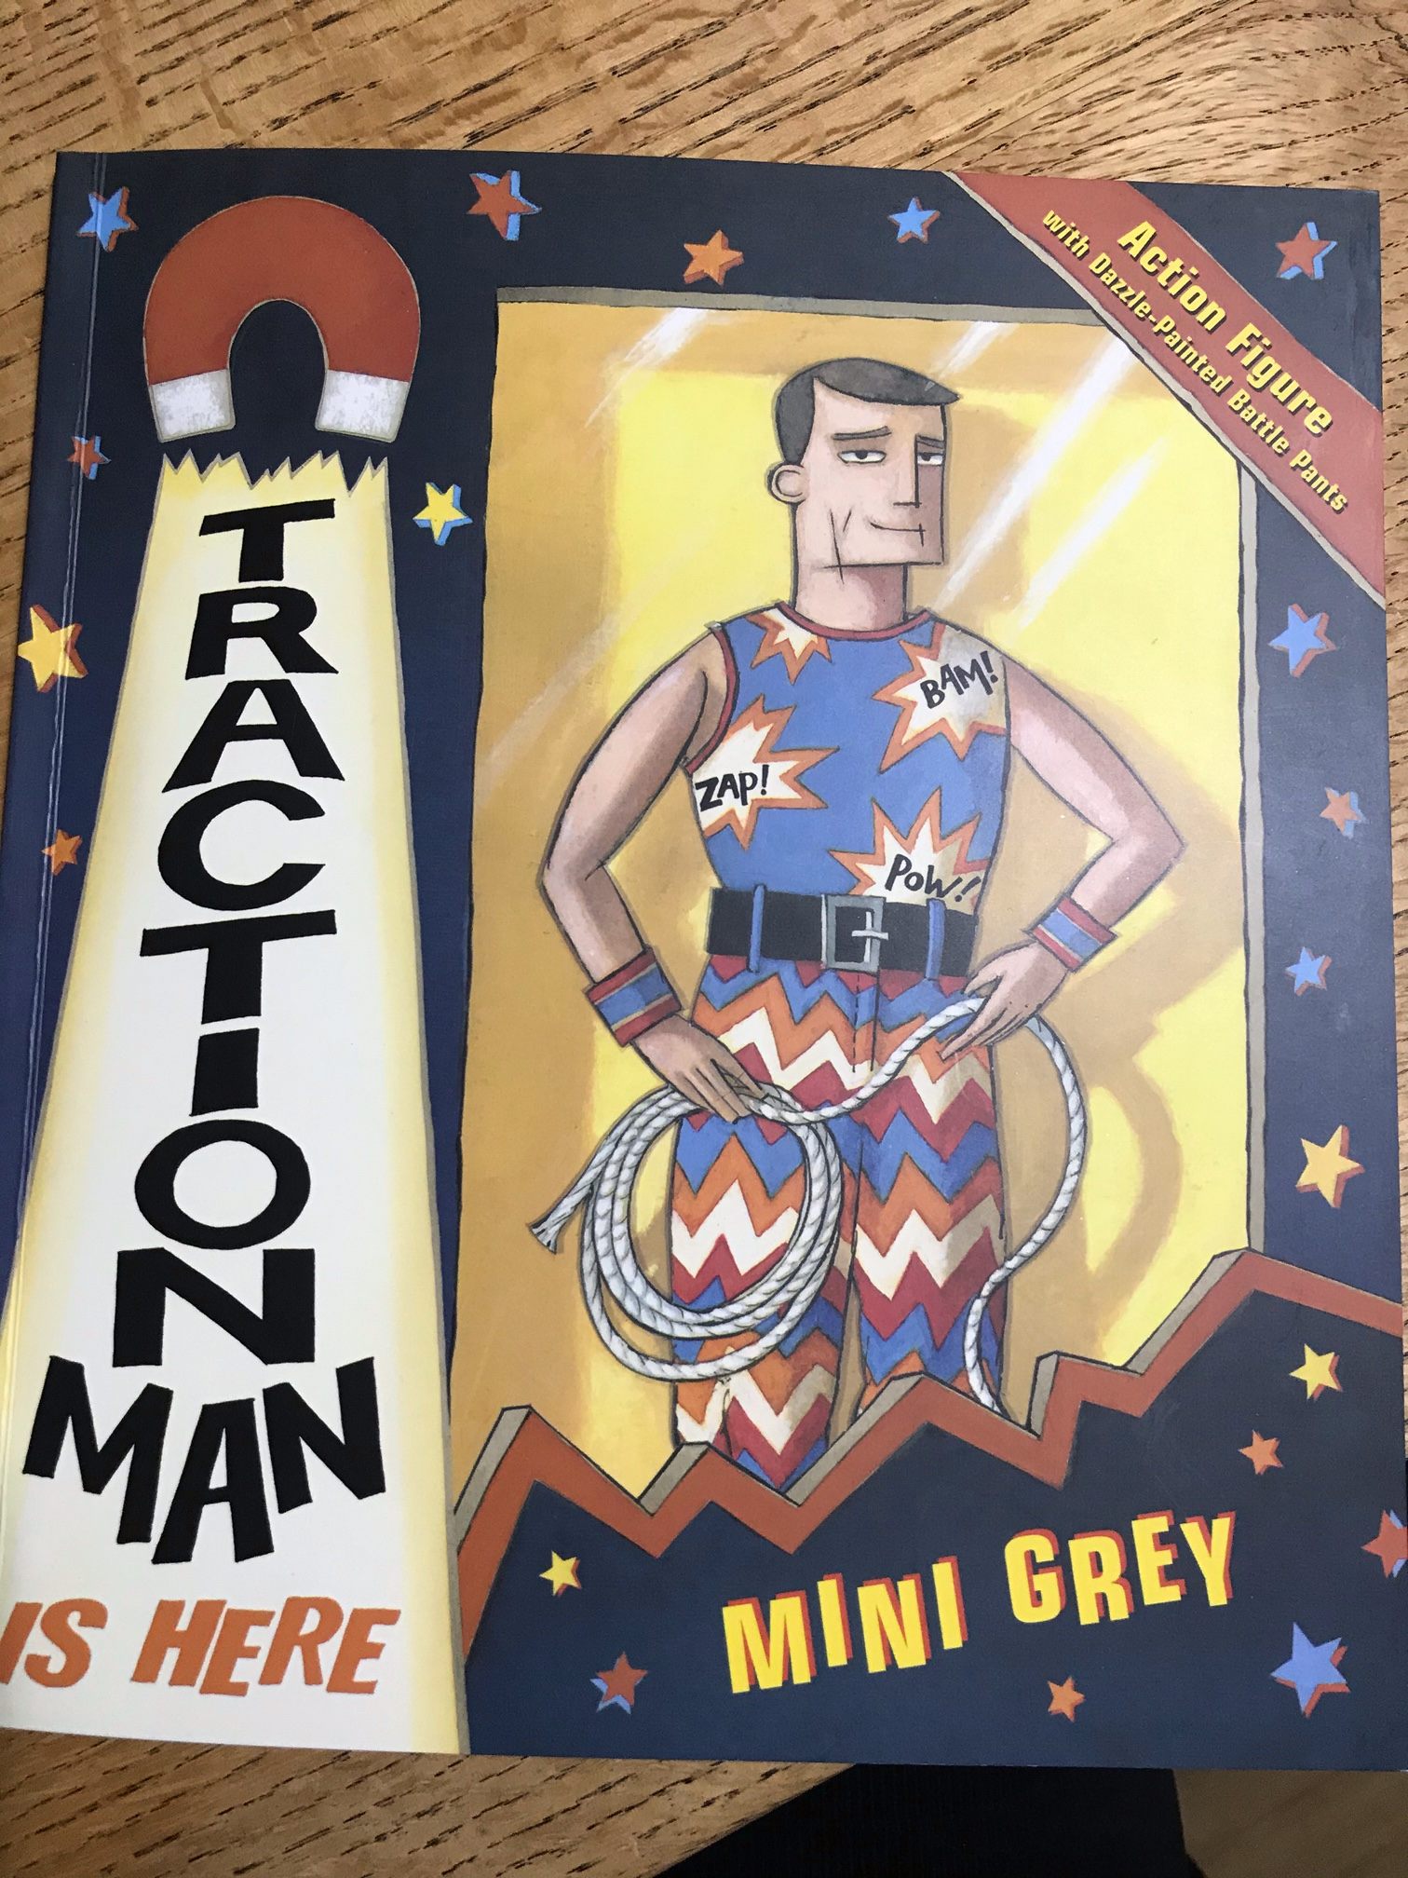
Traction Man is Here!
This is the front cover of our new book…
Have you heard of it or read it before?
If you have heard about it, what do you think might happen in the story?
If you’ve never heard of it, who do you think Traction Man is and what could happen in the story?

Slide 5
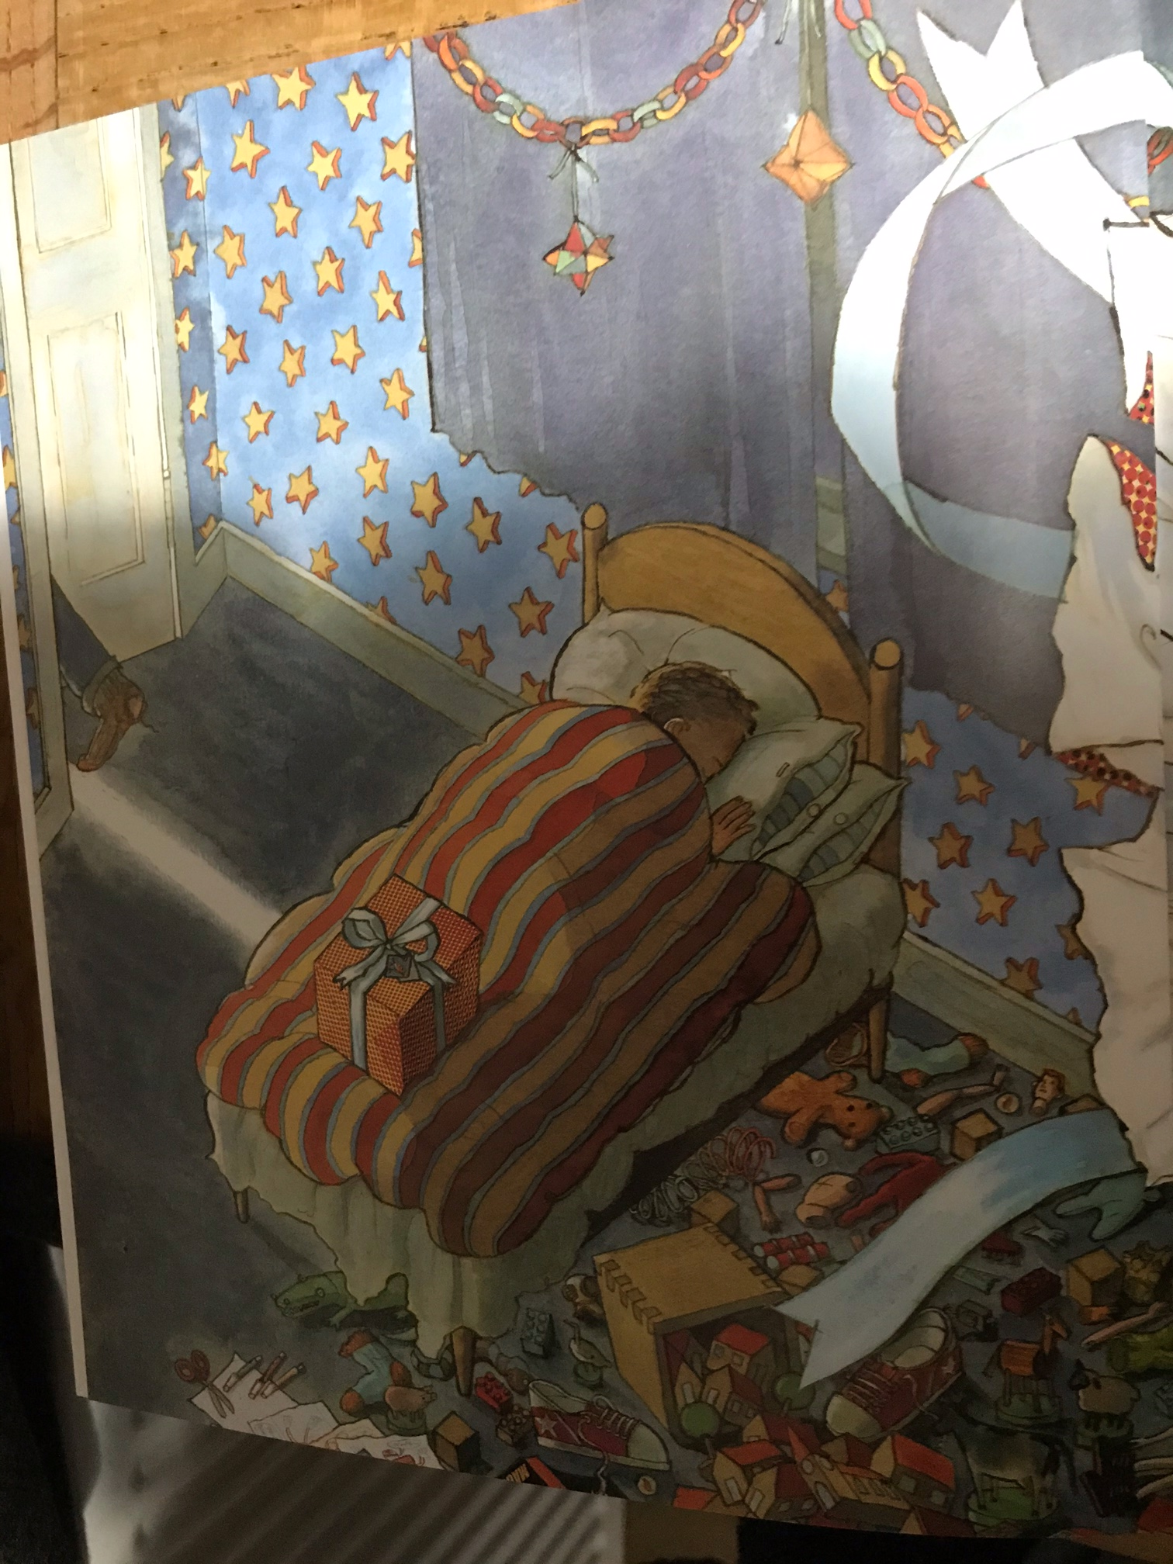
Page 1
Take some time to look closely at the picture…
What do you notice? Think about:
The toys
The drawings
The decorations
The present
Who is this little boy and what is happening in this illustration?
Does it remind you of anything you have seen before?

Slide 6
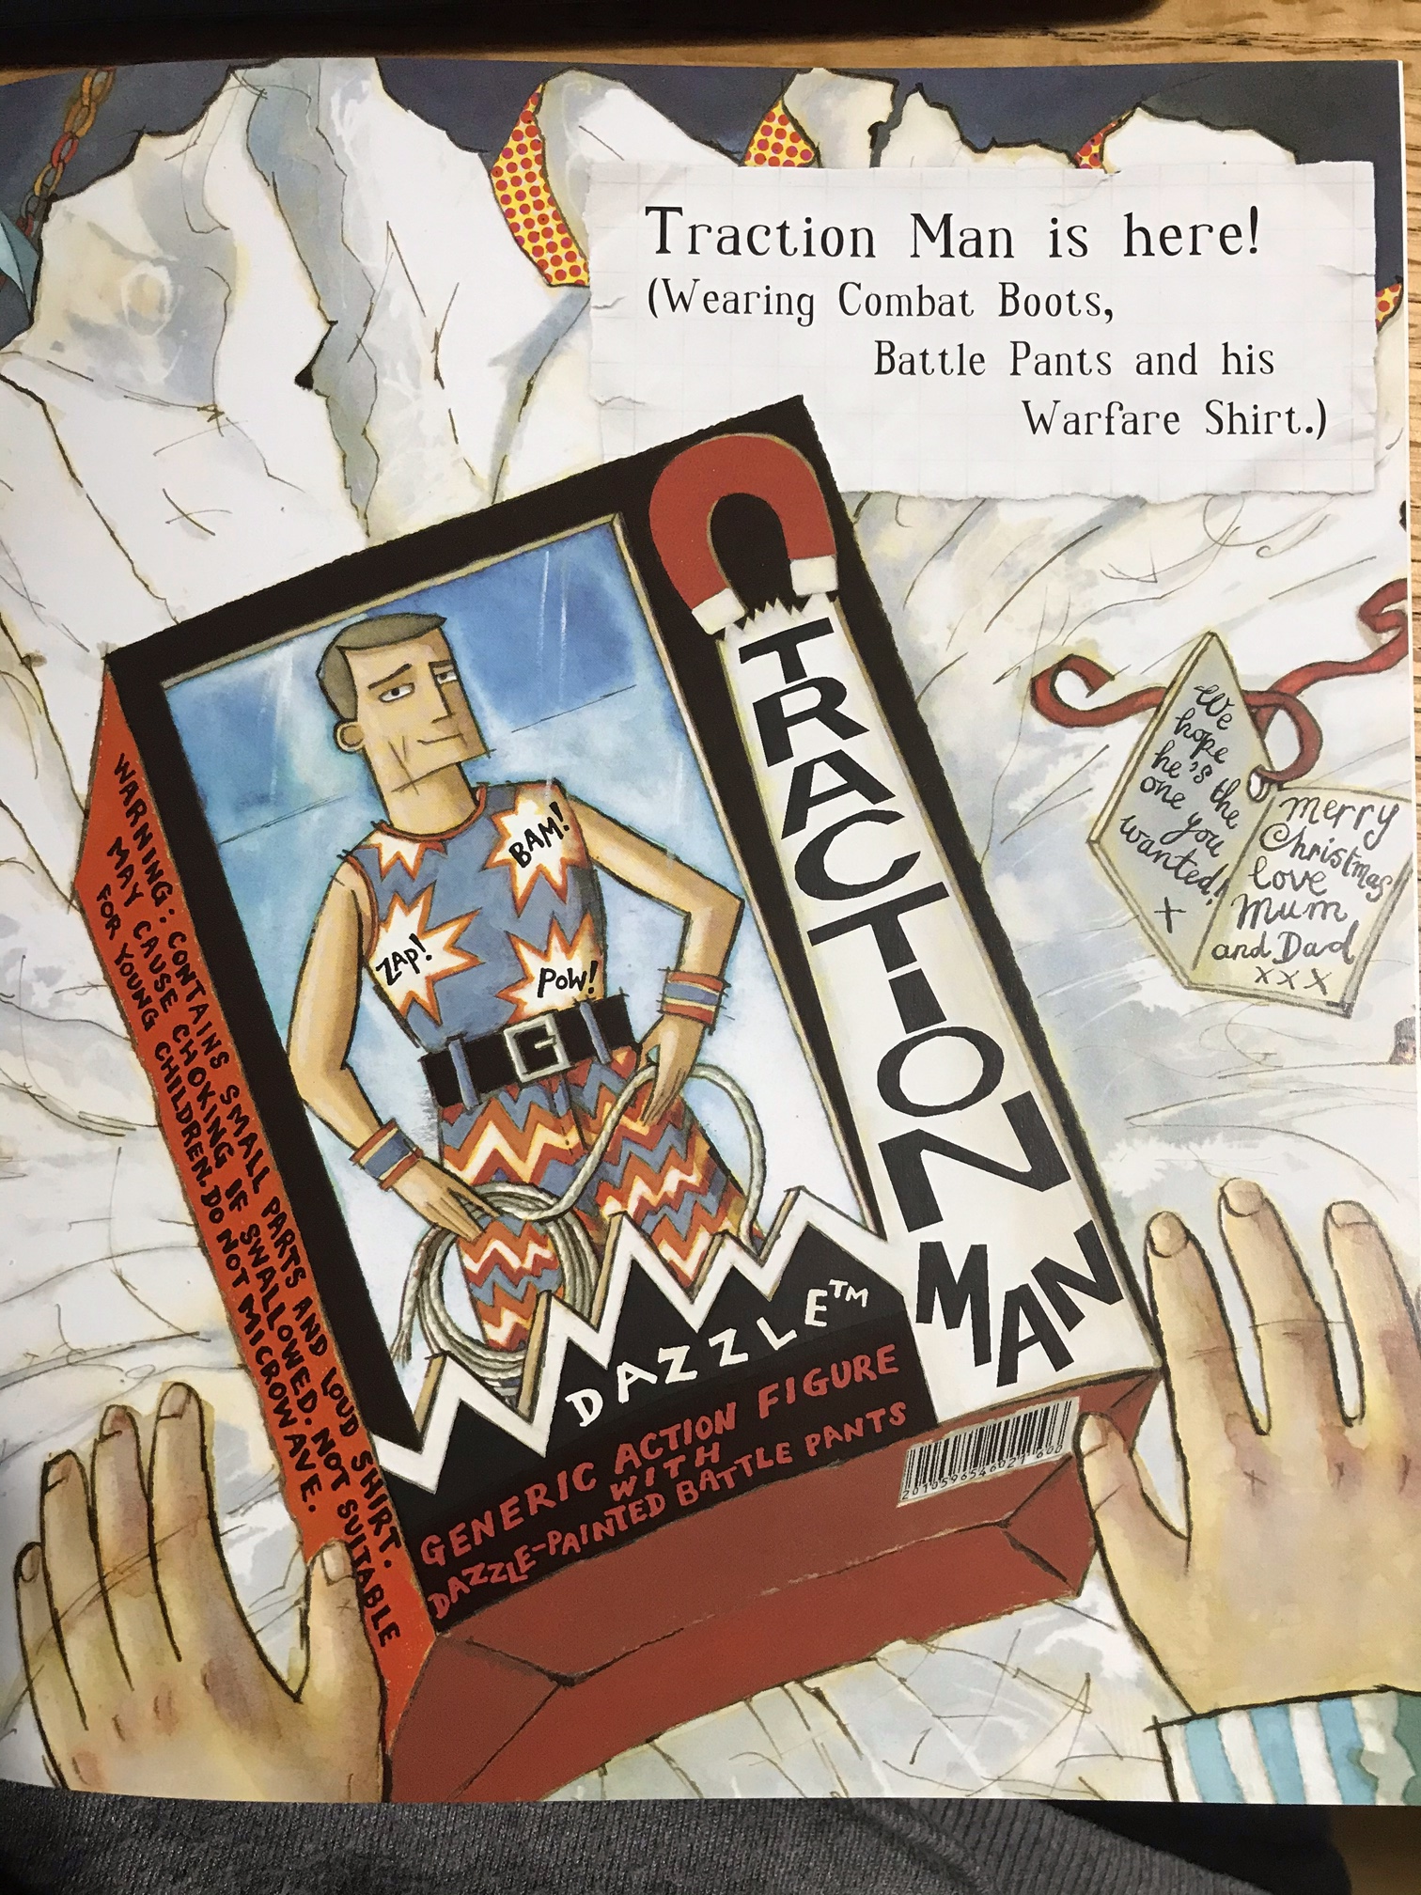
Page 2
Whose perspective are we seeing this from? How do you know?
Listen to me reading the text on this page:
What do you notice about the way I read it?
Now watch this video for the Toy Story film:
https://www.youtube.com/watch?v=rNk1Wi8SvNc
You’ll notice the character voices and another voice, this is a voiceover. What does a voiceover do? What tone of voice does the person use? Have a go at using a voiceover for something happening at home…

