Slide 1
Year 6 – Term 3 R.E.
Islam – Week 2

Slide 2

Good Afternoon Ash Class
Well done for all the work you completed last week. We are all really impressed on how you have adapted to our online learning.

Slide 3
The first thing we need to do this week is to check the knowledge organiser that you completed last week.
These are the correct definitions. If you have got any incorrect, please correct them.
Hijab |  | A veil worn by most Muslim women in the presence of any male outside of their immediate family, which usually covers the head and chest, and sometimes the face.
Wudu |  | Ritual washing carried out before Muslim people pray.
Shahadah |  | The first pillar of Islam. The Muslim declaration of faith.
Allah |  | The Arabic word for God.
Qur’an |  | The Muslim holy book. Muslims believe the text within it were revealed to the prophet Muhammed from Allah.
Zakat |  | The third pillar of Islam. Compulsory giving of 2.5% of a person’s income.
Salah |  | The second pillar of Islam. An Arabic word that means to pray or bless.
Mosque |  | Holy place of worship, learning and prayer for Muslims.
Mecca |  | A city in Saudi Arabia. It is the most important and Holy place for Muslims as it is where the prophet Muhammed was born. Muslims all around the world pray facing this holy city.
Prayer mat |  | A piece of material placed on the ground to allow Muslim people to pray on a clean and pure space.

Slide 4
The Muslim Faith
On the next page there are some images and words.
With the information you learnt last week from the video clips, can you describe what is happening in these images using the words at the bottom of the page.
In your book or on a piece of paper, write todays date and underline it. Then write the title: The Muslim Faith - and underline the title.
Write the number of the image in the margin and then write the appropriate word or words next to it.
You may also like to add a sentence explaining the word/ words in more detail.

Slide 5
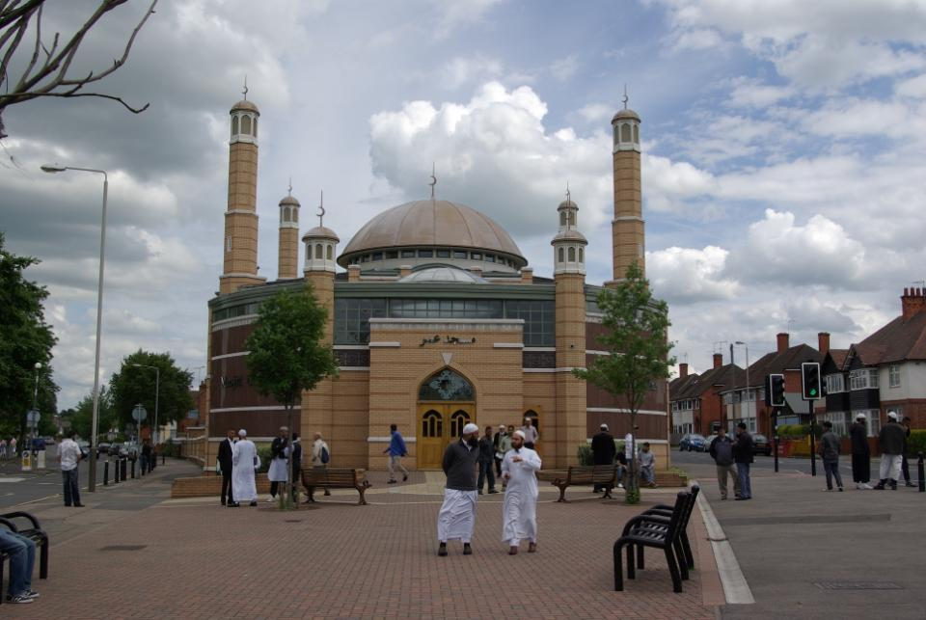
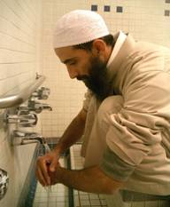
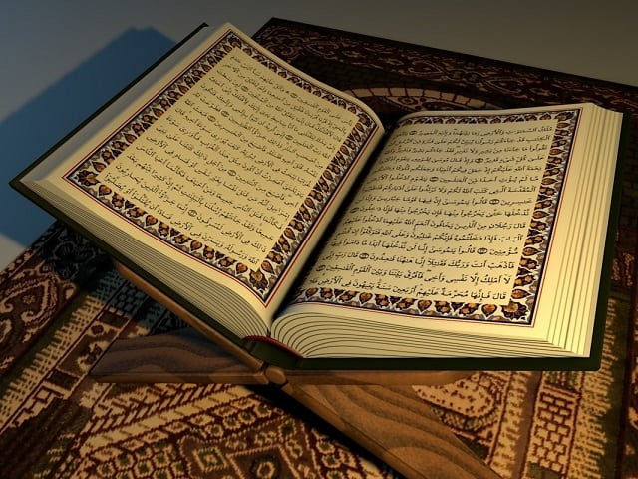
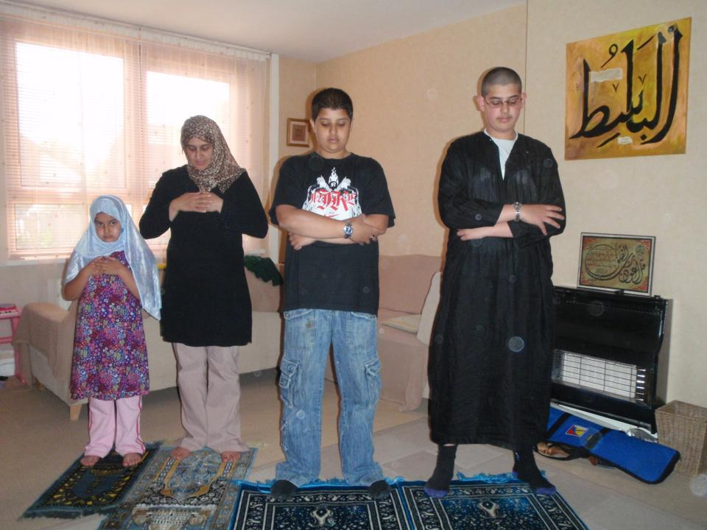
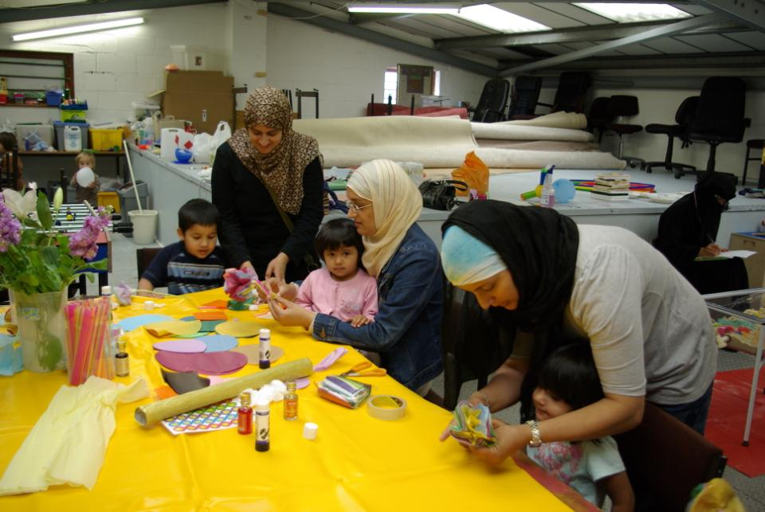
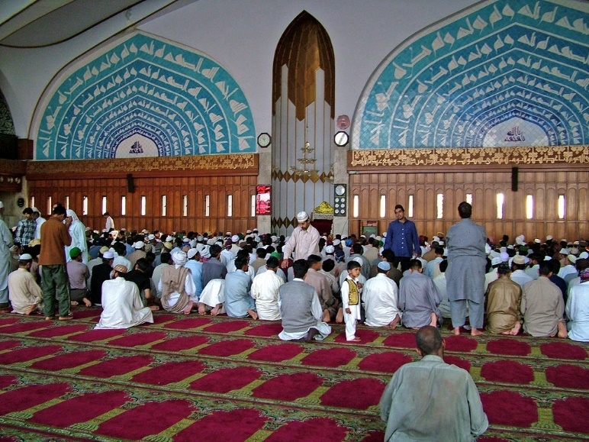
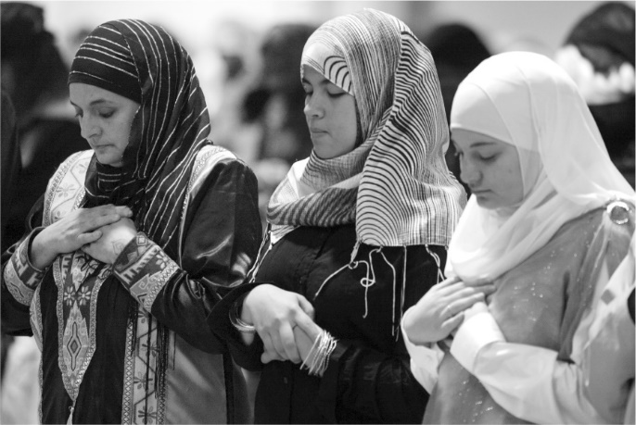
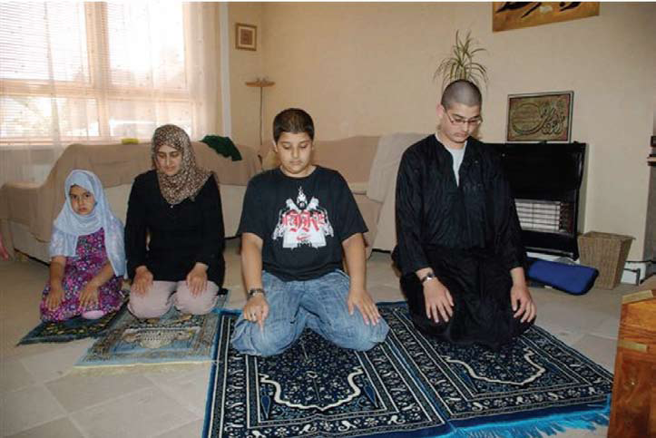
1.
2.
3.
6.
4.
5.
Mosque Shahadah
Prayer mat salah
Prayer zakah
Hijab Mecca Qur’an
Wudu Allah
8.
7.

Slide 6
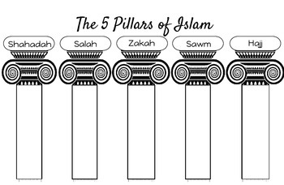
The Five Pillars of Islam
Muslim people, who follow Islam, have five duties which are called The Five Pillars of Islam.
Every Muslim tries to carry out these five things and it helps them to feel that they are members of the worldwide community.
The five pillars are often illustrated as in the diagram below:

Slide 7
The Five Pillars of Islam Activity
In your books or on a piece of paper - turn your page horizontal (you will need a new page in your book for this activity).
Write the title: The Five Pillars of Islam - and underline it.
Draw the five pillars with a pencil, using the whole piece of paper.
Write the name of each pillar at the top of each of the pillars.
Click on the video link below ( this is the same video clip as last week) – which gives information on the five pillars.
https://youtu.be/c5c9-1zxPeA
Write 1 or 2 sentences( at the bottom of the pillars) to explain what each of the pillars represent to the Muslim community.

Slide 8
Next week we will go through the images and the definitions of the five pillars or if you join us on zoom on Thursday afternoon we can go through them then. Again no need to email this work to the ash class email. Please keep all your work safe as when we return to school it will be stuck into your R.E. book.
Remember, even though you are working from home, we still expect the same writing standards as if we were in class – which we know you will all do.
If you have any questions please contact us on ;
ashteacher@west-malling.kent.sch.uk
Well Done Everybody and if you can join us on Thursday at 2pm for our zoom catch up, we can discuss this weeks work.

