Slide 1
Year 6 – Term 3 R.E.
Islam – Week 3

Slide 2

Hello Ash Class
Well done for all your hard work over the last two weeks. We are all impressed with how much effort and enthusiasm you have all shown.

Slide 3
Last week we looked at The Five Pillars of Islam. This week we are focusing on the third pillar – Zakah. This is when Muslims give a percentage of their savings each year to those in need. It reminds Muslims of their duty to the poor and that wealth is a gift from Allah.

Slide 4
In your book or on a piece of paper, write the date and underline it. Miss a line and write the L.I.
Thursday 21st January 2020
L.I. –To be able to explain how Zakah works.
I can explain the importance of the pillar of Zakah
I can explain why money is given away and why
I can give some reasons for the importance of generosity

Slide 5
Think about what your have learnt about the pillar of zakah from the last 2 weeks.
In your book write the title (leave a line underneath the L.I.) :The Third Pillar of Zakah - and underline it.
Draw the diagram below.
Write around the bubble what you can remember about the pillar of Zakah.
On the next 2 slides there is some more information about Zakah. Add any extra information to your diagram in a different coloured pen.
Where does Zakah go to ?

Slide 6
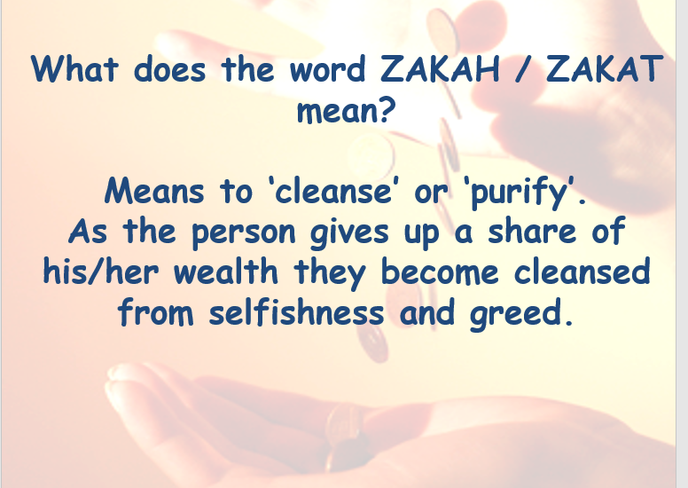
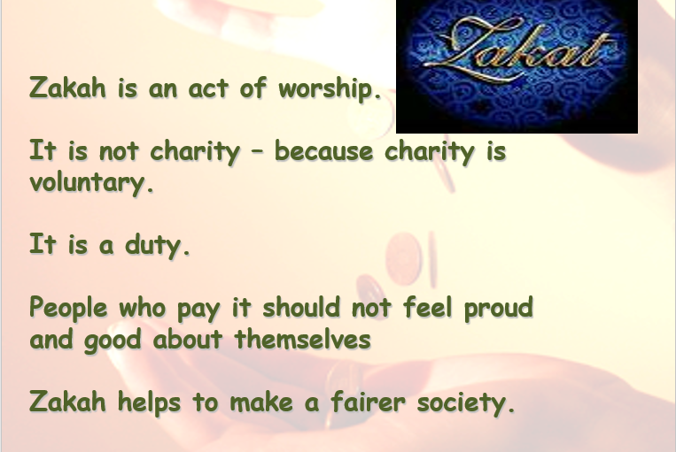
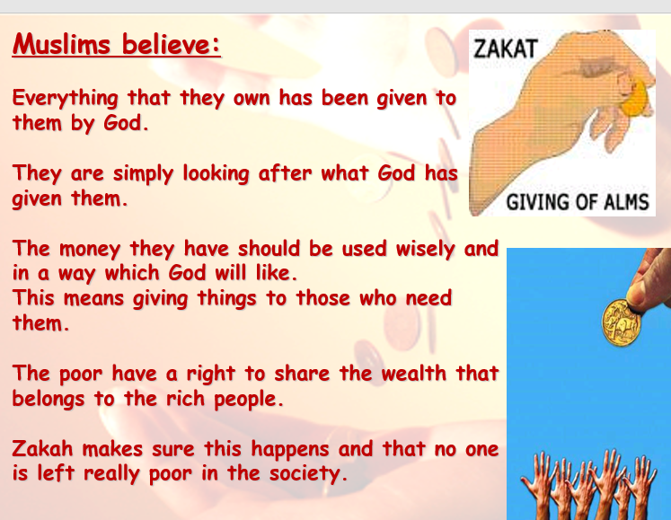
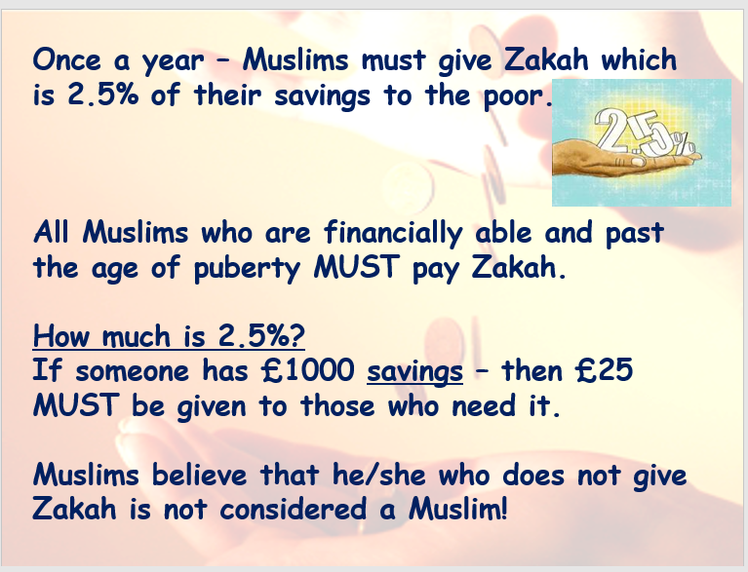

Slide 7
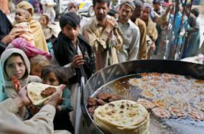






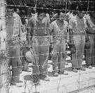
Zakah goes to:
The poor and the needy
Travellers who need money
Muslims studying Islam
People in debt
Schools, Hospitals, Libraries, Mosques
New Muslims
Prisoners of
war

Slide 8
Why do you think Muslims give away so much of their savings?
Please write your answer in your book
Miss a line and start your sentence as below:
I think that some reasons why Muslims choose to give away money is because...
How do you think it makes them feel ?
In you books write down your answer – remember to miss a line !
You could start you sentence as below:
I think it makes Muslims feel…

Slide 9
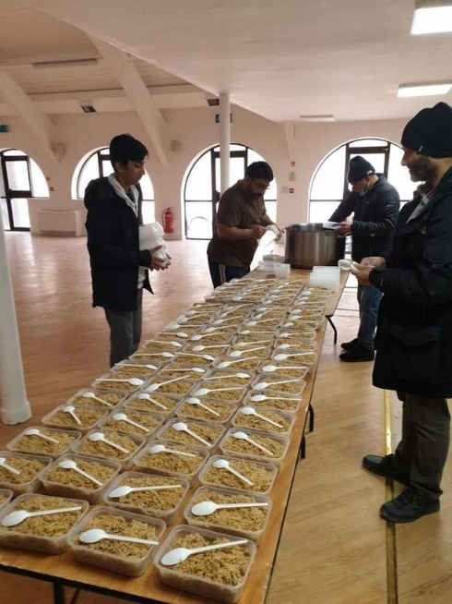
Read this article about how a Muslim charity provided food for the lorry drivers stuck on the M20 before Christmas
Muslim charity workers are spending the festive season supplying hot food and snack boxes to lorry drivers
stuck at Dover.
Over 420 meals and boxes of snacks have been provided to those stuck in parked queues along
the hard shoulder of the M20 and further meals will be delivered over the coming days,
according to The Muslim Charities Forum (MCF).
This scale-up will involve delivering over 3,000 meals per day over the festive period to drivers who will
be isolated and away from their families during the holiday period.
More than 1,000 lorries have left the UK since Wednesday evening but many are still trapped
at the port of Dover.
The drivers were stranded after France introduced travel restrictions on hauliers crossing the
Channel following the emergence of a new mutated strain of coronavirus in the UK.
MCF CEO Fadi Itani said: “This is a deeply desperate situation for numerous drivers that will be unexpectedly spending Christmas and the New Year away from their families. Through this COVID crisis, drivers and truckers have been hugely important in keeping this country moving through the delivery of essential goods. It is only right that in this time where they need support, that we come together to provide them with food, water and essential supplies in appreciation for the vital service.”
Meanwhile, the Al Khair Foundation prepared over 400 lunches of chicken stew and rice as well as hundreds of snack boxes containing drinks, crisps, biscuits and a cereal bar.
Al Khair Foundation Head of Special Projects, Imran, Nisar said: “We plan to keep delivering until all the truckers have gone home – even on Christmas Day if necessary. Some of them don’t even have water in their cabs so these supplies are making a big difference to them and also raises their morale. They were so grateful for some basic supplies and a hot meal while they wait to be able to move and go home.”

Slide 10
What does this practical action teach you about what Muslims believe?
Think about what Muslims believe and how its their duty to help those in need.
Write in your book –remembering to miss a line!
You could start your sentence as below:
The practical action that these Muslims took to help the lorry drivers stuck on the M20 shows….

Slide 11
Why do you think its important to be generous?
Can you remember from last term some of the things that Rev Green talked about and how the local Christian community provided for those in need of help ?
In your book list your reasons giving an explanation for each.
Remember to miss a line !
For example: Giving items to a charity shop that you no longer need - these are then sold and the money then used to help those who need help.

Slide 12
Well done everyone.
Remember to send in your 3 weeks of R.E. by Friday 22nd January to
Remember we have a zoom catch up on Thursday at 2pm – if you have any questions.
I'm looking forward to looking at all you work.
Well done for working so hard
ashteacher@west-malling.kent.sch.uk

