Slide 1
Year 6 – Term 3 R.E.
Islam – Week 4

Slide 2

Hello Ash Class
We are now half way through this term.
You have all been working so hard and it was lovely to read through your R.E. work. Well done.

Slide 3
This week we are looking at the fourth pillar of Islam – Sawn.
This is when Muslims refrain from eating food and drinking during daylight hours during the 9th month of the Islamic calendar. This is called Ramadan.
Fasting helps Muslims to appreciate how the poor suffer. It also shows obedience to Allah by following his commands.
The end of Ramadan is celebrated with a festival called
Eid-ul-Fitr.

Slide 4
In your book or on a piece of paper, write the date and underline it. Miss a line and write the L.I.
Thursday 28th January 2021
L.I. – To know why Muslims fast at Ramadan and how they celebrate the end of Ramadan.
I can explain why Muslims fast.
I can explain what happens at the festival of
Eid-ul-Fitr.

Slide 5
Click onto the link below. This will take you to Ash Class R.E. page, where there is a video for you to watch.
https://www.west-malling.kent.sch.uk/re/
Have your whiteboard and pen ready so you can take some notes to answer the questions on the next slide.
Also, look at the next slide – 10 Exciting Facts about Eid-ul-Fitr, these will help you answer the questions.

Slide 6
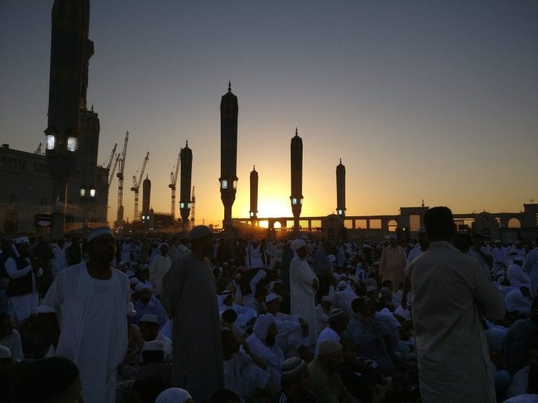
10 Exciting Facts about Eid ul-Fitr
Eid, in Arabic, quite literally means “Feast, or Festival”.
Here’s 10 interesting facts about Eid al Fitr!
1.Eid ul-Fitr is a three day celebration to mark the end of Ramadan and the end of fasting.
2.During the month of Ramadan, Muslims fast from sun up to sundown to honour the month that the Quran was revealed to the Prophet Mohammed.
3.Eid ul-Fitr is a literal translation of the event that’s being celebrated – ‘Festival of the Breaking of the Fast’ or ‘the Feast of Fast-Breaking’.
Madinah, Saudi Arabia.
Sunrise. Eid 2018.
4.Across the world, Eid ul-Fitr starts at different times – even on different days – depending on location because the celebration doesn’t begin until
the new Moon appears in the sky.
5.The festival lasts typically for three days but depending on how it falls on the calendar, it could last much longer – if the three days fall mid week,
Muslims will likely still be celebrating over the weekend.
6.The celebration isn’t only about having a feast of delicious food but also in exchanging gifts, especially to children. These gifts of money, accessories,
home goods or flowers are called ‘Eidi’.
7.Before leaving to perform morning prayers, Muslims wake up to cleanse their bodies in a ritual called “Ghusl”. Then they grab their finest clothes and
decorate their hands with elaborate henna patterns.
8. After getting dressed and they are ready for the day. Muslims gather for prayers in Mosques or outdoor locations. Afterwards, they may visit
the graves of loved ones to pray and clean the gravesites.
9.Eid ul-Fitr is known in different names across the Muslim world. Among the Muslim communities of Southeast Asia, it is also known
as Hari Raya Aidilfitri or Hari Raya Puasa which means ‘celebration day’.
10.The most common greeting on this occasion is ‘Eid Mubarak’ which means ‘Have a blessed Eid!’

Slide 7
Answer these questions in your books. Miss a line after your L.I. -then miss a line after each question.
What are the main reasons for fasting?
What happens at sunset during Ramadan?
When is Ramadan and how long does it last?
How does fasting help Muslims to understand people who are less fortunate then themselves?
What do Muslims prayer for during Ramadan?

Slide 8
At the end of Ramadan, Muslims celebrate the festival of Eid-ul-Fitr. It means ‘The festival of breaking of the fast’.
In your books, miss a line and write the title – Eid-ul-Fitr – and underline it.
Draw the table below with the headings and underline the headings.
Answer the questions in the table from the information you have found out about Eid-ul-Fitr.
What is Eid-ul-Fitr ? | Why do Muslims celebrate this festival?
What do Muslims do on this day? | What type of food do they eat during the festival?

Slide 9
Think about your own experiences of giving to charity, community and forgiveness.
Think about :
Why would you choose a charity – is it personal to you?, is it something you have an interest in ?
How does it make you feel?
What are the benefits of helping a charity to you?
Then answer this question in your book –Why do you like to help charities? Remember to miss a line. You could start your sentence as below;
The reason why I like to help charities is because..

Slide 10
Well done everyone.
If you have any questions please contact us on ;
ashteacher@west-malling.kent.sch.uk
OR
Join us for our weekly zoom session on Thursday at 2pm where we can answer any question you may have.
Well done for working so hard

