Slide 1
Year 6 – Term 3 R.E.
Islam – Week 6

Slide 2

Hello Ash Class
We are now at the end of term 3.
It’s certainly been a very different term from what we were all expecting.
We know it’s difficult not being in school but you have all worked so hard and we are so proud of all of you.

Slide 3
This week we are looking at where Muslims get their advice and guidance from.
In your book or on a piece of paper, write the date and underline it. Miss a line and write the L.I.
Thursday 11th February 2021
L.I – To know where Muslims get their guidance from.
I can explain who the prophet Muhammad (pbuh) was.
I can explain why the Qur’an and the Hadith are so important to Muslims.
I can answer the big question - Who are Muslim people and what do they believe?

Slide 4
Some sources where Muslims get their advice and guidance
Muslims get their advice from a variety of sources including the Qur’an. The Qur’an is the Muslim holy book. They believe that the words come directly from Allah and that they should follow the words and instructions of the Qur’an exactly.
Muslims also use the hadith for guidance to help them stay on the straight path. The Hadith is a collection of sayings from the prophet Muhammed (pbuh), it offers Muslims guidance alongside the teachings of Allah in the Qur’an.
Muslims always say peace be upon him (pbuh) every time they say or mention the Prophet Muhammad’s name. This is as a sign of respect and blessing to the prophet.

Slide 5
Who was the prophet Muhammad? (pbuh)
Click onto the link below. This will take you to Ash Class R.E. page, where there is a video for you to watch.
https://www.west-malling.kent.sch.uk/re/
Have your whiteboard and pen ready so you can take some notes to answer the questions on the next slide.
Watch this video clip to find out about the Prophet and the beginning of the Islamic faith. There is a lot of information in it, but it will help you to understand the background to some of the Muslim beliefs and practices.

Slide 6
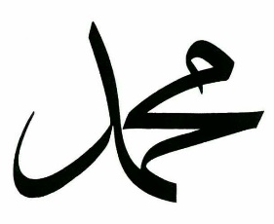
From the information you have found out about the prophet Muhammad, answer the following questions in your books.
Miss a line after your L.I. -then miss a line after each question.
REMEMBER to answer in full sentences, for example;
The prophet Muhammad (pbuh) was….
Who was the prophet Muhammad (pbuh)?
What happened on the Night of Power?
What was the result of this night?
Why did Muslim people not draw or create images of Muhammad (pbuh) or Allah?

Slide 7
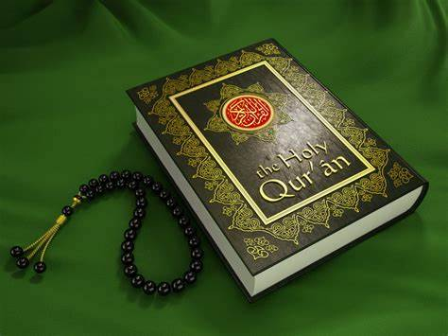
The Qur’an.
Click onto the link below. This will take you to Ash Class R.E. page, where there is a video for you to watch.
https://www.west-malling.kent.sch.uk/re/
Have your whiteboard and pen ready so you can take some notes to answer the questions below.
Answer the following questions in your books.
REMEMBER to miss a line after you last questions on the prophet Muhammad (pbuh) -then miss a line after each question.
Why do Muslim people read and learn the Qur’an?
Muslims believe that the Qur’an contains the words of Allah. How they treat and use the Qur’an reflects this.
How do Muslim people treat and use the Qur’an?

Slide 8
The Hadith
Muslims use the hadith for guidance to help them stay on the straight path. The Hadith is a collection of sayings from the prophet Muhammed (pbuh), it offers Muslims guidance alongside the teachings of Allah in the Qur’an.
Over the next few slides -Read the seven passages from the hadith and then answer the questions at the end.
1. Respect a good deed (no matter how small it may seem), even if it is having a cheerful face when you meet another person.
Based on Riyad as-Salihin, Book 2, Hadith 695
2. Whenever a beggar or a person in need came to Prophet Muhammad, the Prophet would say, ‘Help this person and you will be rewarded for it.’
Based on Sahih Al-Bukhari, Book 78, Hadith 58

Slide 9
3.There is a reward for showing kindness to every living thing.
Based on Al-Adad Al-Mufrad, Book 20, Hadith 378
4. Allah doesn’t look at your bodies or your appearance, but, rather, at your heart and your actions.
Based on Sahih Muslim, Book 45, Hadith 42
5. Prophet Muhammad said, ‘The strong person is not the one who is good at wrestling, but the one who can control his anger.’
Based on Riyad as-Salihin, Book 1, Hadith 45
6. Prophet Muhammad said, those who are truthful are good, those who are good are on the path to paradise. A man keeps on telling the truth until he becomes a truthful person.
Based on Sahih Al-Bukhari, Book 78, Hadith 121
7. The person who does not show mercy to others, will not be shown mercy.
Based on Sahih Muslim, Book 43, Hadith 88

Slide 10
Read these questions carefully.
You don’t need to write out the hadith, just put the number of that hadith in the margin then write your thoughts about it.
Choose 4 of the hadiths, read the questions below and write your thoughts about each of the statements you have chosen.
What do these sections from the hadiths teach Muslims about how to live and about Allah?
AND
What do they teach you about the Muslim faith?

Slide 11
Think back through all you have learned in this unit to help you answer this question:
Who are Muslim people and what do they believe?
Look back on the previous 5 weeks of work and this week’s work to help you answer this question.
REMEMBER to add as much information as you can and give reasons why.

Slide 12
Well done for completing the whole of term 3 online!
If you have any questions please contact us on ;
ashteacher@west-malling.kent.sch.uk
OR
Join us for our weekly zoom session on Thursday at 2pm where we can answer any questions you may have.
Well done for working so hard. Have a rest during half term and we’ll see you all in a weeks time.

