Slide 1
Year 6 – Term 4 R.E.
Humanism – Week 1

Slide 2

Hello Ash Class
Welcome back to Term 4.
Unfortunately we are still unable to learn in our classroom, so we are continuing our online learning – but hopefully only for a few weeks.
This PowerPoint is an introduction to this term’s R.E.

Slide 3
For the first 2 weeks of home learning we are going to explore Humanism.
We will look at what Humanism is and focus on one family and how being a Humanist affects their decisions and choices in life.
By the end of the 2 weeks you should be able to answer the big question:
WHAT IS HUMANISM?

Slide 4
In your book or on a piece of paper, write the date and underline it. Miss a line and write the L.I.
Thursday 25th February 2021
L.I. - What is Humanism?
I can explain what a Humanist is.
I can say what things are important to Humanists.

Slide 5
Humanism isn’t a religion but a way of thinking and living. Humanists do not believe in God or gods. They believe that this is our only life so it is very important to live a worthwhile, happy life for ourselves and others.

Slide 6
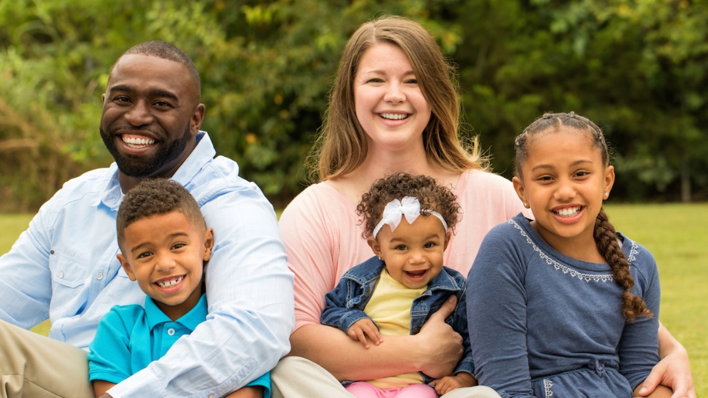
Taryn and her family, who are Humanists.
This is Taryn and her family, who are Humanists.
Hi! My name is Taryn and I am in year 5. This is my Mum, Sarah, and my baby sister, Thandi.
Hi! My name is Jayden and I am in year 2. This is my Dad, Toben.

Slide 7
What is Humanism?
What questions do you have about this week’s learning question?
In your book or on a piece of paper, draw the bubble in the centre of your book and write, “What is Humanism?” in the centre.
Add any thoughts and any questions that you have and write them around the thought bubble .
You can also write what you think Humanism might mean.
What is Humanism?

Slide 8
Read this quote from Stephen Fry, who is a Humanist, then answer the question on the next slide.
‘A humanist is someone who will never tell you what to believe. We will never tell you what is absolutely true. We will never make claims that cannot be proven and that you cannot find out for yourself. We believe life is an adventure and that nobody knows the answers or the destination.’
Stephen Fry, Patron of Humanists UK

Slide 9
From reading the quote, what things do you think are important to Humanists?
Miss a line after your L.I.
Write your answer in a full sentence, starting;
The things that are important to humanists are…

Slide 10
The following statement is Taryn and her family’s beliefs as Humanists.
Read it carefully and then answer the question at the end.
We believe science provides the best way to understand the world.
We do not believe there is a god or believe we cannot know if there is a god.
We do not believe in an afterlife and therefore believe we should make the most of the one life we know we have and respect different people’s choices and ways of life.
We believe we should use reason and empathy when deciding how to behave.
We value humanity and celebrate human achievements (scientific, artistic, social).
What questions do you have about these beliefs and values?
Miss a line in your book and write your views and any questions you have about what Taryn believes and her values as a Humanist.

Slide 11
Humanism is not a religion. It is a philosophy or an approach to life. Humanists don’t see any good evidence that a god or gods exist. They are therefore atheists (they don’t believe in a god or gods) or they are agnostics (they believe we can never know if a god or gods exist). Humanism, however, is more than just not believing in a god. Humanists also have many positive beliefs about how we can understand ourselves and the world and how we should live our lives
For me, the most important thing is not whether I believe in a god or not but it is how I live my life. Humanists believe we can be good and happy without the need for gods or religion.

Slide 12
Think through these big questions with Taryn.
In your books, miss a line and draw 2 bubbles with the questions inside. Then add your thoughts around the question.
Is how you live your life more important?
Does it matter whether you believe in a god or not?

Slide 13
Well done everyone.
If you have any questions, please contact us on:
ashteacher@west-malling.kent.sch.uk
OR
Join us for our weekly zoom session on Thursday at 2pm where we can answer any question you may have.
Well done for working so hard

