Slide 1
Year 6 – Term 4 R.E.
Humanism – Week 2

Slide 2

Hello Ash Class
This will be our last week of online learning.
Next week we will be back in the classroom. We are looking forward to seeing you all again.
This week we are continuing to look at Humanism, focusing on the values of Humanists and what makes them happy.

Slide 3
In your book or on a piece of paper, write the date and underline it. Miss a line and write the L.I.
Thursday 4th March 2021
L.I. - What is Humanism?
I can explain some values that are important to Humanists.
I can explain why happiness is important to Humanists.

Slide 4
What do Humanist value?
This is a quote from Richard Norman, a Humanist philosopher.
A philosopher is someone who practices a set of ideas, standards or beliefs to describe behaviour and thought.
The satisfaction of creative achievement… the excitement of discovery…relationships with others…the life of the emotions… the enjoyment of beauty in art and nature… These, we know, are the things which enrich our experience.

Slide 5
What does the quote by Richard Norman tell you about what he values as a Humanist?
In your book or on a piece of paper, write your answer.
REMEMBER to miss a line after your L.I.
You could start your sentence:
The quote by the Humanist Richard Norman, tells me his values are….because….

Slide 6
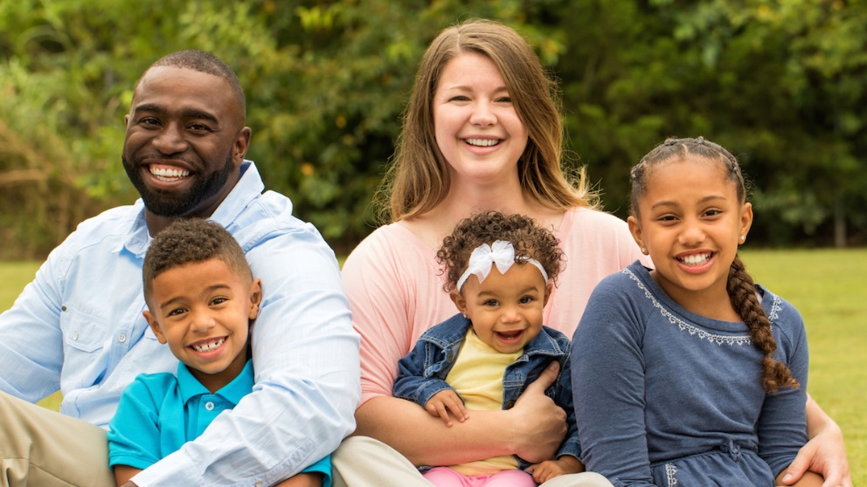
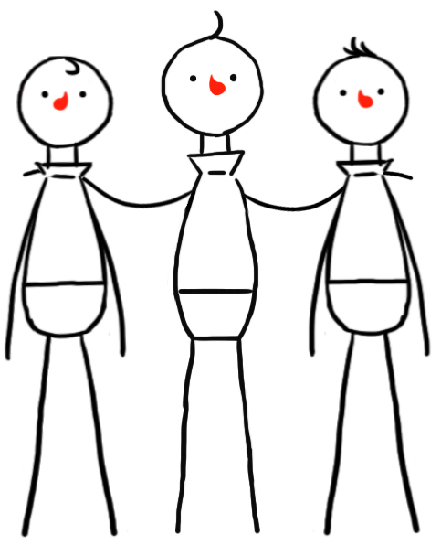
Taryn and Her Family.
Last week your were introduced to Taryn and her family who are Humanists.
The following quotes are some values that are important to Taryn and her family.
Read the quotes and answer the question at the end.
For me, freedom is one of the most important things in life: freedom to live my life however I wish, as long as I do not cause harm to others. All human beings have the freedom to find their own way to make their lives feel meaningful.
I do not believe in an afterlife, so this life is everything to me. We should find what makes us happy and make the most of our lives. We should also try to help others to do the same.
The most important thing in life is forming good friendships and relationships with others. The human community is also important, and we should remember that all human beings around the world are part of one extended family.

Slide 7
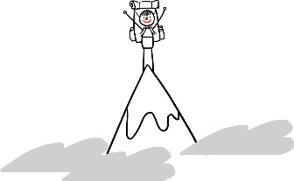
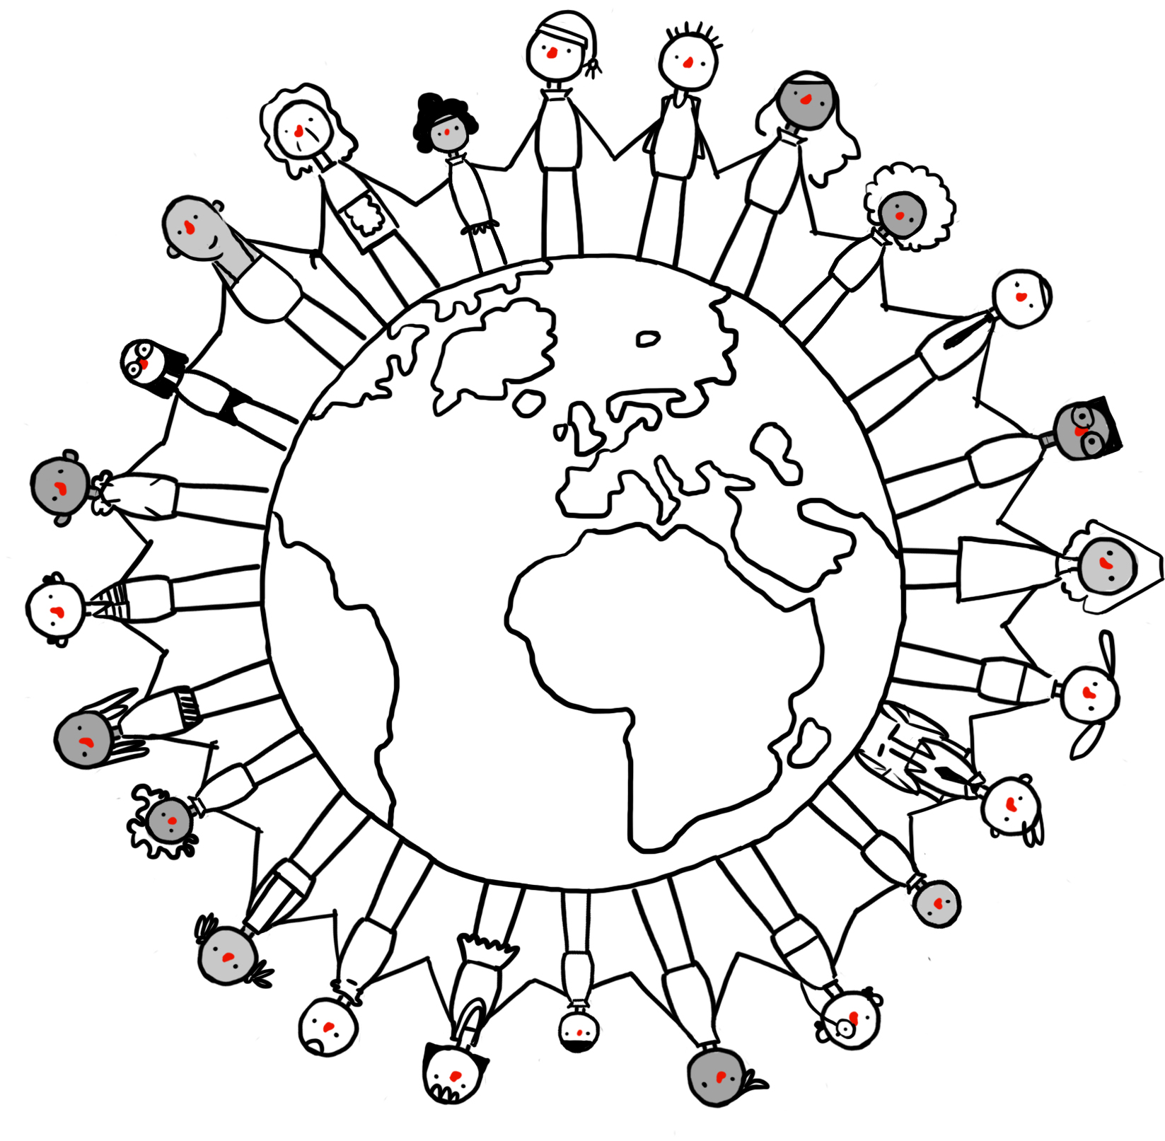
Human beings should celebrate the many intellectual and creative achievements of humankind, such as science, medicine, technology, art, music, and literature. We should try to make the most of our talents and abilities and be optimistic about what we might achieve in the future.
We are all part of humanity and part of the human story. We are all linked across time to our ancestors and our descendants. Human beings have made incredible progress and we should aim to help our children and their children continue that progress. That is the human spirit.
Humanists believe in a world that promotes democracy and human rights. We believe in the importance of equality and social justice. We should work to improve the quality of life for all human beings. Empathy can help me to see how I would like to be treated if I were in somebody else’s situation. We should take care of each other.

Slide 8
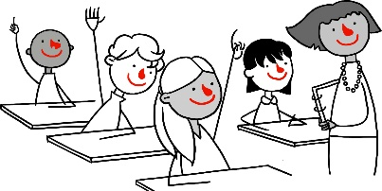
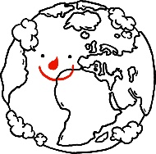
I value the natural world around me. Without it we would not survive, and this world is the only one we have. It is a source of beauty and wonder, and we should take care of it.
I value our curiosity and our capacity to ask questions. By looking for evidence, and thinking carefully about the answers, we have been able to discover so much about our world and ourselves and have been able to improve the quality of our lives.
In your book or on a piece of paper make a list of the values that are important to Taryn and her family.
REMEMBER to miss a line and then start your list.

Slide 9
Why is Happiness Important to Humanists?
How would you describe happiness?
In your book, miss a line then write the sub title –
Why is Happiness Important to Humanists?
You might want to start your sentence
To me, happiness means ….

Slide 10



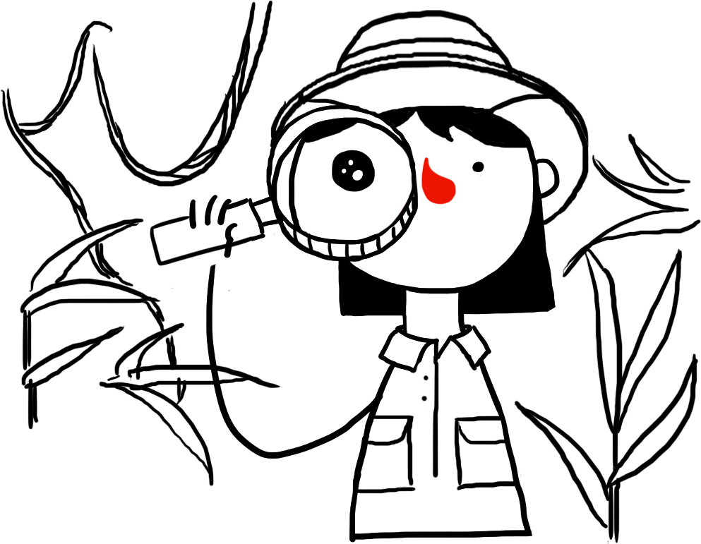
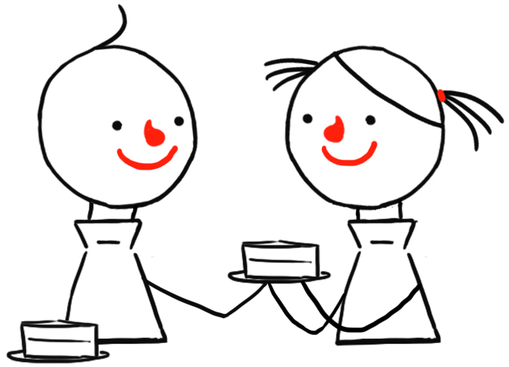


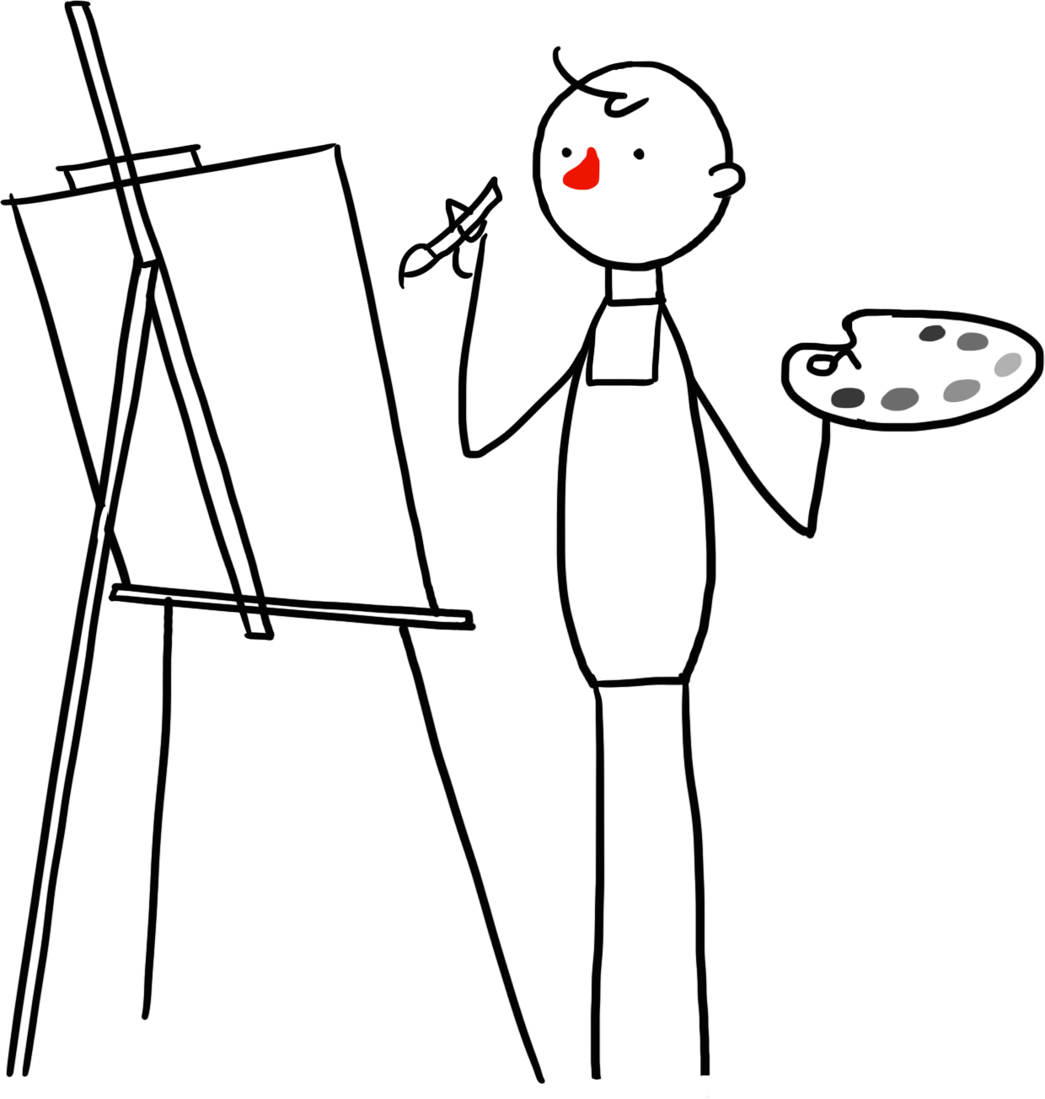

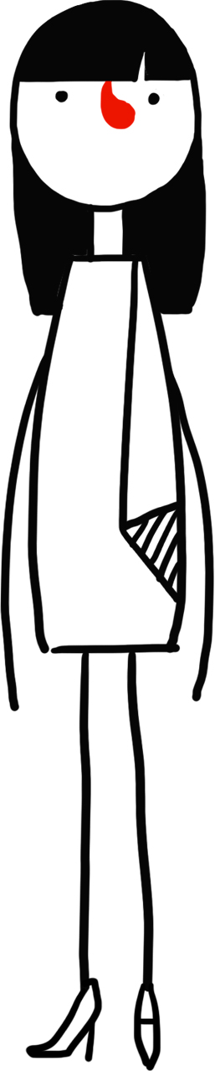
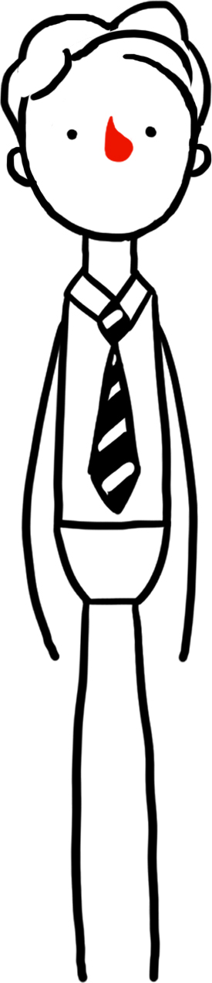


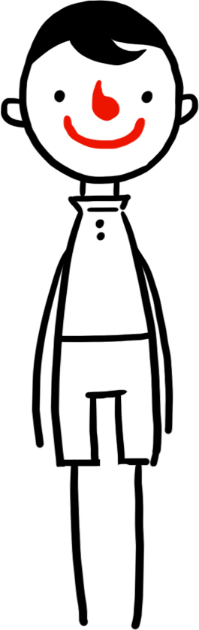
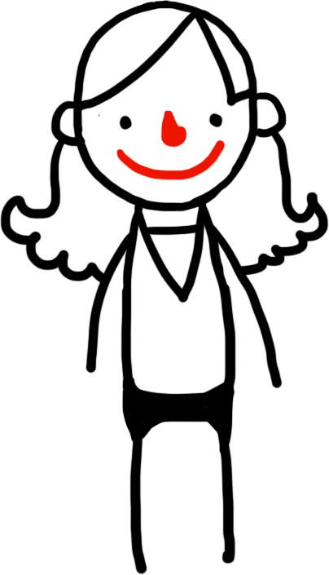
Below are some possible ingredients of happiness.
£

Slide 11
Write your answers to the following questions in your book.
REMEMBER to miss a line after your last sentence.
Do you agree that the images are ingredients for happiness? Why?
Would you add anything else that you think is a good example of happiness?
Which images do you think might not make people happy? Why?

Slide 12
Which three happiness ingredients might be the most important for a Humanist?
Write down your choices in your book and give a reason. You could set it out as below
Choice 1
Choice 2
Choice 3
Reason
Reason
Reason

Slide 13
Humanists believe that we can all find our own different ways to be happy as long as we don’t harm other people or prevent others from being happy.
Food, drink, and games can be an important part of a happy life.
But more important are making good friends, learning new things, fulfilling our goals and making others happy.
Read this poem by Robert Ingersoll. (1833 – 1899)
‘Happiness is the only good.
The place to be happy is here.
The time to be happy is now.
The way to be happy is to make others so.’
What does this poem teach you about humanist beliefs about happiness?
In your book write your answer, giving reasons.
You could start your sentence:
This poem tells me that Humanists believe happiness is…

Slide 14
Many Humanists like to think through big questions about life. Taryn is also thinking about happiness.
In your books, on a new page, write the 4 questions and then draw a bubble around them, as in the diagram below..
Write your thoughts around the thought bubbles.
What sorts of things stop people from being happy?
Is it ok to sometimes not be happy?
What is the best way to stop people being unhappy?
Is it possible to make everyone happy?

Slide 15
Think about what you have learned to help you answer this question: Why is happiness important to Humanists?
REMEMBER to miss a line in your book.
You could start your sentence:
I think that happiness is important to Humanists because…

Slide 16
Well done everyone.
If you have any questions please contact us on:
ashteacher@west-malling.kent.sch.uk
OR
Join us for our weekly zoom session on Thursday at 2pm where we can answer any question you may have.
This is our last week for online learning. Next week we will be back in the classroom. We are so looking forward to seeing you all in person on Monday 8th March
Well done for working so hard

