Slide 1
Term 4 – year 6 pshe – healthy me !
Week 1

Slide 2

Importance of a healthy routine
What is a healthy routine and why is it so important?
Sometimes, especially now as we are doing lots of schoolwork at home, we get so busy that we forget to think about all the things that can help us stay happy and healthy. Now, more than ever, it’s important that we all have healthy routines to help us get through the challenges we face with home-schooling and other changes in our lives due to covid-19.
It can be easy to forget about the importance of making healthy choices and keeping fit during the day but it’s really important for your mental and physical wellbeing.
Having lots of energy from eating well, getting the right amount of sleep and staying fit are all key to staying calm under pressure and having a healthy mind and body. It’s important to find the balance of looking after your mind and body with the rest of the demands of a school day. That means making sure you do things that make you happy and feel good too.

Slide 3
In your book or on a piece of paper, write the date and underline it. Miss a line and write the L.I.
TUESDAY 22ND February 2021
L.I. –The importance of a healthy routine.
I know the importance and benefits of a healthy routine for mind and body.
I can show that I can make small, healthy changes.

Slide 4
Food is Fuel
We all know that healthy food is important to keep our bodies healthy but did you know that it is also important for our mental wellbeing?
Think about three types of food we eat during celebrations or on certain days of the year, or something you might eat when you need cheering up or when we get together with friends or family. Party food can be delicious but too much can make us feel sick and unwell. It’s important to eat these things in moderation.

Slide 5
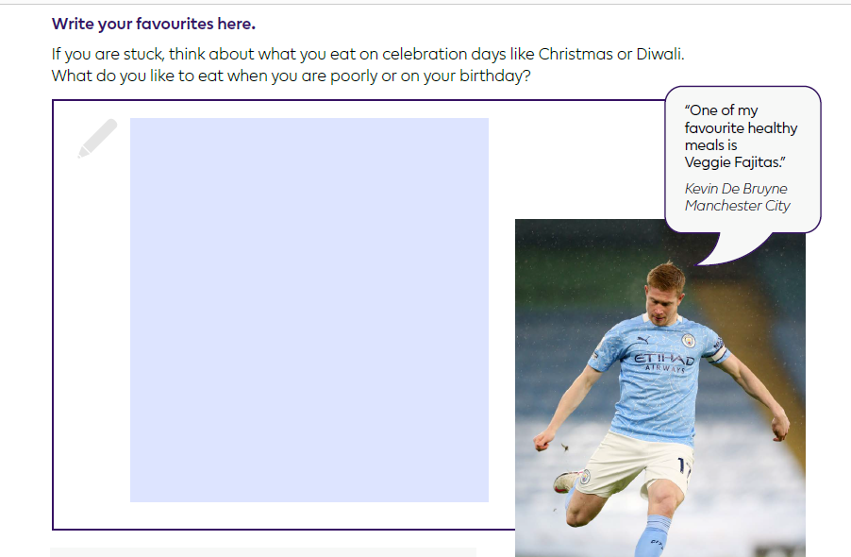
Now answer the question below about what your 3 favourite foods are.
Write the question in your book or on a piece of paper and write your answer underneath.
Miss a line after your L.I. and write the title - My favourite foods.
List your 3 favourite foods. If you are stuck, there are suggestions opposite to help you.
Did you know... that healthy eating can help boost your memory, help you sleep well and can help prevent you becoming unwell?

Slide 6
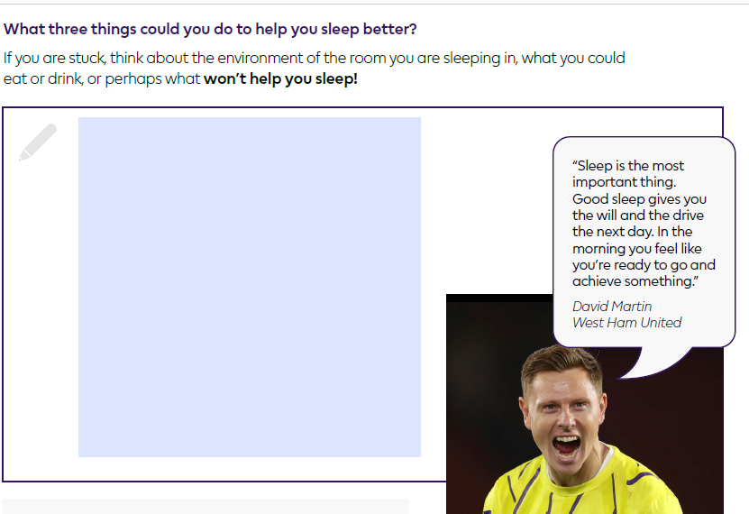
Counting those zs
Sleep is really important for our mental and physical wellbeing. Not only do our bodies heal themselves, grow and rest while we sleep but not getting enough can make us grumpy and miserable.
Leave a line and write down the question opposite and answer it.
Did you know... that your body releases a hormone called melatonin to encourage you to sleep? Light from screens prevents your body releasing it – that’s why screen time before bed is so bad for you!

Slide 7
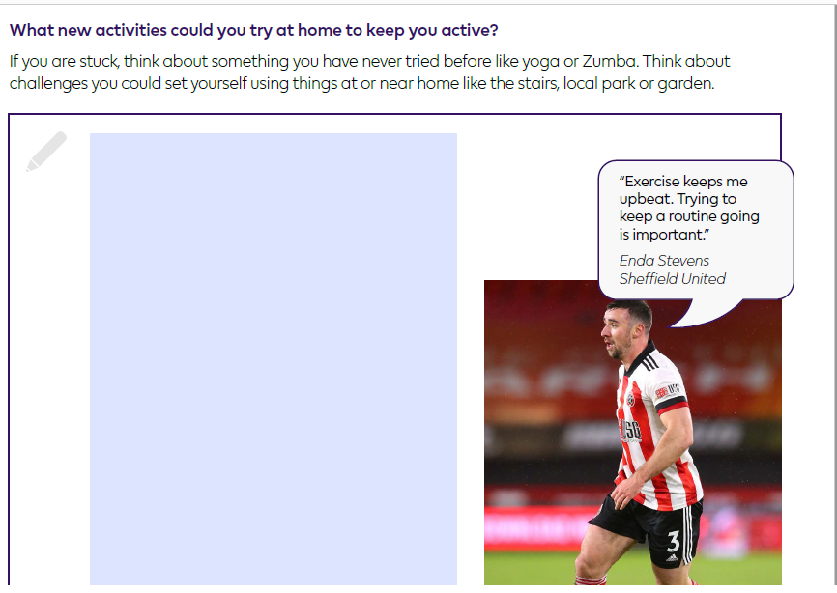
Keep moving!
Staying fit is key to helping us feel great. It might be hard to do P.E. with classmates at the moment or to go to our usual clubs but there are lots of easy activities to do at home to keep our minds and bodies active.
Exercise can combat stress, help us gain stamina and improve our mood and self-esteem.
Leave a line and write the question opposite and answer it.
Did you know... that when you exercise, your body produces some chemicals called endorphins that help boost your mood?

Slide 8
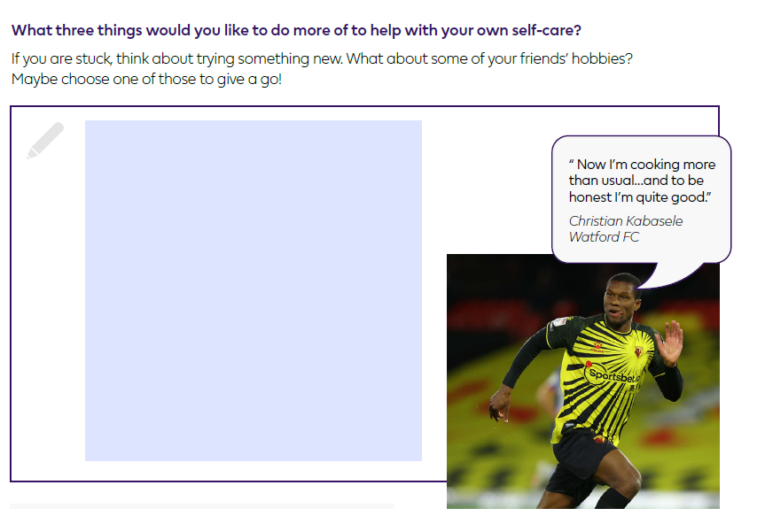
Self-care
Doing things to look after yourself is also really important for your mental and physical health - that means doing things you enjoy or that make you feel good.
It might be reading, chatting to a friend, making cookies, listening to music or kicking a football around – it doesn’t matter what it is as long as you make time for it.
Leave a line and write the question opposite and answer it.
Did you know... that relaxing and doing something you enjoy helps reduce anxiety and puts you in a good mood?

Slide 9
Now you have explored some of the things that are important for a healthy routine, next week you will look at
My Daily Routine Challenge
to see if you can build some of these ideas into your own daily routine.

