Slide 1
Term 4 – year 6 pshe – healthy me !
Week 2

Slide 2

THE IMPORTANCE OF A HEATHY ROUTINE
Last week you looked at the importance of a heathy routine and how it’s really important for your mental and physical wellbeing.
This week you are going to put into practice what you learnt last week by creating your own daily routine challenge.

Slide 3
In your book or on a piece of paper, write the date and underline it. Miss a line and write the L.I.
Tuesday 2nd march 2021
L.I. –The importance of a healthy routine.
I can make small changes and create my own daily routine.
I can show that these changes make a difference to me.

Slide 4
My daily routine challenge
It is so important to make sure we take care of ourselves during these challenging times, from eating healthily to finding ways to feel more positive.
Using the challenge template worksheet,(on slide 7) I want you to create your own daily routine that is healthy for your mind and body. Think about ways to keep fit, eat healthily and get enough sleep, make sure your routine focuses on both your physical and mental health.

Slide 5
How can you build activities into your day to help you feel good and boost your mental and physical wellbeing?
There are all sorts of ideas for activities that you can add to your daily routine to help you feel good. Ideally, aside from the things you have to do like schoolwork and chores, for a balanced sense of wellbeing you should aim to do something creative, something active, something to help you feel like you are improving yourself and something just for you.
Take a look at the bank of ideas on the next page to help you choose what you might add to your daily routine below. You can also add in your own ideas.

Slide 6
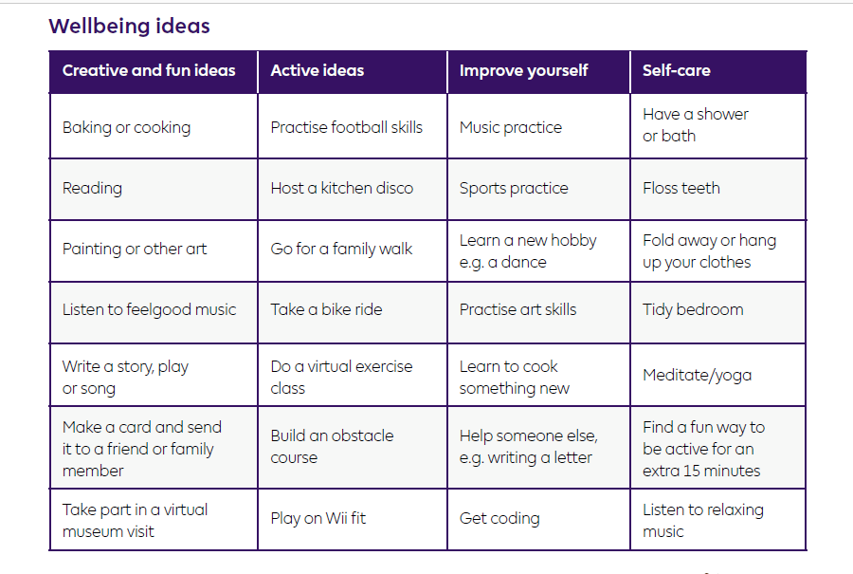
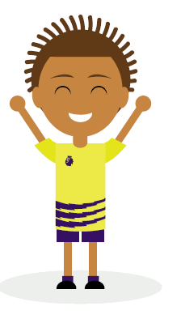
Bank of ideas

Slide 7
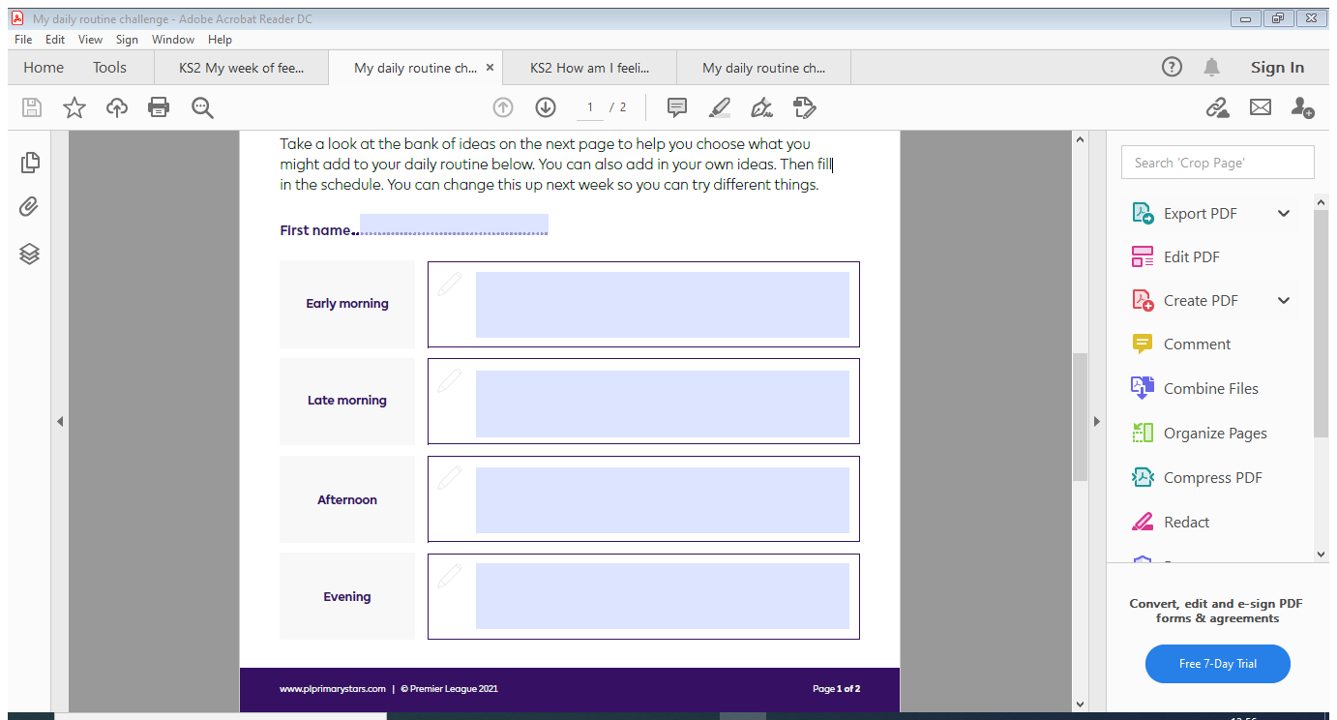
In your book or on a piece of paper, set out your page to look like the diagram below.
Think about what you would like to add to your daily routine, early in the morning, late morning, afternoon and evening.
From the Bank of Ideas, think about what activities you could add to your routine, early in the morning, late morning, afternoon and evening.
Once you have completed this daily challenge, try and put it into operation tomorrow and the rest of the week.

Slide 8
NOW YOU HAVE PUT YOUR DAILY CHALLENGE TO USE, HOW DID YOU DO ?
DID IT MAKE YOU FEEL BETTER WITHIN YOURSELF?
WAS IT FUN TRYING SOMETHING DIFFERENT?
In your book or on a piece of paper, answer the following question.
REMEMBER to miss a line after your daily challenge chart and answer this question.
How did the small changes you made in your daily routine make you feel?
Answer in a full sentence/s and explain how it made you feel. You could start your sentence;
The small changes I made to my daily routine made me feel…because

Slide 9
Well done everyone.
We are back in class next week - it will be lovely to see you all.
If you have any questions please contact us on
ashteacher@west-malling.kent.sch.uk
or
Join us for our weekly zoom session on Tuesday or Thursday at 2pm where we can answer any questions you may have.
Well done for working so hard.

