Slide 1
English
(narrative writing based on Viking Boy)

Slide 2
Monday 4th January 2021
LI: to plan a story
I can discuss and listen to ideas
I can write my story plan in 5 sentences

Slide 3
Story Plan
Opening – introduces the main character(s) and setting
Problem – an event happens that causes the main character(s) to do something
Build-up – all the events that lead to the problem being resolved (usually involves a journey)
Resolution / climax – how the problem is resolved
Ending – How life continues (back to normal)

Slide 4
Story plan for Viking Boy
Opening: Gunner and his family lived peacefully on their steading in the fjord.
Problem: Raiders attack the farm and kill his father. Gunner swears and oath to avenge his father’s death.
Build-up: Gunner travels on a long journey to find his father in Valhalla.
Resolution / climax: Gunner returns to the family steading and kills Skuli.
Ending: Gunner becomes the chief of the steading and life returns to normal again.

Slide 5
Your task:
Write a story plan, using the five headings, for your own story with Gunnar as the main or one of the main characters.
These were some of the ideas for the ‘problem’ that we discussed in class today. You can use one of these or come up with ideas of your own.
a raid on another local steading and Gunnar comes to the rescue
one of Skuli's relatives seeks revenge on Gunnar
Orm tracks Gunnar down to kill him for killing his son
Gunner decides to return to Kaugang with Rurik to set all the slaves free
Have this ready for the lesson at 11 o’clock tomorrow.

Slide 6
Tuesday 5th January 2021
LI: to write the opening to my story
I can introduce the main character(s)
I can set the scene and describe the setting

Slide 7
Fjord
betrothal
calm
peaceful
valley
beautiful
Lush green
victorious
celebrations
nestled
Hence forth
Gauk
Gunner
Helga
Rurick
Skuli
Bjorn
Orm
(Starkard)
Odin
Brunhild
Thorkel
Kaupang

Slide 8
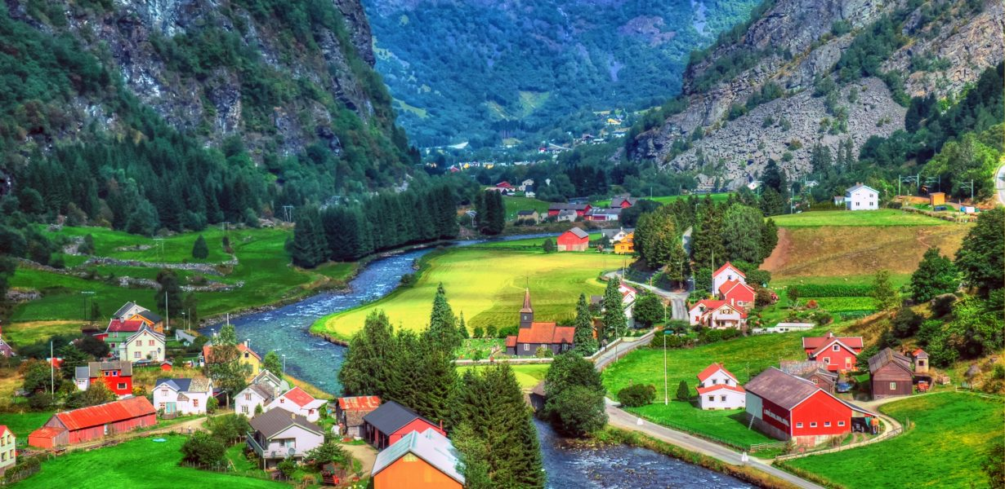

Slide 9
Your task is to write your opening paragraph.
Ideas for opening sentences:
The following morning after Gunner had avenged his father’s death …
It all began on a simple day, just like any other…
Not even a summer had passed since Gunner had killed Skuli and won back his father’s steading…
After Gunner had killed Skuli, he thought the war was over … but it was only just beginning.
It has been one year since Gunner fulfilled his oath to avenge his father and kill Skuli.
Gunner awoke the morning after his father was avenged but little did he know, it wasn’t the end.

Slide 10
Wednesday 6th January 2021
LI: to introduce the ‘problem’ to my story
I can use paragraphs correctly
I can include detail and description (using adjectives, adverbs and descriptive techniques effectively)

Slide 11
When should you begin a new paragraph?
Change of time
Change of place
Change of subject

Slide 12
What descriptive techniques could you use?
Adjectives (wow words)
Adverbs (wow words)
Alliteration
Simile
Metaphor
Relative clauses
Personification

Slide 13
Your task is to write the next section of your story.
Remember to refer back to your plan
Remember to include your success criteria

Slide 14
Thursday 7th January 2021
LI: to use some speech in my story
I can use speech to move my story forward
I can punctuate speech correctly

Slide 15
Speech Punctuation
Capital letter to start the speech (inside the inverted commas)
Closing punctuation (inside the inverted commas)
When there is a new speaker, start a new line
Use inverted commas (“ ” or ‘ ’ ) around the words that are spoken
https://www.bbc.com/bitesize/clips/zvftsbk

Slide 16
Your task is to write the next section of your story (the build-up)
Remember to follow your plan
Remember to include some speech from your characters and punctuate it correctly.
Remember to include detail and description

Slide 17
Friday 8th January 2021
LI: to continue writing my story
I can use a variety of sentence openers
I can use words & phrases that show the passing of time

Slide 18
Word & phrases to show the passing of time:
The following evening …
A day had passes …
As the night appeared …
As the shadows grew long …
During the aftermath …
As the sun set … As the sun rose … As the dawn appeared
As the light faded … As the shadows faded …
Sometime later … After … Earlier … Before … Meanwhile …

Slide 19
Your task is to continue your story:
Remember to use a variety of sentence openers
Remember to use some of the time words and phrases to show how time is passing
Remember to include detail and description

Slide 20
Monday 11th January 2021
LI: to complete the climax / resolution to my story
I can use exciting action words (verbs & adverbs) to describe what my characters are doing
I can use clear and concise sentences to describe the action

Slide 21
Exciting Action Words & Phrases
… standing toe to toe with a warrior …
… screaming a war cry … … the sounds of battle …
… his blade flashed … … stepped forwards, their blades raised …
… raining blows on his shield … … their blades clanged together …
… swung his axe … … aiming a blow at his ….
… the blade swished above his head …
… he raised Death-Bringer … … the sound of metal clanging on metal …
… blood spattered over … … Death-Bringer was singing …
… soon cut down … … stepped over the bodies …
… a band of armed Vikings rushing … … a bright gleam sweep clean through …

Slide 22
Your task is to write your battle / fight scene
Remember to use exciting action words and phrases to describe what your characters are doing
Remember to be clear and concise (keep to the point)

Slide 23
Tuesday 12th January 2021
LI: to conclude and edit my story
I can end my story in a sensible, believable way
I can edit & improve my story using the success criteria

Slide 24
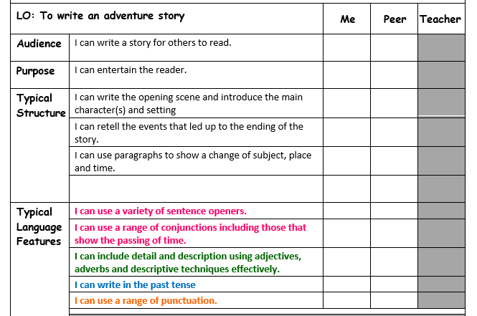
Success Criteria Checklist

Slide 25
Your task is to prepare your story for publishing
Remember to read it all through and make sure that the reader will understand it
Remember to use the checklist to help you to edit and improve your story
Remember to check spellings

