Slide 1
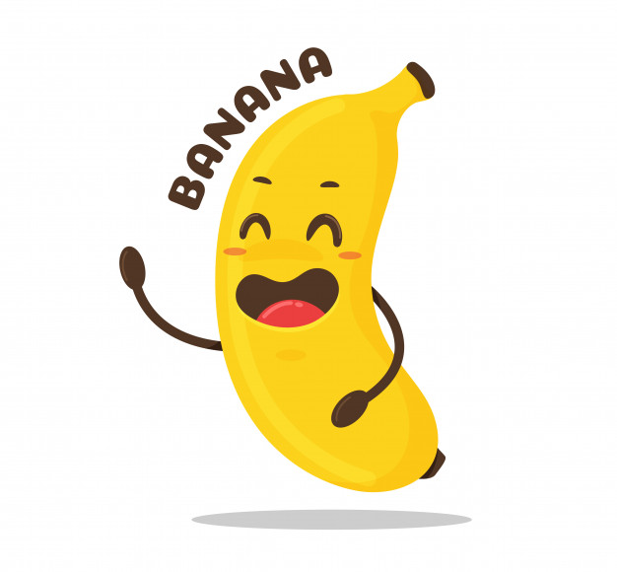
Banana Recount

Slide 2
Thursday 14th January
LI: to know the stages of banana production
I can make appropriate notes
I can add to my notes during discussions
I can explain the stages of banana production

Slide 3
Watch and listen to the videos carefully
Make notes about the stages of banana production
https://www.west-malling.kent.sch.uk/english-1/
In your groups, use your notes to discuss and make a list of the stages in chronological order.

Slide 4
Friday 15th January &
Monday 18th January
LI: to identify emotions
I can identify emotions and behaviour
I can link emotions to each stage of banana production
I can create a bank of words & phrases to describe emotions and behaviour

Slide 5
Stages of Banana Production
Large purple flowers appear.
Fruits begin to grow in hands (very small at first, in long lines).
The whole bunch is covered with plastic to protect it from insects and strong winds.

Slide 6
4. The bananas take about 3 months to grow large enough to be harvested (they like the warm weather and lots of water).
5. They are checked for size (length – about 8 inches / width - using a metal measuring gauge).
6. Foam pads are put in between all the hands to protect them and they are covered in plastic again.
7. The whole bunch is carefully chopped down (harvested) and carried on a foam pad on the shoulder of a worker.

Slide 7
8. The bunch is attached to a zip-line along with many other bunches and taken through the plantation to the processing plant.

Slide 8
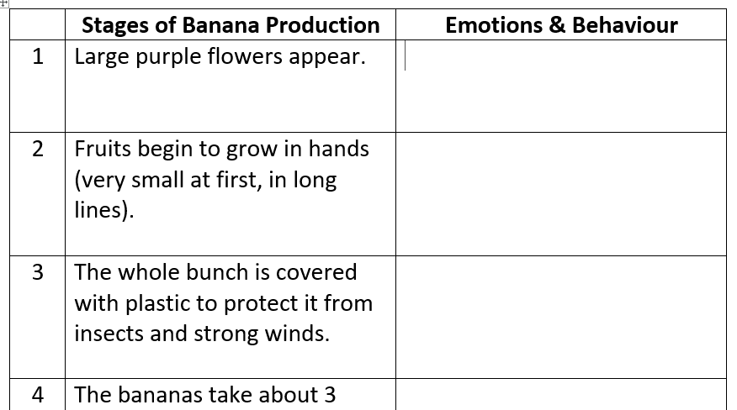
Drawing a table like this one may help to organise your thoughts and plan out your writing.

Slide 9
Tuesday 19th January
LI: to plan my recount
I can plan stages in chronological order from a flashback
I can link emotions & behaviour to each stage
I can plan some elements of humour into my writing

Slide 10
Your task is to organise your writing
Group the stages in your chronological list together – this will be the number of paragraphs you write (approximately)
Make sure that you know how you (as a banana) feel at each stage and why. What do you do or say that shows how you are feeling?
Was there anything humorous that happened on your journey? Did all the fingers in your hand find it funny or was it just you? How did this make the other fingers feel?

Slide 11
Wednesday 20th January
LI: to write an introduction to my recount
I can explain who I am & what I am doing/where I am
I can write in the present tense
I can include my emotions & behaviour

Slide 12
Where am I? (ideas)
On a supermarket shelf
In a fruit bowl in an expensive hotel / kitchen
In a homeless shelter
On a shelf in a smoothie bar
In a fridge
In a bin with other rotting fruit & veg
In a child’s lunch box

Slide 13
Opening sentence (ideas)
I’m awake! It’s cold dark and gloomy …
Well, here I am, in the bin with …
Hi, here I am, in a smelly, disgusting bin with Greg the lemon
Here I sit on a shelf in a homeless centre, next to a can of beans who is laughing with joy …
Sitting in this fruit bowl with a pear and an orange, we are getting bored!
Wow! What a view! But who are all these people walking past me?
Pick me! Pick me!
A hand reaches out, this time they must be coming for me – they must, they must!
Woah I screamed! Shhhh whispered Craig the apple…

Slide 14
Ideas for opening:
Wow! What a view! But who are all these people looking at me? I’m really confused – one minute I am in a warm, cosy box with my good friends and hands who have entertained me on my journey - and the next, I am pulled out and dumped on this cold, hard shelf and I feel like everyone is staring at me!
Your task is to write your opening

Slide 15
Thursday 21st January
LI: to begin retelling my journey
I can start my journey from my banana plant
I can write in the past tense
I can include my emotions & behaviour

Slide 16
Ideas?
As I sat back, memories started to flood in of when I was a small banana …
So here is how my journey started …
This is how my journey began ..
I suddenly had a flash back of how I arrived here …
Hey – let me tell you my story …

Slide 17
Ideas?
It all began …
It all started in sunny Costa Rica
My journey began in …
My existence began in …
I was only a baby banana when it all began …

Slide 18
Your task is to write your second paragraph and begin retelling your journey.

Slide 19
Friday 22nd January
LI: to continue retelling my journey
I can write about what happened to me on my journey
I can include my feelings, reactions & opinions
I can be specific & descriptive (adjectives, adverbs, powerful verbs)
I can use time words & phrases

Slide 20
Monday 25th January
LI: to continue retelling my journey
I can use technical language
I can include my feelings, reactions & opinions
I can be specific & descriptive
I can use time words & phrases

Slide 21
Technical Language
bunch
hand
fingers
imported
exported
boxed up
graded
conveyor belt
washed
vat of water / bath
banana plant
plantation
processing plant
ripening room
ethylene gas
branded
ripened

