Slide 1
Poetry Competition for 7-11 Year-Olds

Slide 2
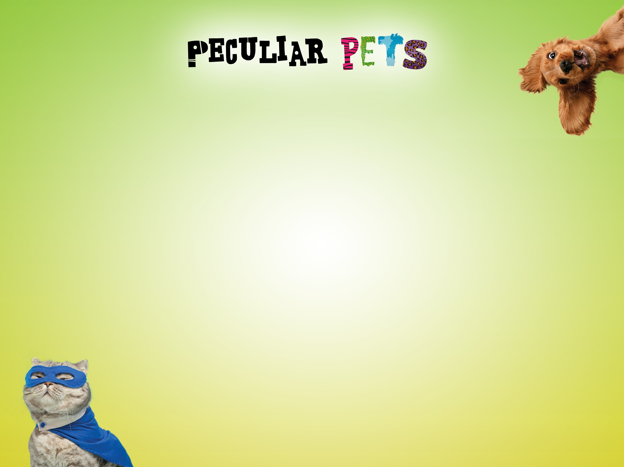
LI: to generate ideas for a peculiar pet
Monday 1st February
I can take part in a group discussion
I can create a character to write my poem about

Slide 3
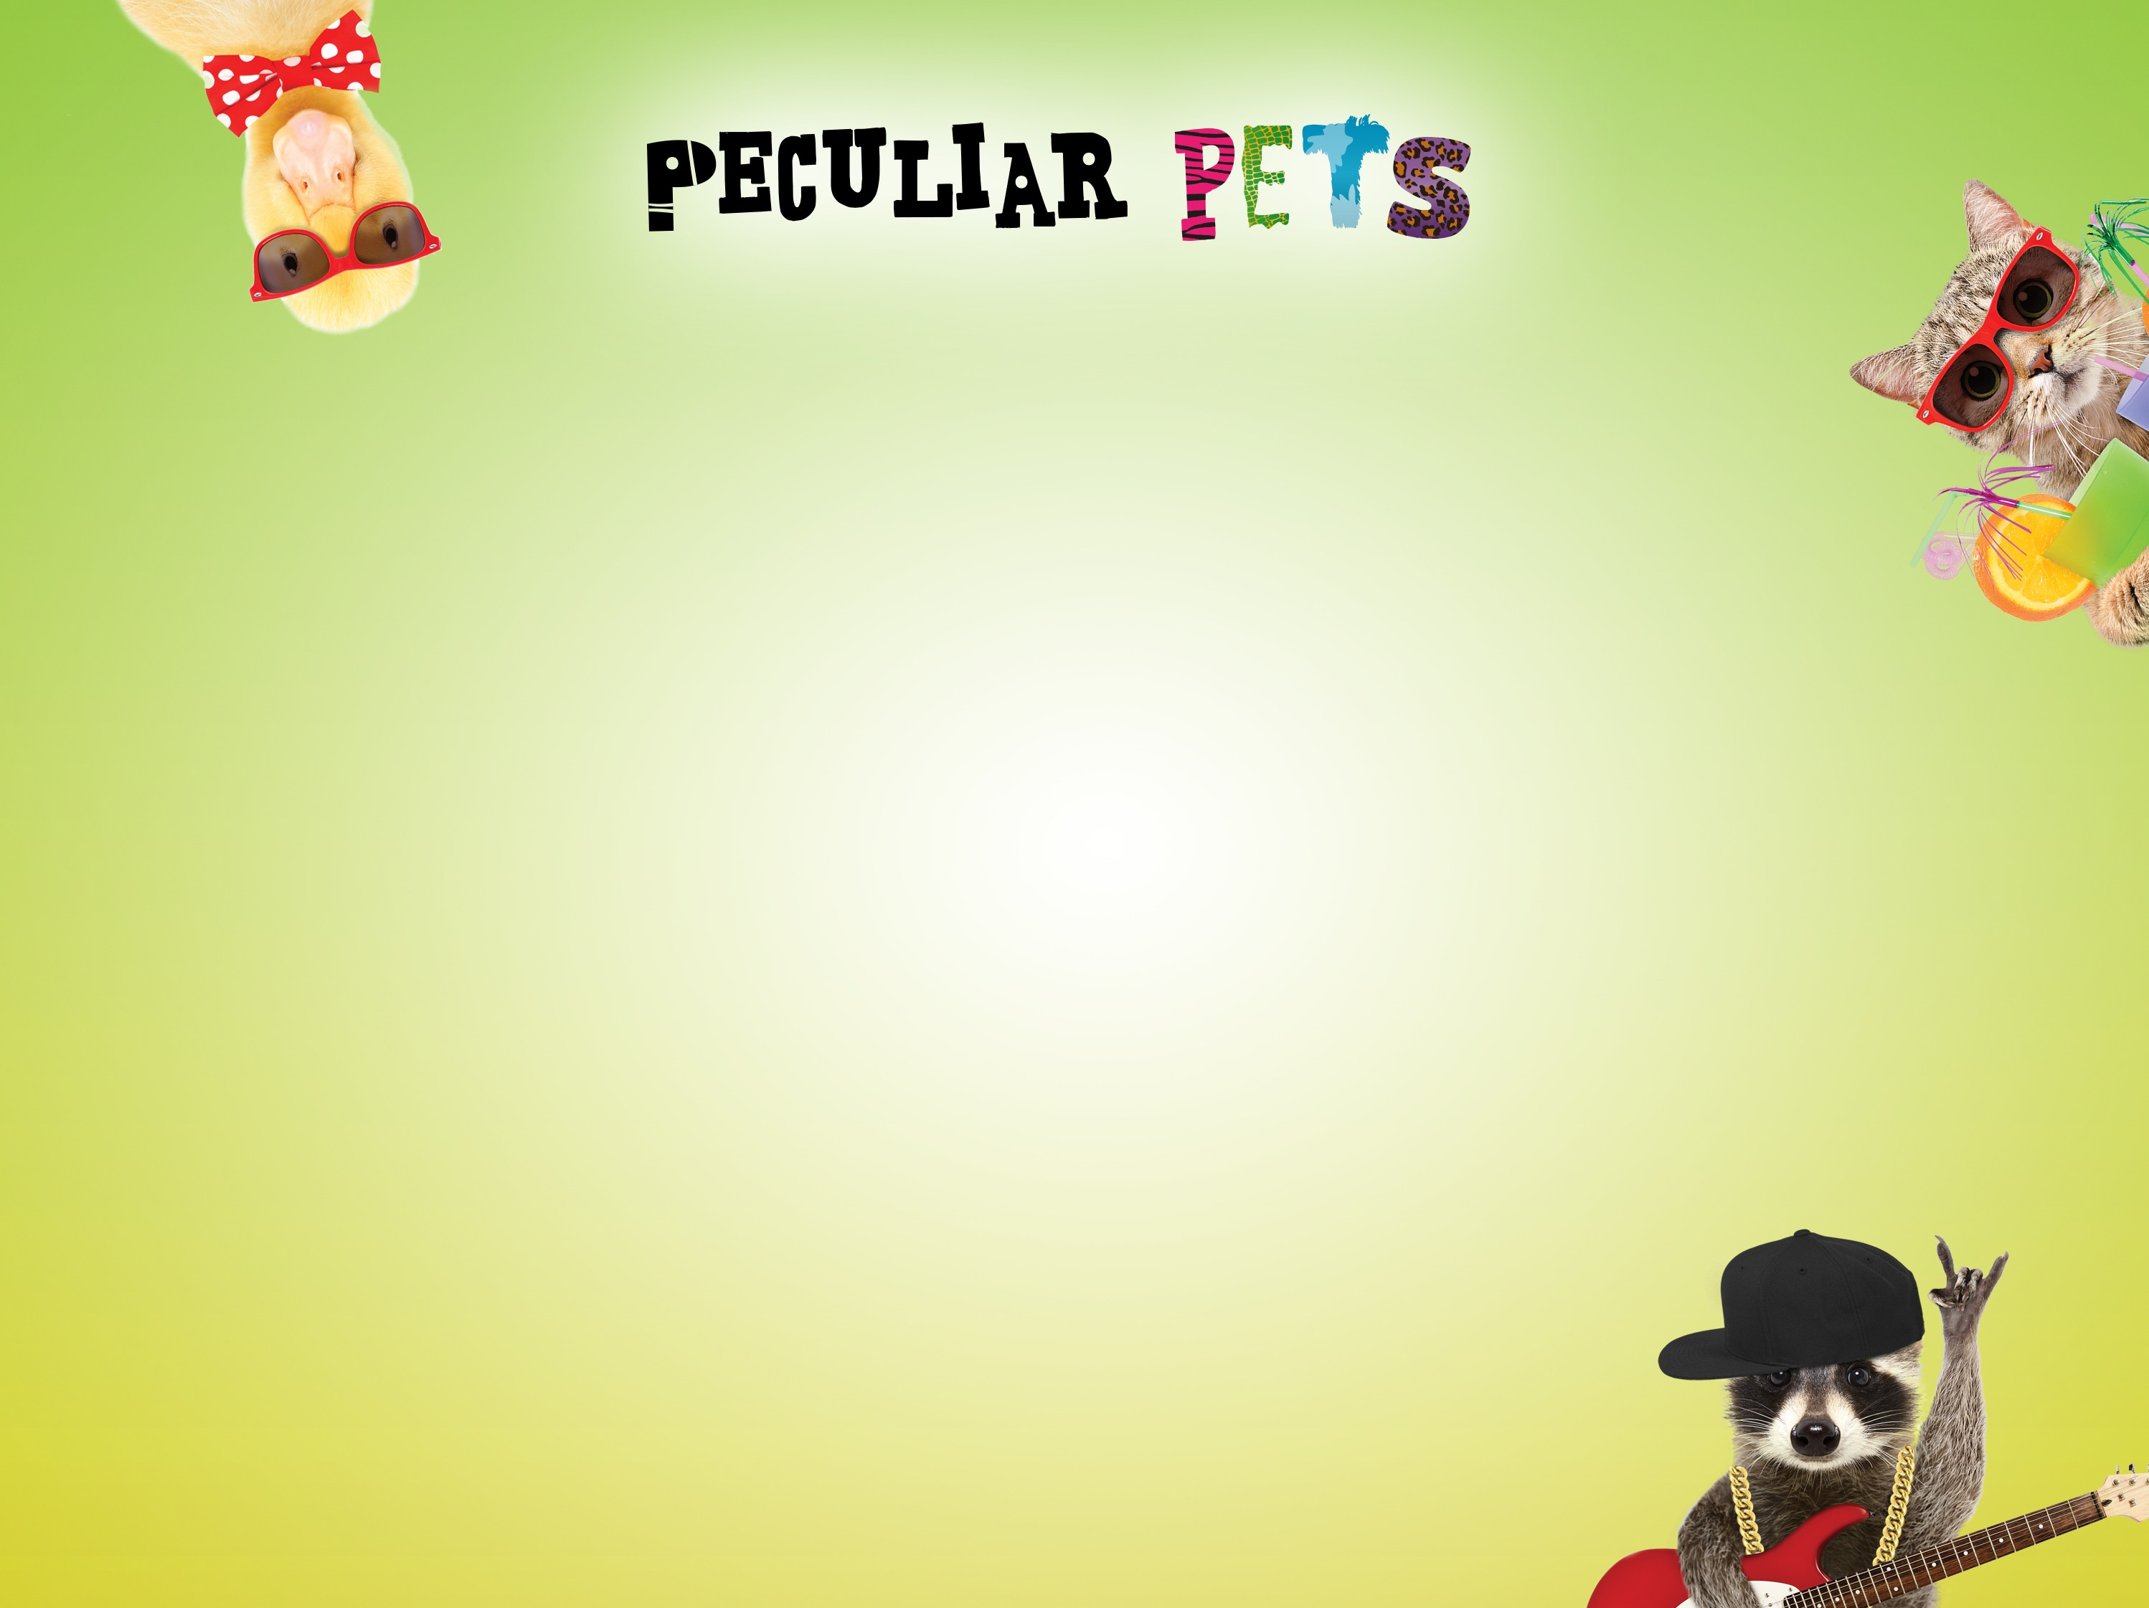
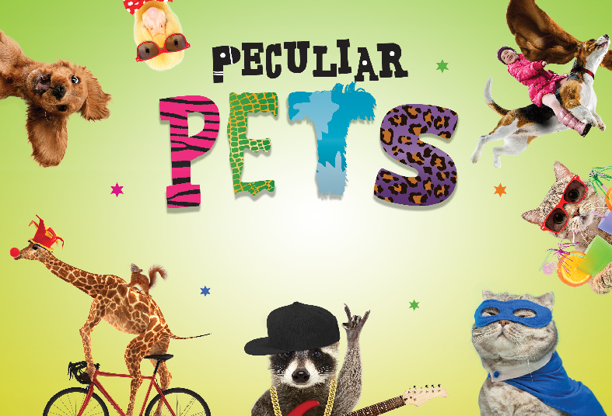
Poetry Competition for 7-11 Year-Olds
Watch the video that introduces you to the activity:
https://westmallingprimary.secure-primarysite.net/english-1/

Slide 4

Your task today is to draw or create a picture of your peculiar pet.
Remember
You can use your own ideas or ideas from your discussions.
You can draw your picture or use a computer to help you.
Your pet has to be unique.

Slide 5
LI: to explore poetry techniques and types
Tuesday 2nd February
I can name some different types of poems
I can explain some poetry techniques

Slide 6
Types of poems
Acrostic
Narrative
Rhyme
Free verse
Nonsense
Limerick
Rhyming couplets
Sonnet
Haiku
Tankas
Kennings
Riddles
Shape
Tongue twister
Alphabet poem
Rap
Epic
Concrete
Lyrics
Choral poem
Performance

Slide 7
Poetry types are styles that you can write in...
There are lots of poetic forms to choose from.
Rhymes
Do you know what a rhyme and a half rhyme are?
In case you didn’t know, a half rhyme is a similar but not identical sound.
E.g. ‘Egyptian’ and ‘description’ rhyme but
‘Egyptian’ and ‘kitchen’ are a half rhyme.

Slide 8
Can you guess if these are half rhymes or rhymes?
I’m a giant purple puppy with a soft furry tummy.
Bob the giraffe is floating in space, it’s such an amazing place!
I’m a ferocious dragon Viking and my life is very exciting!
I’m a snake-scorpion baby, I like to eat bugs daily.
Hello, I’m Doctor Lion, In the air ambulance I am flying!

Slide 9
Narrative Poetry
A narrative poem is a type of poem that tells a story. They don't have to rhyme and are almost story-like except they usually use poetic techniques, description and verses or shorter sentences.

Slide 10
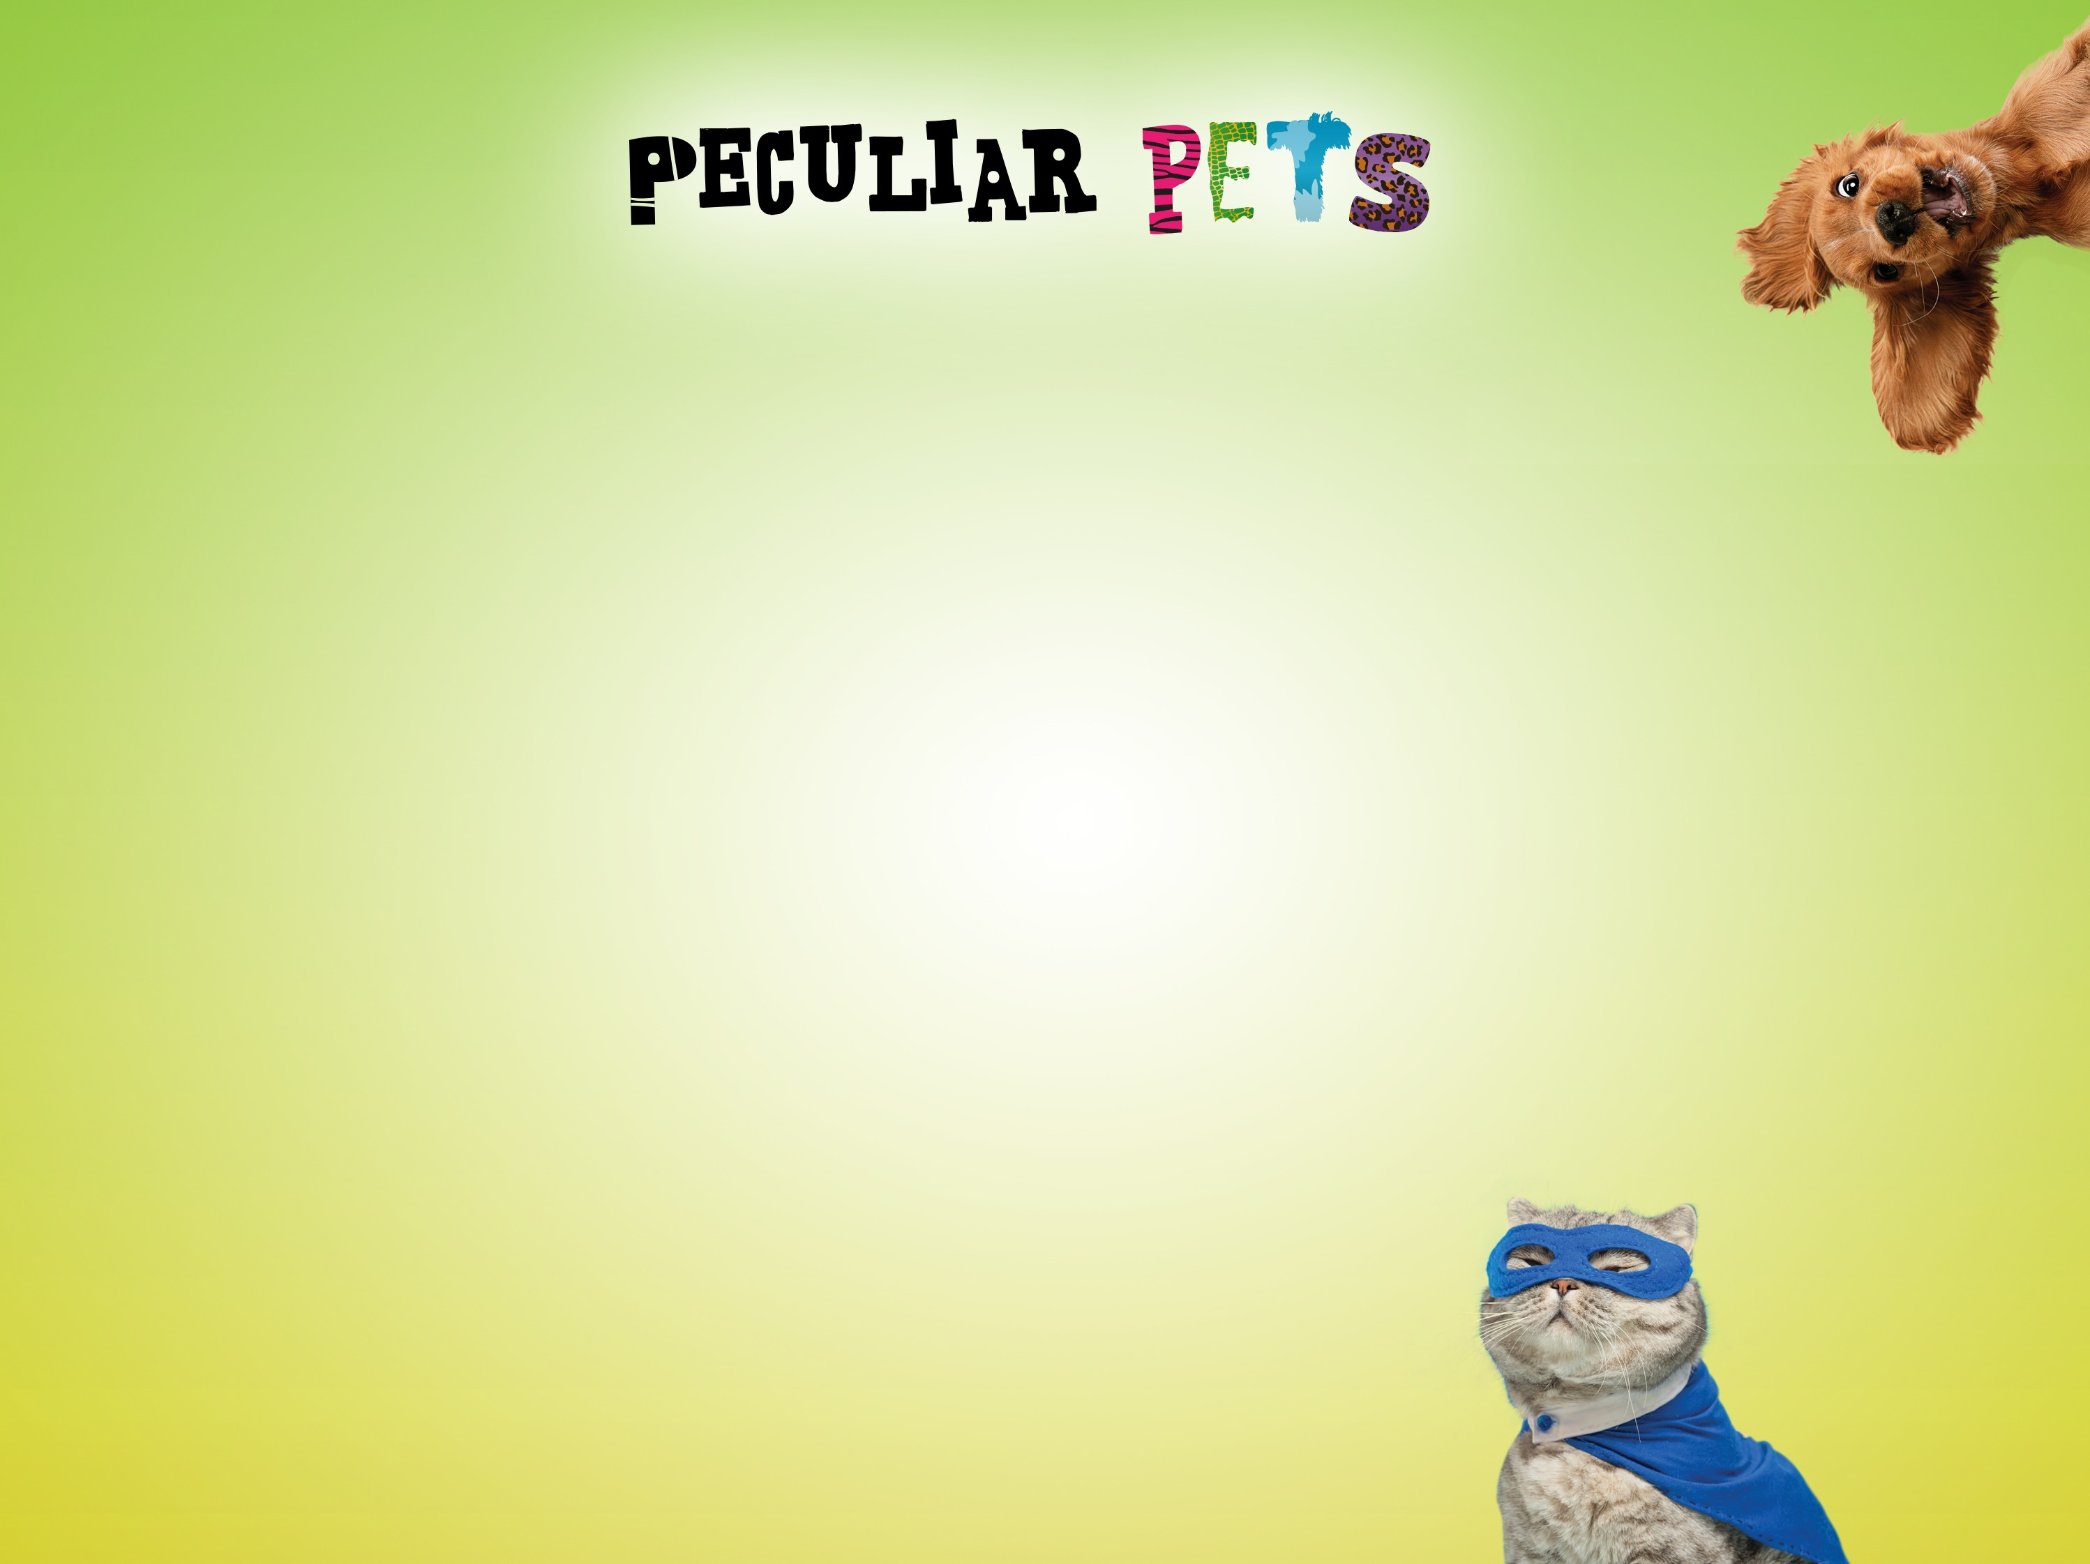
I took my Hydro Hippo out for a walk,
It boosted up its hydro engine and Vroom! Whoosh!
We were off!
Zooming by trees and houses,
Bumping over paths,
Splash!
We were in the river!
My Hydro Hippo chilled out,
We bobbed along for a bit
Then...
Vroom! Whoosh!
My clothes were dry
by the time we got home!
Example of a narrative poem...

Slide 11
Acrostics
By writing the name of your peculiar pet as the acrostic word, you can then have fun telling the reader about it...
D inocorn is a very special pet
I t lives in the shed
N ight-time is when it comes out to play
O h it shines and shimmers in the moonlight
C ome and see it!
O range eyes and blue claws
R oar! It calls to me when it’s time to play
N o one else has a Dinocorn, it’s my very special pet.

Slide 12
Poetic Techniques
Poetic techniques are writing tools that make your poem more interesting to read.
Simile
Personification
Metaphor
Onomatopoeia
Repetition
Alliteration
Rhyme
Verse / stanza
Imagery
Powerful adjectives
Powerful adverbs

Slide 13

Poetic techniques are writing tools that make your poem more interesting to read.
Imagery - using description, particularly senses, to paint a picture in the reader’s mind.
The were-rabbit was fluffy but huge with fangs as long as your arm!
Simile - describing something like or as something else. Roger the T-rex was friendly like a puppy, as loud as thunder and as terrifying as a thousand spiders!
Onomatopoeia - a word that names a sound, but also sounds like that sound!
Stomp! Stomp! Zanloo the badger-horse was on her way to cause trouble again!

Slide 14
Barney is an octopus that works in a shop, are these sentences using imagery, a simile, or onomatopoeia?
Barney is as slippery as an eel.
Gloop! Gloop! Goes Barney as he slides through the store.
Barney smiled as he scanned the items through the till. He loved wearing his purple uniform and baseball cap... and he loved scanning shopping as fast as possible with his 8 strong tentacles!

Slide 15
Now you are ready to get writing!
If you have any questions,
now is the time to ask.
It’s time to write your
peculiar pet poem!

