Slide 1
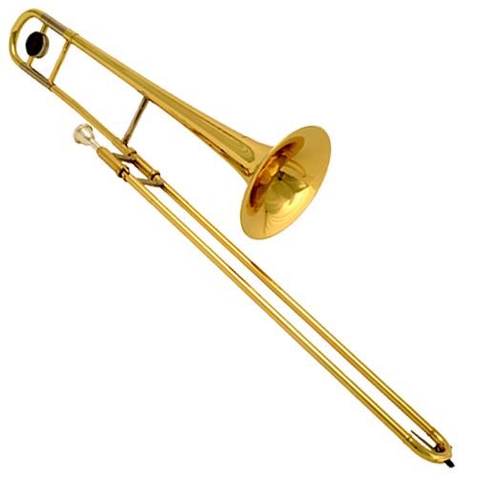
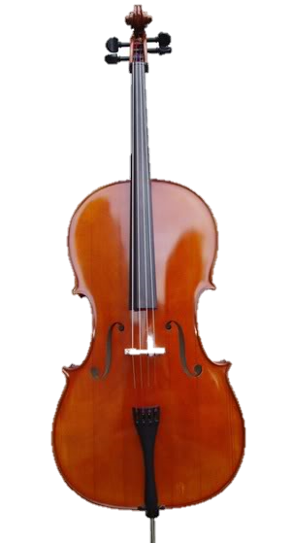
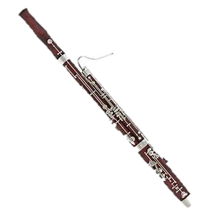
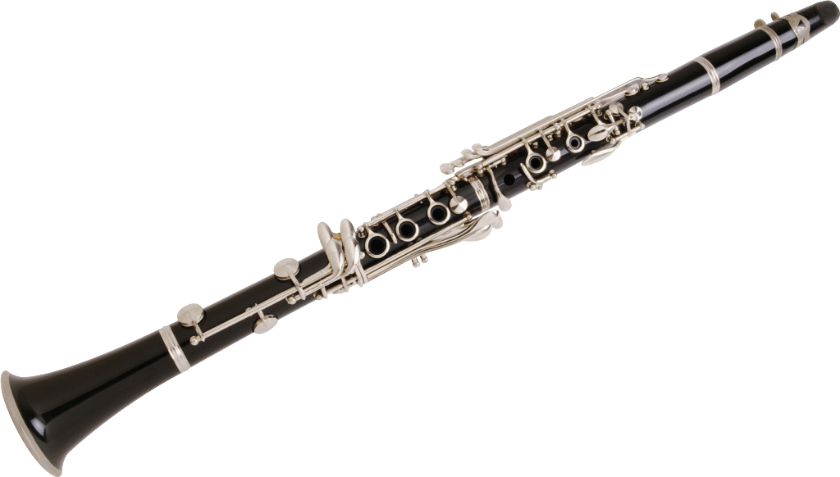
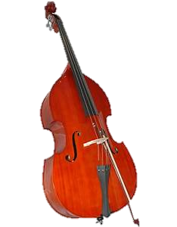
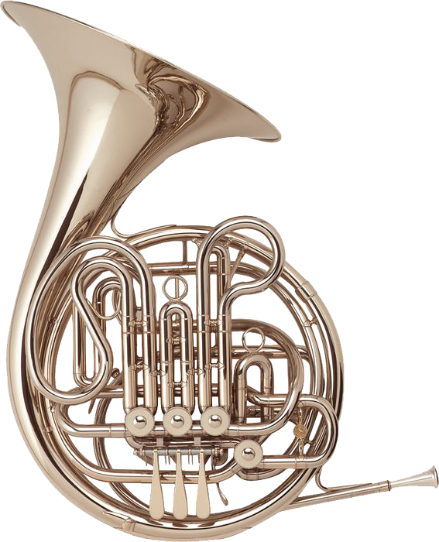
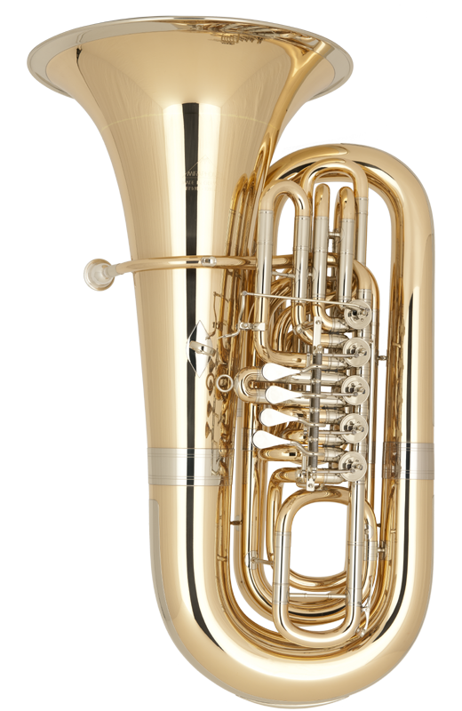
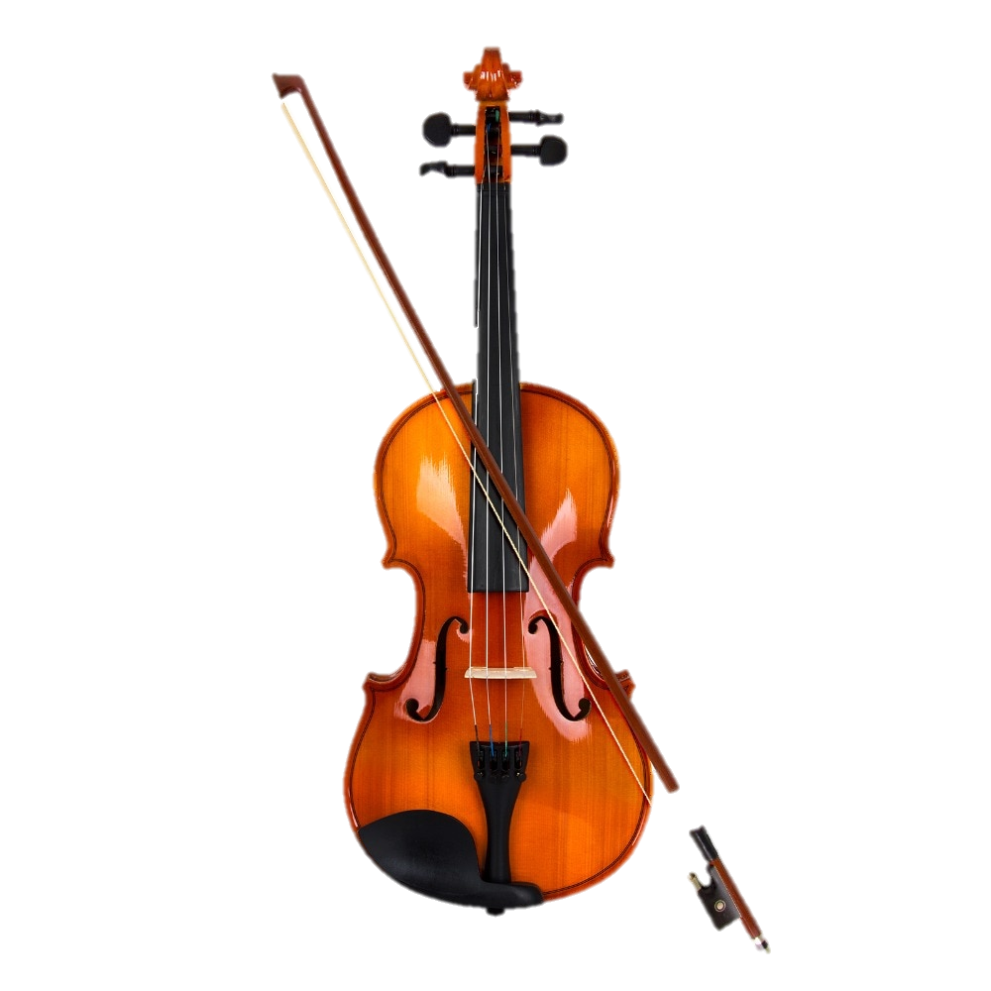
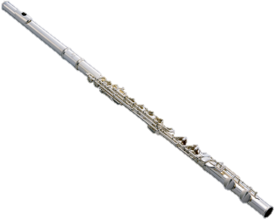
Instruments of the Orchestra
Click on the following instruments to hear all about the
instruments of an orchestra!

Slide 2
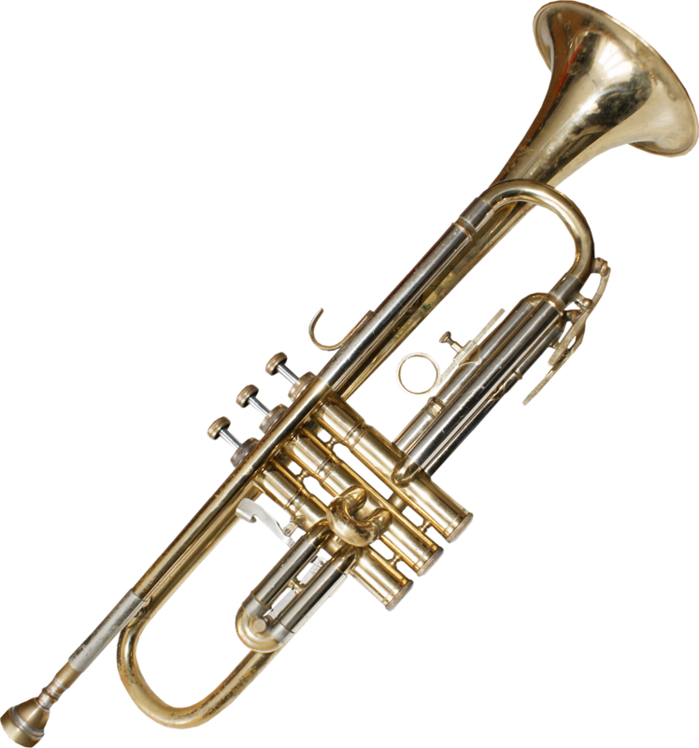
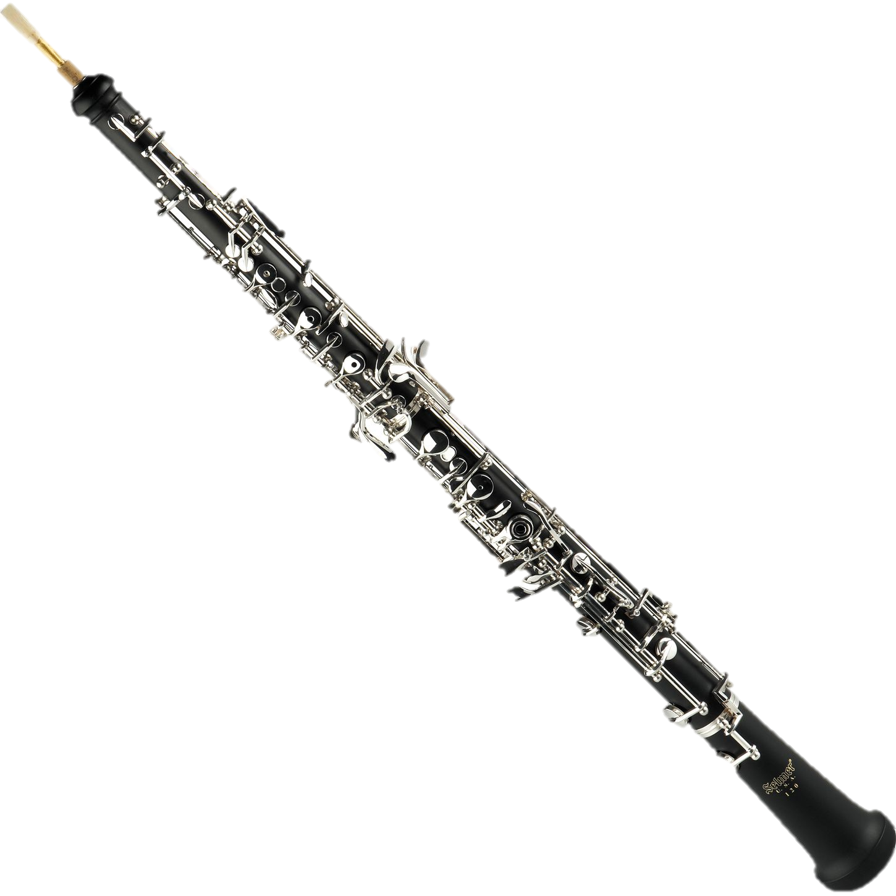
Instruments of the Orchestra
Cut out and stick or drag the instruments to their correct families. Can you label the names of any of the instruments? Are there any other instruments that you can add to the boxes?
Woodwind
Brass
String

Slide 3
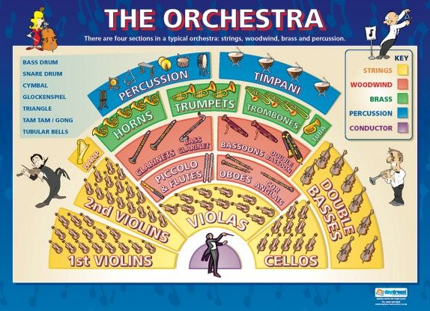

Instruments of the Orchestra
Choose a stringed instrument to describe and use the following questions to help support your description: How is the instrument played? What does it sound like? What material is it made from? _____________________________________________
______________________________________________________________________
____________________________________________________________________________________________________________________________________________________________________________________________________________________________________________________________________________________________________________________________________________________________________________________________________________________________________
Click here!
Choose a brass instrument to describe and use the following questions to help support your description: How is the instrument played? What does it sound like? What material is it made from? ________________________________________________________________
__________________________________________________________________________
________________________________________________________________________________________________________________________________________________________________________________________________________________________________________________________________________________________________________
__________________________________________________________________________

