Slide 1
Please watch - Taking Flight https://www.literacyshed.com/takingflight.html

Slide 2

Today you are going to write the ending to your adventure story.
Success Criteria
You will need to include an ending to close your story.
You will need to add short, snappy sentences.
You will need to add dialogue (speech). Remember to use inverted commas (speech marks).

Slide 3
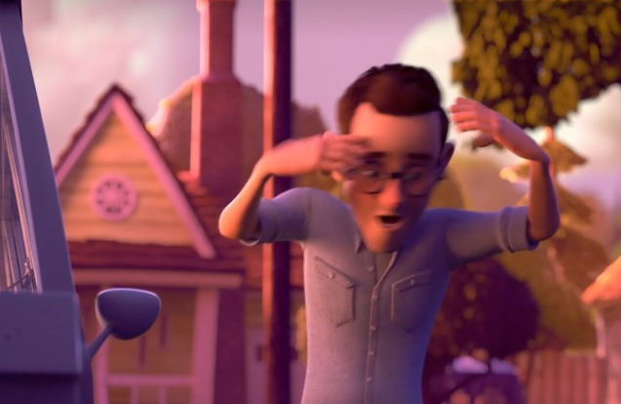
Ending
New paragraph
How can you start this paragraph? Maybe with speech? “What has happened here?” shouted Dad in frustration.

Slide 4
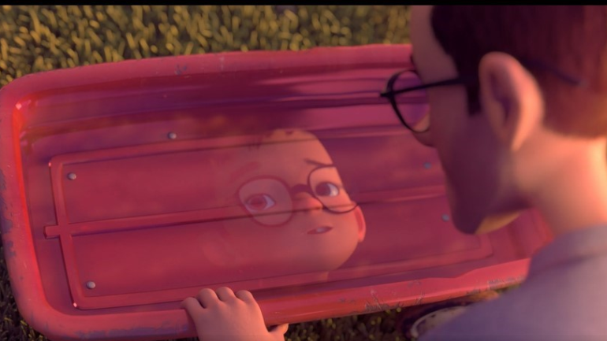
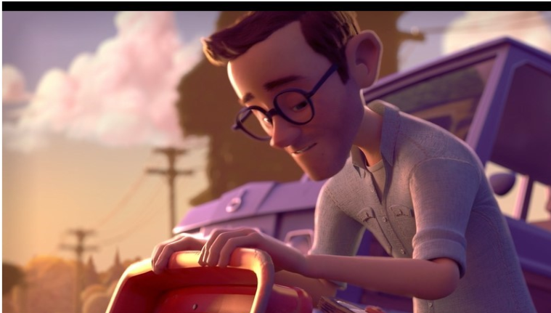
Write the key words. What does dad notice? What might he say? What does he see in the reflection? What does this remind Dad of?

Slide 5
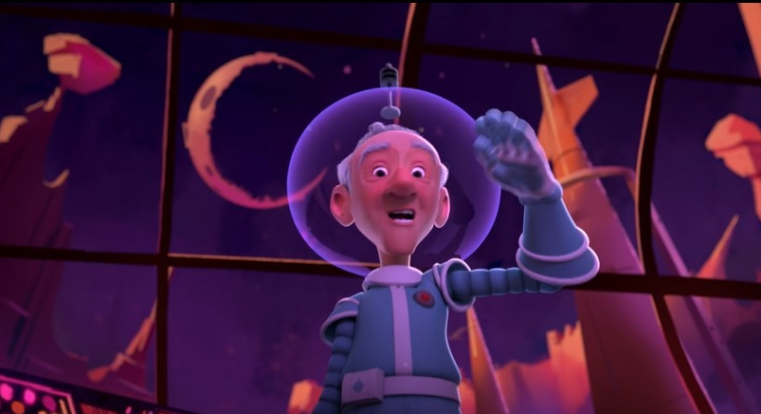
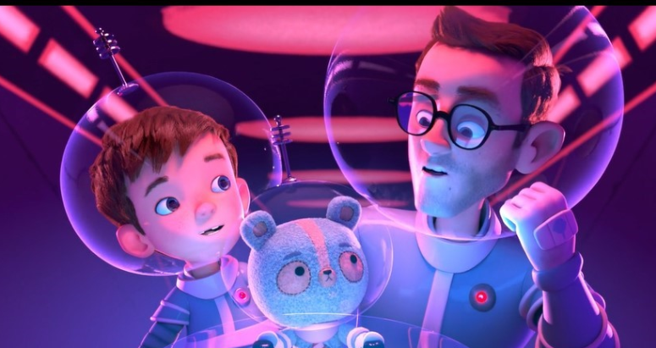
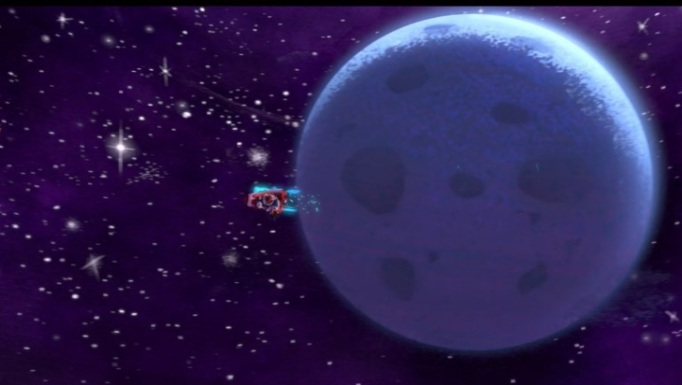
Write the key words. Where do they go? How do they all feel?

