Slide 1
Please watch - Taking Flight https://www.literacyshed.com/takingflight.html

Slide 2
Today you are going to write the middle of your adventure story.
Success Criteria
You will need to include a resolution where the characters solve the dilemma.
You will need to include dialogue (speech)
You will need to include short, snappy sentences for effect.

Slide 3
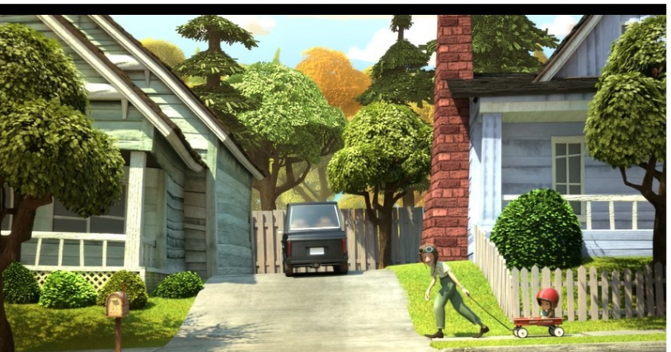
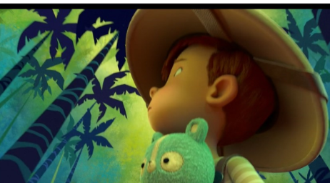
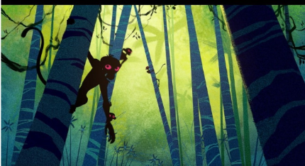
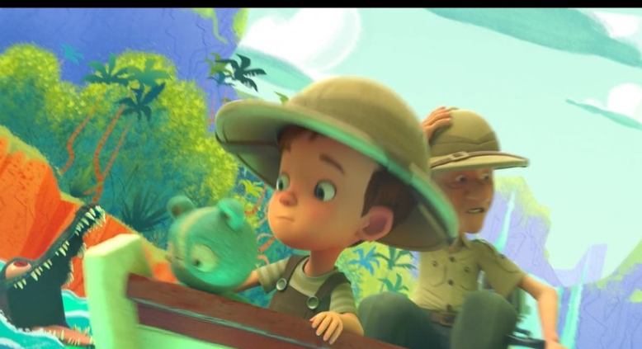

New paragraph
What could your sentence opener be? Try not to start with then, the, Tony or Grandad.
Escaped Monkeys. Write some key words. What do you see, hear, smell and feel?
Can you add the words buoyancy and float?
Notes:
You will need to include a resolution where the characters solve the dilemma. In this story, the dilemma is solved when Grandad takes Tony for a ride in the trailer and their adventures begin. They see escaped Monkeys. How would you describe what they see, hear, feel and smell? The canopy of leaves blocked the light. Leaves rustled as curious monkeys, swung from tree to tree to investigate their visitors. They could hear the monkey’s calling to one another which made Tony feel frightened.
You will need to include short, snappy sentences for effect. For example: Suddenly a waterfall was in front of them. Without warning, the force of the current moved the boat quickly. There was no time to turn. The boat tipped over the edge and…

Slide 4
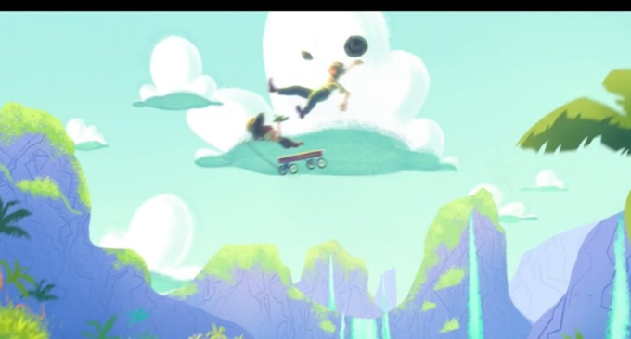
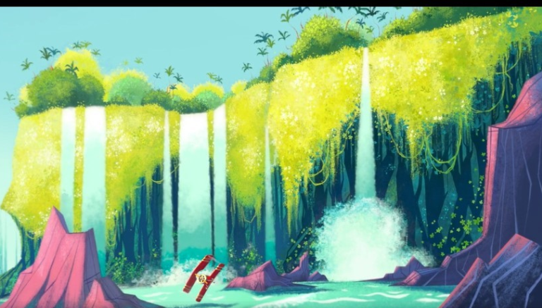
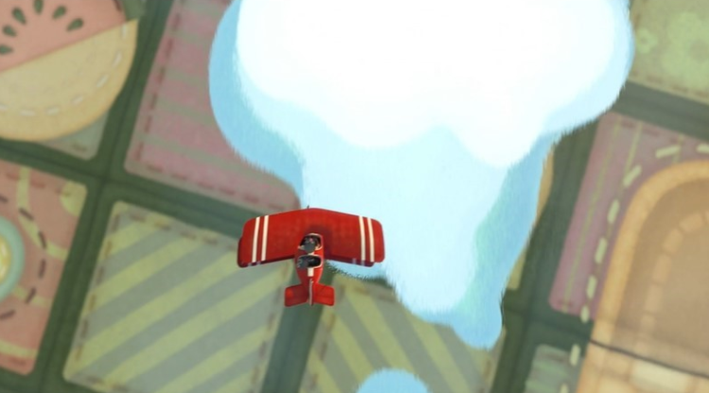
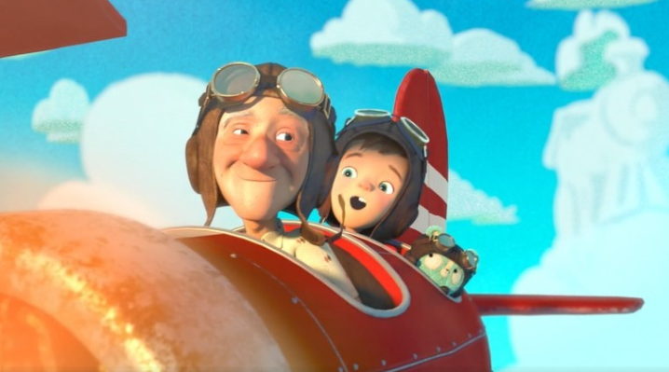
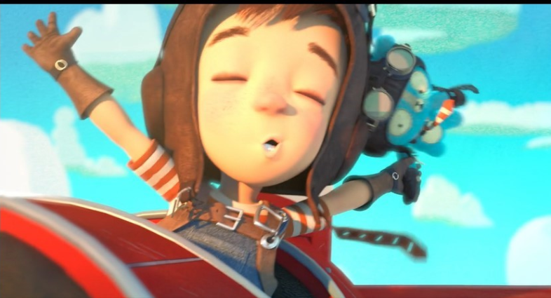
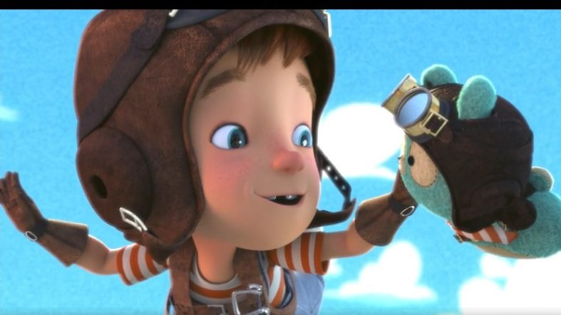
New paragraph. Think of a sentence starter that starts with an adverb. For example: Quickly
Dialogue (speech) What do Tony and grandad say to each other?
What can they see, hear, smell and feel?
Notes:
Next they are flying? Again how would you describe what they see, hear, smell and feel? Remember to add dialogue and short sentences.

Slide 5
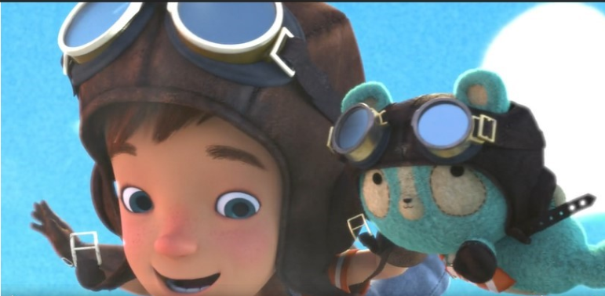
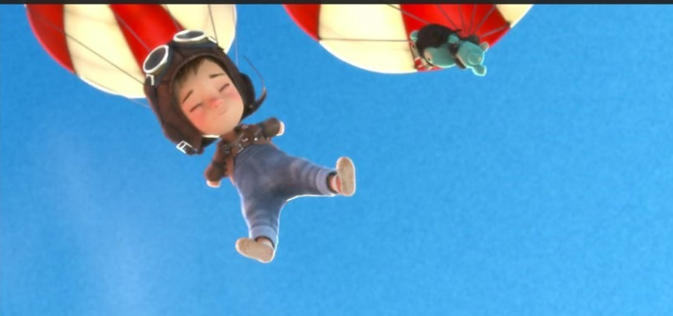
Can you add Scientific vocabulary in this part of the story?
Gravity, falling and air resistance?
What is Tony feeling?

Slide 6
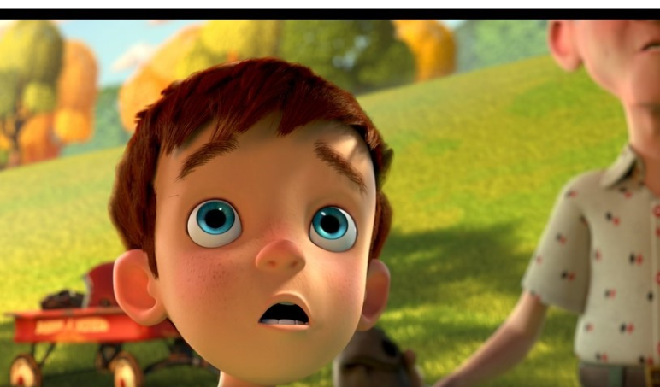
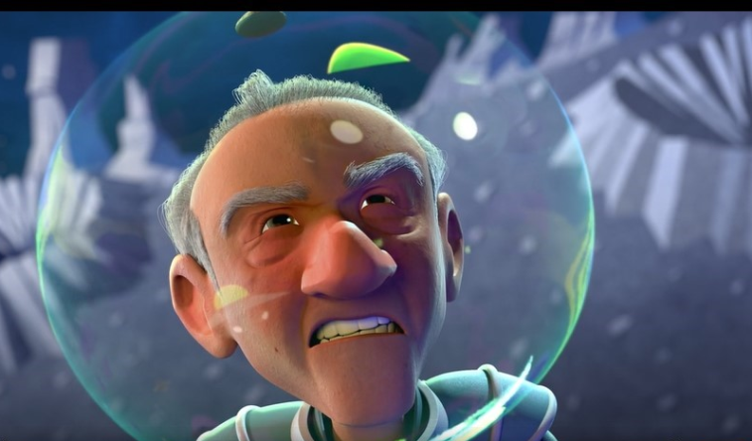
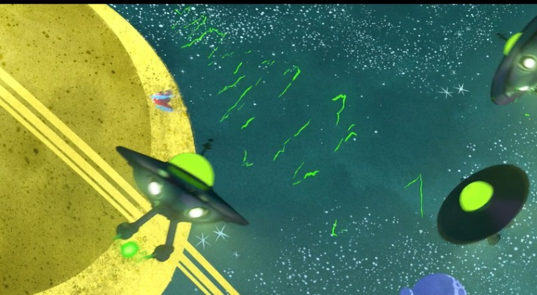
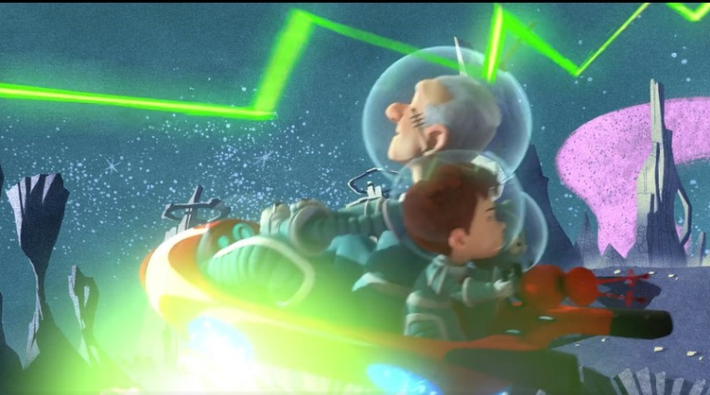
New paragraph.
Think about your sentence opener: After a tiring morning, Grandad and Tony enjoyed a rest in the park when…
Write key words to describe how they are feeling, what they see, hear and smell.
Dialogue (speech) What do they say to each other?
Notes:
Finally, they have an adventure in space. Again, how would you describe what they see, hear, feel and smell? Remember to add dialogue and short sentences.

