Slide 1
Please watch - Taking Flight https://www.literacyshed.com/takingflight.html

Slide 2

Today you are going to write the beginning of your adventure story.

Slide 3
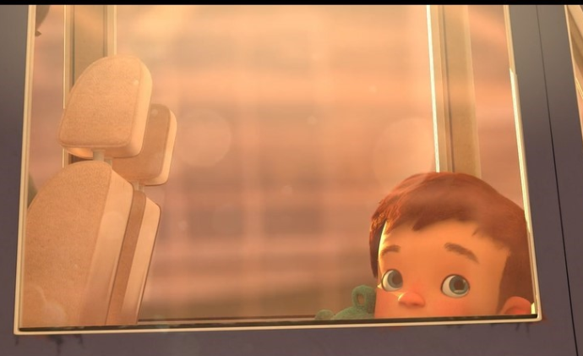
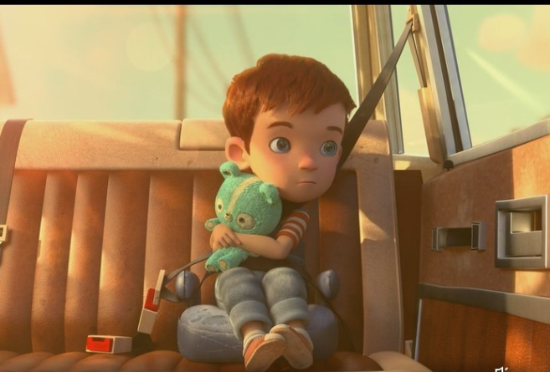
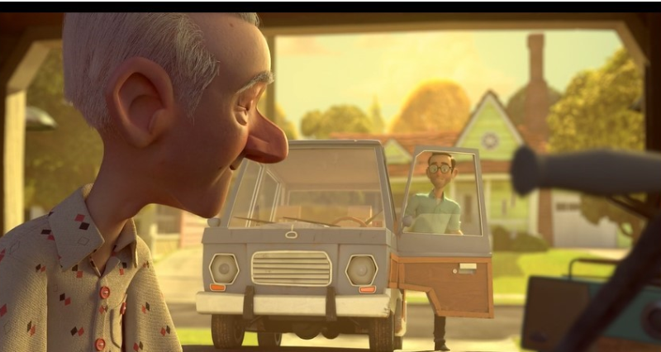
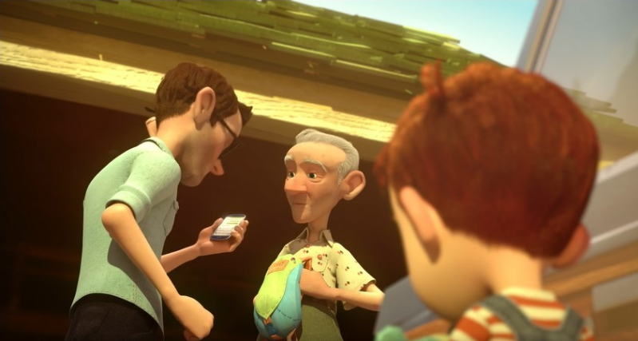
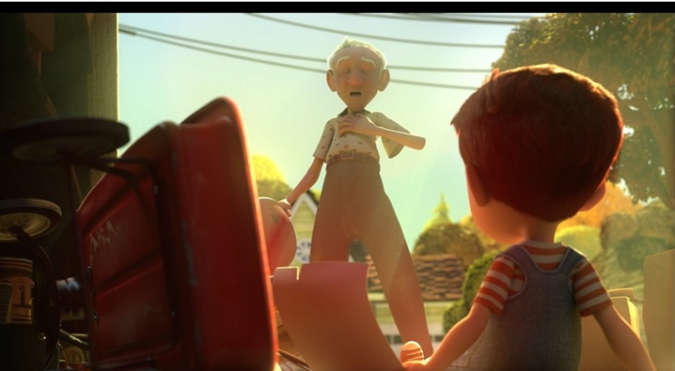
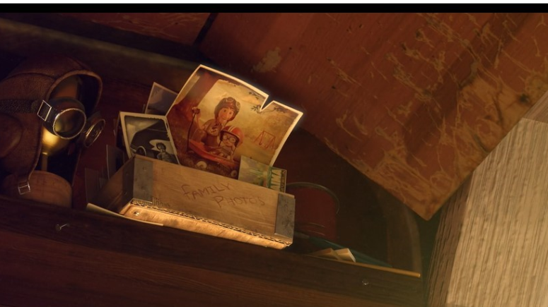
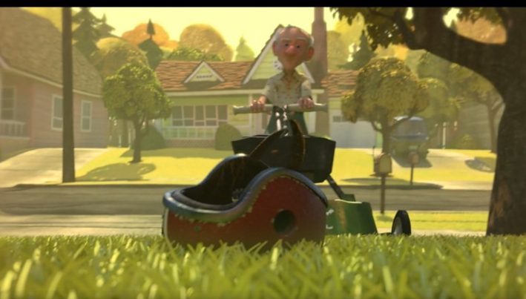
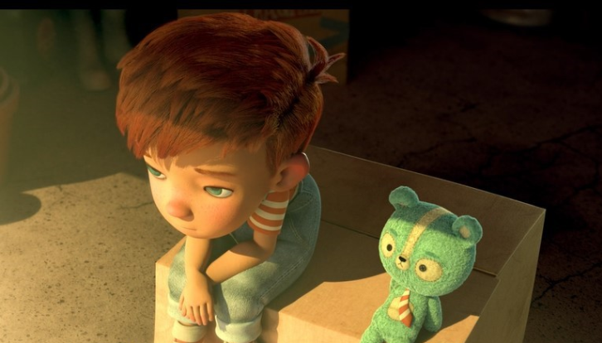
Introduce Dad and Grandad
Dad is always busy, working. He is feeling anxious, he is in a rush.
Grandad is calm, relaxed. Happy to have Grandson over.
Could add dialogue here? (speech) What is Dad saying to Grandad?
Possible sentence starter: It was just an ordinary day.
Introduce Tony – Tony a young boy was on his way to his Grandad’s again.
Tony was feeling disappointed but had Ted for company.
Grandad worried.
What does Grandad say to Tony?
What might Tony ask Grandad?
Out of the corner of his eye, he sees an old photograph.
Grandad busy cutting the lawn.
Tony is feeling bored.
Notes:
The beginning of the story
Tony starts the day, with dad taking him to Grandad’s, where he thinks he is going to have a boring day (which is the dilemma/problem)
How would you describe the setting?
Who are the characters? Tony, Grandad and Dad
Think of words (adjectives) to describe how Tony is feeling? Disappointed, fed up, sad, bored.
How do you think Dad and Grandad are feeling? Dad in this story is feeling both rushed, anxious, worried, sad. Grandad is feeling happy.
How are you going to build up to the middle of the story? In this story Tony spots an old photograph of his Dad when he was younger having fun with his Grandad.
You could add dialogue here? “Grandad” asked Tony, “Is this you and Dad?”

