Slide 1
Monday 11th January

Slide 2

This week you are going to write an adventure story.

Slide 3
Please watch - Taking Flight https://www.literacyshed.com/takingflight.html

Slide 4
Today, you are going to create a story board for either the story Taking Flight or your own adventure story that follows a similar structure to Taking Flight.

Slide 5
Success Criteria
You will need to include a title.
You will need to describe the setting.
You will need to introduce a character/characters.
You will need to include a build-up.
You will need to include a dilemma, where something goes wrong.

Slide 6
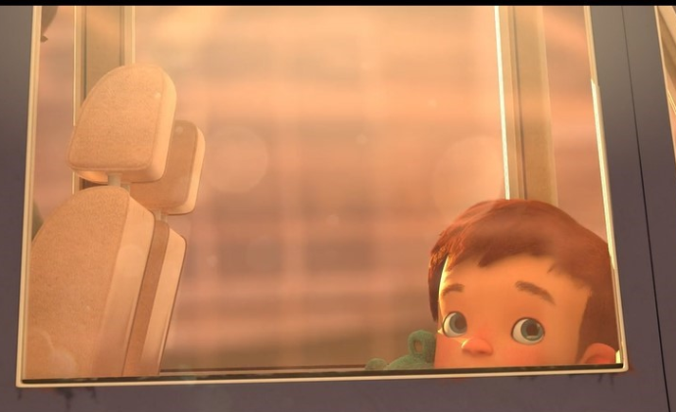
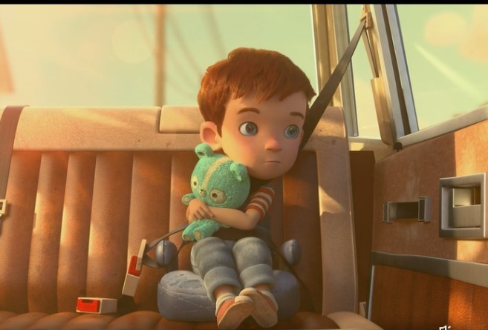
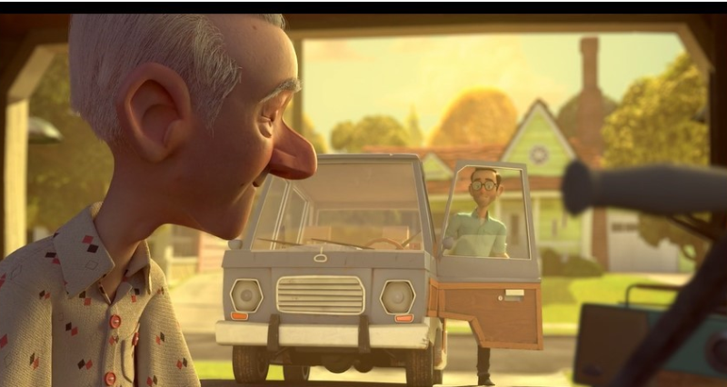
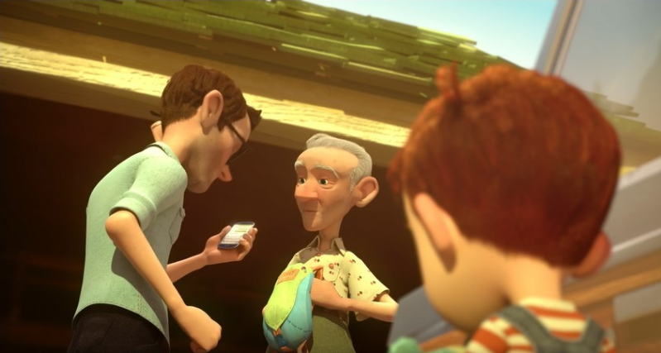
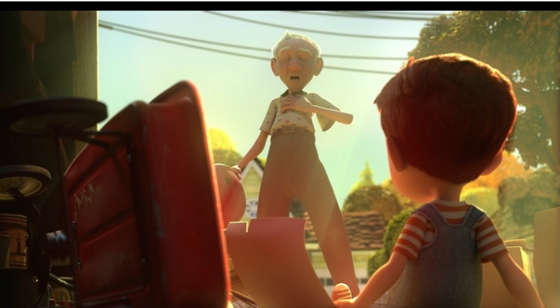
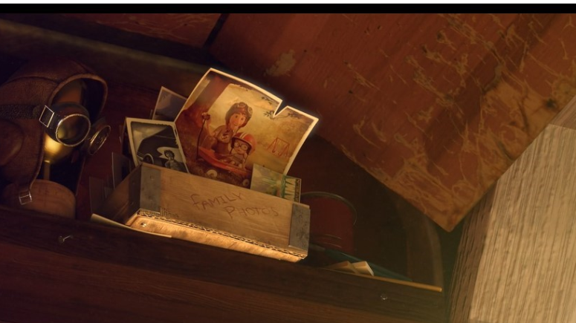
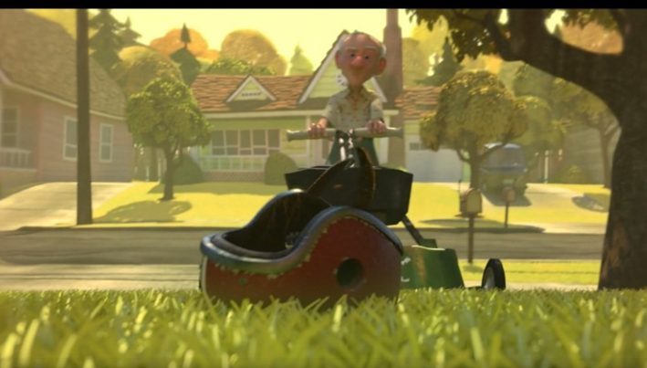
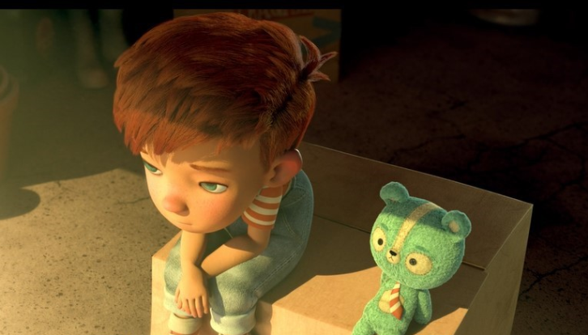
Introduce Dad and Grandad
Dad is always busy, working. He is feeling anxious, he is in a rush.
Grandad is calm, relaxed. Happy to have Grandson over.
Could add dialogue here? (speech) What is Dad saying to Grandad?
Possible sentence starter: It was just an ordinary day.
Introduce Tony – Tony a young boy was on his way to his Grandad’s again.
Tony was feeling disappointed but had Ted for company.
Grandad worried.
What does Grandad say to Tony?
What might Tony ask Grandad?
Out of the corner of his eye, he sees an old photograph.
Grandad busy cutting the lawn.
Tony is feeling bored.

Slide 7
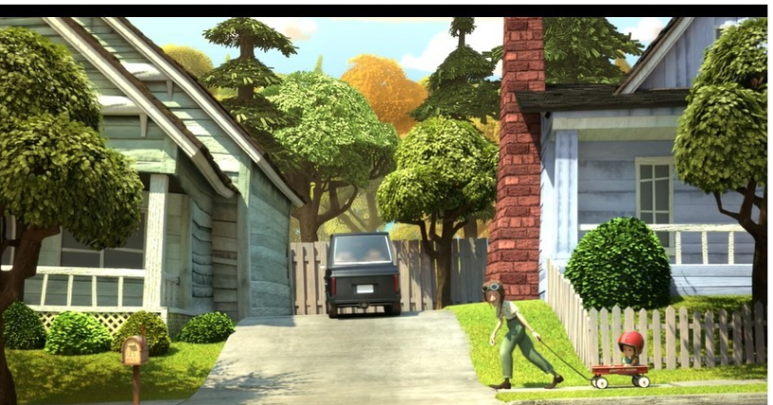
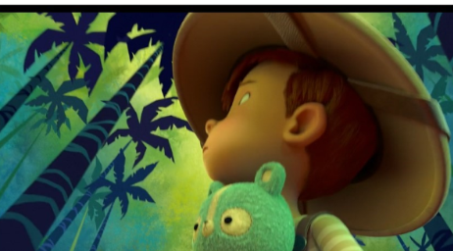
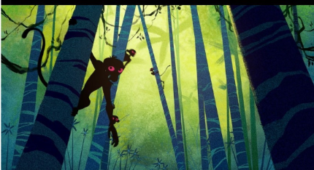
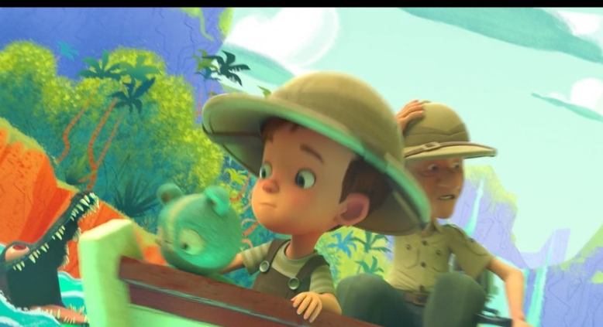
New paragraph
What could your sentence opener be? Try not to start with then, the, Tony or Grandad.
Escaped Monkeys. Write some key words. What do you see, hear, smell and feel?
Can you add the words buoyancy and float?

Slide 8
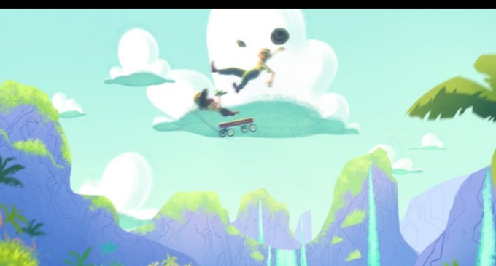

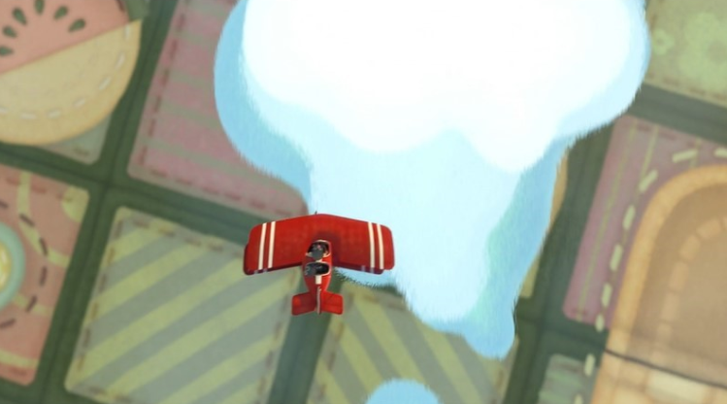
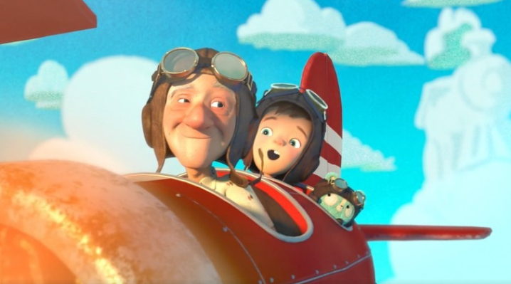
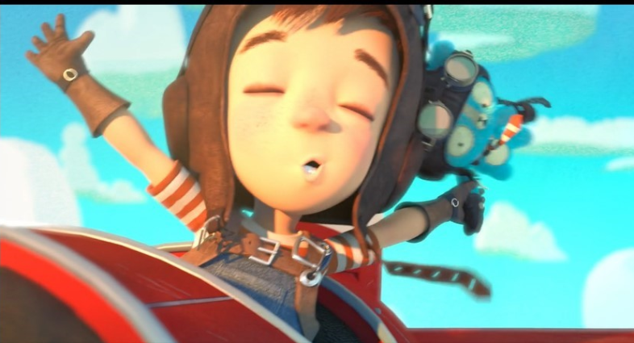
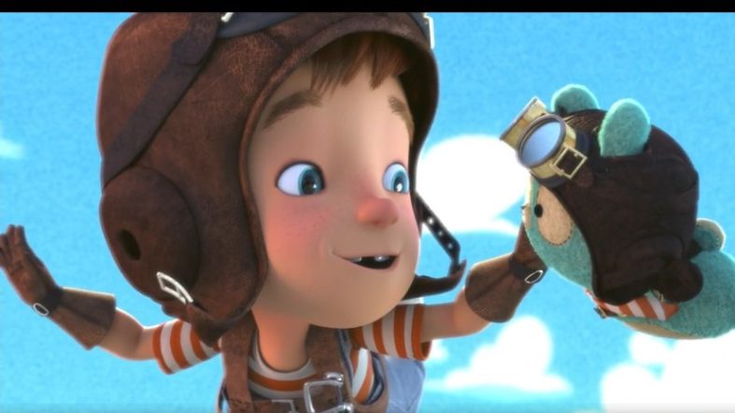
New paragraph. Think of a sentence starter that starts with an adverb. For example: Quickly
Dialogue (speech) What do Tony and grandad say to each other?
What can they see, hear, smell and feel?

Slide 9
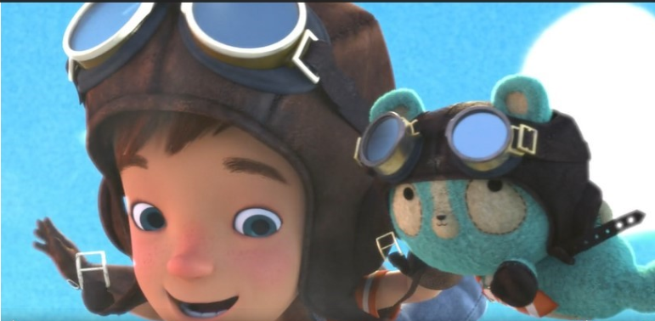
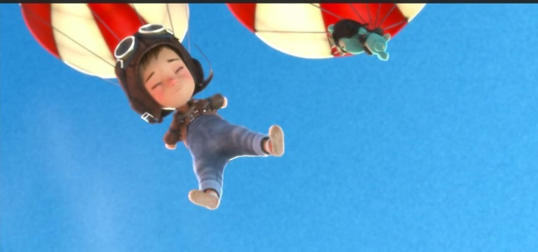
Can you add Scientific vocabulary in this part of the story?
Gravity, falling and air resistance?
What is Tony feeling?

Slide 10
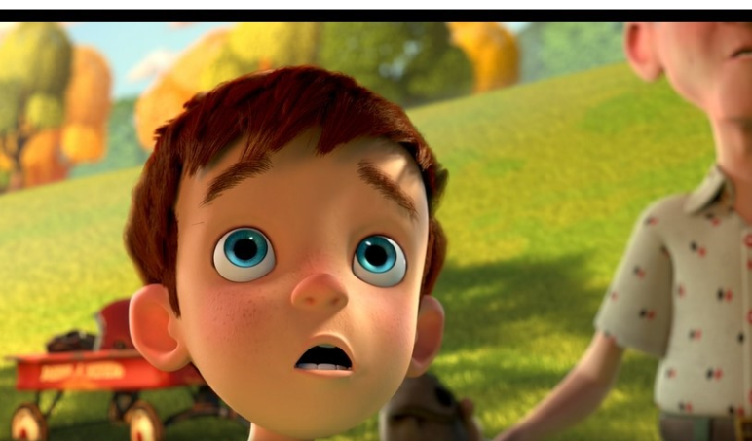
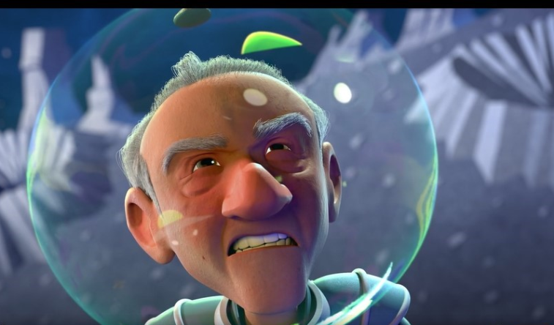
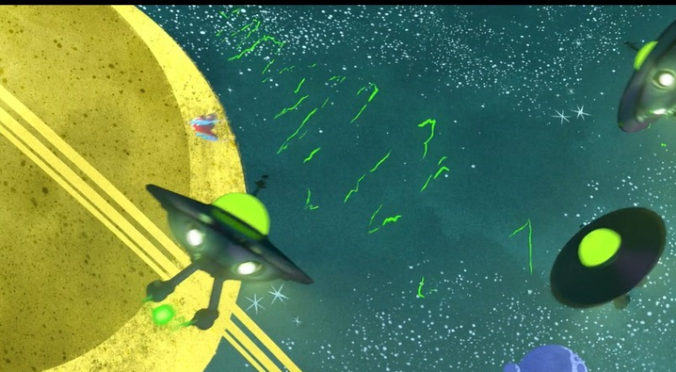
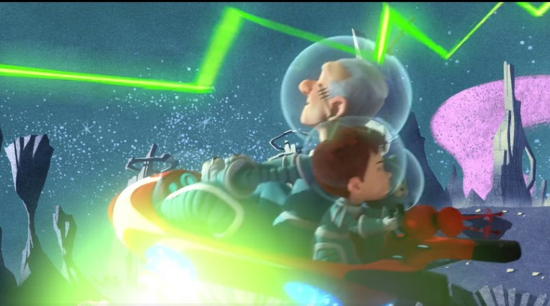
New paragraph.
Think about your sentence opener: After a tiring morning, Grandad and Tony enjoyed a rest in the park when…
Write key words to describe how they are feeling, what they see, hear and smell.
Dialogue (speech) What do they say to each other?

Slide 11
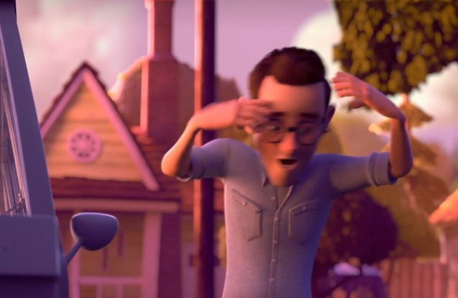
Ending
New paragraph
How can you start this paragraph? Maybe with speech? “What has happened here?” shouted Dad in frustration.

Slide 12
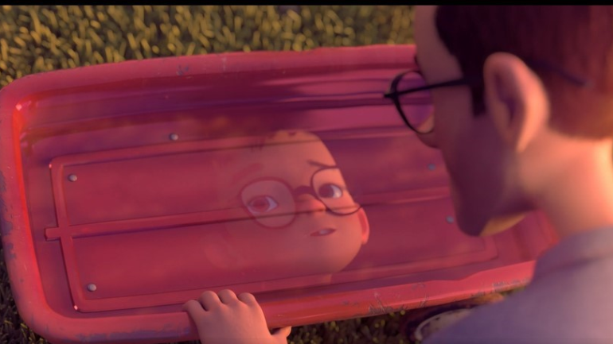
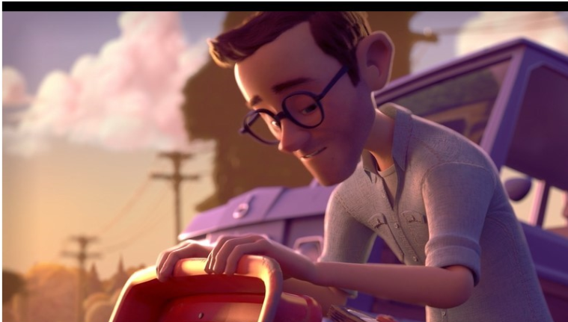
Write the key words. What does dad notice? What might he say? What does he see in the reflection? What does this remind Dad of?

Slide 13
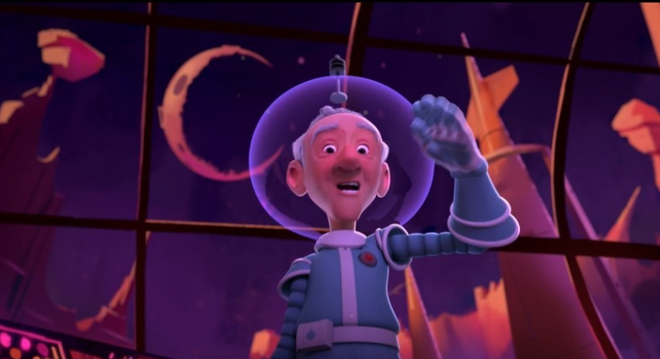
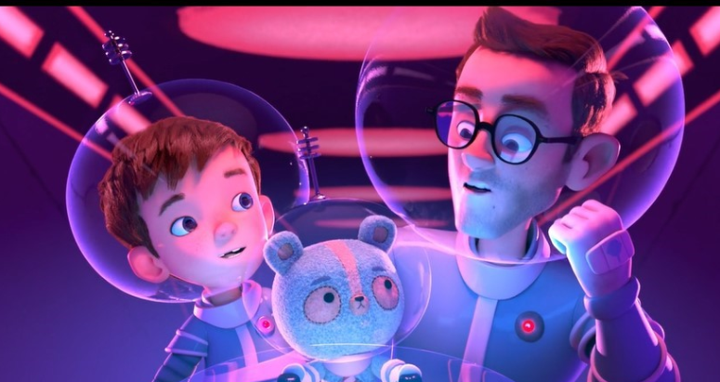
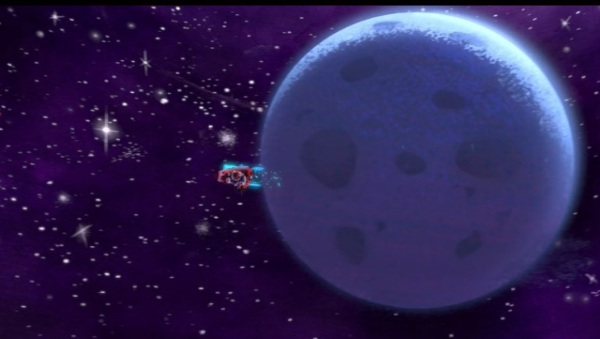
Write the key words. Where do they go? How do they all feel?

Slide 14
Now it is time to create your own storyboard.

