Slide 2


Writing to Persuade
Writing to persuade means that you want to convince your reader that what you’re saying is true. You’ll need to do this by thinking carefully about the language you use and the information that you provide.
There are different ways of writing to persuade, such as:
adverts or posters;
a persuasive talk or speech;
a campaign.
Can you think of
a time when you’ve had to persuade someone? Think about what you said and the words that you used.

Slide 3
Features of Writing to Persuade
Imperative verbs tell the reader what to do. They help to get your message across really clearly.
Buy this floating fence post today!
Improve the places that you love.
The most important part of writing to persuade is being able to convince your reader of something. To do this effectively, you’ll need to use a range of different features.
Imperative
Verbs
To make sure that you really get your point across, you’ll want to repeat important facts or the name of the product.
Be careful not to make your writing sound too repetitive.
Considered
Repetition
Use adverbials to engage with your reader.
Surely, you can agree…
Unbelievably, this product is on sale at the incredibly low price of…
Adverbials
Rhetorical questions are questions which don’t need an answer. They can help your reader to feel like you are talking specifically to them.
Are you fed up with…?
Rhetorical
Questions

Slide 4

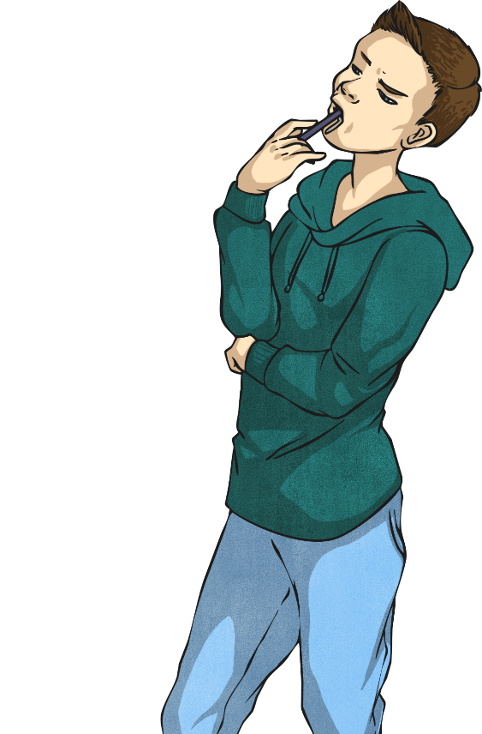
Can You Spot These Features?
Have a look at this example of persuasive writing. Can you spot the features?
imperative verbs
considered repetition
adverbials
rhetorical questions

Slide 5
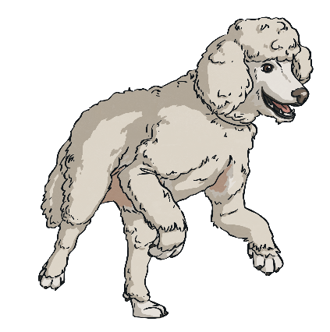


Advert
Man’s Best Friend’s Best Friend
Confused by the title? Unsure as to why man’s best friend needs their own best friend? Let me, Diggles Digby of 4 Parkview Terrace, explain.
For centuries, we have stood faithfully by the side of humans. We have provided unrivalled compansionship, vital support and have survived the multitude of ‘cute’ cat videos which endlessly plague our master’s devices. Of course, my canine compatriots, we do this because we enjoy it. However, there are still days when the words, “Should we get a cat?” ring bitter in the ears of even the strongest of dogs. That’s why I am introducing you to Man’s Best Friend’s Best Friend: the perfect friend for the perfect friend.
Made with an extra-chewable rubber interior and an exterior which guarantees a minimum moult of 60% onto your owner’s freshly-cleaned carpets, the MBFBF is the product you deserve. What’s more, the ergonomic design is guaranteed to fit all jaws from chihuahua to mastiff.
So, what are you waiting for? Beg your master for the treat you deserve and ensure that they bring home an MBFBF today.
Which features did you manage to spot?

Slide 6
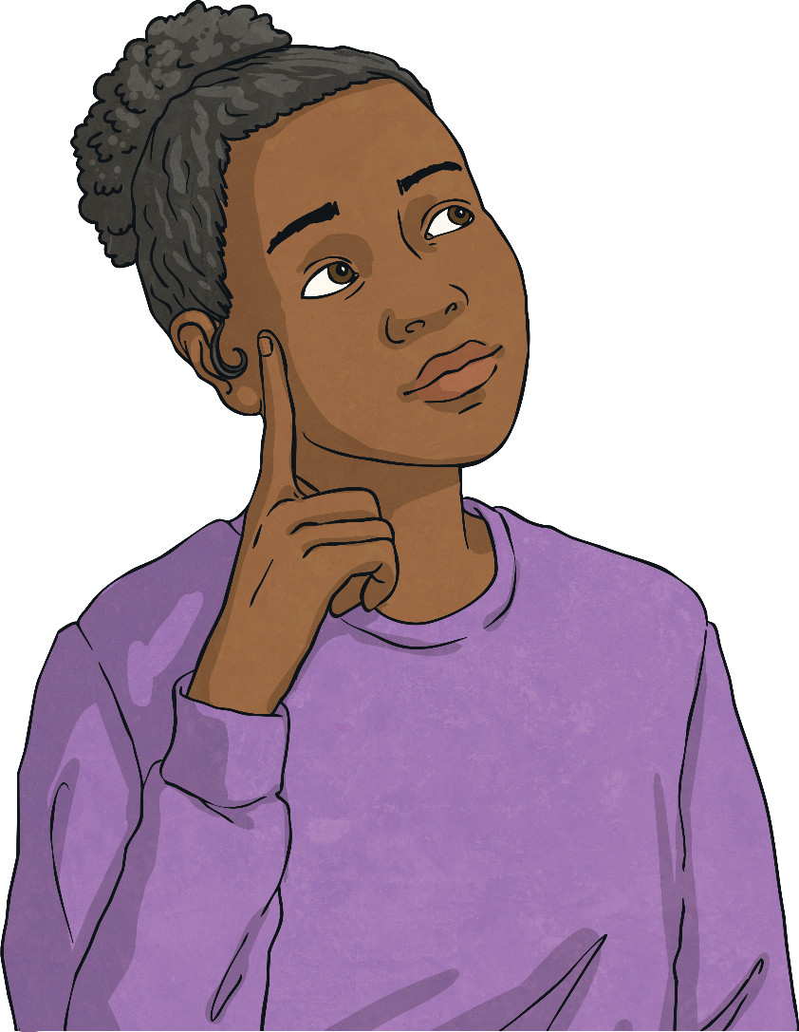
Did You Spot the Features?
Did you manage to spot any of these features in the persuasive writing?
imperative verbs
considered repetition
adverbials
rhetorical questions
Were there any other features you spotted which weren’t on this list?

