Slide 1

Writing a great Recount
Photo courtesy of dotmatchbox@flickr.com - granted under creative commons licence – attribution

Slide 2
Learning Objective
To know how to write about events and experiences.

Slide 3

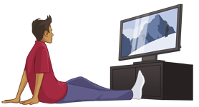

Introduction
Who did the activity?
What did they do?
When did it happen?
Where did it all take place?
Why was the activity carried out?
Set the scene…

Slide 4

Main Body
Write about what happened during the activity.
Write in paragraphs.
Write in chronological order.
Use detailed and technical vocabulary.
Use sequential words.

Slide 5

Sequential Words
Here are a few examples:
Finally
Later
Meanwhile
Next
Firstly
Then
Eventually
What others can you think of?

Slide 6

Concluding Paragraph
Write about the highlights of the event.
How would you describe the general atmosphere of the event?
What have you learnt?
What would you recommend to others?

