Slide 1
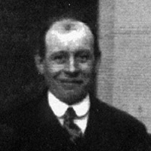
William Stephenson
By Phoebe

Slide 2
William H Stephenson
William H Stephenson
Born – 19 April 1889
Died – 19 August 1953
Job – Chief Stoker/Sailor
William Stephenson, the chief stoker, was also a Hull trawler man. He died of cancer in hospital in Hull in 1953, aged 64

Slide 3
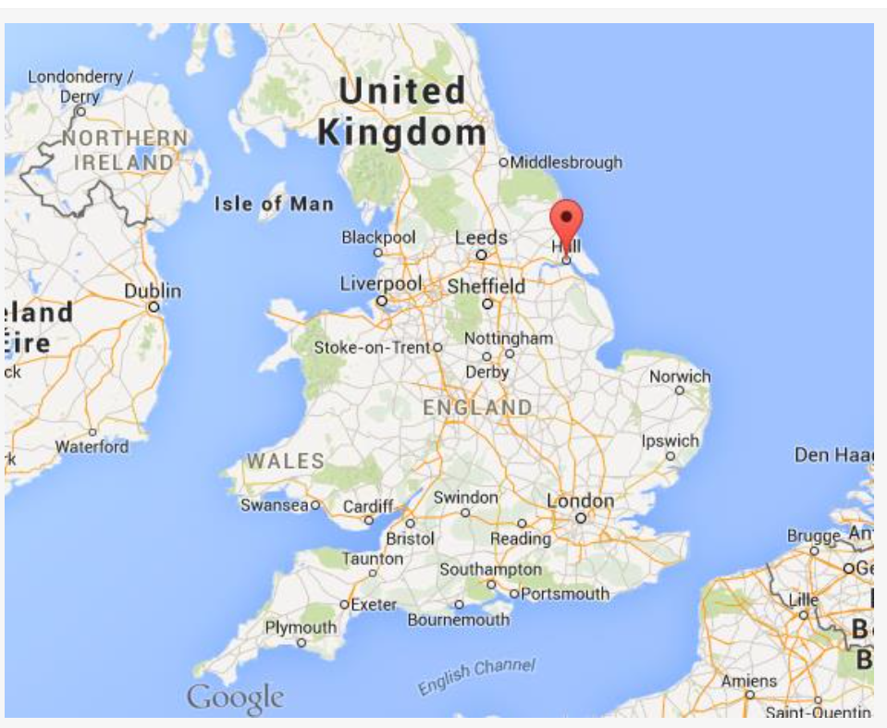
Early life
William grew up and was
born in Hull. He was a trawler man.

Slide 4
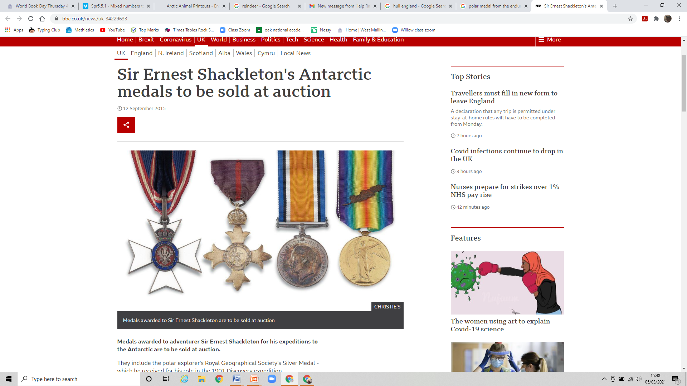
Honours and memorials
Unfortunately William did not get a medal like he should have as Shackelton
Didn't think he deserved one as well as a few others. We don't know why but we assume it`s because he couldn`t do his job when the endurance sank.

