Slide 1

Ernest Shackleton’s crew

Slide 2

Here is some of shackleton’s crew
Bertram Armytage
Philip Lee Brocklehurst, Sir (Bart)
Bernard C Day
Ernest Edward Mills Joyce
James Murray
Eric Stewart Marshall
Harry Dunlop
George Edward Marston
Frank Wild

Slide 3
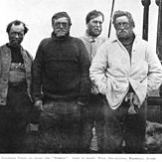
Eric Stewart Marshall Facts
He was Born on the 29th of March 1879
Shackleton Met him at a party
He qualified for a surgeon
He Was part of the Army
He died on the 26th of February 1963

