Slide 1
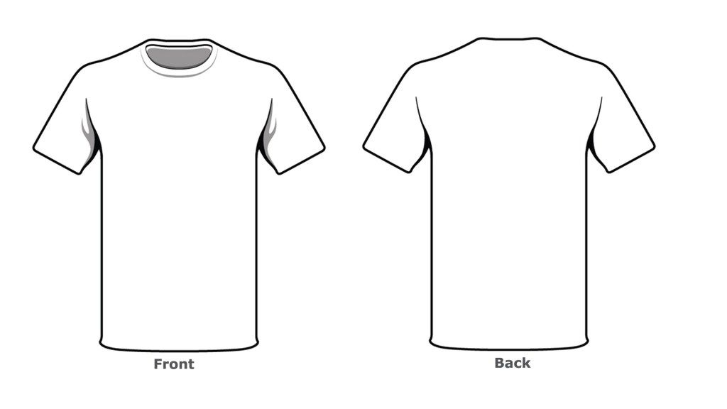
Together We Can
Bring A Brighter Future

